Slide 1
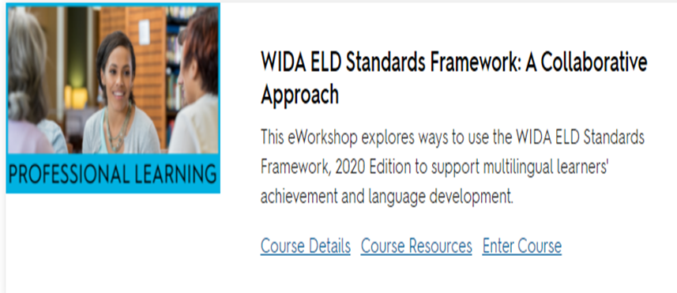
WIDA ELD Standards Framework: A Collaborative Approach
Module 1
Notes:
Today we are going to look at Module 1 of the e-Workshop called “WIDA ELD Standards Framework: A Collaborative Approach.” In this workshop we will explore ways to use the WIDA ELD Standards Framework, 2020 Edition to support multilingual learners’ achievement and language development.

Slide 2
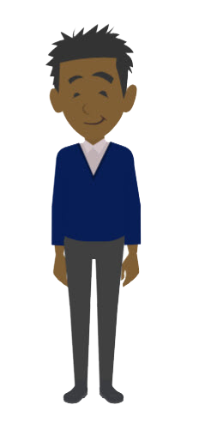
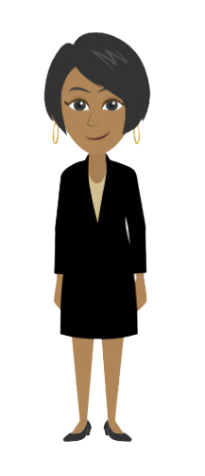
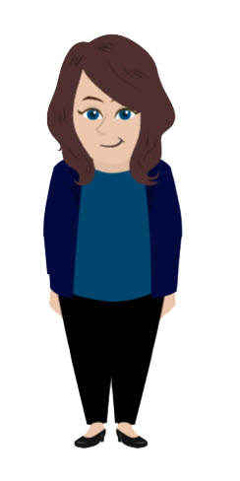
Module 1: Connect Current Knowledge and Practices to the WIDA ELD Standards Framework
Learning Objective:
Identify the purpose and function of the WIDA ELD Standards Framework.
Focus on Educator Perspectives
Working Directly with Multilingual Learners
Supporting Educator Learning
Creating School-Wide or District-Wide Systems
Communicating with Families and Communities
Notes:
The focus of this module is to give an overview of the WIDA ELD Standards Framework, 2020 Edition and to introduce educator collaboration as one way to learn about the standards framework and to discuss school and classroom application. WIDA takes a book club approach to learning in this eWorkshop, viewing each module as a chapter from a book. Each module begins with a video from the book club facilitator, Edith. Each module will end with discussion questions based on the four educator perspectives introduced in Module 1.
Why the focus on educator collaboration?
The WIDA ELD Standards Framework offers new opportunities for teacher collaboration. Educators optimize students’ opportunities to learn when they collaborate to integrate content and language and engage students in rich content learning. During the focus groups and piloting phase of the WIDA ELD Standards Framework, 2020 Edition, this potential for the WIDA ELD Standards Framework to serve as a bridge between language and content perspectives was one of the strongest themes that emerged from the data.

Slide 3
Educator Perspectives
What role do you hold in your school or district?
Working Directly with Multilingual Learners - Jack
Supporting Educator Learning – Nicole
Creating School-Wide or District-Wide Systems - Claudia
Communicating with Families and Communities- Amy
Notes:
What role do you hold in your school or district? Share the name of the character or characters that best represent your role.

Slide 4
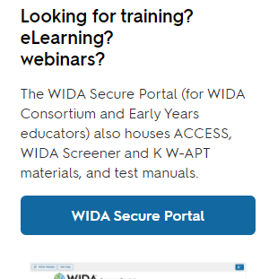
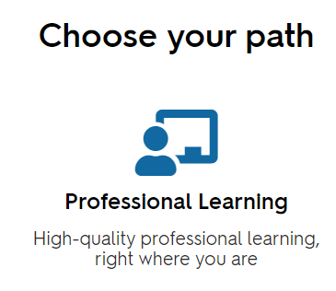
Navigating to Module 1
Log into WIDA
Select Secure Portal
Select Professional Learning
Notes:
Now we will navigate to Module 1 in the e-workshop. You will need a WIDA Secure Portal account to access the course.
If you need a WIDA Secure Portal account:
Email help@wida.us and ask to set up a WIDA Secure Portal account for assessments and eLearning. You must use your district email address.
You will receive an email from WIDA Client Services Center informing you that an account has been set up.
Go to the WIDA Login webpage: https://wida.wisc.edu/login
Select: WIDA Secure Portal
Login to the WIDA Secure Portal with your district email address and password. (You may want to bookmark this login page.)

Slide 5
Navigating to Module 1
Find WIDA ELD Standards Framework: A Collaborative Approach in the list
First time? Select Course Details then Enroll Now
Been in before? Select Enter Course
OR
Notes:
Next we will access the Canvas course for this e-workshop.
To access the course:
Click on “Professional Learning.”
Scroll to: “WIDA ELD Standards Framework: A Collaborative Approach”
Click on “Course Details” (or “Enter Course” if you are already enrolled).
Click on the “Enroll Now” button.

Slide 6
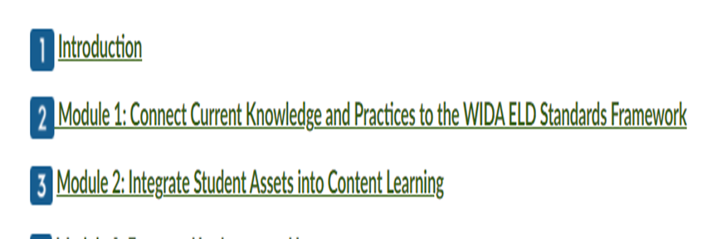
Navigating to Activity on Page 3
Select Module 1: Connect Current Knowledge and Practice to the WIDA ELD Standards Framework
Click “next” at the bottom of each page to get to the 3rd page: “Explore the WIDA ELD Standards Framework”
then
Notes:
Now go to Module 1.
Then click “Next” at the bottom of each page to get to the 3rd page: “Module 1: Explore the WIDA ELD Standards Framework”

Slide 7
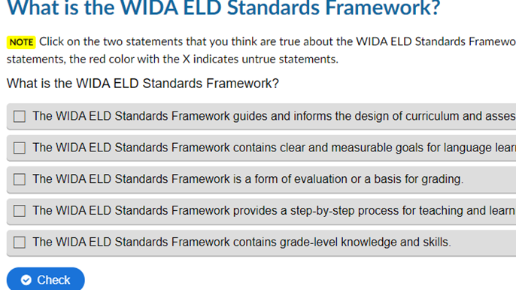
You’ve Arrived!
Read the statements aloud and discuss whether they are true or false, then check your answers!
Select the items that are in each section. Use page 10 of the Standards Framework for help.
Notes:
Do the first 2 activities together with your partner or group:
What is the WIDA ELD Standards Framework? - Read the statements aloud and discuss whether they are true or false, then check your answer for each.
What is in my WIDA ELD Standards Framework, 2020 Edition document? – Select the items that are in each section. You can look at page 10 in the Standards Framework to get help! The item will be outlined in green if you are correct!
If you have extra time, discuss what parts of the framework you would like to explore further or have already read or used.

Slide 8
Activity: What is in my WIDA ELD Standards Framework, 2020 Edition Document?
Share out: What is one thing in the framework that you want to explore further?
Notes:
Share back with the whole group: What is one thing in the framework that you want to explore further?

