Slide 1
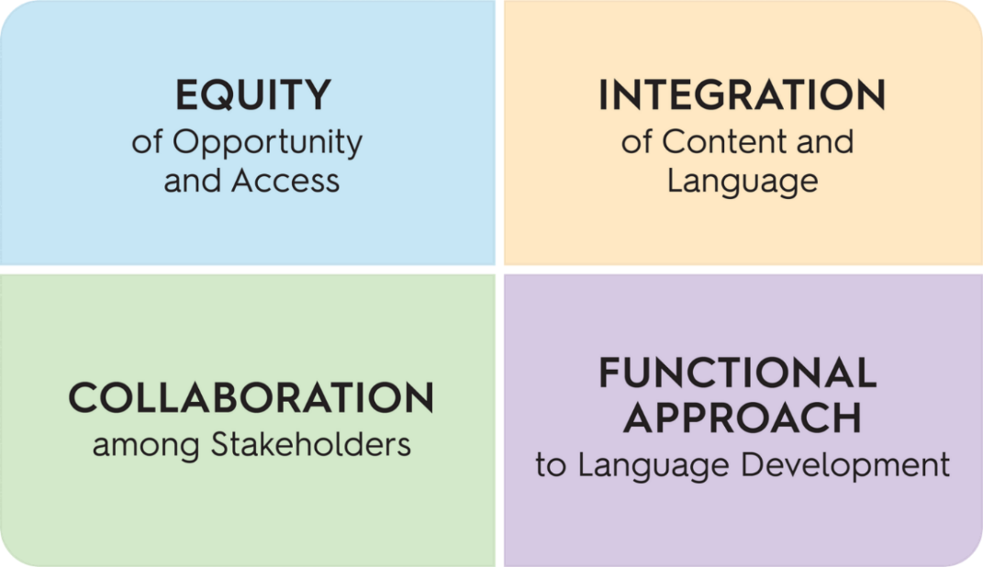
Module 2: Integrate Students Assets into Content Learning
Learning Targets:
Recognize how WIDA ELD Standards Framework builds on multilingual learners’ assets for learning.
Recognize the critical role of collaboration in content AND language learning among students and among teachers.
BIG Ideas:
Equity of Opportunity and Access
Collaboration among Stakeholders
Notes:
In today’s session we will recognize how the WIDA ELD Standards Framework builds on multilingual learners’ assets for learning. We will also examine the critical role of collaboration in content AND language learning among students and teachers.
Instruction that draws upon students’ assets is a key aspect of equity-focused instruction and reflects the WIDA foundational BIG ideas of Equity of Opportunity and Access and Collaboration among Stakeholders.

Slide 2
Student Assets
“Teaching and learning should revolve around who our language learners are, what they can do and how we can benefit from the tremendous assets they bring to school. ”
—Margo Gottlieb
WIDA Co-Founder & Lead Developer
Notes:
Let’s take a moment to consider this quote from Margo Gottlieb, Co-Founder and Lead Developer of the WIDA Standards. (Read quote)
Post in chat: “Teaching and learning should revolve around who our language learners are, what they can do and how we can benefit from the tremendous assets they bring to school. ” -Margo Gottlieb WIDA Co-Founder & Lead Developer

Slide 3
Benefit of Student Assets
In the chat, share your response to the quote.
Guiding Questions:
What assets do language learners bring to school?
How do you benefit from these assets?
Notes:
In the chat, please share your response to the quote: What assets do you think language learners bring to school? How do you benefit from these assets?

Slide 4
What are examples of student assets?
Linguistic Assets
Knowledge of multiple languages
Varying representation of ideas
Metalinguistic and metacognitive awareness
Diverse strategies for language learning
Cultural Assets
Different perspectives and ways of thinking and knowing
Diverse practices, beliefs, and social norms in families and communities
Ability to navigate a variety of sociocultural contexts and develop relationships in a global society
Notes:
The WIDA Can-Do Philosophy includes a strong focus on language learners’ assets, contributions, and potential. They identify 4 types of assets that multilingual learners bring. (Read off assets)
Post in chat: https://wida.wisc.edu/sites/default/files/resource/WIDA-CanDo-Philosophy.pdf

Slide 5
What are examples of student assets?
Experiential Assets
Varied life and educational experiences
Diverse approaches to learning and expressing content knowledge
Social and Emotional Assets
Unique personal interests and needs
Awareness of and empathy for diverse experiences
Knowledge and enrichment of community resources
Notes:
(Read assets)

Slide 6
Breakout Room Discussion
How can we make space for our teams (building, grade-level) to recognize students’ assets and integrate and/or draw upon them in classroom instruction?
Notes:
Let’s take 5 minutes to discuss this question in breakout rooms. (Read question)
In chat:
How can we make space for our teams (building, grade-level) to recognize students’ assets and integrate and/or draw upon them in classroom instruction?

Slide 7
Standard 1 – The Ever-Present Focus!
Standard 1 is always a given and is present in all content instruction.
“Students communicate to learn but also to convey personal needs and wants, to affirm their own identities, and to form and maintain relationships” WIDA ELD Standards Framework 2020 p. 24
Notes:
Standard 1 is present in both social and instructional contexts. Students communicate to learn but also to convey personal needs and wants, to affirm their own identities and to form and maintain relationships.

Slide 8
WIDA Standard Statement 1
Take a look at p.24-25 (Standard 1)
Read/re-read this short section
Identify the KEY concepts that stand out for you
Share in the chat: What do you notice or wonder?
Example: “I noticed that interactive learning is critical for multilingual learners to engage fully in content learning”
Example: “I wonder how we can emphasize interactive learning as a primary focus in our classrooms?”
Notes:
Now we will read a short section from the WIDA standards document on pages 24 to 25 that describes Standard 1. As you read, identify the KEY concepts that stand out for you. What do you notice or wonder? Write your idea in the chat but wait to hit enter until we return.
Allow 5 minutes to read and write a noticing or wondering in the chat. Wait until everyone returns to hit “enter” and then watch the “waterfall” of ideas in the chat. Give a few minutes to read these over and highlight a few themes.

Slide 9
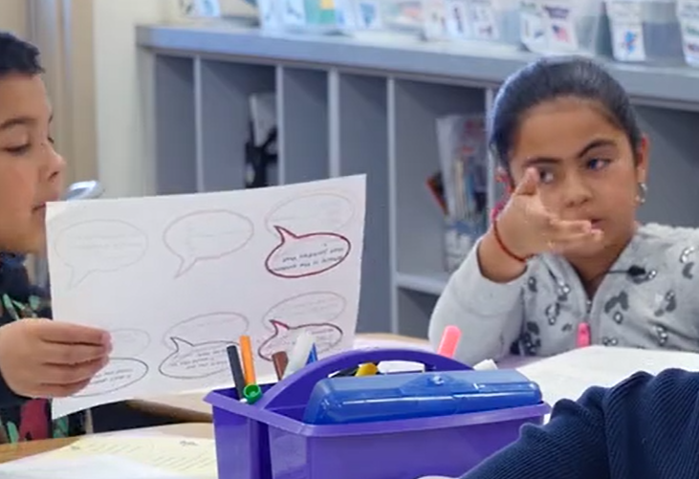
Supporting Collaboration in the Classroom for Content and Language Learning
As you watch…
Reflect on Standard 1
Notice students’ interactions and the assets they bring
Notice instructional supports & tools
Notes:
We are going to watch a 2nd grade classroom engage in academic discourse on academic content related to their own lives. As you watch, reflect on Standard 1 and notice the students’ interactions and assets they bring. Also note the instructional supports and tools the teacher provides to support this collaborative conversation.
You can stop at each of the questions and have participants answer live or as a Zoom poll.
First stop: Expectations for engaging in collaborative conversations.
Second stop: Planning to engage in collaborative conversations
Third Stop: Ways that students engage in collaborative conversation about their personal feelings of realistic situation (connected to Standard 1)
Fourth Stop: Same
Fifth Stop: Final summative statement

Slide 10
Breakout Room Discussion
How were students positioned as active members in a learning community in this classroom?
What resources did students use as they engaged in discussion together?
How might collaboration look in other grade levels or content areas?
Notes:
Now let’s take 5 minutes to discuss this in breakout rooms.
In the chat:
How were students positioned as active members in a learning community in this classroom?
What resources did students use as they engaged in discussion together?
How might collaboration look in other grade levels or content areas?

