Slide 1
Pathways to Graduation
OSPI-WSAC Wednesday Webinar Series
December 4, 2019
Linda Drake, SBE
Director, Career & College Ready Initiatives
Kim Reykdal, OSPI
Program Supervisor Lead, School Counseling
Office of Superintendent of Public Instruction
Chris Reykdal, State Superintendent

Slide 2
Context Gathering Poll
Who’s listening in?
Building Administrator
School Counselor
Teacher
CTE Director
ESD staff
District staff
State Agency
CIP
Education Association
Other
How familiar are you with the new Graduation Pathways?
I’ve received some training and/or info about the final rules already but want to hear it again
I know the basics but haven’t gotten the new details about the final rules
I’ve heard there are new graduation requirements but haven’t received any info yet

Slide 3
So many questions!
What counts for a CTE Graduation Pathway?
How are we supposed to know if our seniors can graduate?
Why did the legislature do this?
Who is supposed to make sure a student’s HSBP lines up with their grad pathway?
What if we can’t offer all the pathways?
How do we convince students to take the assessment now?

Slide 4
Today’s Objectives
The Why of HB1599
Graduation Pathways overview
Other Graduation Requirement changes
Next Steps for Implementation
Support and Resources

Slide 5
Values
Vision
All students prepared for postsecondary pathways, careers, and civic engagement.
Mission
Transform K–12 education to a system that is centered on closing opportunity gaps and is characterized by high expectations for all students and educators. We achieve this by developing equity-based policies and supports that empower educators, families, and communities.

Slide 6
OSPI Equity Statement
Each student, family, and community possesses strengths and cultural knowledge that benefit their peers, educators, and schools.
Ensuring educational equity:
Goes beyond equality; it requires education leaders to examine the ways current policies and practices result in disparate outcomes for our students of color, students living in poverty, students receiving special education and English Learner services, students who identify as LGBTQ+, and highly mobile student populations.
Requires education leaders to develop an understanding of historical contexts; engage students, families, and community representatives as partners in decision-making; and actively dismantle systemic barriers, replacing them with policies and practices that ensure all students have access to the instruction and support they need to succeed in our schools.

Slide 7
“…requires education leaders to examine the ways current policies and practices result in disparate outcomes for our students…
“…actively dismantle systemic barriers, replacing them with policies and practices that ensure all students have access to the instruction and support they need…”

Slide 8
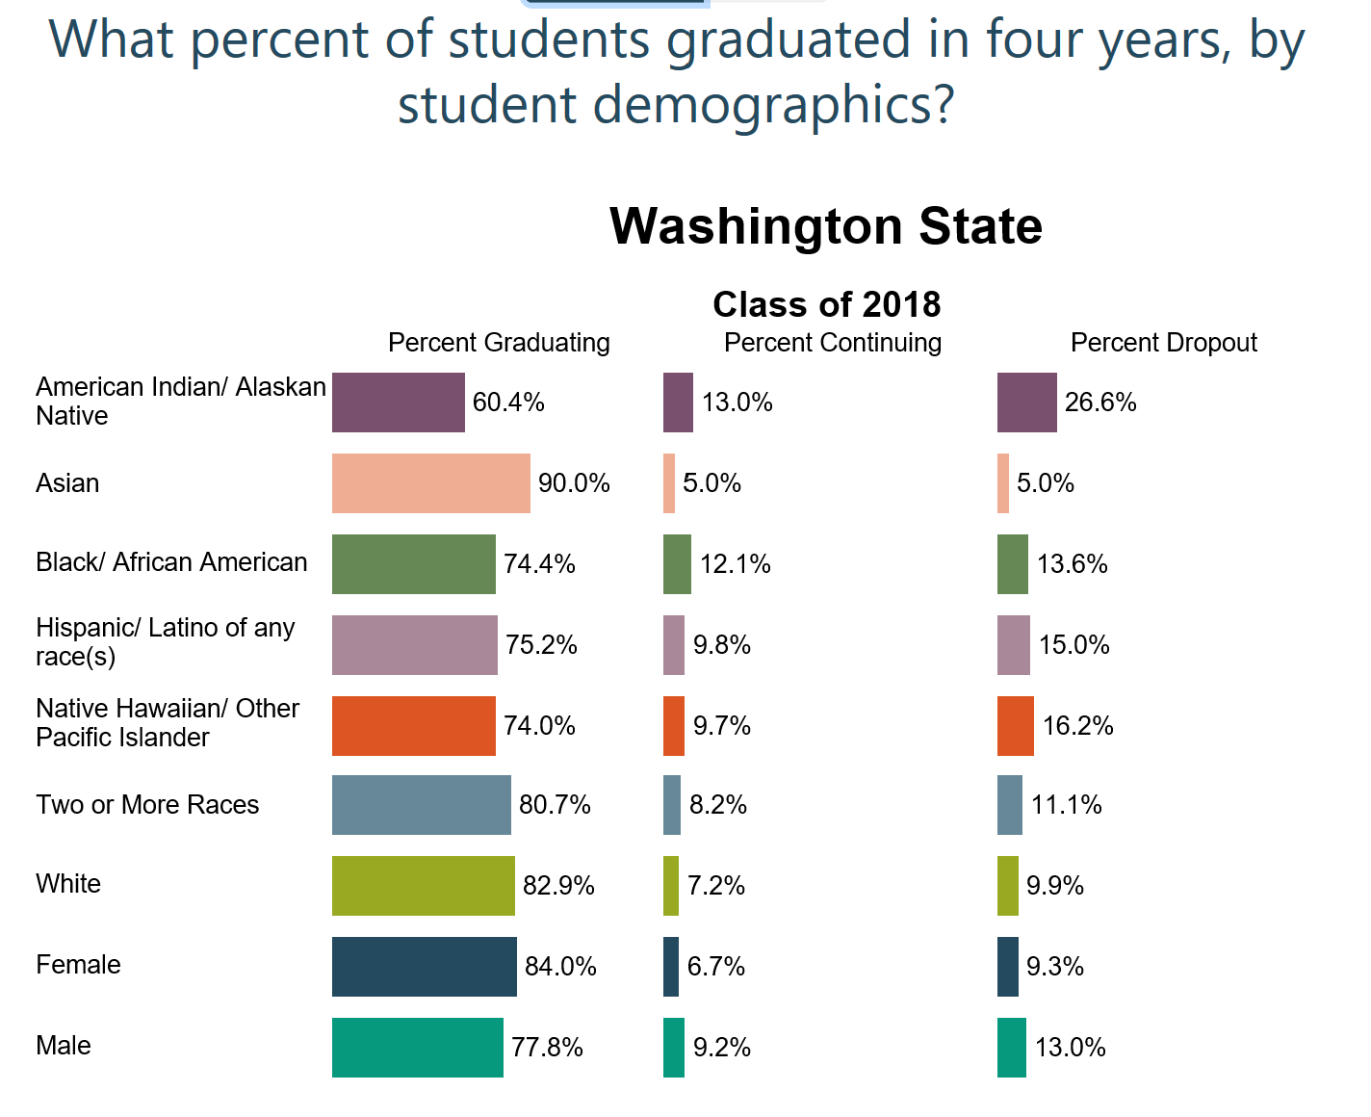
Graduation:
All means all.

Slide 9
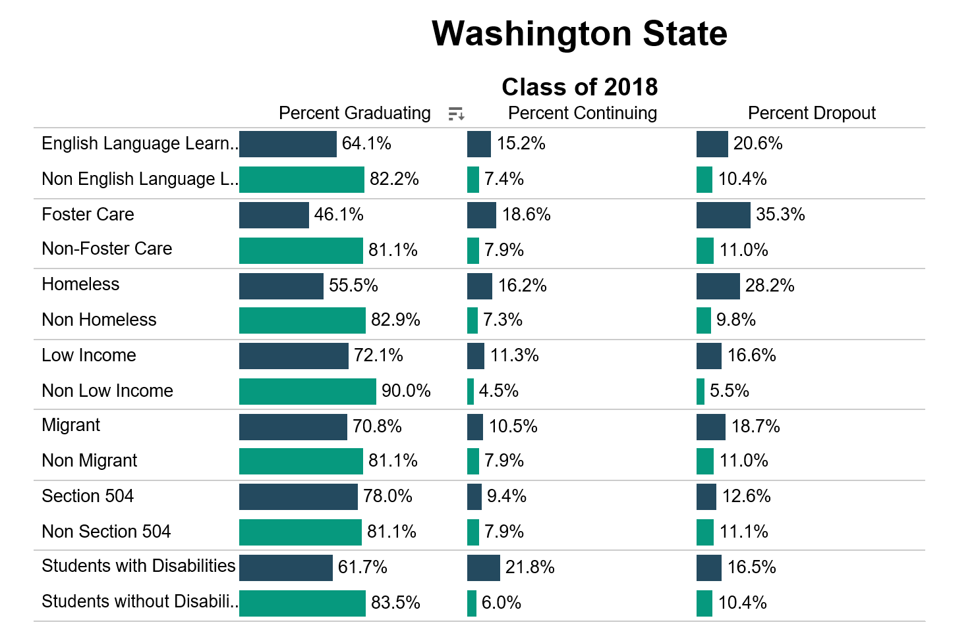
Graduation:
All means all.

Slide 11
How do we make sure each and every student has a clear path for after high school, starting with the first year after graduation?

Slide 12
Class of 2020 Graduation Requirements
High School & Beyond Plan
(HSBP)
High School Instruction
(24 credits)
Graduation Pathway(s)

Slide 13
All means all.
All students can use new pathways, including student receiving special education supports
Certificate of Individual Achievement through Class of 2021
WA-AIM remains available for students with significant cognitive challenges
WAC 180-51-115: Graduation credit and subject area reqs. may be substituted with comparable
content per the HSBP, if determined necessary by the student’s IEP team

Slide 14
Graduation Pathways Are…
Equal in value and expectations
Connected to students’ post-high school goal(s) = HSBP
Built to prepare students for a meaningful first step after high school

Slide 15
Graduation Pathways Are Not…
Ways to “track” students
New “boxes to check” for graduation
“Alternatives” to the high school state assessment

Slide 16
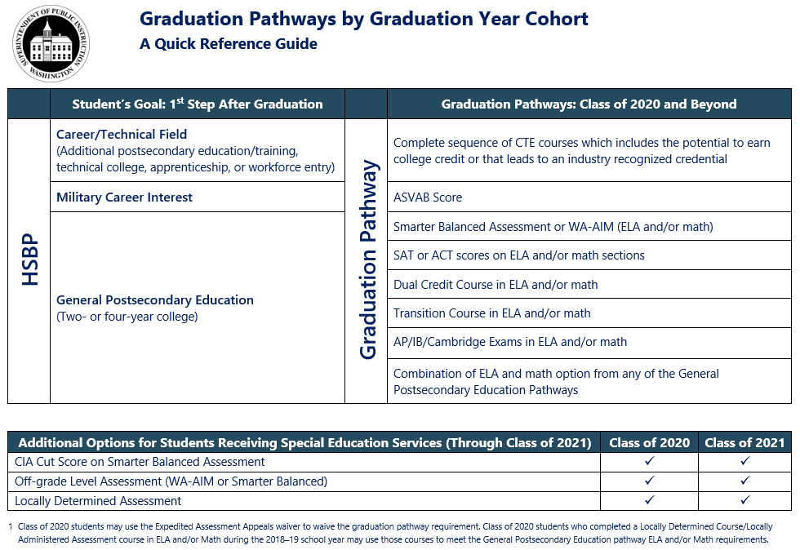
Graduation
Pathways:
A Meaningful 1st Step After High School

Slide 17
CTE Graduation Pathways
2 High School Credits in CTE courses
Same CTE Program Area or approved local sequence
Includes dual credit opportunity and/or leads to a credential
Or
Complete a Core Plus program

Slide 18
Local CTE Grad Pathway Sequences (using more than 1 CTE program area)
2 High School Credits in CTE courses
Locally approved
(board or designee, and/or CTE advisory committee)
Approved by OSPI
(45 day turnaround)
Approved local sequences available statewide
(notify OSPI if using)

Slide 19
Military Pathway (ASVAB)
SBE posts minimum AFQT score annually
Currently 31
Students not required to meet other enlistment criteria
Meet or exceed minimum score to serve (year taken or any year after, before student turns 21)
Students must be informed about how their info may be shared with military and provided an option to opt in OR out of further recruitment processes

Slide 20
Smarter Balanced Assessment or WA-AIM (ELA and Math)
Graduation scores set by SBE
WA-AIM still available for “significantly cognitively challenged” students

Slide 21
College Admission Exams (ELA and Math)
ACT
Minimum score set by SBE
ACT w/ writing
Math section
SAT
Minimum score set by SBE
SAT w/ writing (recommended, not in ELA score)
Math section

Slide 22
Dual Credit Exams (ELA and Math)
Advanced Placement
Minimum score = 3
List of acceptable exams
Cambridge International
Minimum score = E
List of acceptable exams
International Baccalaureate
Minimum score = 4
List of acceptable exams
SL or HL exams
A or AS exams

Slide 23
Dual Credit Courses (ELA and Math)
Advanced Placement
Must earn a C+ or higher each term
Same list as exams
Cambridge International
Must earn a C+ or higher each term
Same list as exams
International Baccalaureate
Must earn a C+ or higher each term
Same list as exams
1.0 HS credit (can combine courses)

Slide 24
Dual Credit Courses, Cont. (ELA and Math)
Career and Tech Ed
Must meet HS reqs. for ELA/Math
100 level or higher college course
Running Start
College in the High School
Must meet HS reqs. for ELA/Math
1.0 HS credit
Must meet HS reqs. for ELA/Math
1.0 HS credit
100 level or higher
“Paying” for college credit not required
Articulation agreement
100 level or higher
1.0 HS credit

Slide 25
Transition Courses (ELA and Math)
Bridge to College
State approved
Math and English courses available
College course placement with a B grade or higher
SBE Rules
Must result in college-level course placement (100 level or above)
Local agreement must be in place with college
Must meet HS core or elective credit requirement

Slide 26
Combining ELA and Math Pathways
Students use any combination of assessments or courses from any of the ELA and math pathways

Slide 27
Class of 2020
Expedited Assessment Appeal (EAA) waiver still available
Students not required to attempt “alternatives” prior to using EAA waiver
Any pathway(s) connected to HSBP goals

Slide 28
SBE 1599 Follow-Up Survey / Leg Report
Modify existing pathways
Barriers to implementation
Additional grad pathways
Due to Legislature by December, 2022

Slide 29
OSPI’s Role is Changing

Slide 30
OSPI’s Graduation Role: Data and Reporting
Counts of students in each pathway
Student participation in pathways, disaggregated
Pathway options at each district

Slide 31
OSPI Graduation Role: Programmatic Supports
Closing opportunity gaps through resourcing pathway access, expansion
Support assessment practices: formative, interims, summative
Build local data use and practices

Slide 32
What else changed for our students?

Slide 33
High School and Beyond Plans
FAFSA / WASFA information
Electronic HSBP available by Fall 2020
SBA scores inform 11th grade course choices
HSBP/IEP Transition Plan alignment

Slide 34
Credit Earned Before High School
Students/families can request non-numerical grades for courses by end of 11th grade
Local districts should plan on reviewing/updating a policy
Credit automatically added to HS transcript; students/ families must opt out by end of 11th grade

Slide 35
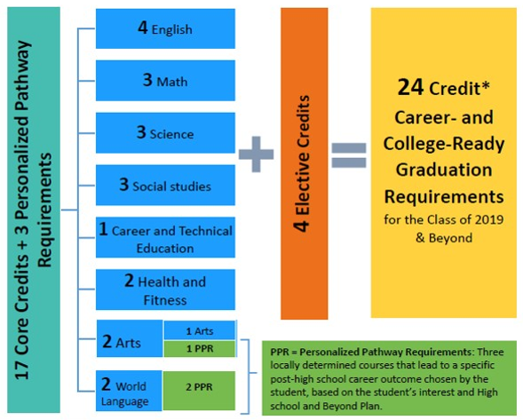
24-Credits Required for Graduation

Slide 36
Two Credit Waiver
Local districts must adopt a policy
Up to 2 credits waived for “student circumstances”
Cannot be 17 core credits

Slide 37
Changes to Social Studies Credits
1.0 credit of “Elective”
0.5 credit Civics must be stand-alone course
0.5 credit of Contemporary World History / Geography
Still 3.0 credits total

Slide 38
Academic Acceleration
Automatically enrolled courses must align to HSBP
Amends existing statute; requires districts to adopt policy by 9/2021
Meeting / exceeding standards on SBA assessments results in auto enrollment, leading to dual credit

Slide 39
Next Steps
What do we need to grow our options?
Current district / building capacity in pathways
Address opportunity gaps
Add/Update Board Policies

Slide 40
Available State Resources
State Board of Ed
Graduation Pathways: rules and general information
ASVAB specific resources
Class of 2020 grad reqs information
OSPI
HB1599 General Information / FAQ
Graduation Pathways Toolkit (update Jan 2020)
CTE Course Sequence approval form
HSBP/IEP Transition Plan alignment tools
Career Guidance Wa curriculum
HSBP template (9 languages!)
WSAC
Financial Aid Resources / Information

Slide 41
Questions & Answers
What else can we help you answer?
Type in the chat….

Slide 42
Please let us know how we can support you!
our
Kim Reykdal, OSPI
Program Supervisor Lead,
School Counseling
Kim.Reykdal@k12.wa.us
Linda Drake, SBE
Director, Career and College
Ready Initiatives
Linda.Drake@k12.wa.us

Slide 43
Creative Commons
Except where otherwise noted, this work by the Office of Superintendent of Public Instruction is licensed under a Creative Commons 4.0 International License.
Many of our images come from Canva.com and TheNounProject.com.

