Slide 1

Community Partners’ Call
2.14.2024

Slide 2
Black History Month
For almost 50 years, February has been the month to celebrate the achievements and contributions of Black people in the United States. It’s important to pause and acknowledge Black history, and at the same time, we know that Black history is U.S. history, and the powerful contributions of Black people of the African diaspora need to be recognized every single day

Slide 3
Explore More Events and Rotating Exhibitions
The Northwest African American Museum (NAAM), located in the historic Colman School building in the Central District, is a great place to visit year-round. This museum is grounded in a mission to “use heritage to heal,” aiming to preserve the connection of people of African descent to their home in the Pacific Northwest.
Starting in February, Henry Art Gallery will have an exhibit of the work from talented Black artist Hank Willis Thomas titled “LOVERULES”. The exhibit features some of the conceptual artist’s most iconic and well-known artworks across a range of media, investigating diverse themes. There will be an official public opening event on Friday, February 23, 7:00 p.m. – 9:00 p.m.
During the entire month of February, Rainier Avenue Radio is converting the Columbia City Theater into the “Call to Conscience Black History Museum”, featuring installations, exhibits, artifacts, interactive activities, and virtual experiences celebrating the achievements of Seattle’s Black and African American community. More than 15 exhibits will explore various facets of Black history, providing context for where things are today and a deeper understanding of the issues still left to face. The pop-up museum will be open Tuesdays – Sundays, 11:00 a.m. – 7:00 p.m.
Starting February 3, the Museum of History and Industry (MOHAI) will have an exhibit entitled “100 Years of Junior League of Seattle: Explore the Northwest Art Project“, featuring Black artists such as Jacob Lawrence and Barbara Earl Thomas. MOHAI is included in Seattle Museum Month, which offers Downtown Seattle hotel guests half-price admission to museums across the region throughout the month of February. Additionally, the MOHAI Resource Center in Georgetown is home to the Jacqueline E.A. Lawson Resource Center. This exhibit is open to the public (by appointment) and has many fascinating photos and artifacts showcasing the culture and history of Black people in the Puget Sound region.

Slide 4
Continued
The Onyx Fine Arts Collective is the oldest and largest African-descent collective of artists in the Pacific Northwest. Their mission is to educate, inspire, cultivate, and showcase the artwork of artists of African descent from our Pacific Northwest communities. Town Hall Seattle will have various talks throughout the month for people to enjoy. These include:
Bassekou Kouyate and Vieux Farka Touré: Celebrating Mali’s Rhythmic Soul (February 24 at The Great Hall)
BE Great, a Black Excellence Cultural Festival comes to Occidental Square February 16-17. This free two-day event, presented by the Downtown Seattle Association and Metropolitan Improvement District, will bring together Black culture, arts, music, food and more. Enjoy soulful performances from local musicians, shop the pop-up night market, and explore Black creativity and community.
On February 24, join Black Heritage Society of Washington State, the Wing Luke Museum, and the Washington State Jewish Historical Society to hear about their collaboration, “Confronting Hate Together: The Power of Community”. The event is free to attend and will be held at the Microsoft Lakefront Pavilion and Faye G. Allen Grand Atrium from 11:00 a.m. – 2:00 p.m.
From February 24 to March 9, Seattle Opera presents the West Coast Premiere of “X: The Life and Times of Malcolm X” by Pulitzer Prize winner Anthony Davis. This groundbreaking opera explores the life of Malcolm X through a series of biographical vignettes set to a score combining modernism, minimalism, and jazz, and is the first opera written by a Black composer to run on Seattle Opera’s main stage.

Slide 5
Free Seattle KingCounty Clinic Feb 15-18
Seattle/King County Clinic returns February 15-18, 2024 and will provide FREE dental, vision, and medical services to anyone who struggles to access and/or afford care on a first-come, first-served basis. No ID is required, and interpreters will be available.
Please spread the word to your partners about this important event. Follow this link for digital materials (graphics, newsletter and social media text, & more) for you to share with your networks.

Slide 6

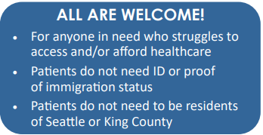
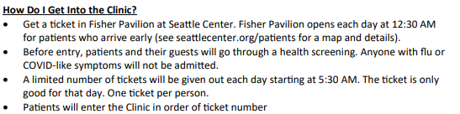

Slide 7
Social graphic: Post on social media, send in an email, add to your website, etc.: Amharic ( አማርኛ) | Chinese (中文) | Chinese (傳統的) |Khmer (ខ្មែរ) | English | Korean (한국어) |Marshallese (Kajin M̧aje) | Oromo (Afaan Oromoo)| Russian (русский) | Somali (Soomaali) | Spanish (Español) | Tigrinya (ትግሪኛ)| Ukrainian (Українська) | Vietnamese (Tiếng Việt)
Social Media Graphics

Slide 8

Where to find shelter from the cold in King and Snohomish counties | The Seattle Times
Severe Weather Response - KCRHA

Slide 9

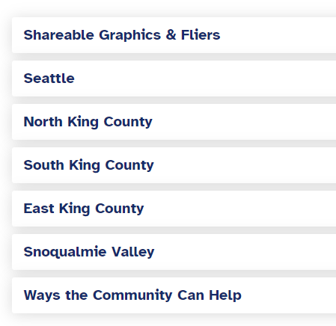
Severe Weather Response - KCRHA
With persistent overnight freezing temperatures in the forecast, KCRHA is extending the Tier 3 Severe Weather Response Protocols activation until January 17, 2024, with a potential for extension, in accordance with our Severe Weather Policy. A Tier 3 activation means that the KCRHA is working to coordinate with cities to open additional 24/7 emergency shelters and warming centers, as well as several other activities which are outlined in our Cold Weather Activation Thresholds document.

Slide 10
Flu, RSV and COVID on the rise – PUBLIC HEALTH INSIDER
We’ve seen an increasing number of visits to local emergency rooms for cases of influenza (flu), respiratory syncytial virus (RSV), and COVID-19 in King County. (Check out our comprehensive respiratory data dashboard to track trends for COVID-19, RSV, flu and other respiratory viruses
Preventing illness this cold and flu season
Here are some tips to help prevent spreading and catching respiratory viruses:
Wear a high-quality, well-fitting facemask (such as an N95 or KN95) in crowded areas and indoor public spaces.
Improve indoor ventilation by opening windows and doors and using air filtration devices.
Get tested promptly if you have symptoms and get treatment early if you’re eligible (you can order free home COVID-19 tests from the federal government).
If you’re sick, stay home and away from others, especially away from people who may be at high risk for severe disease. While you might experience mild symptoms, a COVID, flu or RSV infection can be a serious illness for small children, older people, pregnant people, and people with chronic conditions, such as compromised immune systems.

Slide 11
Where to get the Flu vaccine Find a vaccination clinic in King County - King County, Washington
Check with your healthcare provider.
Visit VaccineFinder Find flu shot options near you, including pharmacies. The flu vaccine is 100% covered under most insurance plans when you go to an in-network provider or pharmacy.
Several King County school districts have school based health centers (SBHC) If your child lives in a district with an SBHC, they can get vaccines and other healthcare services during operating hours. SBHCs are usually closed over the summer. Call ahead to find out about the best time and way to come to the clinic.
Some community health centers Sea Mar may offer flu shots by appointment to community members, depending on capacity. Call to check availability and cost.
If you don't have insurance or a healthcare provider, the Community Health Access Program (CHAP) can help. CHAP is a free and confidential telephone assistance program for King County residents. Call 1-800-756-5437 or email chap@kingcounty.gov. Check out this brochure to learn more about the many services CHAP offers.
Want to offer flu shots at your workplace? See list for options.

Slide 12
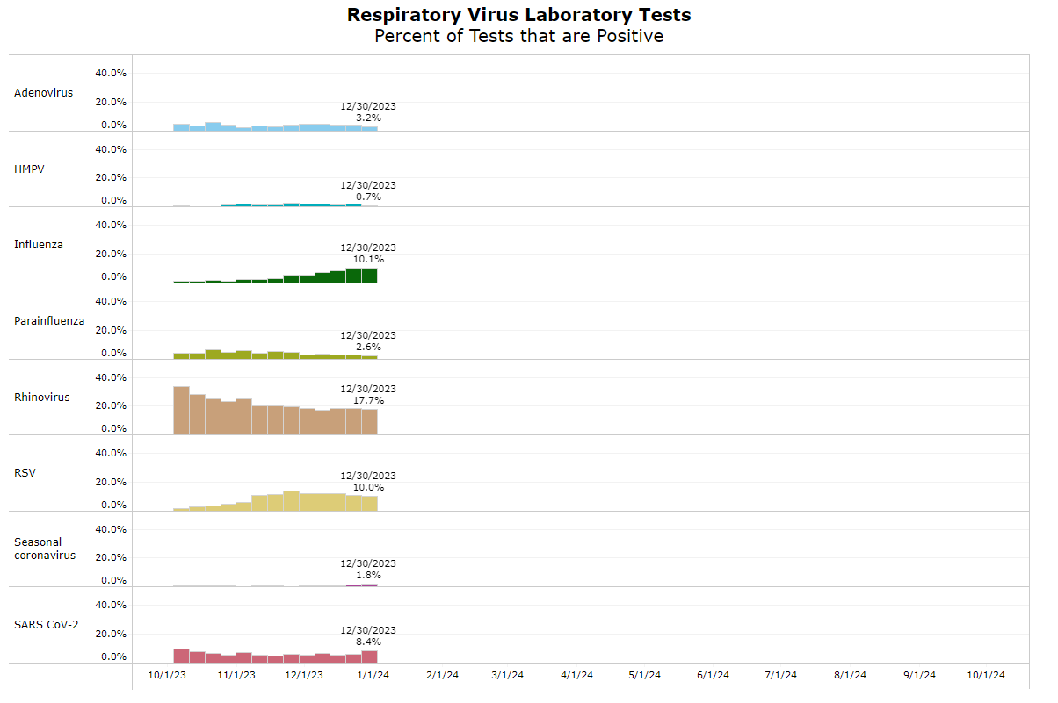
LINK: Respiratory virus data dashboards: COVID-19, Influenza, and RSV - King County, Washington

Slide 13
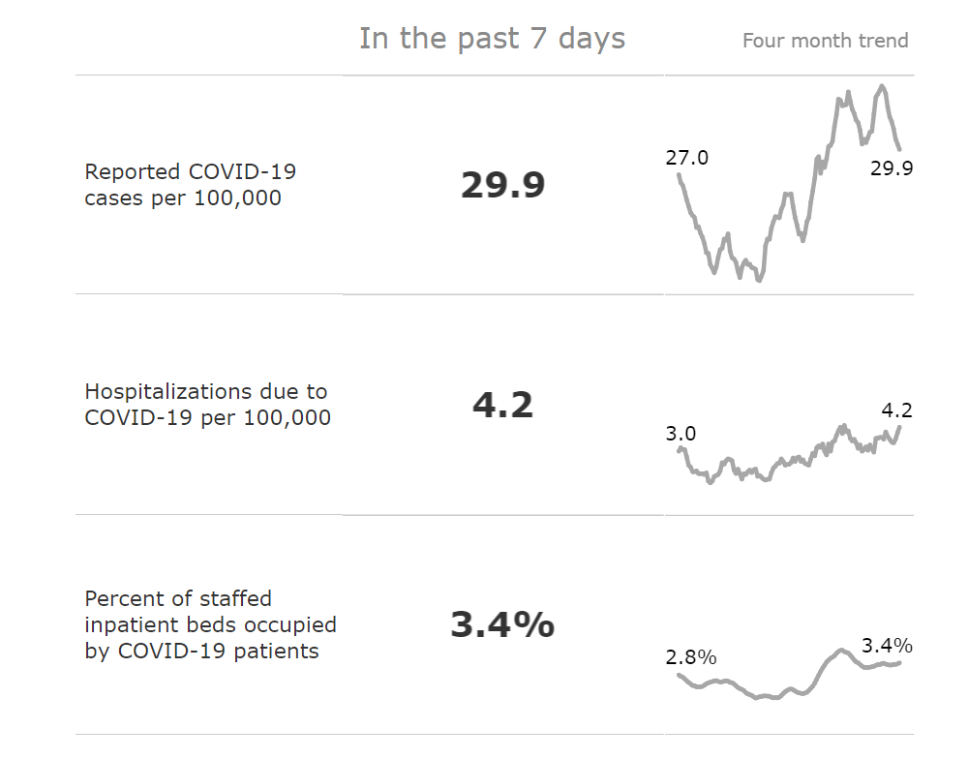
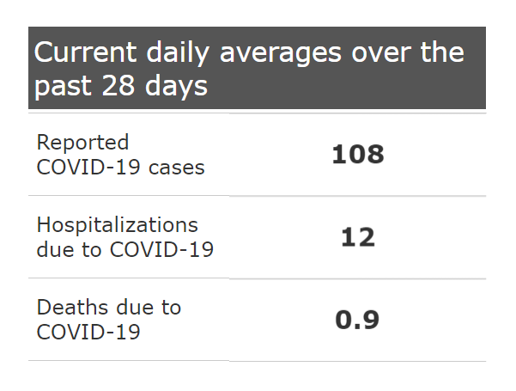
Where are we at with COVID? COVID-19 data - King County, Washington

Slide 14

The New COVID-19 Vaccine for 2023-2024

Slide 15
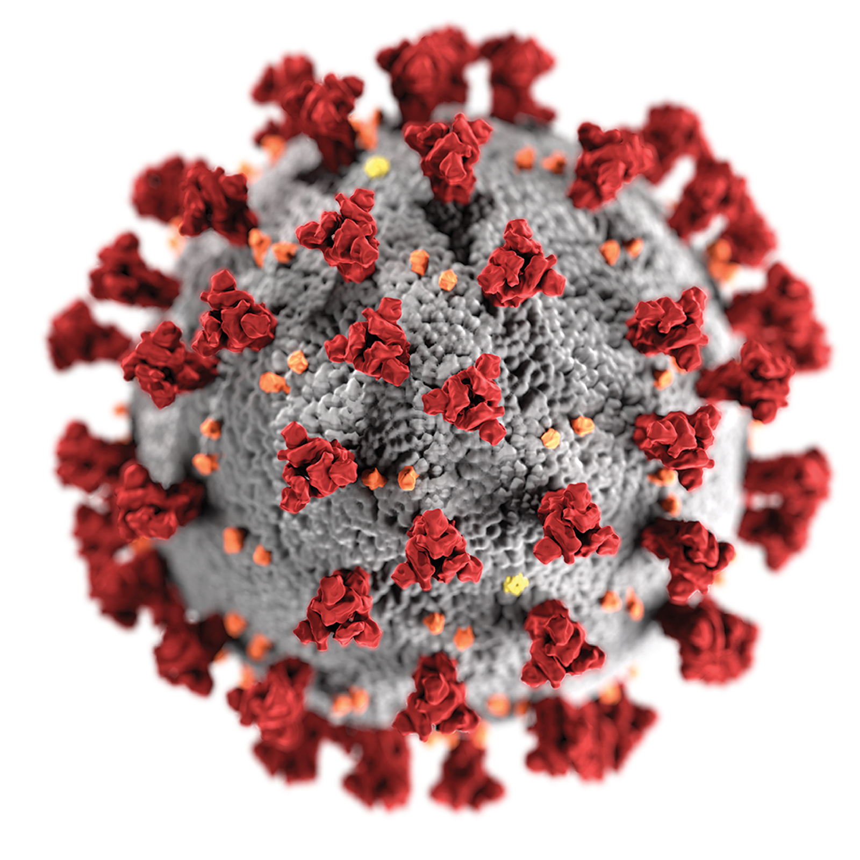

Vaccine preventable infections – COVID-19
Annual boosters made available in the fall
Allows for updates based on the circulating variants
Booster will provide the extra immunity protection especially for those at highest risk for severe disease

Slide 16
A new COVID-19 vaccine was approved to protect everyone this fall and winter.
Everyone 6 months and older should get the updated 2023-2024 COVID-19 vaccine.
It’s especially important for older adults and people with high risk conditions.

Slide 17
The new COVID-19 vaccine is worth getting, even if you’ve been vaccinated before or had COVID.
It will strengthen your body’s ability to fight the new variants of COVID-19 that are spreading now.
Studies show that staying up to date with COVID-19 vaccinations protects people from long COVID. Long COVID includes long-lasting symptoms like difficulty with thinking or breathing, bad headaches, and extreme tiredness.
Anyone can get long COVID, even if you aren’t in a high risk group. So the new vaccine protects everyone.

Slide 18
For COVID-19 vaccination appointments now:
Check Vaccines.gov for pharmacies and clinics that have the new COVID-19 vaccine.
Some pharmacies and clinics will have the new vaccine in the coming days. Many will not have appointments for another week or two, but eventually there will be plenty of appointments.

Slide 19
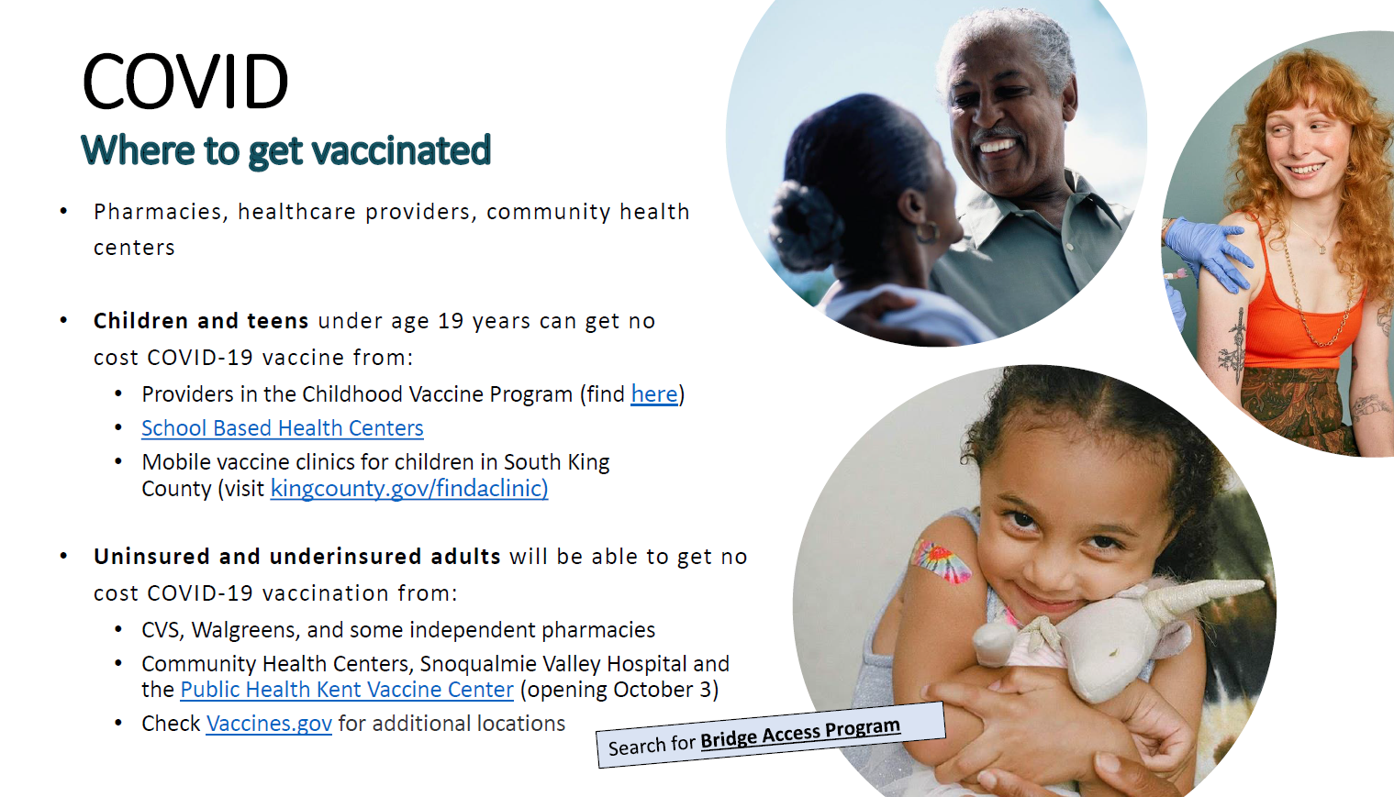

Slide 20
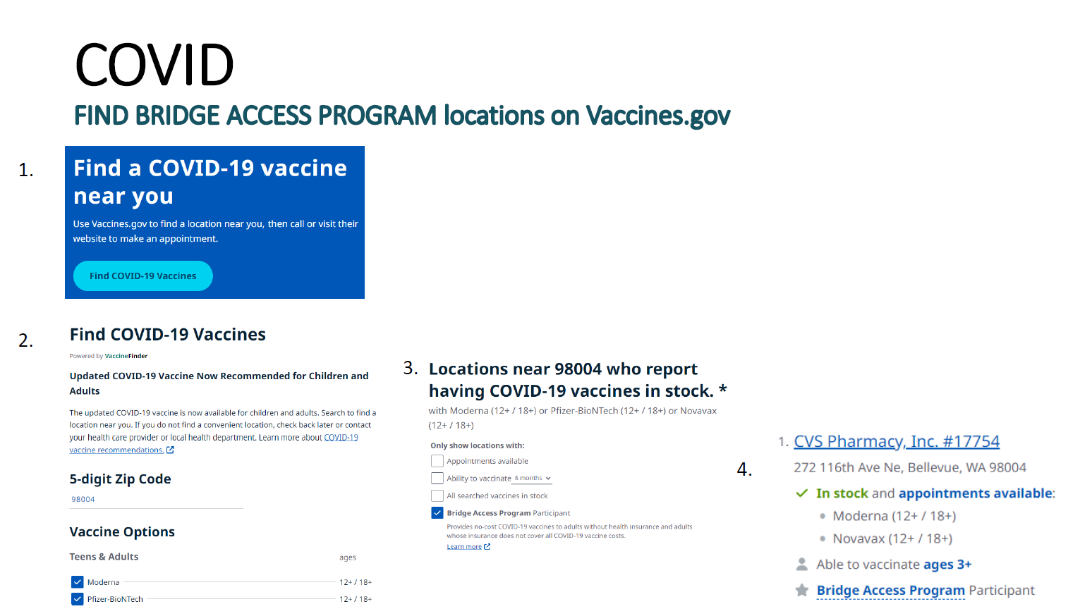

Slide 21
Starting October 3, Public Health will offer the new COVID-19 vaccine at the Kent Public Health Center.
Public Health will also offer:
In-home vaccination if you have a injury, disability, or health condition that makes it difficult to leave home (starting early Oct)
Community vaccination events (coming soon)
Free flu shots when you get a COVID shot
Get more information at kingcounty.gov/vaccine.
Use the Google translate menu for other languages.

Slide 22
Cost of the new COVID-19 vaccine if you have insurance:
Most insurance will pay for the whole cost. This includes Medicare and Medicaid/CHIP, also known as “Apple Health.” You will need to get vaccinated by a provider in your insurance’s network.
Vaccine locations will ask if you have insurance.
Remember to have your insurance information when you make an appointment and when go to get vaccinated.

Slide 23
You can get free COVID-19 vaccination if you are uninsured or your insurance doesn’t cover vaccines.
Free vaccination is available from the “Bridge Access Program.” Locations include:
CVS, Walgreens and some independent pharmacies
Community Health Centers
Public Health’s Kent Vaccination Center
Find locations participating in the Bridge Access Program on Vaccines.gov.

Slide 24
Children and teens who don’t have insurance can get free vaccination from:
Providers in the Vaccines for Children program
School Based Health Centers in many schools in King County
Information about these options: See “Find a vaccination provider for uninsured/underinsured children” on kingcounty.gov/findaclinic . Translated information is available.

Slide 25
Help your body fight the new variants. Get the new COVID-19 vaccine even if you’ve been vaccinated or had COVID.
You should get the new vaccine if it’s been 2 months or more since you got your last COVID-19 vaccine.
Get the new vaccine if you’ve missed getting a booster earlier or if you’ve never been vaccinated.
If you’ve had COVID recently, you can get the new COVID-19 vaccine once you’ve recovered.

Slide 26
It’s safe to get the COVID shot and the flu shot at the same time.
If you want to avoid separate appointments for vaccination, you can get the shots at the same time.
You can get free flu shots at the Kent Vaccine Center when you get a COVID-19 shot.

Slide 27
Questions about the new COVID-19 vaccine?
Call Washington State Department of Health information line: 1-800-525-0127. Say the name of your language for interpretation.
Go to kingcounty.gov/covid/vaccine. Use the Google translate menu for other languages.

Slide 28
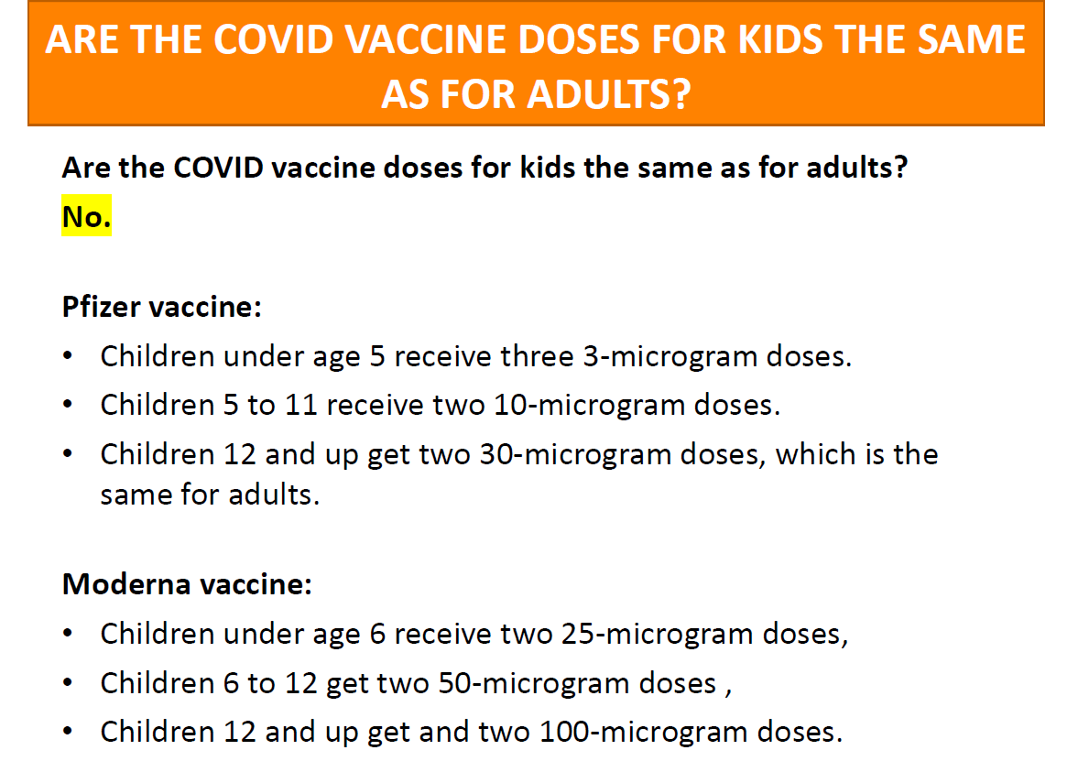

Slide 29
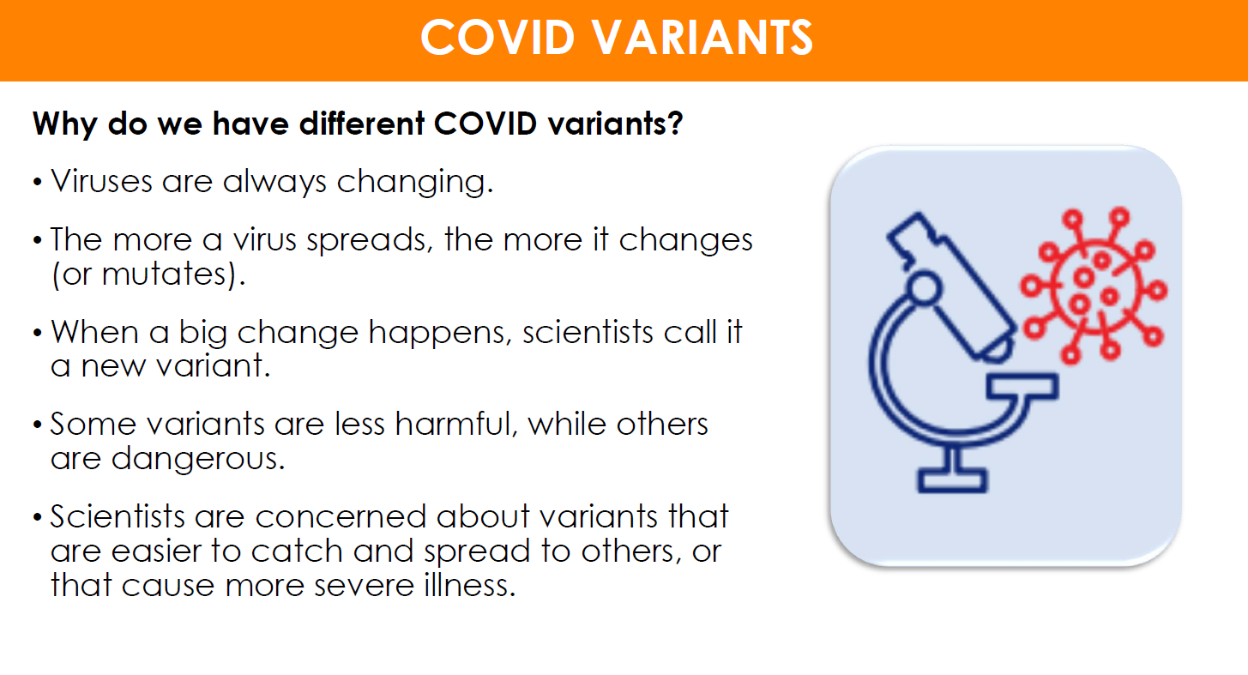

Slide 30
Staying protected against new Variants
The best way to protect yourself from XBB.1.5 subvariant of Omicron is to get vaccinated and stay up to date on COVID-19 vaccines.
Important to assess your risk level and keep that top of mind. If you will be around others in an indoor setting, consider wearing a mask. But not just any mask will do. It is important to wear an N95 or KN95 mask for the best protection.
Avoid poorly ventilated spaces and maintain physical distancing from others. And if you feel sick, stay home and get tested to determine the best course of action.

Slide 31
Where to get COVID-19 tests?
COVID at home test kits are available at all Pharmacy's for a cost. Ranging from 10-25 dollars a box.
Doctors' offices and Pharmacy's.
Check with your heath insurance to see the out-of-pocket costs.
Many health plans offer free and low-cost access to test kits
If you are an organization and need at home test kits; Public Health has access to test kits still until the end of summer.
Please email phpartnerships@kingcounty.gov
Every U.S. household may place an order to receive four free COVID-⁠19 rapid tests delivered directly to your home.
COVID.gov - Free at-home COVID-19 tests
Need help placing an order for your at-⁠home tests? Call 1-800-232-0233 (TTY 1-888-720-7489).
•Check to see if your COVID-19 tests' expiration dates have been extended

Slide 32
Kent Public Health Center Other Resources Happening
Women, Infants and Children nutrition program (WIC)
WIC is a supplemental food program for women who are pregnant or breastfeeding, infants and children and also provides health screening, nutrition and health education, breastfeeding promotion and support, help getting other services and checks for nutritious foods. You may be eligible for WIC services if:
Live in Washington state, and
Are pregnant, a new mother, or a child under five years of age, and
Meet the income guidelines
Have a medical or nutrition need.
Learn more about our WIC services

Slide 33
Kent Public Health Center
Maternity screening/pregnancy tests
Office visit with a nurse to verify pregnancy, determine medical risk and financial status, and refer to appropriate prenatal services, including to DSHS for medical coupons, health care provider for maternity care, appropriate site for maternity support services and WIC Supplemental Food Program.
Birth control and STD clinic
Specific hours: Monday - Thursday, 9 am to 6 pm; Friday, 8 am to 5 pm. Walk-ins welcome or by appointment at 206-477-6950.
Family planning services and education, reproductive health care, HIV and STD screening, pregnancy tests, birth control and referrals. Learn more about birth control.
Emergency contraception (EC)
EC (also called emergency contraception pills) is a special dose of birth control pills that prevents pregnancy after you have had unprotected sex. Some people call EC the "morning after pill," but you actually have up to 5 days (120 hours) after sex to use EC. EC is not an abortion pill.
Children with Special Health Care Needs (CSHCN)
CSHCN assists in planning and obtaining medical care and other resources for the child with a disability or a condition that may prevent normal growth and development. Learn more about CSHCN.
ORCA-LIFT cards (reduced transit fare)
The ORCA card is the easiest, healthiest way to pay your transit fares in the Puget Sound region. After loading your ORCA card with E-purse (electronic purse) funds, and/or a monthly pass, you’re ready to ride! The ORCA card will automatically track paid fares and transfers, so you don't have to. Available at this location to those who qualify. Visit Metro's ORCA-LIFT card website to learn more.

Slide 34

Kent Public Health Center
Teen clinic
Walk-in hours: Every 1st and 3rd Wednesday of the month, 1 pm to 4 pm
Join us for games, prizes, snacks and an afternoon dedicated to teen services!
If you're not available during these times, or just don't want to wait, free or low cost services are available Monday-Friday by appointment or walk-in.
For STD testing and treatment, teens who are 14 and older may access services without getting permission from a parent or guardian. We will not tell anyone about your visit unless you ask us to.
Learn more about teen health services

Slide 35
Mobile Medical Care for people living homeless
Are you… • living on the streets, in a camp, in a vehicle, or in a shelter? • “couch surfing” or staying with family or friends, not on the lease? • living in transitional housing? • Or, have you been homeless in the past year?
If so, the Mobile Medical Program is for you.
On-site the mobile medical team offers:
• Doctor and nurse visits for acute and chronic conditions • STD, HIV and Hepatitis C testing • Pregnancy tests and birth control • Access to behavioral health and substance use specialists • Naloxone overdose prevention training and kits • Dental care for pain and emergency conditions on select days We can also help you connect to: • A doctor’s office that can provide follow-up care • Mental health counseling • Substance use counseling via a harm reduction approach • Enrollment into ORCA Lift transportation assistance • Referrals to shelter, food, benefits, legal and domestic violence programs

Slide 36
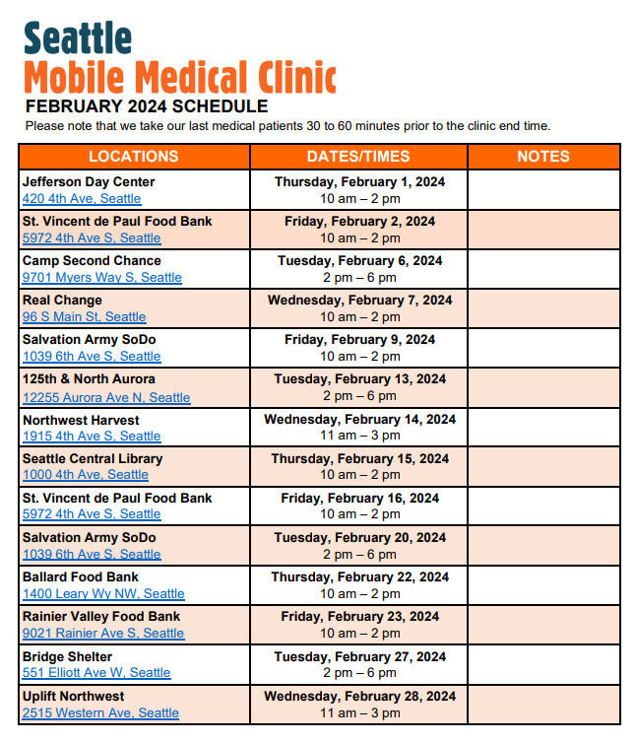
Mobile medical care for people living homeless - King County, Washington

Slide 37
Potential costs for COVID-19 vaccine and antiviral treatments
COVID-19 vaccines and antiviral treatment are currently free to the public. They will remain free, even for people who don’t have insurance, as long as the federal government’s large supply of vaccine and medication lasts. Vaccines purchased by the federal government are predicted to last through the summer and COVID-19 treatments will remain available, depending on the product, through the end of the year.
After these free federal supplies run out, COVID-19 vaccines and treatments will shift to the private market.

Slide 38
Potential costs for COVID-19 vaccine and antiviral treatments
Getting a COVID-19 vaccine will likely be similar to getting the annual flu shot and other routine vaccines. COVID-19 shots and boosters will continue to be free for children under 18 years (through the Washington Childhood Vaccine Program and Children’s Health Insurance Program). In addition, most commercial insurance, Medicare, and Medicaid programs will cover the vaccines for their members.
Starting later this year, people will likely have out-of-pocket costs for COVID-19 treatment, depending on the type of insurance they have. This would be similar to the costs people have for other drugs through traditional coverage.
The federal government is working with vaccine and treatment manufacturers to ensure that Patient Assistance Programs that provide free access to these products are easy to use and broadly accessible.

Slide 39
Treatment
COVID-19 antiviral medications such as Paxlovid purchased by the federal government will remain free regardless of insurance coverage until supplies run out
When the federal supplies of antiviral medications run out later this year, people will likely have out-of-pocket costs for COVID-19 treatment, depending on the type of insurance they have. This would be like the costs people have for other drugs through traditional coverage

Slide 40



Keep in mind…
Public Health

Slide 41
Keep in mind…
Public Health receives data from people who seek out testing.
Case counts become less reliable.
We turn to hospitalizations and death data for disease burden

Slide 42
COVID-19 vaccinations remain a key part of public health intervention.
. ,l
Hospitalizations
. ,l
Deaths
. ,l
?Long COVID

Slide 43
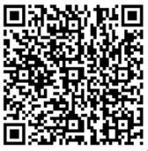
SHOULD NARCAN BE IN THE FAMILY MEDICINE CABINET?
In 2023, there were 697 overdose deaths (59.12% of all deaths) attributed to opioid AND stimulant. ​
321or 27.04% of all deaths were attributed to opioids
QR Code is for KC Overdose prevention Dashboard

Slide 44
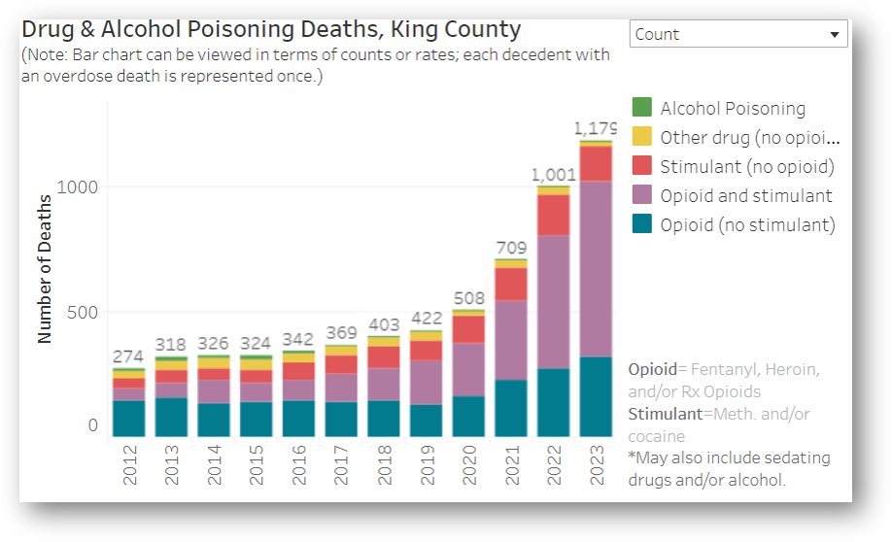
Dashboard

Slide 45
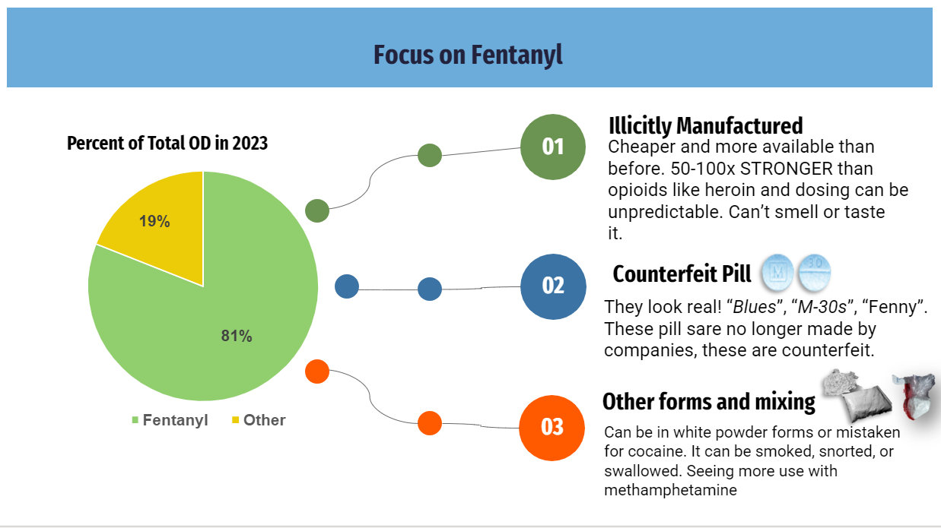
Focus

Slide 46
NALOXONE IS NOW OVER THE COUNTER: ACCESS TO THE MEDICATION WIDENS
Naloxone by Mail
This option is ideal for those who may find in-person access challenging. Deliveries might take up to three weeks based on supply availability.
1. The Kelley-Ross Pharmacy Group provides mail-order and walk-in access within King County. The mail-order program is meant for people who do not have insurance coverage or who can’t easily go to a community organization or a pharmacy to get a kit.
2. Visit the Washington Department of Health for regions outside King County.
To find naloxone near you, search the Washington State Naloxone Finder. Be sure to contact the chosen location to confirm availability.
Naloxone is now available over the counter, and major pharmacies like Walgreens, CVS, Walmart, and Rite Aid sell a 2-dose box for around $45. Not all pharmacies may have it in stock, so it’s best to contact them before you go to confirm availability.
Some health insurance plans may cover the cost or provide a discount since the $45 price may be a barrier for some people who want to buy the medication. People enrolled in Apple Health can get the kit for free, without a copay.

Slide 47
Next Meeting
March 13th 3:30-4:30pm.
Any questions? phpartnerships@kingcounty.gov
Justin Jeffrey
jujeff@kingcounty.gov

Slide 48
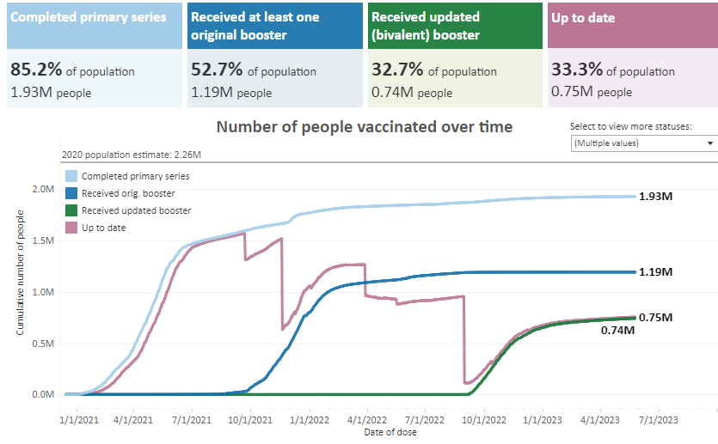
We have had great success with primary vaccines. (over the past month we have increased our vaccine rate by .1%

Slide 49
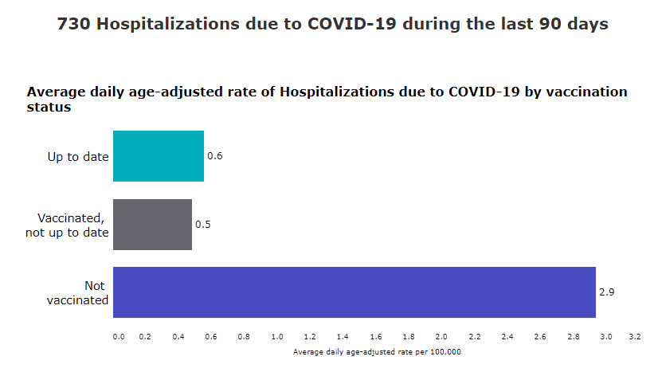
90 Day Hospitalization Vaccinated/Not Vaccinated

Slide 50
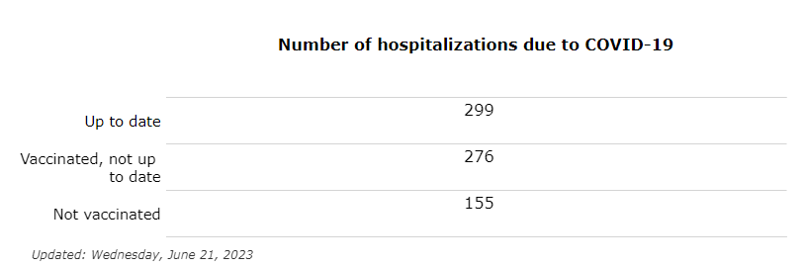
Breaking the Numbers Down even further

Slide 51
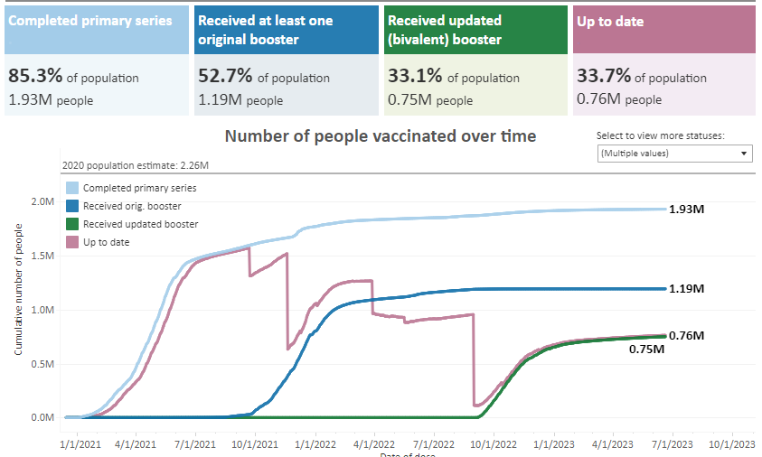
But we have a lot more work to do to bring people up to date.

Slide 52
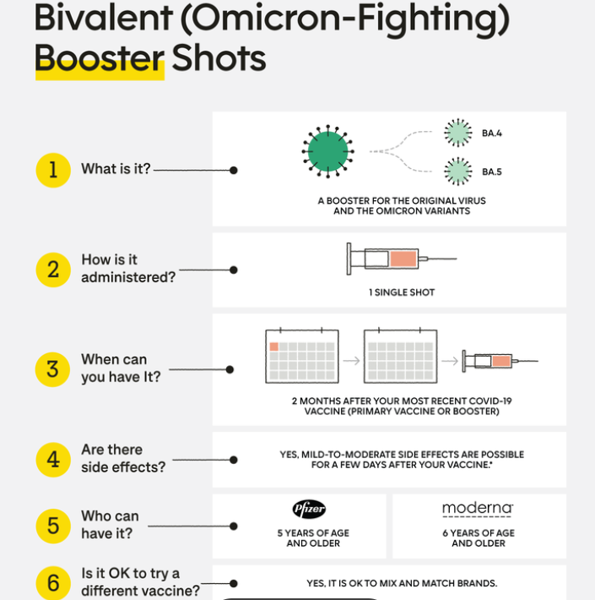
Bivalent (Omicron) Booster

Slide 53
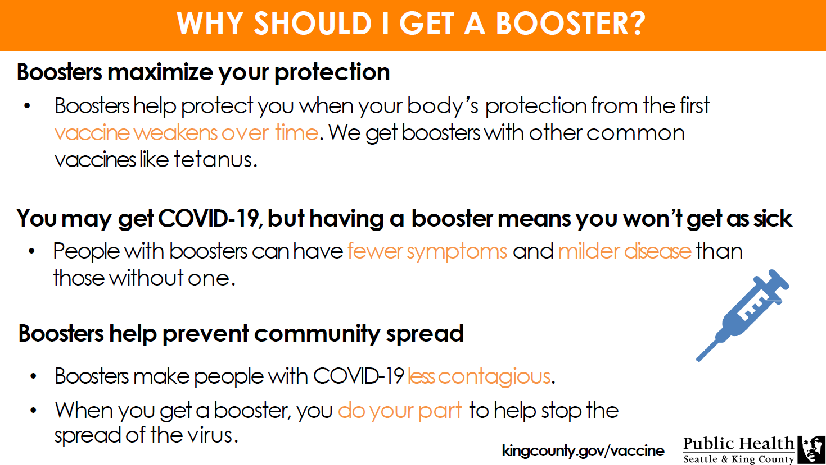

Slide 54
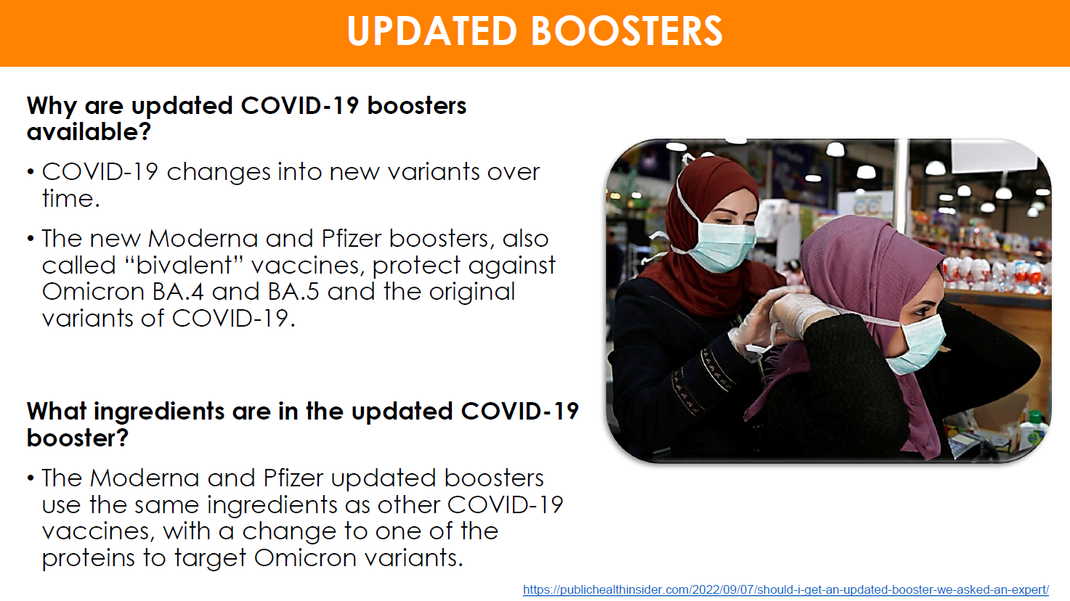

Slide 55
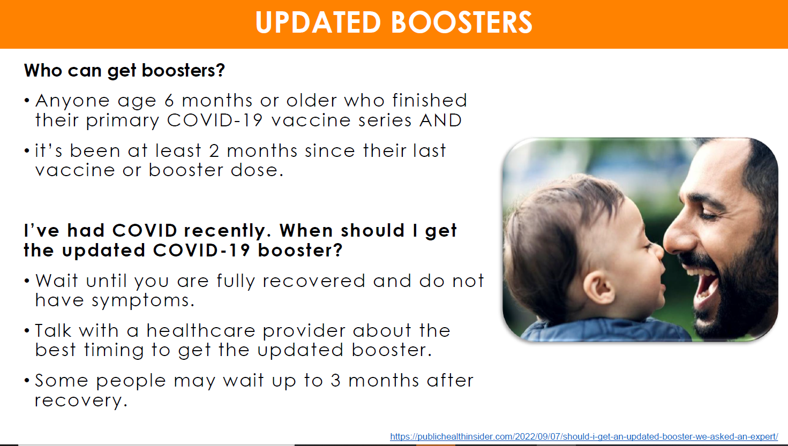

Slide 56

New Updated Bivalent Booster
Who is now eligible to receive the second bivalent booster?
People ages 65 and over.
People over 65 are among those most susceptible to severe outcomes from Covid-19.
These individuals are newly able to receive their second bivalent booster if it’s been at least 4 months since their first bivalent shot.
People who are immunocompromised.
The new guidance from the CDC is that anyone 6 and older with moderate or severe immunocompromise can receive a second bivalent booster if it’s been at least two months since their first.
Depending on their specific medical circumstances, they may be able to receive the bivalent booster as frequently as every two months. They can talk with their provider about this and see if it’s right for them.

Slide 57
