Slide 1

Community Partners’ Call
9.20.2023

Slide 2

The New COVID-19 Vaccine for 2023-2024

Slide 3
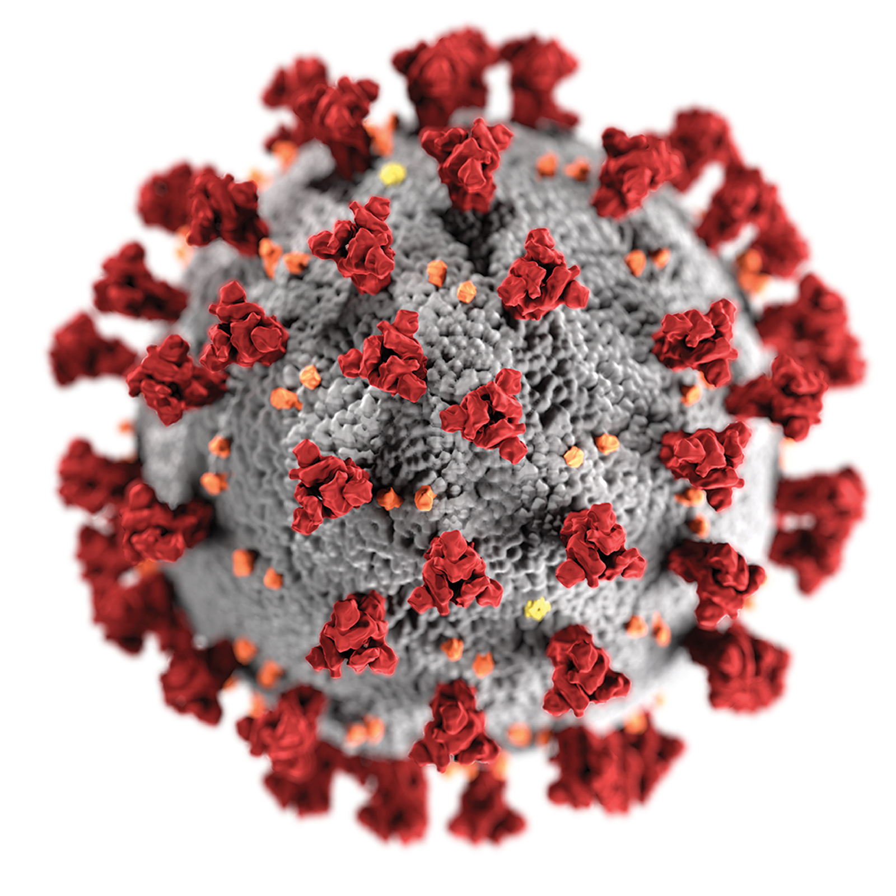

Vaccine preventable infections – COVID-19
Annual boosters made available in the fall
Allows for updates based on the circulating variants
Booster will provide the extra immunity protection especially for those at highest risk for severe disease

Slide 4
A new COVID-19 vaccine was approved to protect everyone this fall and winter.
Everyone 6 months and older should get the updated 2023-2024 COVID-19 vaccine.
It’s especially important for older adults and people with high risk conditions.

Slide 5
The new COVID-19 vaccine is worth getting, even if you’ve been vaccinated before or had COVID.
It will strengthen your body’s ability to fight the new variants of COVID-19 that are spreading now.
Studies show that staying up to date with COVID-19 vaccinations protects people from long COVID. Long COVID includes long-lasting symptoms like difficulty with thinking or breathing, bad headaches, and extreme tiredness.
Anyone can get long COVID, even if you aren’t in a high risk group. So the new vaccine protects everyone.

Slide 6
For COVID-19 vaccination appointments now:
Check Vaccines.gov for pharmacies and clinics that have the new COVID-19 vaccine.
Some pharmacies and clinics will have the new vaccine in the coming days. Many will not have appointments for another week or two, but eventually there will be plenty of appointments.

Slide 7
Starting October 3, Public Health will offer the new COVID-19 vaccine at the Kent Public Health Center.
Public Health will also offer:
In-home vaccination if you have a injury, disability, or health condition that makes it difficult to leave home (starting early Oct)
Community vaccination events (coming soon)
Free flu shots when you get a COVID shot
Get more information at kingcounty.gov/vaccine.
Use the Google translate menu for other languages.

Slide 8
Cost of the new COVID-19 vaccine if you have insurance:
Most insurance will pay for the whole cost. This includes Medicare and Medicaid/CHIP, also known as “Apple Health.” You will need to get vaccinated by a provider in your insurance’s network.
Vaccine locations will ask if you have insurance.
Remember to have your insurance information when you make an appointment and when go to get vaccinated.

Slide 9
You can get free COVID-19 vaccination if you are uninsured or your insurance doesn’t cover vaccines.
Free vaccination is available from the “Bridge Access Program.” Locations include:
CVS, Walgreens and some independent pharmacies
Community Health Centers
Public Health’s Kent Vaccination Center
Find locations participating in the Bridge Access Program on Vaccines.gov.

Slide 10
Children and teens who don’t have insurance can get free vaccination from:
Providers in the Vaccines for Children program
School Based Health Centers in many schools in King County
Back-to-School Vaccination Clinics in south King County. You can get COVID-19 vaccines and all childhood vaccines required by school.)
Information about these options: See “Find a vaccination provider for uninsured/underinsured children” on kingcounty.gov/findaclinic . Translated information is available.

Slide 11
Help your body fight the new variants. Get the new COVID-19 vaccine even if you’ve been vaccinated or had COVID.
You should get the new vaccine if it’s been 2 months or more since you got your last COVID-19 vaccine.
Get the new vaccine if you’ve missed getting a booster earlier or if you’ve never been vaccinated.
If you’ve had COVID recently, you can get the new COVID-19 vaccine once you’ve recovered.

Slide 12
It’s safe to get the COVID shot and the flu shot at the same time.
If you want to avoid separate appointments for vaccination, you can get the shots at the same time.
You can get free flu shots at the Kent Vaccine Center when you get a COVID-19 shot.

Slide 13
Questions about the new COVID-19 vaccine?
Call Washington State Department of Health information line: 1-800-525-0127. Say the name of your language for interpretation.
Go to kingcounty.gov/covid/vaccine. Use the Google translate menu for other languages.

Slide 14
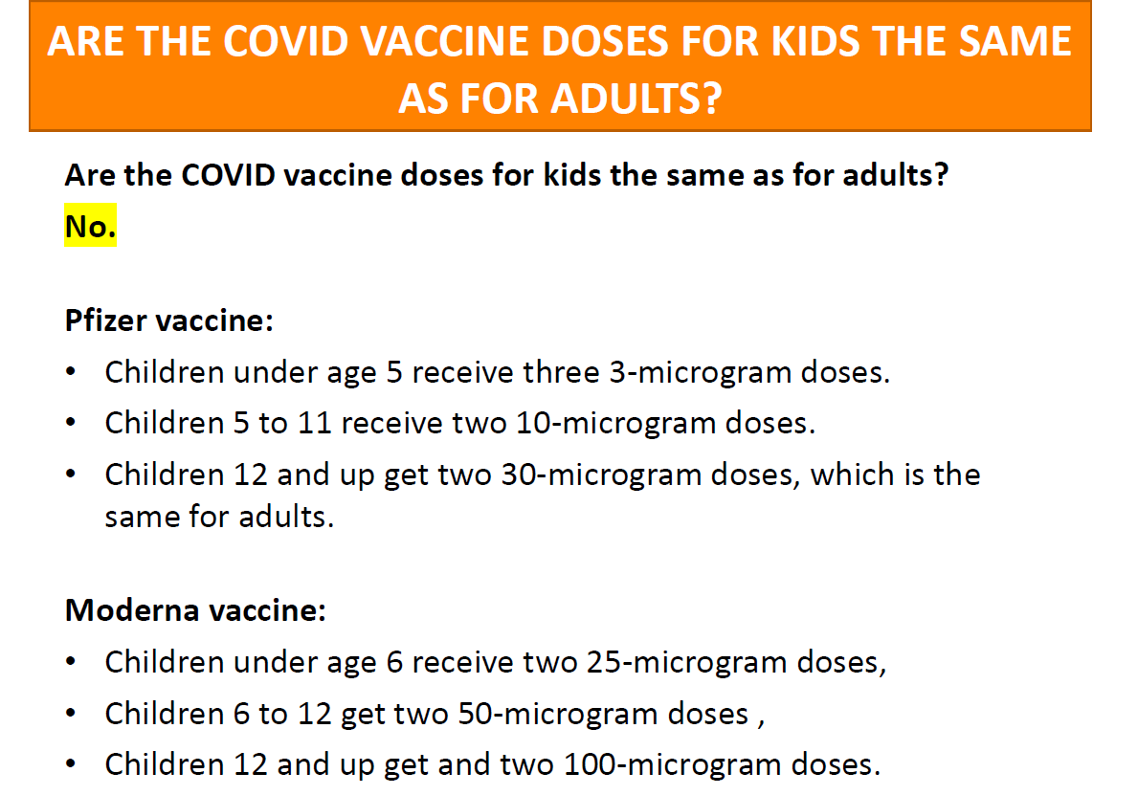

Slide 15
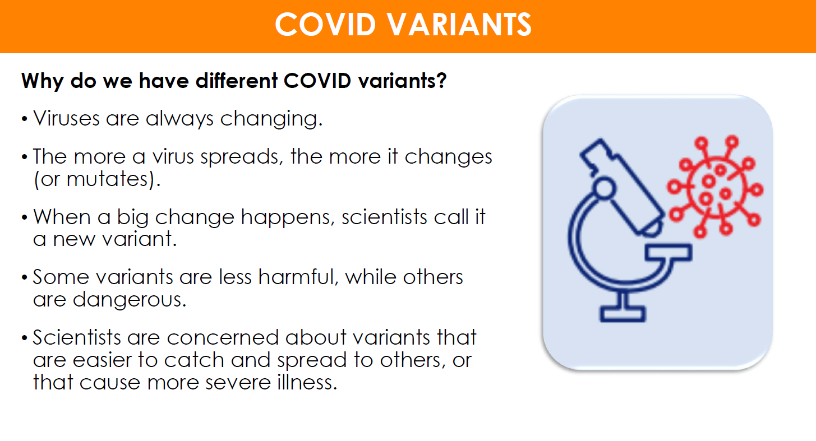

Slide 16
Is the new COVID variant – ‘EG.5’ – spreading in King County?
We are watching COVID variants, but we don’t have the same level of local data about variants as we did during the height of the pandemic. As of September 2023, the CDC is reporting that the newer EG.5 variant makes up about 22% of national COVID cases, and that rate has been increasing. We don’t yet know how much this variant is contributing to the increase in COVID metrics locally.

Slide 17
Staying protected against new Variants
The best way to protect yourself from XBB.1.5 subvariant of Omicron is to get vaccinated and stay up to date on COVID-19 vaccines.
Important to assess your risk level and keep that top of mind. If you will be around others in an indoor setting, consider wearing a mask. But not just any mask will do. It is important to wear an N95 or KN95 mask for the best protection.
Avoid poorly ventilated spaces and maintain physical distancing from others. And if you feel sick, stay home and get tested to determine the best course of action.

Slide 18
Where to get COVID-19 tests?
COVID at home test kits are available at all Pharmacy's for a cost. Ranging from 10-25 dollars a box.
Doctors' offices and Pharmacy's.
Check with your heath insurance to see the out-of-pocket costs.
Many health plans offer free and low-cost access to test kits
If you are an organization and need at home test kits; Public Health has access to test kits still until the end of summer.
Please email phpartnerships@kingcounty.gov

Slide 19
Potential costs for COVID-19 vaccine and antiviral treatments
COVID-19 vaccines and antiviral treatment are currently free to the public. They will remain free, even for people who don’t have insurance, as long as the federal government’s large supply of vaccine and medication lasts. Vaccines purchased by the federal government are predicted to last through the summer and COVID-19 treatments will remain available, depending on the product, through the end of the year.
After these free federal supplies run out, COVID-19 vaccines and treatments will shift to the private market.

Slide 20
Potential costs for COVID-19 vaccine and antiviral treatments
Getting a COVID-19 vaccine will likely be similar to getting the annual flu shot and other routine vaccines. COVID-19 shots and boosters will continue to be free for children under 18 years (through the Washington Childhood Vaccine Program and Children’s Health Insurance Program). In addition, most commercial insurance, Medicare, and Medicaid programs will cover the vaccines for their members.
Starting later this year, people will likely have out-of-pocket costs for COVID-19 treatment, depending on the type of insurance they have. This would be similar to the costs people have for other drugs through traditional coverage.
The federal government is working with vaccine and treatment manufacturers to ensure that Patient Assistance Programs that provide free access to these products are easy to use and broadly accessible.

Slide 21
Treatment
COVID-19 antiviral medications such as Paxlovid purchased by the federal government will remain free regardless of insurance coverage until supplies run out
When the federal supplies of antiviral medications run out later this year, people will likely have out-of-pocket costs for COVID-19 treatment, depending on the type of insurance they have. This would be like the costs people have for other drugs through traditional coverage

Slide 22
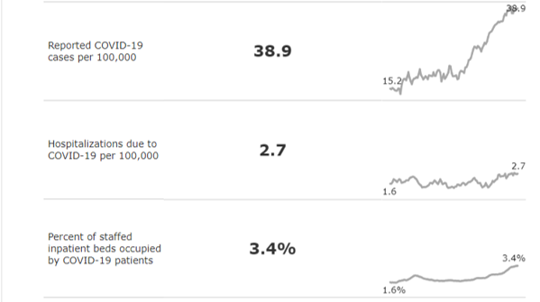
Generally, COVID-19 burden is decreasing in the US and here in King County.

Slide 23
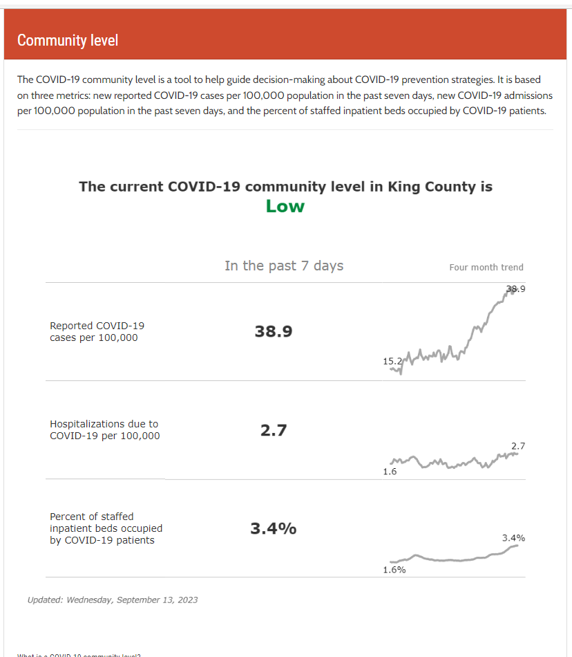
In King County, our current trends show the following:

Slide 24



Keep in mind…
Public Health

Slide 25
Keep in mind…
Public Health receives data from people who seek out testing.
Case counts become less reliable.
We turn to hospitalizations and death data for disease burden

Slide 26
COVID-19 vaccinations remain a key part of public health intervention.
. ,l
Hospitalizations
. ,l
Deaths
. ,l
?Long COVID

Slide 27
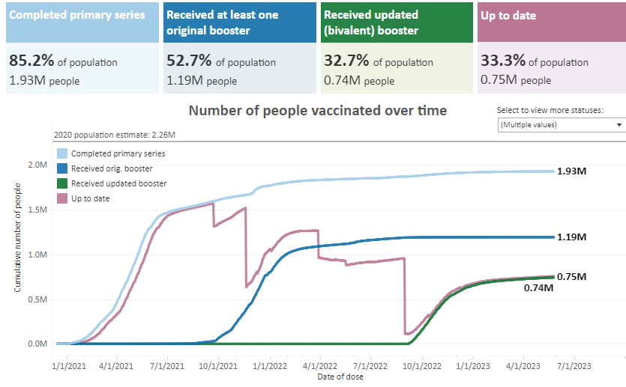
We have had great success with primary vaccines. (over the past month we have increased our vaccine rate by .1%

Slide 28
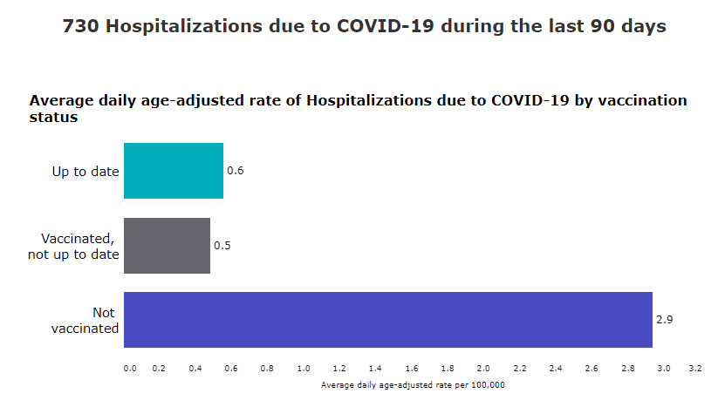
90 Day Hospitalization Vaccinated/Not Vaccinated

Slide 29
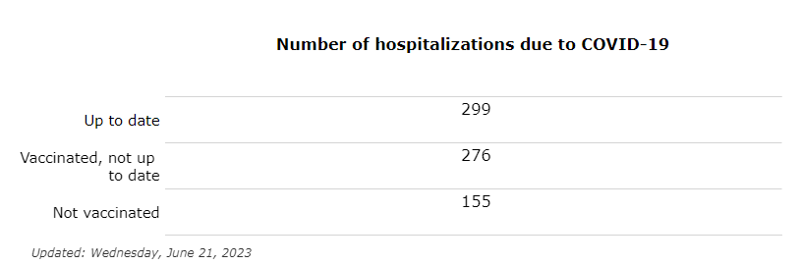
Breaking the Numbers Down even further

Slide 30
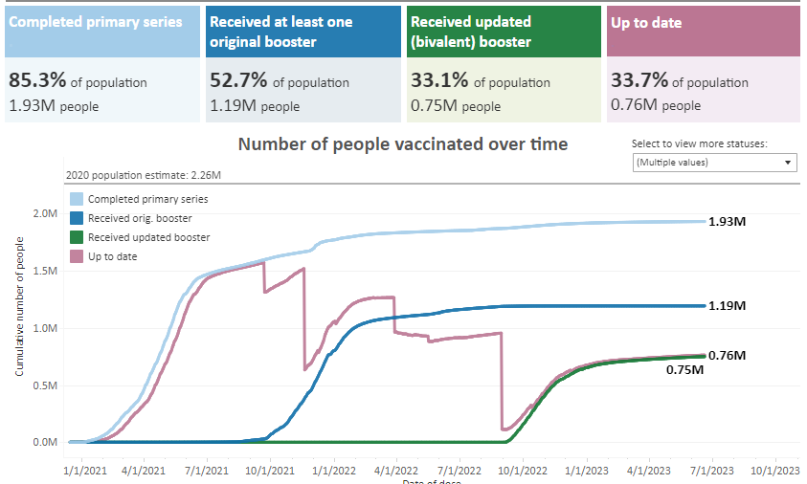
But we have a lot more work to do to bring people up to date.

Slide 31
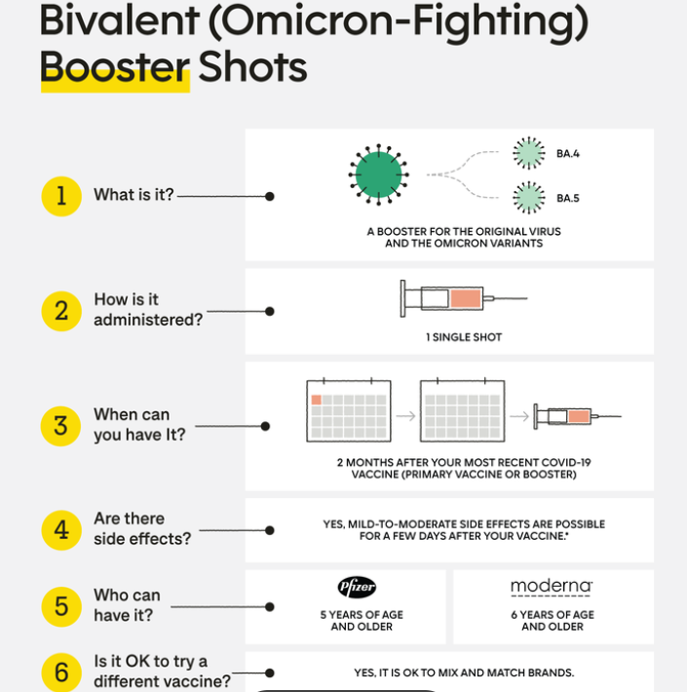
Bivalent (Omicron) Booster

Slide 32
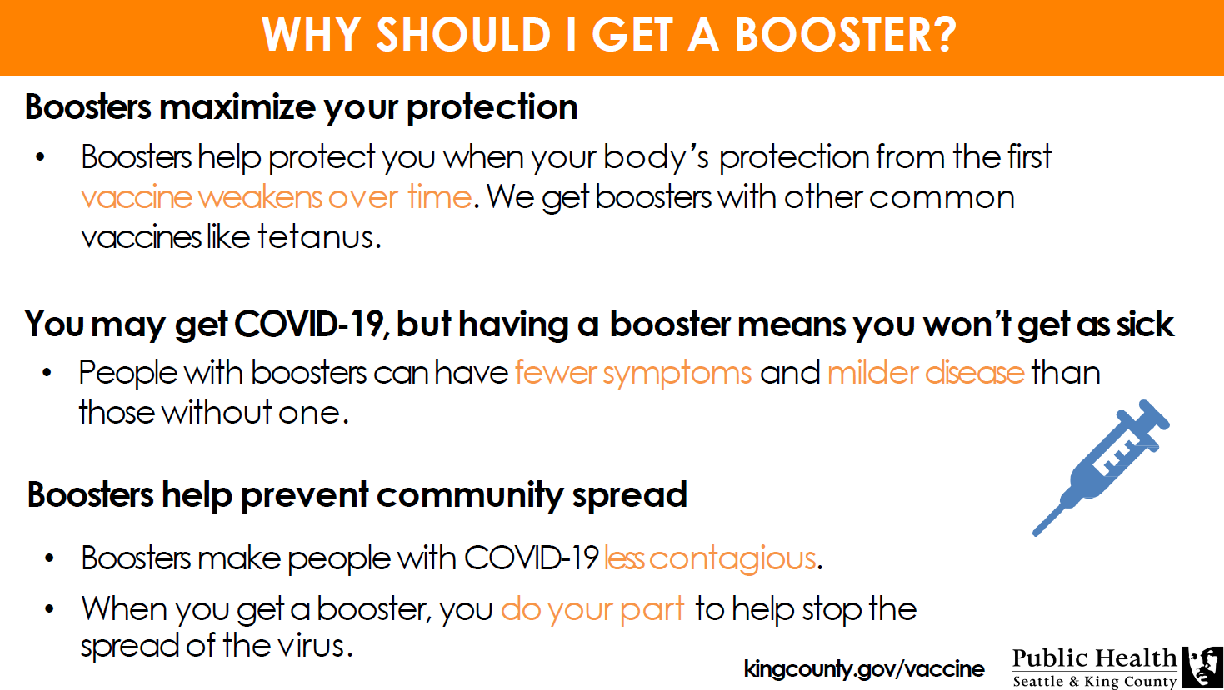

Slide 33
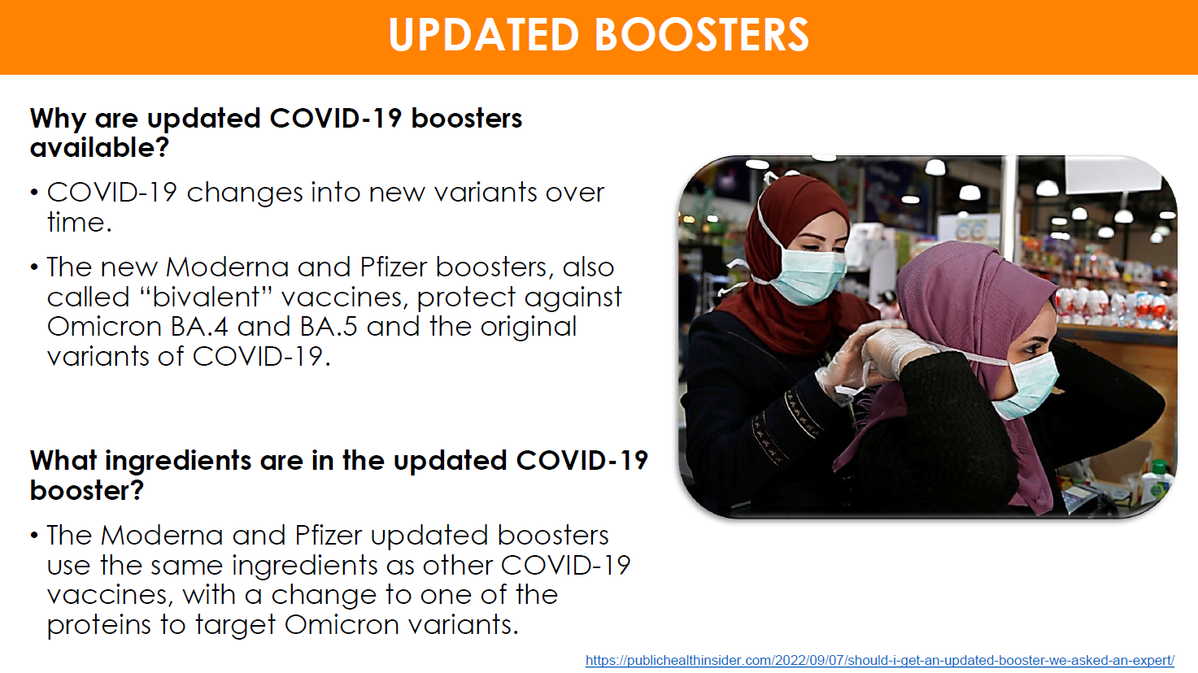

Slide 34
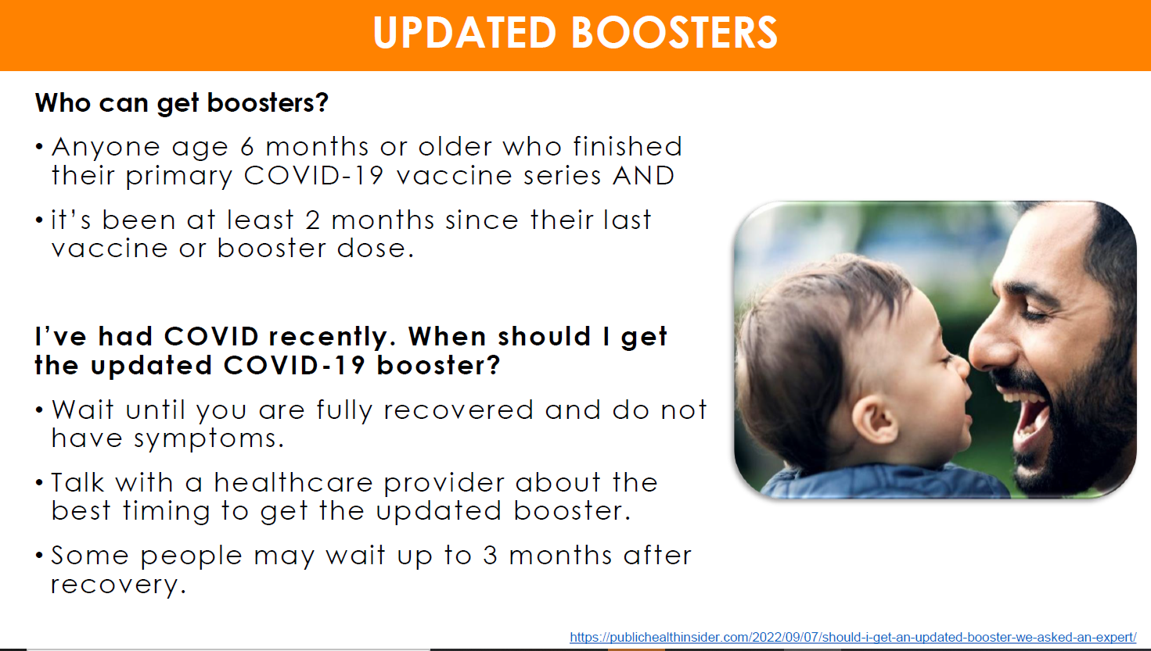

Slide 35

New Updated Bivalent Booster
Who is now eligible to receive the second bivalent booster?
People ages 65 and over.
People over 65 are among those most susceptible to severe outcomes from Covid-19.
These individuals are newly able to receive their second bivalent booster if it’s been at least 4 months since their first bivalent shot.
People who are immunocompromised.
The new guidance from the CDC is that anyone 6 and older with moderate or severe immunocompromise can receive a second bivalent booster if it’s been at least two months since their first.
Depending on their specific medical circumstances, they may be able to receive the bivalent booster as frequently as every two months. They can talk with their provider about this and see if it’s right for them.

Slide 36
