Slide 1


Nursing Assistant Rules
Reuben Argel, MBA, BSN, RN
Director of Nursing Assistant Education

Slide 2
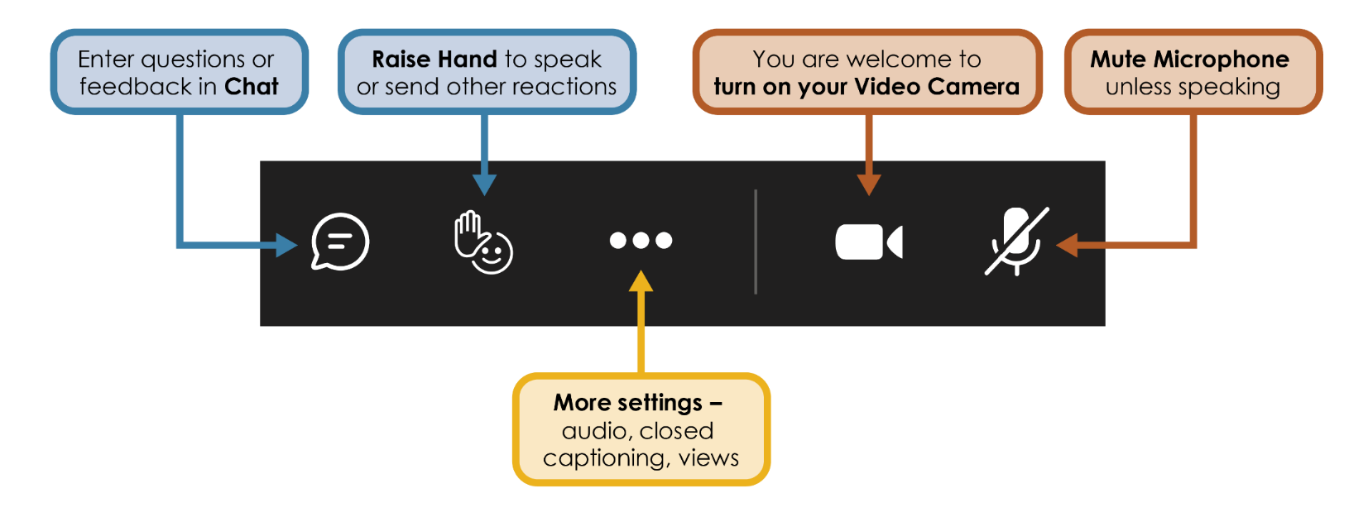
Zoom Features We Will Use Today
Notes:
Before we get started, here are a few Zoom features we’ll be using today…

Slide 3
Meeting Reminders
Be mindful and respectful of all those in attendance.
Please raise your hand to speak and staff will call on you to share.
  State your name before speaking.
  Speak clearly and audibly.
  Keep your mic muted unless asked to share.
Please be mindful of the time and allow others the opportunity to speak.
Please stay on topic.

Slide 4
Where are we now?
Original CR-101 filed in September 2024 to implement skills testing into nursing assistant training programs.
Board recognizes that additional topics need to be addressed within the rulemaking.
In February 2025, the board rescinded the original CR-101 and filed a new CR-101 to address additional topics.
Board filed a Policy Statement to delay the enforcement of the nursing assistant specialty curricula.

Slide 5
Purpose
Implement skills testing in training programs
Make changes to the specialty curricula rule requirements
Address potential impacts from legislation passed in the 2025 Legislative Session and other related priorities
Amends:
Sections in Chapter 246-841A (Nursing Assistants)

Slide 6
Summary of Specialty Curriculum Feedback
Support for flexible, modular frameworks rather than prescriptive curricula
Desire to maintain academic autonomy and better align content delivery with community needs
Discussion about equity between community college and private program requirements
Recommendation for the train-the-trainer sessions tailored to NA instructors and directors.
Suggestion for the state to develop a few approved curricula models that programs could select and adapt from.
Request to allow currently approved instructors to teach the specialties without additional approval steps.
Interest in “grandfathering” for programs already incorporating the specialty topics.

Slide 7

Skills Testing in Training Programs

Slide 8
Historical Background
Mass Testing Ends
Testing transition Credentia to Training Programs
Voluntary Training Program Testing

Slide 9
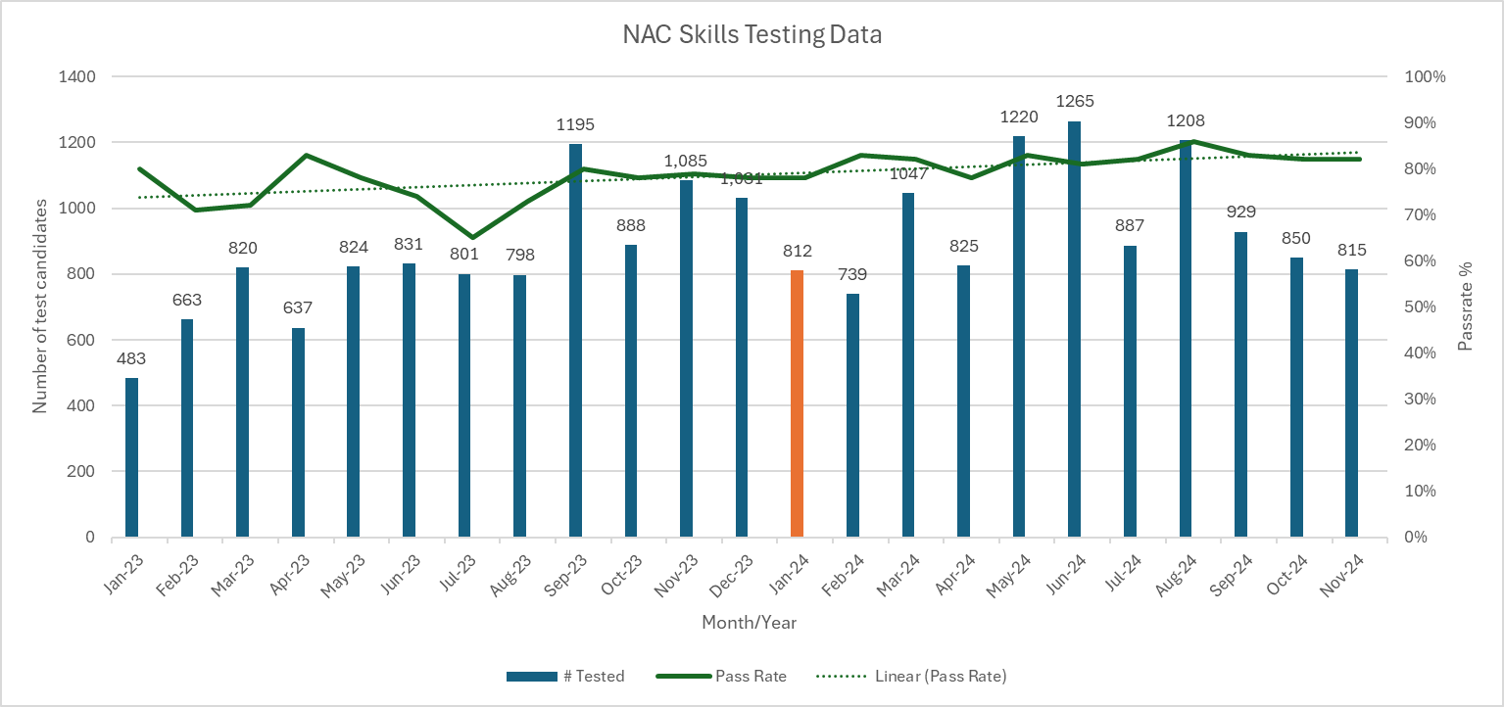
NAC Testing Data: Pilot #1
Training programs perform skills testing after program completion.
More candidates tested since October 2023 with change to training program testing
Increased student confidence/ comfort resulting in higher pass rates.

Slide 10
Rationale for Rulemaking
Spread testing volumes across programs
68 % of programs voluntarily testing
Decrease volume for RTS testing sites (sites taking students other than their own)
Increase student confidence in testing through familiarity with environment and instructors.
Decrease delays in student testing and processing with local testing within program
Decrease “no-show” rate with in-program testing
87% of no shows between Oct 2023-Mar 2024 were RTS

Slide 11
Pilot #2 Testing Results
Skills Testing PRIOR to Program Completion

Slide 12

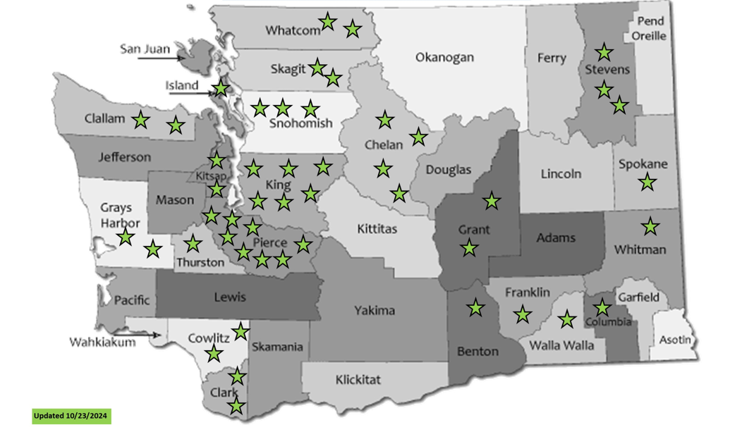
Nursing Assistant Certified Skills Exam Pilot #2
Refined the evaluation tool and other testing materials based on pilot program feedback.
February 2025, survey to gather input on the updated process and programs not currently participating to understand barriers or hesitations
Ruth Rono, DNP, and Team are presenting QI project results at the Seattle Nursing Research Consortium Conference on 04/28/25.

Slide 13
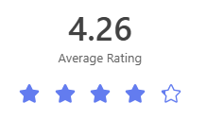
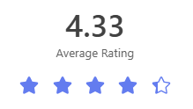
Pilot #2 Program Survey Results:
31 Responses
How satisfied are you with the Nursing Assistant Certified (NAC) skills exam pilot process?
How satisfied are you with the RN Evaluator training provided by WABON?
Likert Scale rating 1 to 5, where 5 is "great" and 1 is "poor".

Slide 14
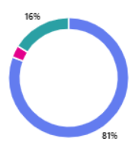
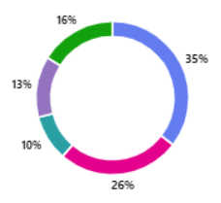

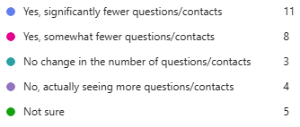
Survey Results Continued…
Did the skills exam pilot help simplify your students' credentialing process?
Have you noticed fewer questions from students about next steps after graduation, or a reduction in calls/emails from former students?

Slide 15
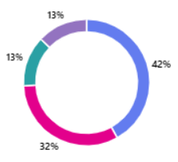
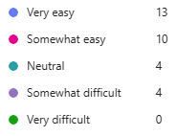
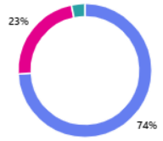
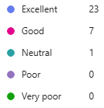
Survey Results Continued…
How easy was it to implement the NAC skills exam pilot process into your NAC training program?
How would you rate your support you've received from WABON staff with information on the NAC skills exam pilot process?

Slide 16
What positive outcomes have you observed from the NAC skills exam pilot process?
Higher pass rate as students are better prepared.
Much more clarity for my students about testing expectations, less anxiety, easier to take exam, higher credential rate.
With the path to credentialing made more linear and "step-by-step", it's been easier to explain the process to students. It's also easier to inform them of expectations and what they should be doing. There's less questions and complaints to staff because we're now in more control over the information (results) flow to our INF students instead of waiting for the interim step of WABON receiving, grading, and distributing test results.
Students have gotten their licenses within two weeks! It’s amazing how simplifying that process is helpful and then also implementing that we assist the student signing up for their license and Credentia accounts.

Slide 17
Would you like to provide feedback or challenges your program has experienced with the NAC skills exam pilot?
The only thing that is a little uncertain is having the skills exam date be the end date for the program
Form has small boxes and is hard to record handwritten documentation
I don’t like the date issue with saying they haven’t completed the class until they have done their skills testing and the order in which they need to take the exams (skills first, then the written exam).
Other program’s students are not taught the same way our students are for the test (regarding Regional test candidates)
The timing of fitting in four testing attempts for students.

Slide 18
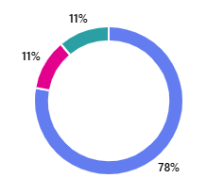
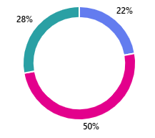
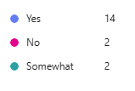

Survey Gathering Feedback from Non-Participating Programs:
18 Responses
Before receiving this survey, were you aware WABON had a new NAC skills exam pilot process?
How would you describe your understanding of the process goals and Benefits for the NAC skills exam pilot.

Slide 19
What is the main reason/barrier on why you are hesitant to try out the skills exam pilot?
There were too many other changes in the near future to the NAC Training program requirements at the time of implementing the skills exam pilot program.
I haven't taken the time to research it. I need to listen to the recordings.
I only test students once a year, since we are a high school program. I need the process to be seamless one time around. I didn't think it was worth me piloting, since I won't be testing students until May.
I would be concerned with a conflict of interest or programs being impartial. It would take the integrity of the program which I believe is built into Nursing programs. As, RN's only take a written exam.
I like having the boundary of having the state grade the exam. I also do not want the added responsibility of grading the exams.

Slide 20
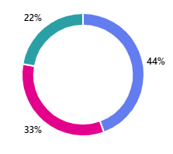
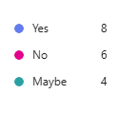
Survey Continued…
Before receiving this survey, were you aware WABON had a new NAC skills exam pilot process?

Slide 21

NAC Skills Exam Data: Nov 20th, 2024 – Feb 2025
Programs: | Test Takers | Passed | Pass Rate
Pilot Programs | 575 | 505 | 88%
Non-Pilot Programs | 1663 | 1435 | 86%
Notes:
This slide shows the data we have collected so far from our pilot programs. We are asking pilot programs to send us a quarterly report of test taker #s and pass rates. Since we started the pilot on 11/20/2024 and most pilot programs didn’t begin the test pilot until January, the numbers for the first quarter will look a bit smaller. We are hoping next quarter these numbers will increase quite a bit, especially since this will be during gradation season and a lot of our pilot programs are colleges/high schools.

Slide 22
Discussion Questions

Slide 23
Question #1
What benefits or improvements have you seen (or would expect to see) from having training programs administer the nursing assistant skills exam prior to program completion?

Slide 24
Question #2
What challenges have you encountered, or do you anticipate, if skills testing becomes a permanent responsibility of training programs?

Slide 25
Question #3
How can the Board best support training programs in implementing or maintaining a successful internal skills testing process?

Slide 26
Question #4
Are there risks or concerns around consistency, impartiality, or test integrity when programs test their own students?

Slide 27
Question #5
What would make it easier for your program to participate in skills testing if you haven’t already implemented it?

Slide 28
Next Steps
Next rule workshop:
  Thursday, April 25, 2025
  1:00 p.m. – 2:30 p.m.
  Join via Zoom
Questions? Contact us at WABONRules@doh.wa.gov

