Slide 1
Rules workshop
MENTAL HEALTH COUNSELORS, MARRIAGE AND FAMILY THERAPISTS, SOCIAL WORKERS

Slide 2
Presenters
Lana Crawford (DOH)
Program Manager
John Simmons (DOH)
Program Support
Melody Casiano (DOH)
Policy Analyst

Slide 3
MS Teams Features We Will Use Today
Video On
Tips
Try to be present
State your name before speaking
Speak clearly

Slide 4
Communication Avenues
DOH Program Staff: licensed.counselors@doh.wa.gov
Send public comments by July 5, 2024
Sign up for GovDelivery for updates
Check our website

Slide 5
Workshop overview

Slide 6
Agenda
Rulemaking Process Overview
Overview of the Departments Rulemaking history
Future Workshops
Review Draft Language

Slide 7
RULES OVERVIEW

Slide 8
What is a Rule?
Rule: a regulation that helps give clarity if the underlying statute is broad or unclear.
An enforceable directive that:
Subjects a person to a penalty or sanction if that person violates a regulation
Sets qualifications for conveying privileges to people or entities
Sets procedures or practices for agency hearings
Licenses or permits individuals or entities and revokes licenses or permits
Sets project or material standards for goods before they can be sold or distributed in Washington

Slide 9
Laws vs. Rules
Laws | Rules
Revised Code of Washington (RCW) | Washington Administrative Code (WAC)
Enacted by the Legislature and signed by the Governor | Rules must fit with the specific statutory authority
Serve as statutory authority or permission for our rules and activities | Used to implement laws and policies
Chapter 34.05 RCW is the law that tells agencies the process it must follow when adopting rules known as the Administrative Procedures Act (APA). | Title 246 WAC holds all Department of Health and State Board of Health rules and must comply with the APA.

Slide 10
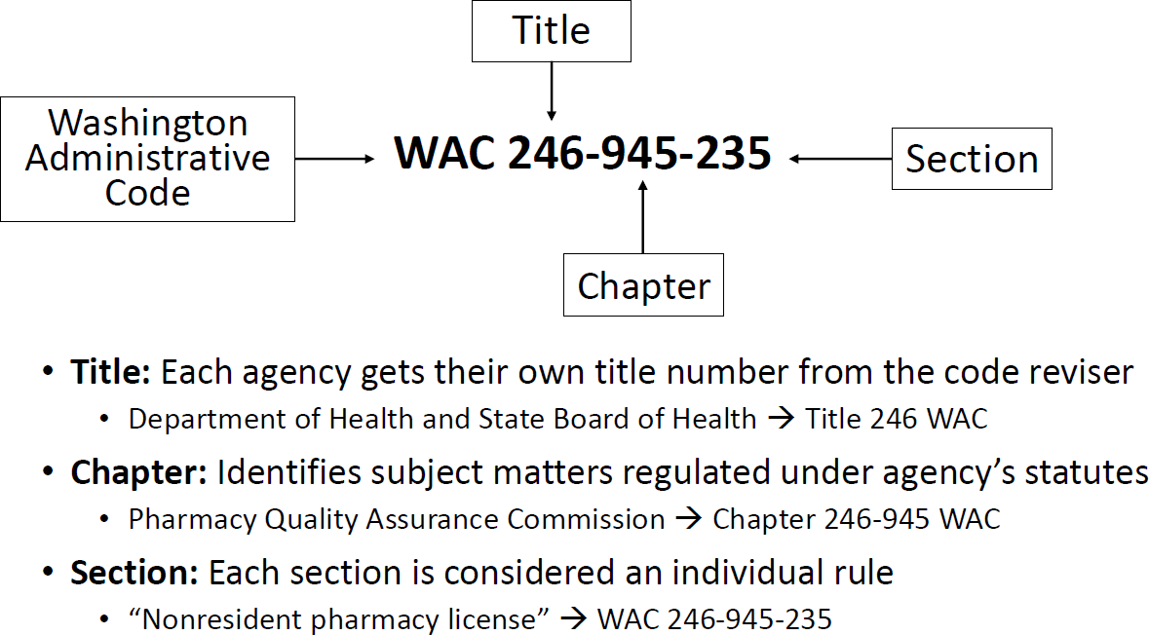
WAC Numbering System
Example from the Pharmacy Quality Assurance Commission

Slide 11
What May Generate Rulemaking?
New or revised legislation
Board/Commission or Department of Health (DOH) identifies need
Formal petitions by interested parties under RCW 34.05.330
Changes in technology or national standards
Court decision
Governor’s directives

Slide 12
STANDARD RULEMAKING PROCESS

Slide 13
Standard Rule Process*
CR101
CR102
CR103
Rulemaking is initiated
Begin drafting rule language
Determine
potential costs
Public meeting(s)
Rules workshop(s)
Written comment
period
Public Hearing (held at least 33 days after the CR102 filing)
Rule language finalized
Agency adopts rule (effective 31 days after CR103 filing)
*Standard rulemaking may take 12 to 18 months to complete.

Slide 14
QUESTIONS?

Slide 15
Overview
In 2023 Second Substitute House Bill 1724 passed. Section 5 of the bill mandated the Department of Health to examine licensure requirements and identify changes that would remove barriers to entering and remaining in the healthcare workforce.
Section 6 of the bill mandated the department to adopt permanent rules by July 1, 2025, to adopt the changes identified as being a barrier to entering and remaining in the healthcare workforce.
In 2024 Engrossed Second Substitute House Bill 2247 passed. This bill removed the limitations on the number of renewals authorized for associate credentials and removed the limitations on marriage and family therapist associate supervision requiring the supervisor to have more than 5 years’ experience.

Slide 16
continued…
Since the board had already commenced updating licensing requirements prior to 1724 and 2247, all rulemaking packages have been merged into one. Except for new sections(1) the directory to help mental health counselor, marriage and family therapist, and social worker associates find supervisors; (2) standards for supervision of associates and (3) a stipend program to offset some costs of supervision (4) allow associate applicants to practice on a pending license.
This series of workshops are meant to:
Review draft language from comments received in the 2022 feedback sessions from the initial licensing requirements rulemaking package and the 2023 feedback sessions held due to 1724.
Gather feedback from the public on all other licensing requirements.

Slide 17
Dates and Topics
Date | Time | Topic
June 26, 2024 | 12:00pm | Review draft language and gain feedback
June 28, 2024 | 12:00pm | Review draft language and gain feedback
July 1, 2024 | 5:00pm | Review draft language and gain feedback
July 16, 2024 | 12:00pm | Review proposed draft language

Slide 18
Approximate Timeline
File a new CR101 – completed April 2024
Rules workshops – Summer 2024
File CR102 – Fall 2024
Public Hearing – Winter 2025
File CR103 – Spring 2025
New rules effective – July 1, 2025

Slide 19
Questions?

Slide 20
To request this document in another format, call 1-800-525-0127. Deaf or hard of
hearing customers, please call 711 (Washington Relay) or email doh.information@doh.wa.gov.

