Slide 1

MEDCON
What it is…….and isn’t!

Slide 2
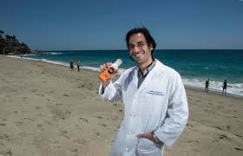
MEDCON???????…..
Medical Consult??
Medium Conman??
Mediocre Content??
Medium Concern??
Medic-Con (see Comic-Con)??
Club Med Con??
Medical Continuity??
Media Consumer??

Slide 3
YES! Medical Consult!!
The official name is Child Abuse Medical Consultation and Training Network
MedCon is a contract between DCYF and Seattle Children’s Hospital for virtual/online consultation of cases with concern for child abuse or neglect once a report of abuse has been “screened in”.
May be accessed by…
  CPS workers and supervisors
  Tribal Social Workers
24/7 access to child abuse medical providers through an online survey link called RedCap.

Slide 4

Scenario 1
Currently hospitalized patient
Hospitalized for abuse or serious neglect
QUESTION: Can I (must I?) ask for a MedCon?

Slide 5
Answer…. No.
Why not?
In most cases, these children are seen by a child abuse medical provider within the community.
Who do I talk to?
All questions regarding the case while in the hospital and after the hospitalization should be addressed to the involved child abuse medical provider.
What if the provider has questions?
IF that provider wishes to consult with another child abuse provider, that should be done by the provider, not CPS, LE, etc.

Slide 6

Scenario 2
Infant referred by PCP for failure to thrive (FTT)
Baby is hospitalized for evaluation
QUESTION: Should I ask for a MedCon?

Slide 7
Answer….No.
Why not?
There are MANY causes of failure to thrive in an infant.
Who do I talk to?
Questions should first be directed to the PCP and medical team evaluating the baby.
What if the provider/medical team has questions?
If the medical team requests a child abuse consultation, they can call the child abuse provider in the community.
If their assessment is that the failure to thrive is due to neglect or intentional starvation, consultation is best done by the child abuse provider in the community.

Slide 8

Scenario 3
Referral is made by grandmother for infant’s mild failure to thrive
PCP is caring for the baby and is not concerned about neglect or abuse
QUESTION: Should I request a MedCon?

Slide 9
Answer….No.
Why not?
PCP has evaluated the infant and has not expressed concern.
Who do I talk to?
Questions should be addressed to the PCP.
If this is difficult or inadequate, involving your Regional Medical Consultant (RMC) is appropriate.
Your RMC can evaluate the records, communicate with the PCP or give guidance about second opinions.

Slide 10

Scenario 4
Referral by school that child is hungry at school, eating out of trash can
Referral by grandmother that child is not eating enough
Parents state child is picky eater and kid looks “OK” on home visit
QUESTION: Is this FTT and should I ask for a MedCon?

Slide 11
Answer…. Yes!
Why?
This is different from “Failure to Thrive”.
This is worrisome for intentional starvation and/or child torture.
Kids can look “OK” but be not gaining weight or actually losing weight.

Slide 12

Scenario 5
4 year old girl has genital complaints but no history of sexual abuse
Is seen by a doctor in urgent care and found to have a “tear”
CPS is called
QUESTION: Should is request a MedCon?

Slide 13
Answer…. No.
Why not?
Child and family must be referred for medical evaluation at nearest child abuse center.
MedCon cannot assess the situation or evaluate the child.
Who do I talk to?
Consultation by phone about where and when child should be seen can be obtained 24/7 on crisis lines or by SCAN/SAC providers on call.
Generic questions about STDs and sexual abuse can be addressed to the RMC or your community child abuse provider.

Slide 14

Scenario 6
Referral for concerns of parents not complying with medical treatment
Child has inadequately treated diabetes
QUESTION: Do I ask for a MedCon regarding medical neglect?

Slide 15
Answer…. No. Usually.
Ok…tell me more…
Questions should be directed back to the medical provider or team making the referral.
They can explain why it’s neglect, what the possible dangers and bad outcomes could be and what their recommendations are.
Alternatively, your RMC may be able to help.
In some cases, an MDT may need to be arranged involving the community child abuse providers.

Slide 16
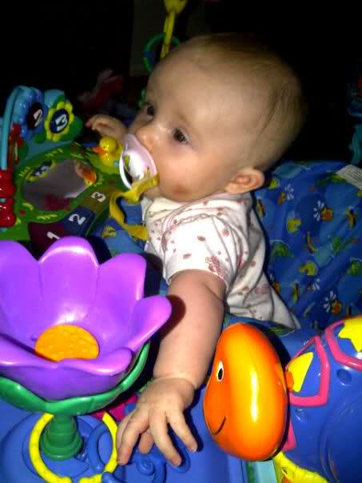
Scenario 7
Referral from daycare about a 5 month baby with a bruise.
You go to daycare, baby looks happy but has a small bruise on the cheek next to the mouth.
Family is nice and says crazy toddler sibling hit baby with a toy.
QUESTION: Is this a MedCon?

Slide 17
Answer…. Yes, it can be.
Sounds like there’s a “but” coming…
BUT, this can only happen during office hours and will require immediate attention! (i.e. should not be submitted at the end of the day or just prior to a weekend when no one is available to quickly review and respond.)
What’s the preferred response?
Ideally, this child should be referred for immediate (within 24 hours) medical evaluation regardless of the MedCon process.
Why?
This is a sentinel injury and is highly correlated with physical abuse and abusive head trauma.

Slide 18

Scenario 8
Your case has been reviewed and an opinion given by Dr. Wiester (what does she know??).
You do NOT agree with her opinion and have been advised by your supervisor to ‘get another opinion’.
QUESTION: Do I do this through MedCon?

Slide 19
Answer…. No!
Why not?
Any questions regarding an opinion given by a child abuse medical provider about a specific patient and situation must be directed back to that medical provider.
“Disagreements” are often due to communication style, continued questions, misunderstandings about the medical details and missing information. Working together improves the process within our statewide community.
What about questions from Lawyers?
Questions from lawyers, etc. should not be delivered through CPS or within the MedCon process.

Slide 20

Scenario 9
Your case has been managed and you need to close it.
Your supervisor notices you don’t have a MedCon opinion and asks you to do this before closing it.
QUESTION: Can I get a quick MedCon to close out my case?

Slide 21
Answer…. No!!
Aw, c’mon. Why not?
MedCons are NOT mandatory on ALL cases, although there are DCYF policies requiring MedCons for certain cases.
MedCons should not be requested to ‘rubber stamp’ a case.
MedCons SHOULD be requested to help with management.
This does not qualify as an ‘emergency’.

Slide 22

Scenario 10
You have received a medical examiner report about a child on your caseload.
You have many questions.
QUESTION: Should I request help reviewing this through MedCon?

Slide 23
Answer…. Yes.
Oh, good. I could use some help.
But, consider the following…
IF the child is reported to have died of abuse or neglect, MedCon is appropriate.
IF the child died from something else, speaking with the RMC is appropriate.
Anything else to consider?
Questions about the medical examiner’s/forensic pathologist’s opinions must be handled carefully.
Questions about risk to other children in the environment are appropriate.

Slide 24
What ELSE can I use aside from MedCon??
RMCs – They can answer medical questions and help with mild neglect cases and cases of potential harm (i.e. “Will mom not filling this prescription cause harm?”).
SCH’s SCAN (Safe Child and Adolescent Network) Team – They can assist with cases at SCH or Harborview where the child has been seen, admitted or is otherwise known to the Team.
SAC (Sexual Assault Center) Teams – They can answer your sexual assault questions and examine children.
Community Child Abuse Providers (MDs and NPs) – They can examine children with abusive injuries that should be seen locally. They also respond to requests submitted via MedCon (i.e. the RedCap survey).

Slide 25

Helpful? More confusing?
Email us and let us know!!
SCANMedcon@seattlechildrens.org
How can we improve?
Other unaddressed topics/problems?

