Slide 1



Slide 2

You can apply from any device with
Internet access

Slide 3
Required Items:
Email address - To apply to the RAD housing waitlist, you will need a few things. An email address – this is required. If you do not have one you will need to create one before starting this process.
Social Security Number - Your Social Security number, if applicable.
Best phone number to reach you - The best phone number to reach you.
Income information - Your household Income information if applicable
Information on your household composition - Information on your household composition and who will be living with you.

Slide 4

To access the website from any Internet-accessible device, type the following into your web browser:
www.fairfaxcounty.gov/housing/RADApplications

Slide 5
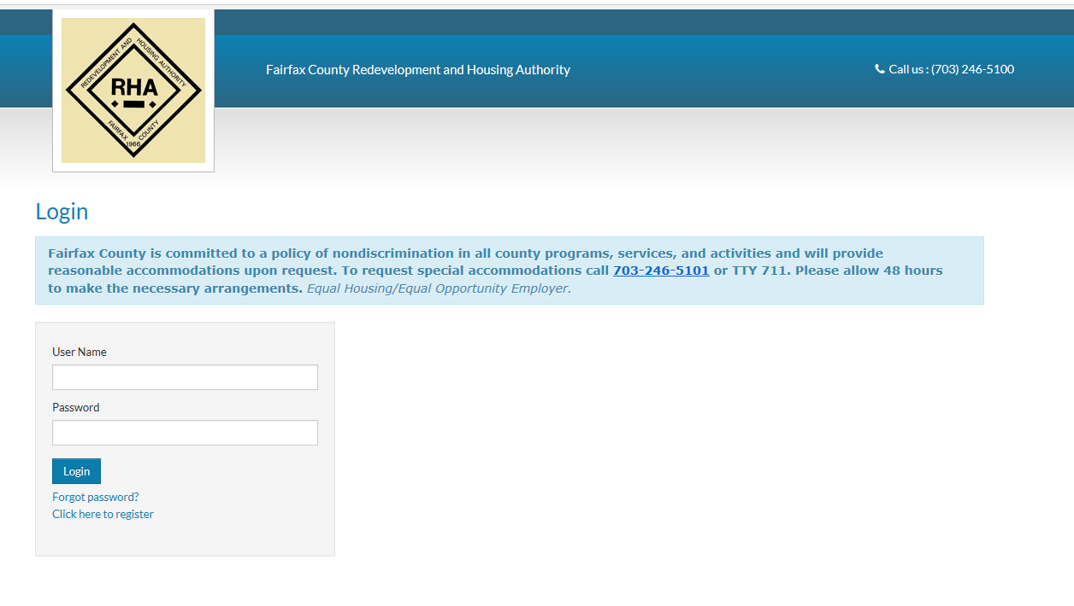

Slide 6
Reasonable Accommodation
If you need a reasonable accommodation call 703-246-5000

Slide 8
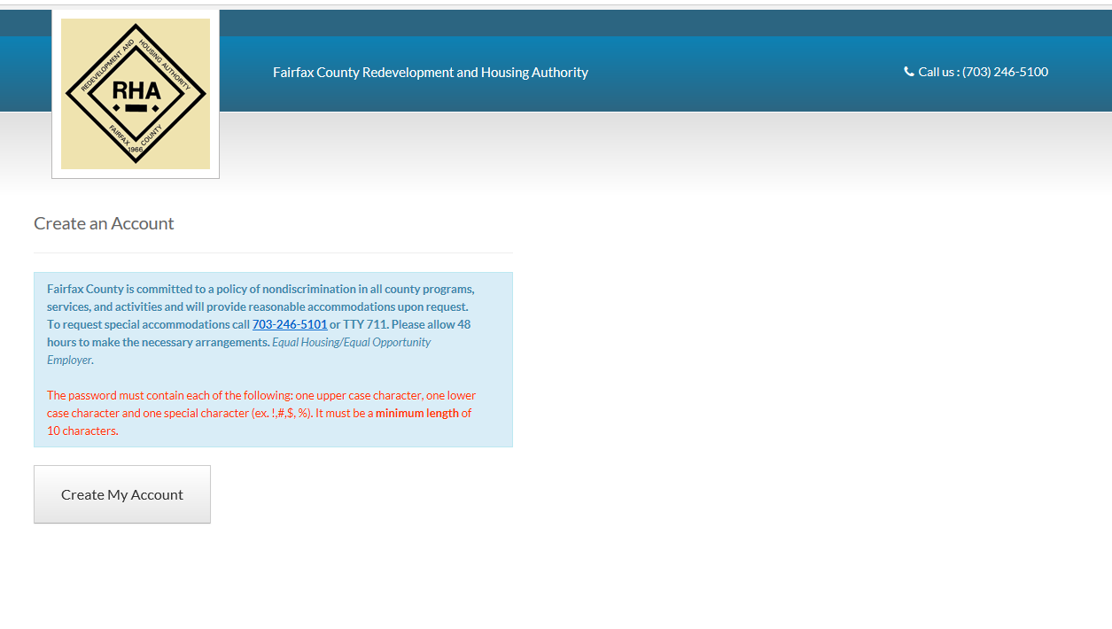

Slide 9
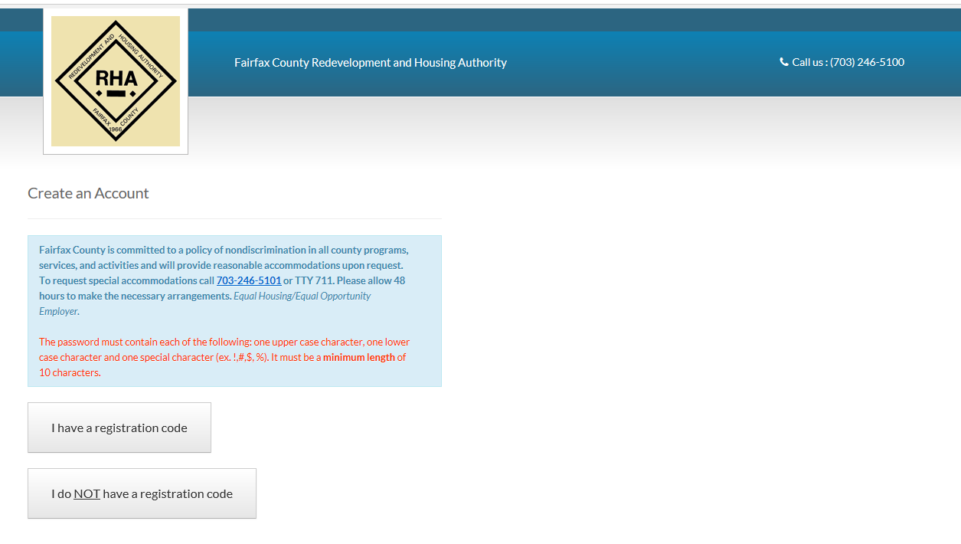
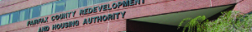

Slide 10
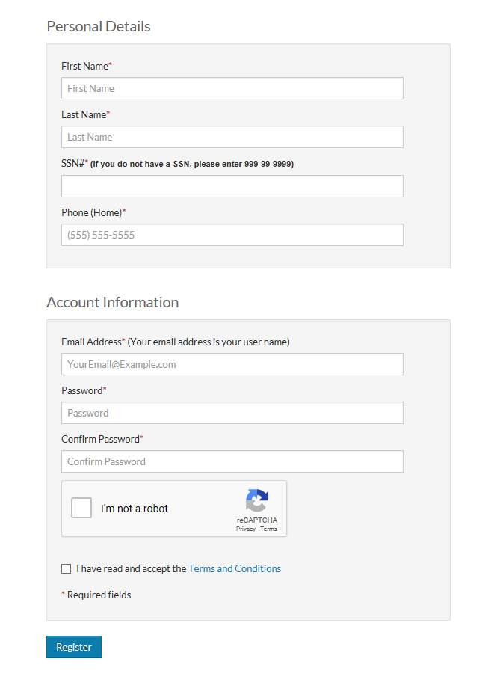

Slide 12
Social Security Number
If you do not have a Social Security Number type in 999-99-9999

Slide 15
Password
Must be a minimum of 10 characters long and must contain at least one lower case, and one upper case letter, one number, and one symbol (such as: ! @ # $ %)

Slide 17
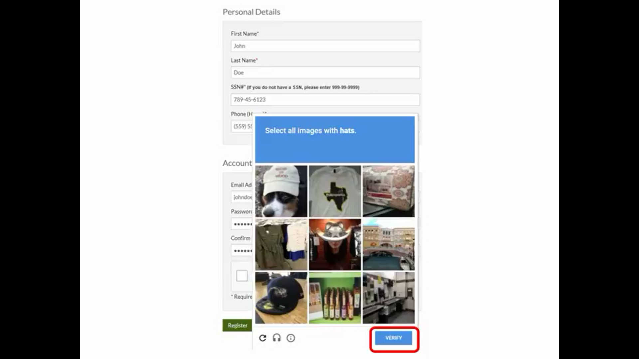

Slide 18


Slide 20
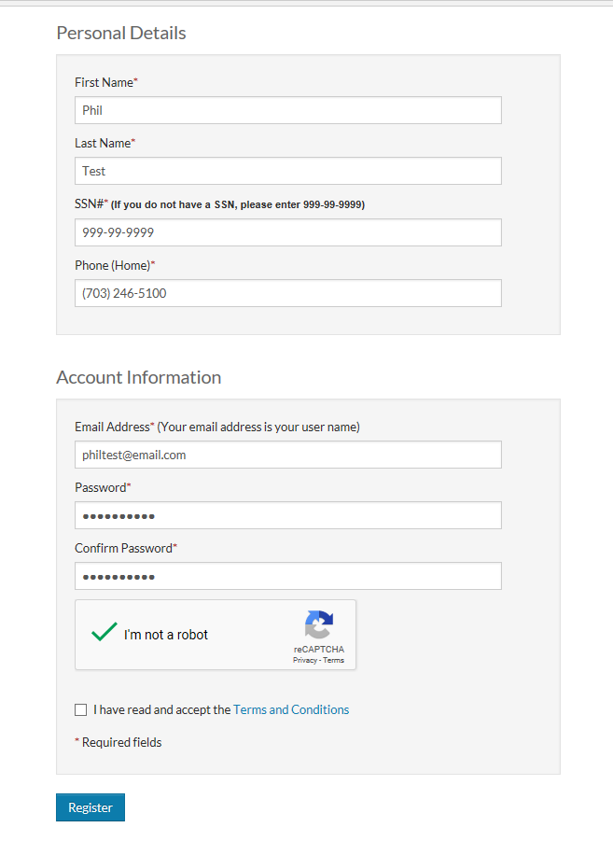

Slide 21
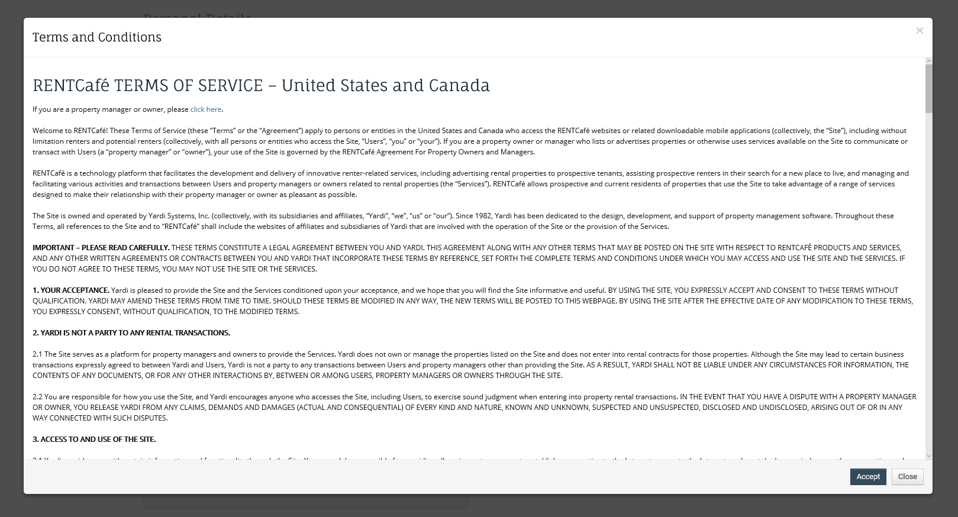

Slide 22
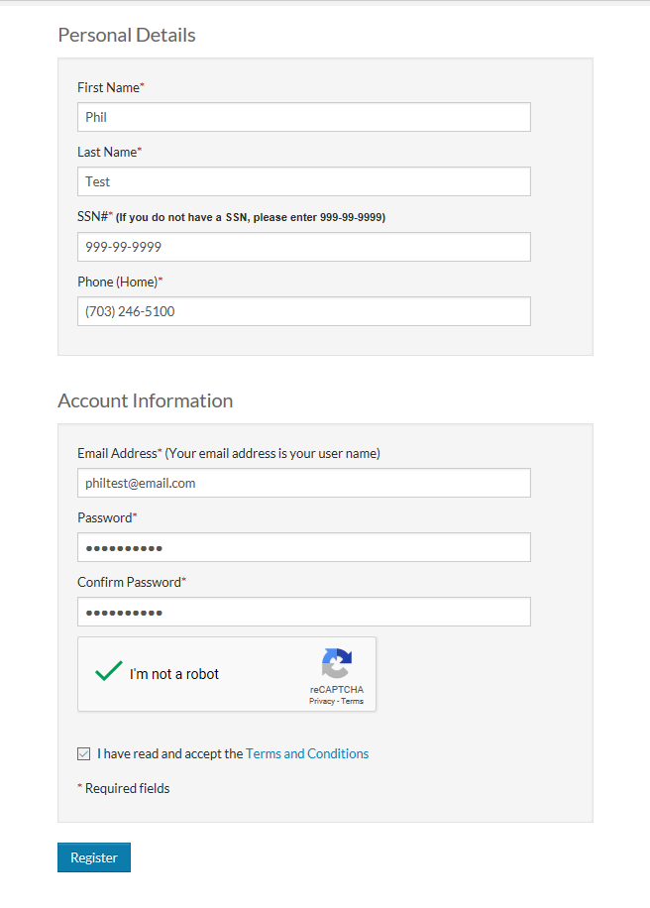

Slide 23
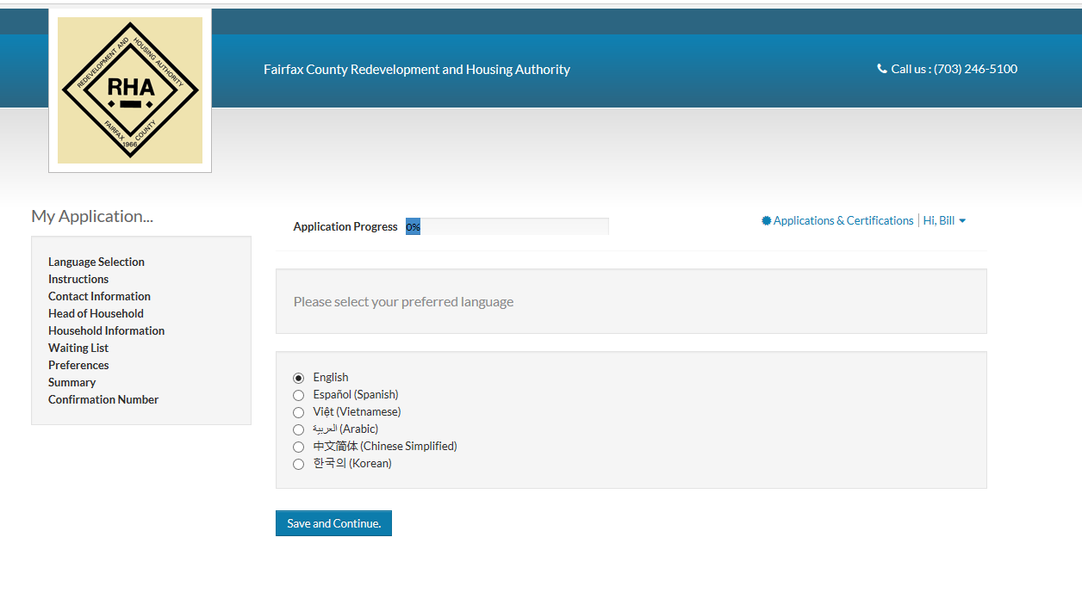

Slide 25
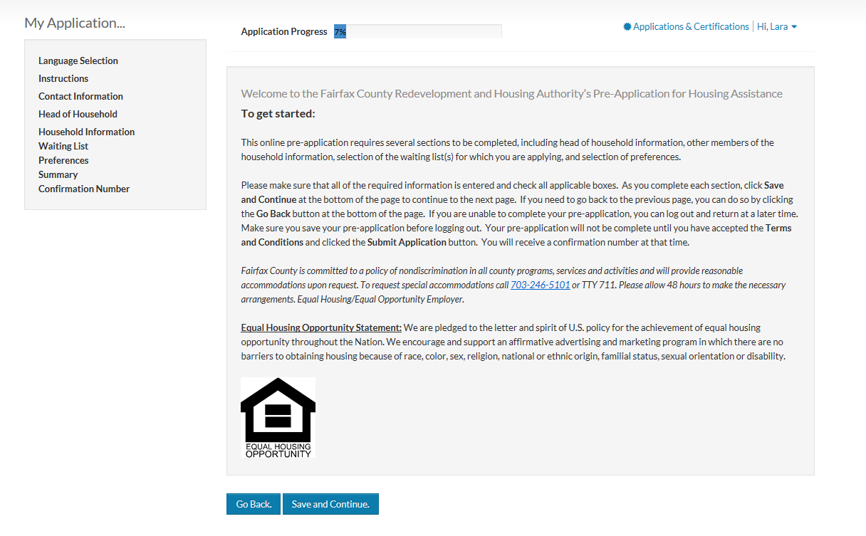

Slide 26
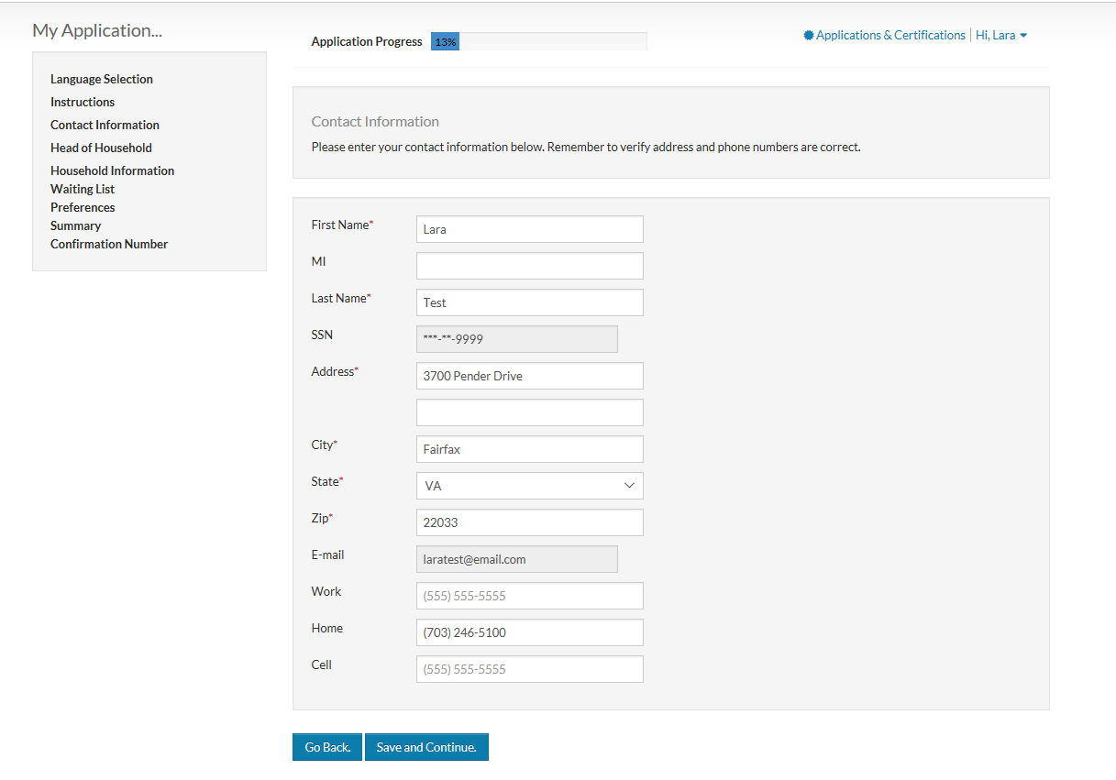

Slide 28
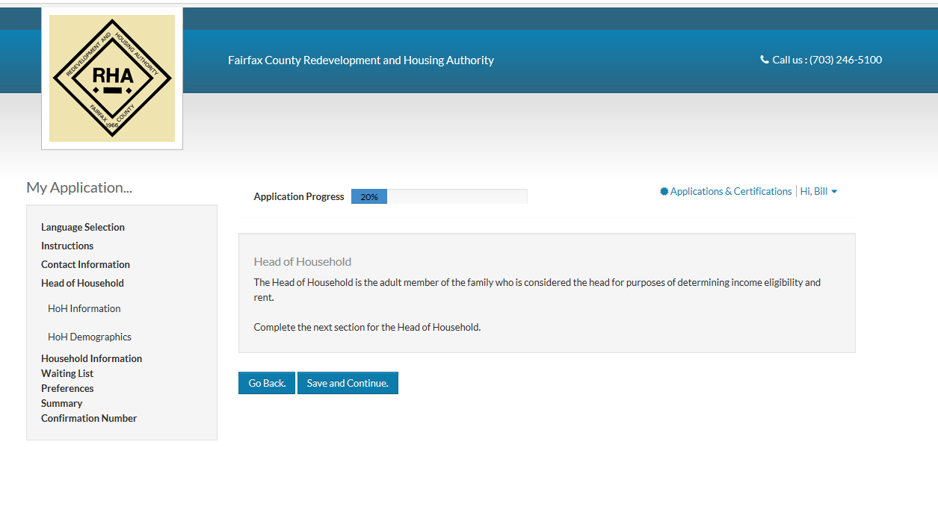

Slide 29
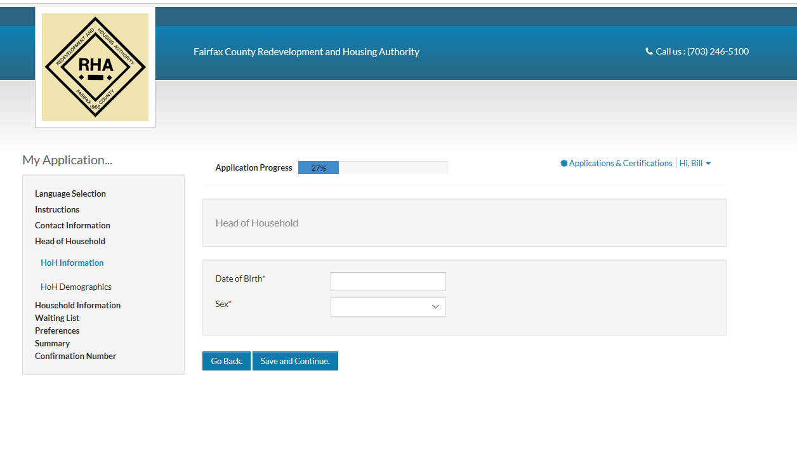

Slide 30
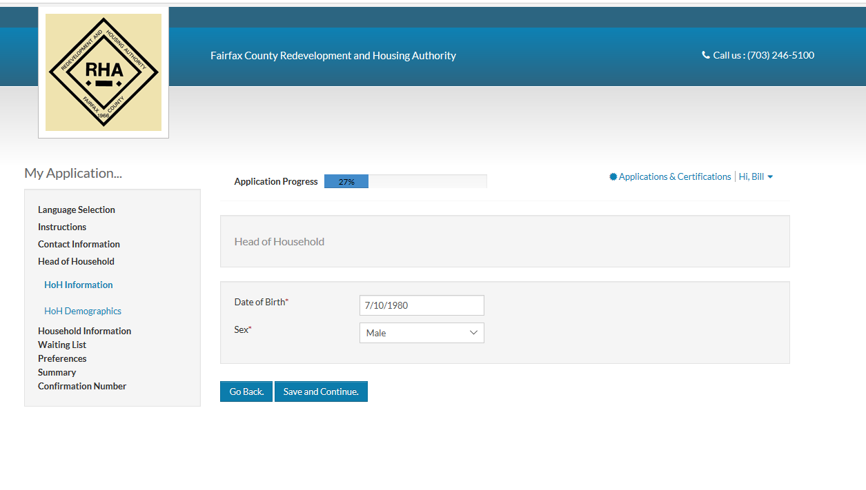

Slide 31
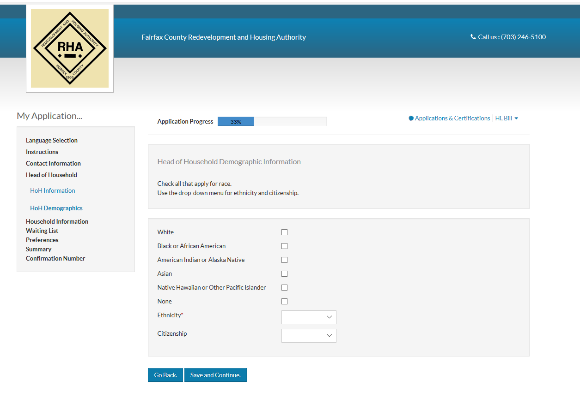

Slide 33
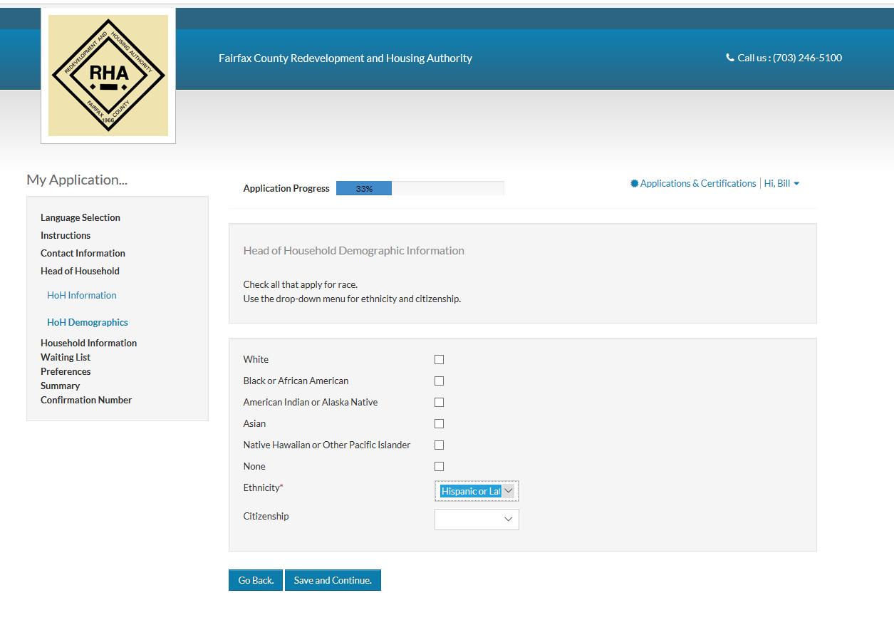

Slide 34



Slide 35


Slide 36
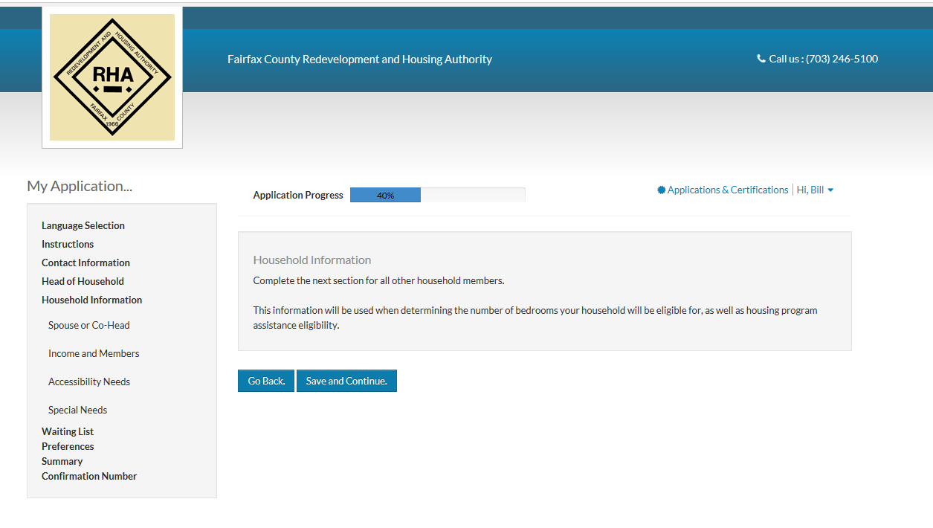

Slide 37
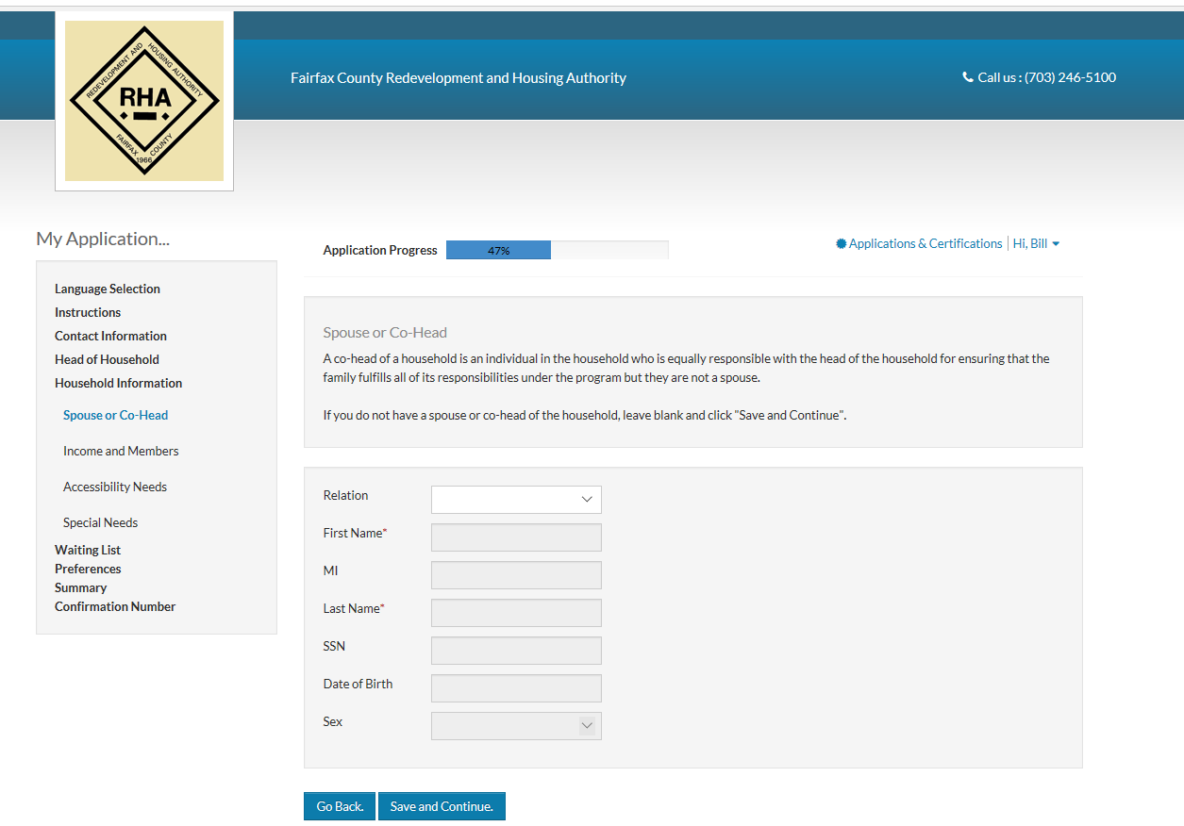

Slide 38
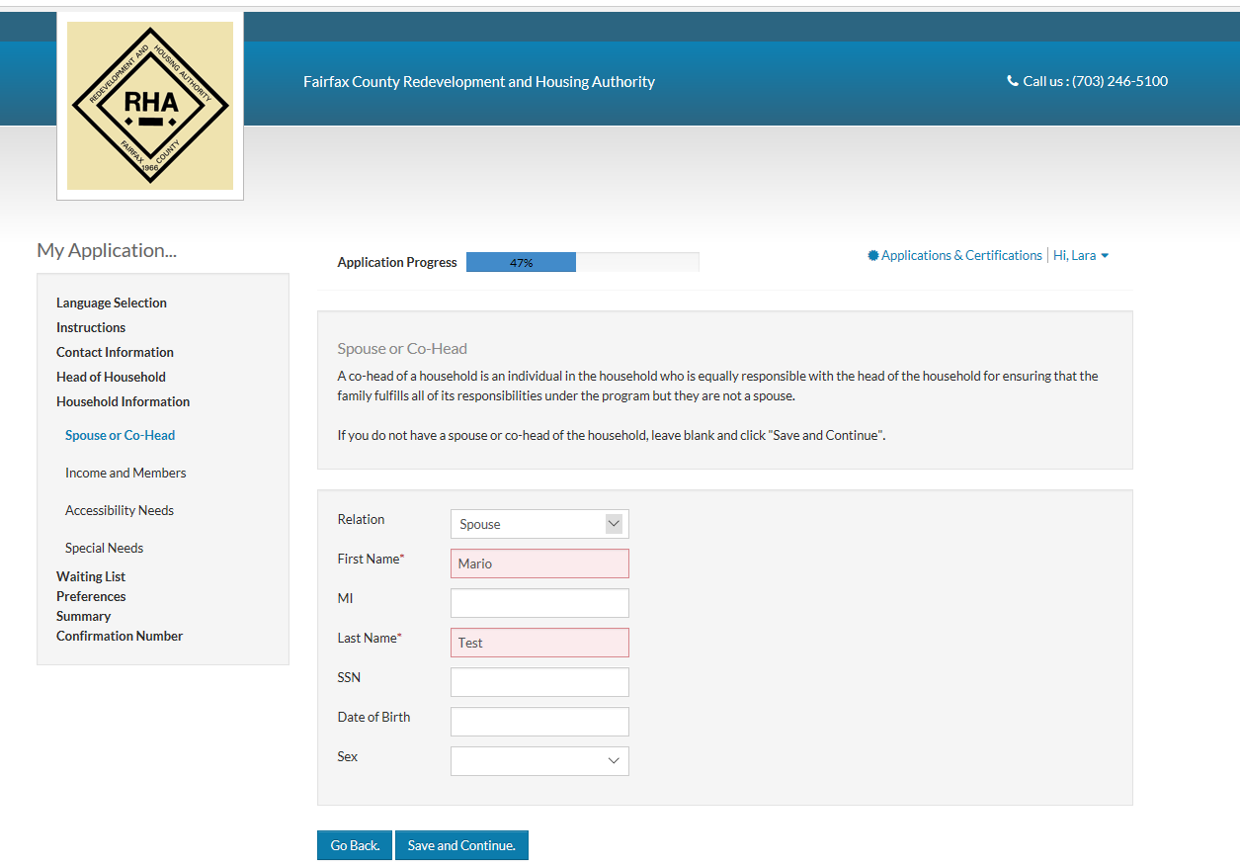

Slide 39
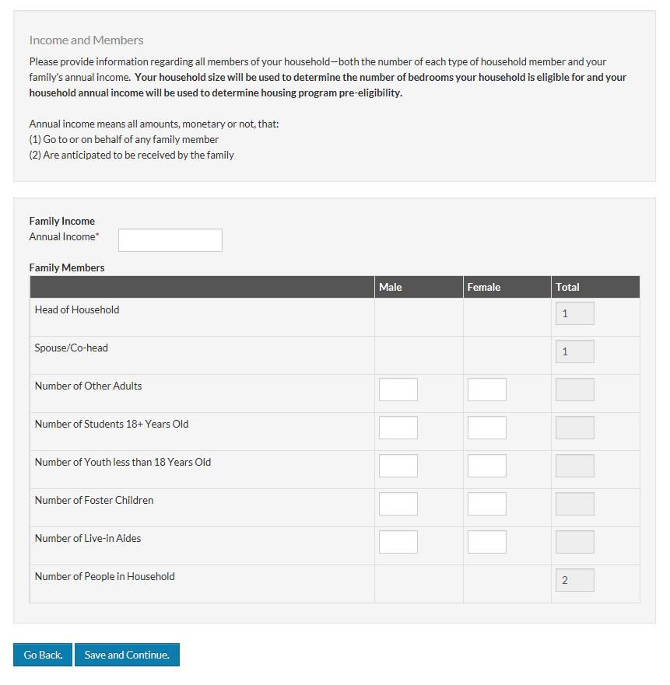

Slide 40
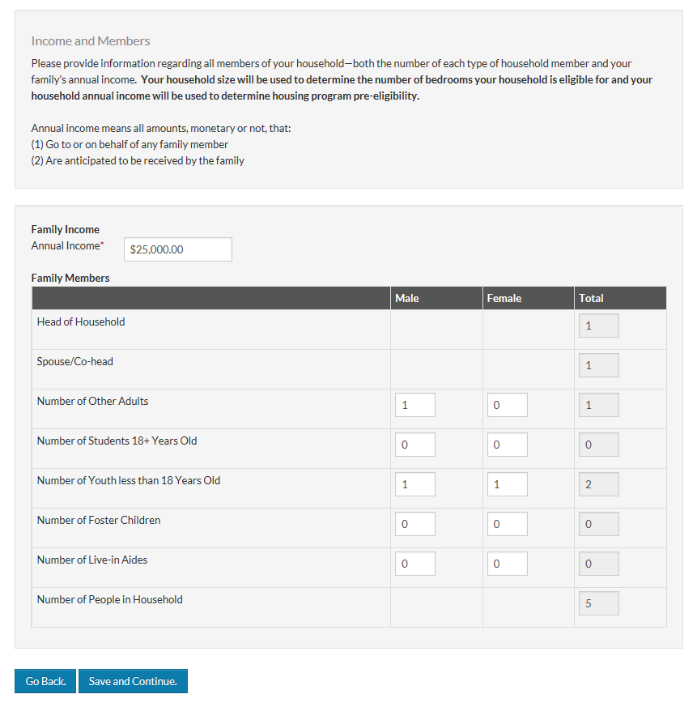
Family Members
If there are no future tenants in a particular category, you must enter a 0.
Do not leave any of these boxes blank.

Slide 42
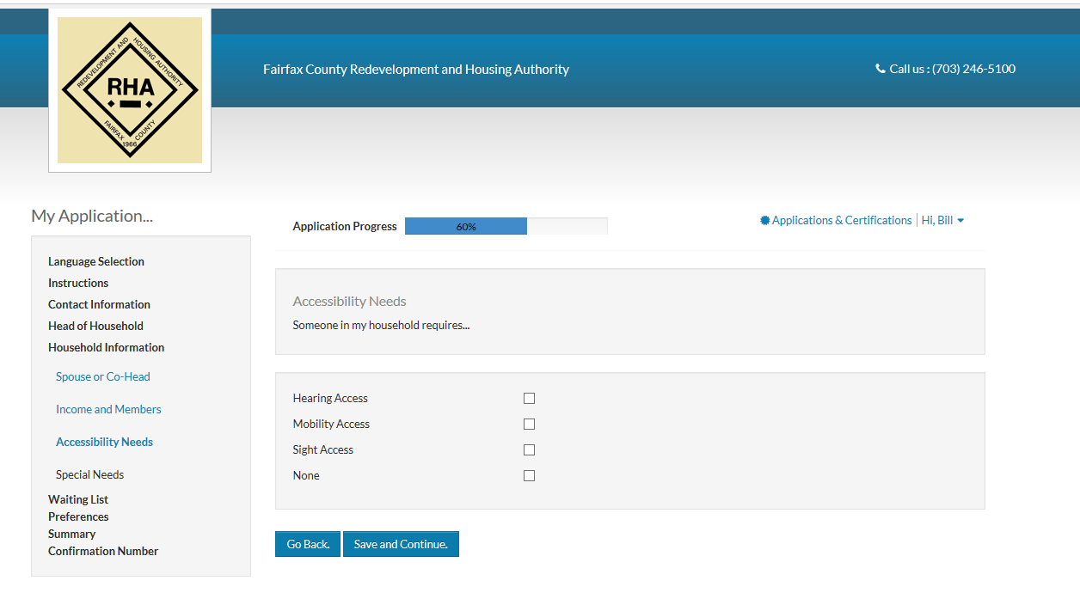

Slide 43


Slide 44
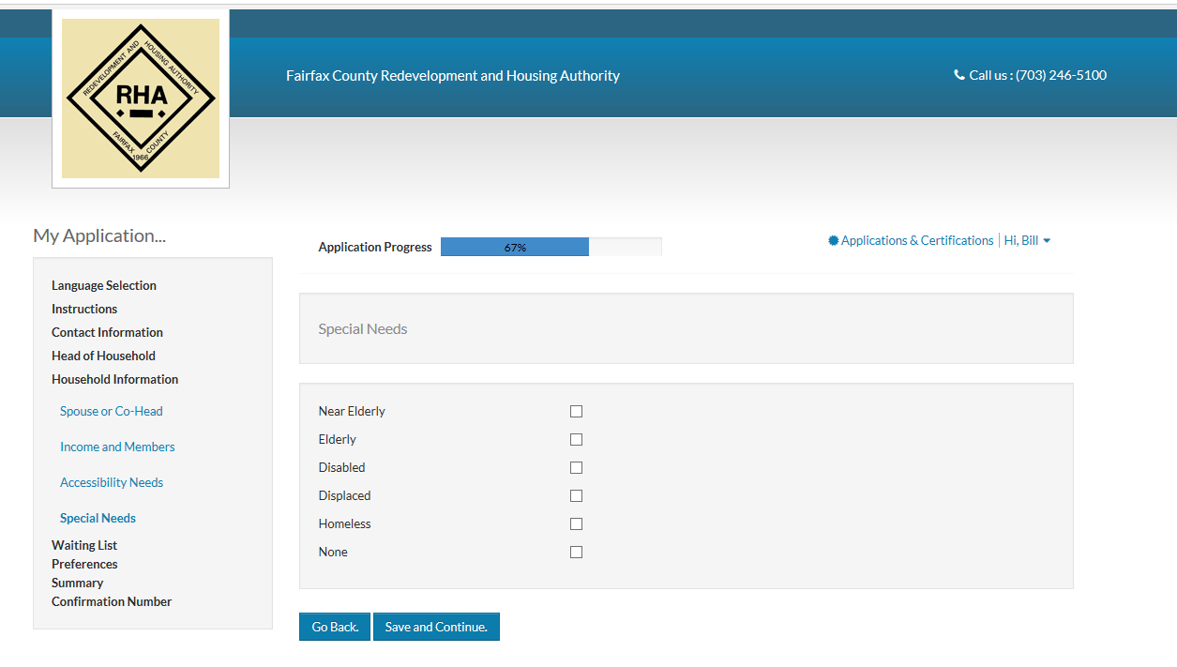

Slide 45


Slide 46
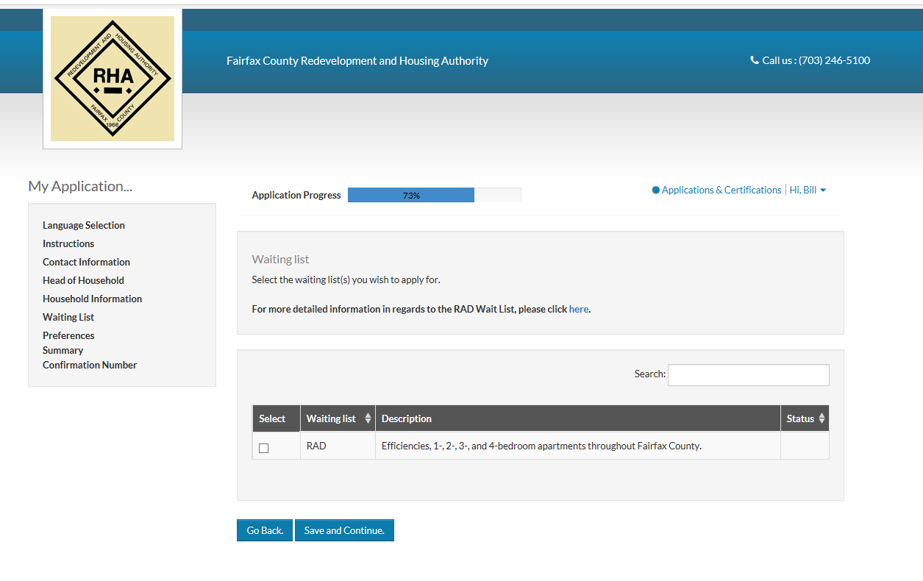

Slide 47


Slide 48
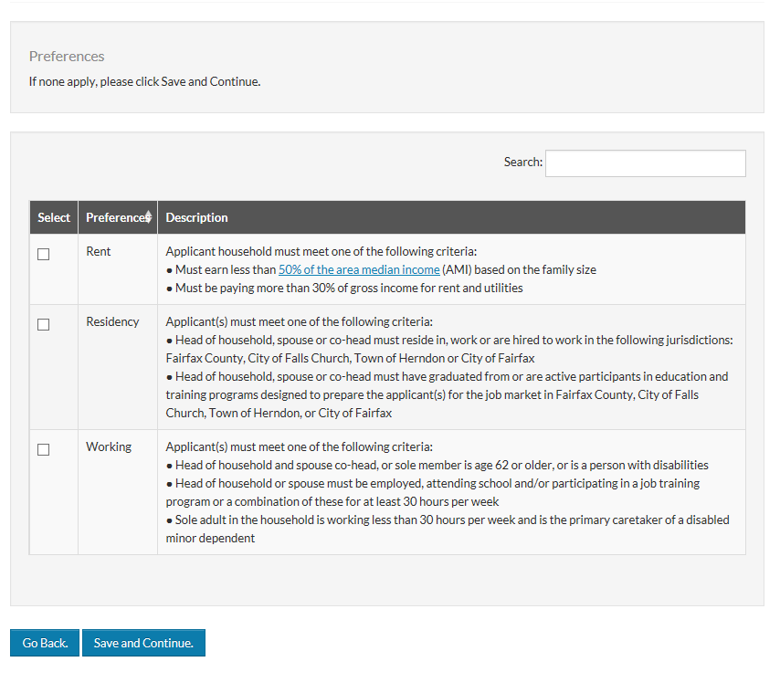

Slide 50
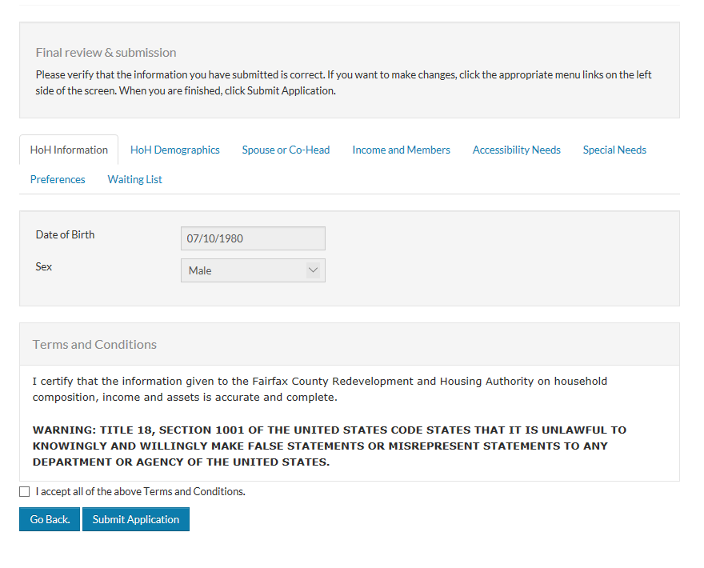

Slide 51
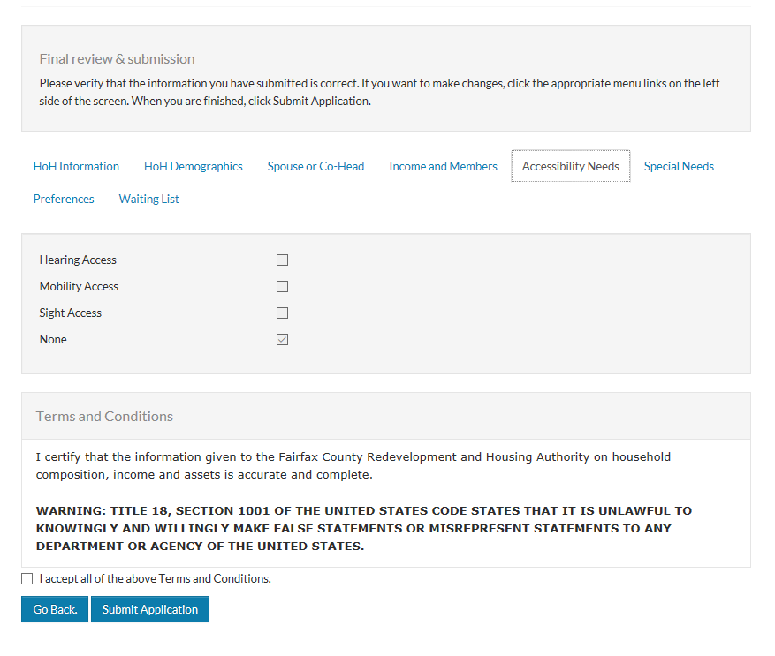

Slide 54


Slide 55
