Slide 1
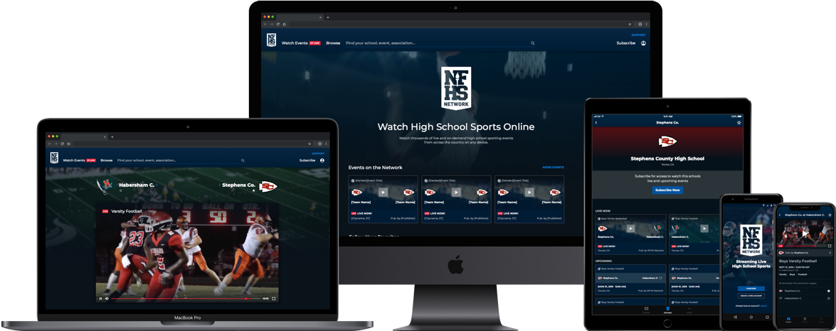
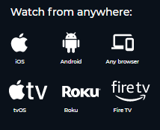
WATCH FAIRFAX COUNTY ATHLETICS ALL YEAR LONG
Watch your high school sports for free on the NFHS Network!
Get unlimited access to watch all Fairfax County events this year on the NFHS Network.
Full access to ALL content for your school on the Network
- All of your school’s live and on-demand sports broadcasts
Friends and family members who can’t make the game will never miss a play again!
Create An Account
Visit: www.nfhsnetwork.com/users/sign_up
Once account has been created:
Search for your high school and press “Follow” button and enjoy watching!
- Go to NFHSnetwork.com
- Search for Oswego High School
- Select the “Follow” feature to stay up to date on your events on the NFHS Network
BEST DEAL
Annual Pass
$55

