Slide 1

Increasing School Readiness by Increasing Access to Preschool in Your Community
Part 1 of 3
January 27, 2021
Notes:
Kris

Slide 2
Objectives and Agenda
This webinar will present recommended strategies and approaches to increase access for preschool aged children via the VPI program and community partnerships as localities begin planning for 2021-2022. Additional details about timelines and requirements will be covered in future webinars and office hours.
Agenda:
Why is increasing access to pre-K critically important in 2021-2022?
How can my division serve more 4-year-olds in VPI?
How can my division expand to other ages in VPI?
What are the opportunities to maximize funding?
How can we partner with community-providers and other grants?
Questions and Answers

Slide 3
Why is increasing access to pre-K more important than ever?

Slide 4
The State of Early Learning in VA
Fall 2020 data shows the significant impact of COVID 19 on Virginia’s youngest learners.
Many young learners are not enrolled in school this year.
  Approximately 18,000 fewer preschoolers and 13,000 fewer kindergarteners are enrolled this year. Preschool drops were 4 times larger among children from economically disadvantaged families, and larger among Black and Hispanic Children.
  Enrollment drops were larger for schools that were virtual only.
COVID has negatively affected young learners’ academic and social-emotional development.
  45% of Virginia’s Kindergarteners started school without the key literacy, match, and social-emotional skills needed to be successful – an increase from past years.
  The drop in kindergarten literacy represents the largest ever single year decrease (5x larger than any other decrease).
  A disproportionate percentage of Black, Hispanic, economically-disadvantaged, and Dual Language Learners are entering kindergarten without the literacy skills they need.
Virginia must expand access to quality early learning to address these challenges.

Slide 5
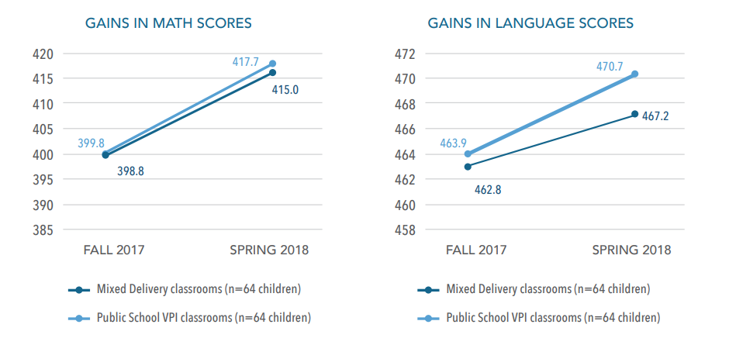
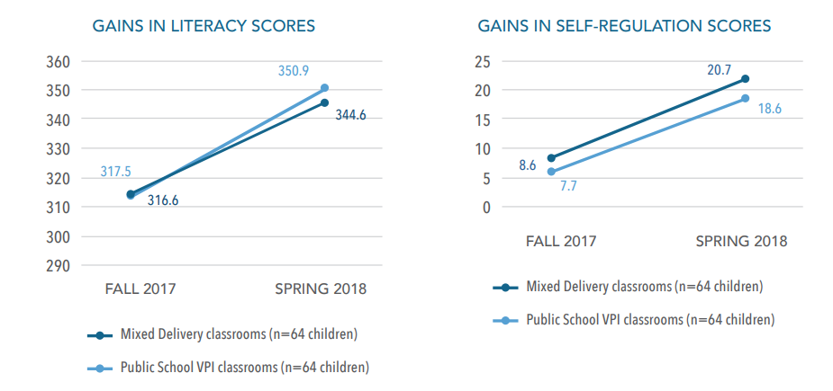
Access to Quality Preschool Matters
At-risk children who experience VPI are ~1.5 times more likely to enter school ready than their at-risk peers who do not participate in any preschool. And Mixed Delivery in Virginia has demonstrated similar gains to VPI. Offering a quality option to the 5,000+ children who would otherwise be on VPI wait lists can increase school readiness in Virginia.
2019 Virginia Kindergarten Readiness Program (VKRP) Results for At-Risk Children
Gains in Child Assessment Scores Among Children in Mixed Delivery and Public School VPI Classrooms, Fall 2017-2018

Slide 6
Renewed Investment in Early Childhood
Governor Northam has continued to indicate the importance of expanded quality early childhood experiences through his budget
Restored investments in VPI in the proposed Governor’s budget.
  The Governor’s budget restores funding for expanded VPI programming, including increased VPI rate, an additional focus on 3-year-olds, and sustaining enhancements from 2020-2021
  The budget also allows for additional flexibility to help localities maximize their funds and slots to serve the children who need it most.
Continued support of the Unification of Virginia’s Birth-Five Early Learning System.
  In July 2020, Governor Northam signed legislation to officially unify the early childhood system.
  Oversight and administration of child care licensing and subsidy will transition to the VDOE on July 1, 2021.
  The Unified Measurement and Improvement System, which will eventually be implemented in all publicly-funded programs (including VPI) will start with practice year 1 for PDG communities in July 2021.

Slide 7
Call to Communities – Planning Begins Now
As we begin preparing for enrollment for 2021-2022, it is more important than ever that localities consider the true needs within their community, and how coordinated and collaborative outreach can serve more children.
Divisions should begin planning for expanded preschool programming now, considering:
How many preschool aged children could benefit from a quality preschool in your locality?
What are the creative strategies that can be utilized to increase access and impact?
The May 15 Spring VPI Application must include plans for expanded programing.
Spring recruitment for 2021-2022 should reflect plans to serve more at-risk four- and three-year-olds.
Communities should begin coordinating with partners (e.g., Head Start, child care) now to discuss how to serve more at-risk children.
Communities should also ensure federal COVID-19 relief fund initiatives (e.g., extended session) fully include preschool.
Today’s webinar will review the strategies and approaches localities should consider as they plan for enrollment. Future webinars will review details and timelines for implementation.

Slide 8
How can my division serve more 4-year-olds?

Slide 9
Serving More 4-Year-Olds
Divisions can serve more 4-year-olds by expanding their enrollment practices and qualifying criteria. These strategies were available this year, and remain for 2021-2022.
Strategy | What this would mean for Divisions
Report the full number of 4-year-olds your division can serve by including a spring waitlist. | Indicating a waitlist on the May 15 VPI Application may result in additional state-allocated seats (4s). Divisions who do not project to use all of their allocated seats may have them reallocated to other divisions Divisions will learn results of reallocation by July 1, 2021.
Increase the teacher-child ratio in VPI Classrooms. | VPI Programs that meet VPI Program Guidelines will be permitted a 1 to 10 ratio (not to exceed 20).
Submit a waiver for increased local criteria. | Seek a waiver to serve more than 15% of slots through local criteria to meet the needs of more at-risk children in the community.
Offer VPI in a community-provider setting. | Receive additional funds for offering VPI in a community-provider setting.

Slide 10
Serving More 4-Year-Olds
Divisions can serve more 4-year-olds focusing on enrolling children with identified disabilities, and enrolling children beyond September 30.
Strategy | What this would mean for Divisions
NEW: Focus enrollment on including students with disabilities in VPI classrooms. | For 2021-2022 a target inclusion rate of 10% all children enrolled in local VPI programs are children with Individualized Education Programs. VPI programs falling below 10% will provide reasons target was not achieved and actions to meet or exceed the target in the next school year.
NEW: Continue enrolling eligible VPI students during the fall. | Enrollment of eligible VPI students may continue after the traditional October 1 cut off date at a prorated amount.

Slide 11
Key Questions & Recommended Actions
Questions to Consider:
After filling all allocated VPI slots, how many children are on a wait list? How many of these could your division serve if provided additional VPI slots for 2021-2022?
How could increasing the number of slots filled using local eligibility criteria be helpful for meeting the unique needs of your community?
What barriers are preventing you from increasing the number of children with disabilities who are fully included in VPI classrooms? How can they be eliminated?
To Do:
Include additional VPI 4-year-old slots needed as “wait list” students (May 15)
Apply for Local Eligibility Criteria Waiver (spring, summer, fall)
Develop a Local VPI Plan supporting inclusive practices for children with identified special needs
Apply for the 3-year-old pilot (May 15)

Slide 12
How can my division expand to other ages in VPI?

Slide 13
Serving More Children in VPI
The 3-year-old VPI pilot will be expanded in 2021-2022. In addition, VPI programs should consider if there are 5-year-olds who did not benefit from preschool who may opt for VPI.
Strategy | What this would mean for Divisions
EXPANDED: Serve 3-year-olds as part of VPI. | Eligible 3-year-olds may be served in the same or separate classrooms as other VPI students. The same eligibility criteria, funding levels, and options for a community-based setting apply. This is a pilot program. 3-year-olds are NOT included in the allocated number of VPI slots a division receives. All 3-year-old slots must be requested and approved.
UNDER CONSIDERATION: Enroll eligible 5-year-olds as part of allotted VPI slots. | In response to COVID 19, some families may prefer to enroll their child in Pre-K, even when age eligible for kindergarten. Divisions may enroll 5-year-olds who otherwise qualify for VPI in 2021-2022. Flexibility would NOT change the allocated number of VPI slots.

Slide 14
Key Questions & Recommended Actions
Questions to Consider:
How many 3s are not being served by Head Start and/or subsidy and how can we best serve them?
What would it take to offer single-age or mixed-age classrooms or both?
What will it take to open new slots for at-risk 3s in 2021-2022?
To Do:
Apply for 3-Year-Old Pilot (May 15) --- Additional information about the pilot application will shared during the February 24 Increasing School Readiness by Increasing Access to Preschool Webinar (1 p.m.) and in a future Superintendent’s Memo.
Consider sharing option for 5-year-old enrollment with parents during spring enrollment timeline

Slide 15
What are the opportunities to maximize funding for VPI?

Slide 16
Maximizing Funds for VPI
Proposed increased per slot funding for VPI will raise the funds available. Other strategies can help maximize funding to support VPI.
Strategy | What this would mean for Divisions
NEW: Plan for increased funds for VPI slots. | The Governor’s budget proposes raising each VPI slot to be: $7,655 (full-day slot) $3,828 (half-day slot) This will impact the amount each division receives from the state, as well as local match.
Offer VPI in a community-provider setting and access add-on funds. | Add-on grant for each VPI slot (all ages) served in a community-provider setting. The add-on amount varies by region: $3,500, $2,500, $1,500
Increase amount of in-kind contributions counting towards local match. | Up to 50% of local match can be in-kind contributions

Slide 17
Key Questions & Recommended Actions
Questions to Consider:
How can additional funds be used to support needs of children, families, teachers and VPI initiatives (e.g., local CLASS observations, curriculum, professional development)?
How can additional funds for VPI seats in community providers be used to bridge the gap between actual costs in private preschool and public preschool programs?
How can community provider add-on funds be used to serve 3- or 4-year-olds in community provider settings?
To Do:
Begin budget development for 2021-2022 VPI program based on proposed increases
Reach out to preschool providers in your community to discuss serving 3- or 4-year-olds and how the community-provider add-on funds can support this work.

Slide 18
How can we partner with community providers to reach school readiness goals?

Slide 19
Grants for Partnering with Community
Beyond accessing the VPI community-provider add-on, there are two other opportunities that VPI divisions should consider supporting or expanding in their region.
Grant | What this would mean for Divisions
Mixed Delivery Grants Administered by Virginia Early Childhood Foundation (VECF) | Competitive grant funding to support public-private delivery of preschool services (3s and 4s) in private (non-school based) settings. Provides significant funding for slots in mixed delivery settings (e.g., community providers) Initiatives follow many VPI quality expectations, while also having flexibility to field-test innovative strategies, including regarding teacher qualifications Learn more at VECF website (vecf.org/opportunities-ahead/)
Preschool Development Grants B-5 (Administered by VDOE, VECF, and UVA administered) | Competitive grant funding to build, expand, and sustain birth-to-five (B-5) system that supports school readiness. Does NOT fund slots or seats in any settings. Focus on building a coordinated community effort to support effective interactions and experiences for all publicly-funded ECE programs. Will participate in Practice Year 1 of the Unified Measurement and Improvement System Learn more at VECF website (vecf.org/opportunities-ahead/).

Slide 20
Questions to Consider and Recommended Actions: Mixed Delivery
Questions to Consider:
What do we know about the needs, resources, and priorities of families with young children in our community? Do VPI, Head Start, and/or child care subsidy consistently have waiting lists that leave children and families unserved?
What barriers exist to families being able to access high quality preschool for their children?
What organizations and leaders can be brought in to determine what new resources would best address these barriers?
Could increasing access to slots in community preschool and child care settings help meet the needs of unserved children and families?
How can your locality ensure that resources are made available to those most in need of them?
To Do:
Review information about MDG on VECF’s MDG webpage.
Visit VECF’s Opportunities Ahead webpage on 2/1 for more on the LOI and Application Process.
Start or restart conversations with community partners about how Mixed Delivery can increase access to high quality preschool for eligible children in your community

Slide 21
Questions to Consider and Recommended Actions:
Preschool Development Grant (PDG)
Questions to Consider:
Could we provide more effective professional development to teachers in all publicly funded settings if we had access to timely accurate assessments of the quality of interactions in all publicly funded settings?
How can additional funds and infrastructure be used to support needs of children, families, and teachers (e.g., local CLASS observations and professional development)?
How can we ensure that families are aware of preschool and child care options available to them?
To Do:
Review materials related to the PDG opportunity on VECF’s website, including the PDG Overview Information Session Webinar and Resources Document
Start or restart conversations with community partners about how PDG B-5 can support your community:
  In building community infrastructure
  In preparing the uniform measurement and improvement system
  In measuring and increasing access to and strengthen quality of ECCE for at-risk children in your community

Slide 22
Summary of Proposed Strategies for Serving More Preschoolers
Preparing for the May 15 VPI Application

Slide 23
Strategy | What this would mean for Divisions
Report the full number of 4-year-olds your division can serve by including a spring waitlist. | Indicating a waitlist on the May 15 VPI Application may result in additional state-allocated seats (4s). Divisions who do not project to use all of their allocated seats may have them reallocated to other divisions Divisions will learn results of reallocation by July 1, 2021.
Increase the teacher-child ratio in VPI Classrooms. | VPI Programs that meet VPI Program Guidelines will be permitted a 1 to 10 ratio (not to exceed 20).
Submit a waiver for increased local criteria. | Seek a waiver to serve more than 15% of slots through local criteria to meet the needs of more at-risk children in the community (starting spring 2020)
NEW: Focus enrollment on including students with disabilities in VPI classrooms. | For 2021-2022 a target inclusion rate of 10% all children enrolled in local VPI programs are children with Individualized Education Programs. VPI programs falling below 10% will provide reasons target was not achieved and actions to meet or exceed the target in the next school year.

Slide 24
Strategy | What this would mean for Divisions
NEW: Continue enrolling eligible VPI students during the fall. | Enrollment of eligible VPI students may continue after the traditional October 1 cut off date at a prorated amount.
EXPANDED: Serve 3-year-olds as part of VPI. | Eligible 3-year-olds may be served in the same or separate classrooms as other VPI students (apply as part of May 15 VPI Application) The same eligibility criteria, funding levels, and options for a community-based setting apply. This is a pilot program. 3-year-olds are NOT included in the allocated number of VPI slots a division receives. All 3-year-old slots must be requested and approved.
UNDER CONSIDERATION: Enroll eligible 5-year-olds as part of allotted VPI slots. | In response to COVID 19, some families may prefer to enroll their child in Pre-K, even when age eligible for kindergarten. Divisions may enroll 5-year-olds who otherwise qualify for VPI in 2021-2022. Flexibility would NOT change the allocated number of VPI slots.

Slide 25
Strategy | What this would mean for Divisions
NEW: Plan for increased funds for VPI slots. | The Governor’s budget proposes raising each VPI slot to be: $7,655 (full-day slot) $3,828 (half-day slot) This will impact the amount each division receives from the state, as well as local match.
Offer VPI in a community-provider setting and access add-on funds. | Receive additional funds for offering VPI in a community-provider setting (must be included on May 15 VPI Application). Add-on grant for each VPI slot (all ages) served in a community-provider setting. The add-on amount varies by region: $3,500, $2,500, $1,500
Increase amount of in-kind contributions counting towards local match. | Up to 50% of local match can be in-kind contributions

Slide 26
Grants for Partnering with Community
Grant | What this would mean for Divisions
Mixed Delivery Grants Administered by Virginia Early Childhood Foundation (VECF) | Competitive grant funding to support public-private delivery of preschool services (3s and 4s). Fully funds slots in mixed delivery settings (e.g., community-providers) Programs follow many VPI quality expectations, while also having flexibility to field-test innovate strategies. Learn more at www.vecf.org/opportunities-ahead/
Preschool Development Grants B-5 (Administered by VDOE, VECF, and UVA administered) | Competitive grant funding to build, expand, and sustain birth-to-five (B-5) system that supports school readiness. Does NOT fund slots or seats in any settings. Focus on building a coordinated community effort to support effective interactions and experiences for all publicly-funded ECE programs. Will participate in Practice Year 1 of the Unified Measurement and Improvement System Learn more at VECF website (vecf.org/opportunities-ahead/)

Slide 27
Webinars & Office Hours
The VDOE will host a two additional webinars to assist divisions in planning for existing enhancements and proposed revisions to VPI. VPI Office Hours will also be held to answer questions and brainstorm ideas for increasing access to preschool.
Wednesday, February 24 at 1 p.m. | Increasing School Readiness by Increasing Access to Preschool in Your Community: Part II
Wednesday, March 24 at 1 p.m. | Increasing School Readiness by Increasing Access to Preschool in Your Community: Part III
Registration Link for Webinars
Thursday VPI Office Hours
Starting weekly on February 11 (alternating weeks 11 a.m. or 2 p.m.)
Registration Link for Office Hours

Slide 28
Questions and Answers
Mark Allan – Mark.Allan@doe.Virginia.gov
Erin Carroll – Erin.Carroll@doe.Virginia.gov

Slide 29
Resources for VPI Programs
The VDOE will continue to collect resources that will be helpful to VPI Programs as they plan to expand their programs.
Guidelines for Student Eligibility – These will be emailed to PreK coordinators soon.
VPI Guidelines – Guidelines apply to 2020-2021 school year. They will be updated early this spring for 2020-2021.
Guidance for Observing Virtual PreK – This observation tool aligns with the domains and dimensions in the PreK CLASS tool.
Guidance for Local CLASS Observations- Information on how to plan for and conduct local CLASS observations in preschool classrooms.

