Slide 1


School PRIDE in the 21st Century Strategies to Ensure Inclusive School Environments for LGBTQ+ Students
Facilitated by: Ted Lewis (they/them), Executive Director (ted.lewis@sidebysideva.org) John Taylor (he/him), Associate Director (john.taylor@sidebysideva.org) www.sidebysideva.org Phone: 804-644-4800 Youth Support Line: 888-644-4390

Slide 2
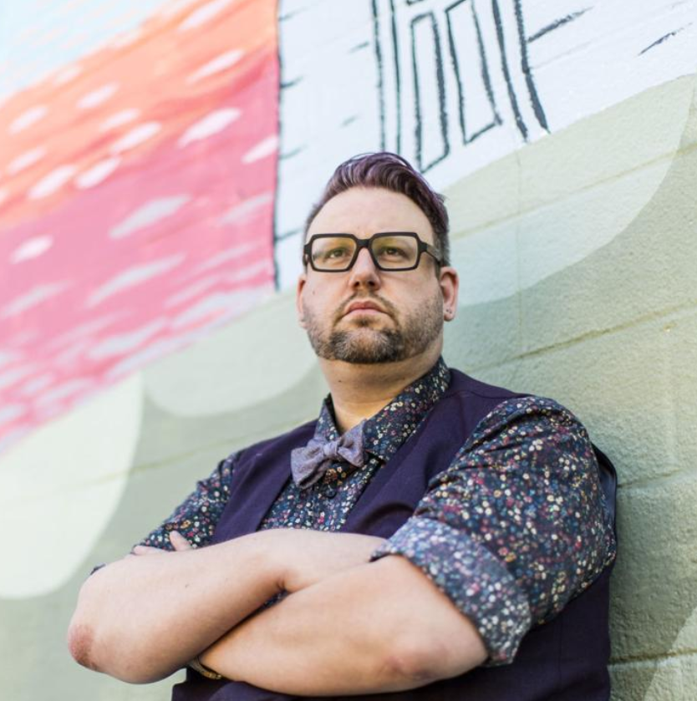

Introductions
Ted Lewis (they)
Executive Director
John Taylor (he)
Associate Director

Slide 3
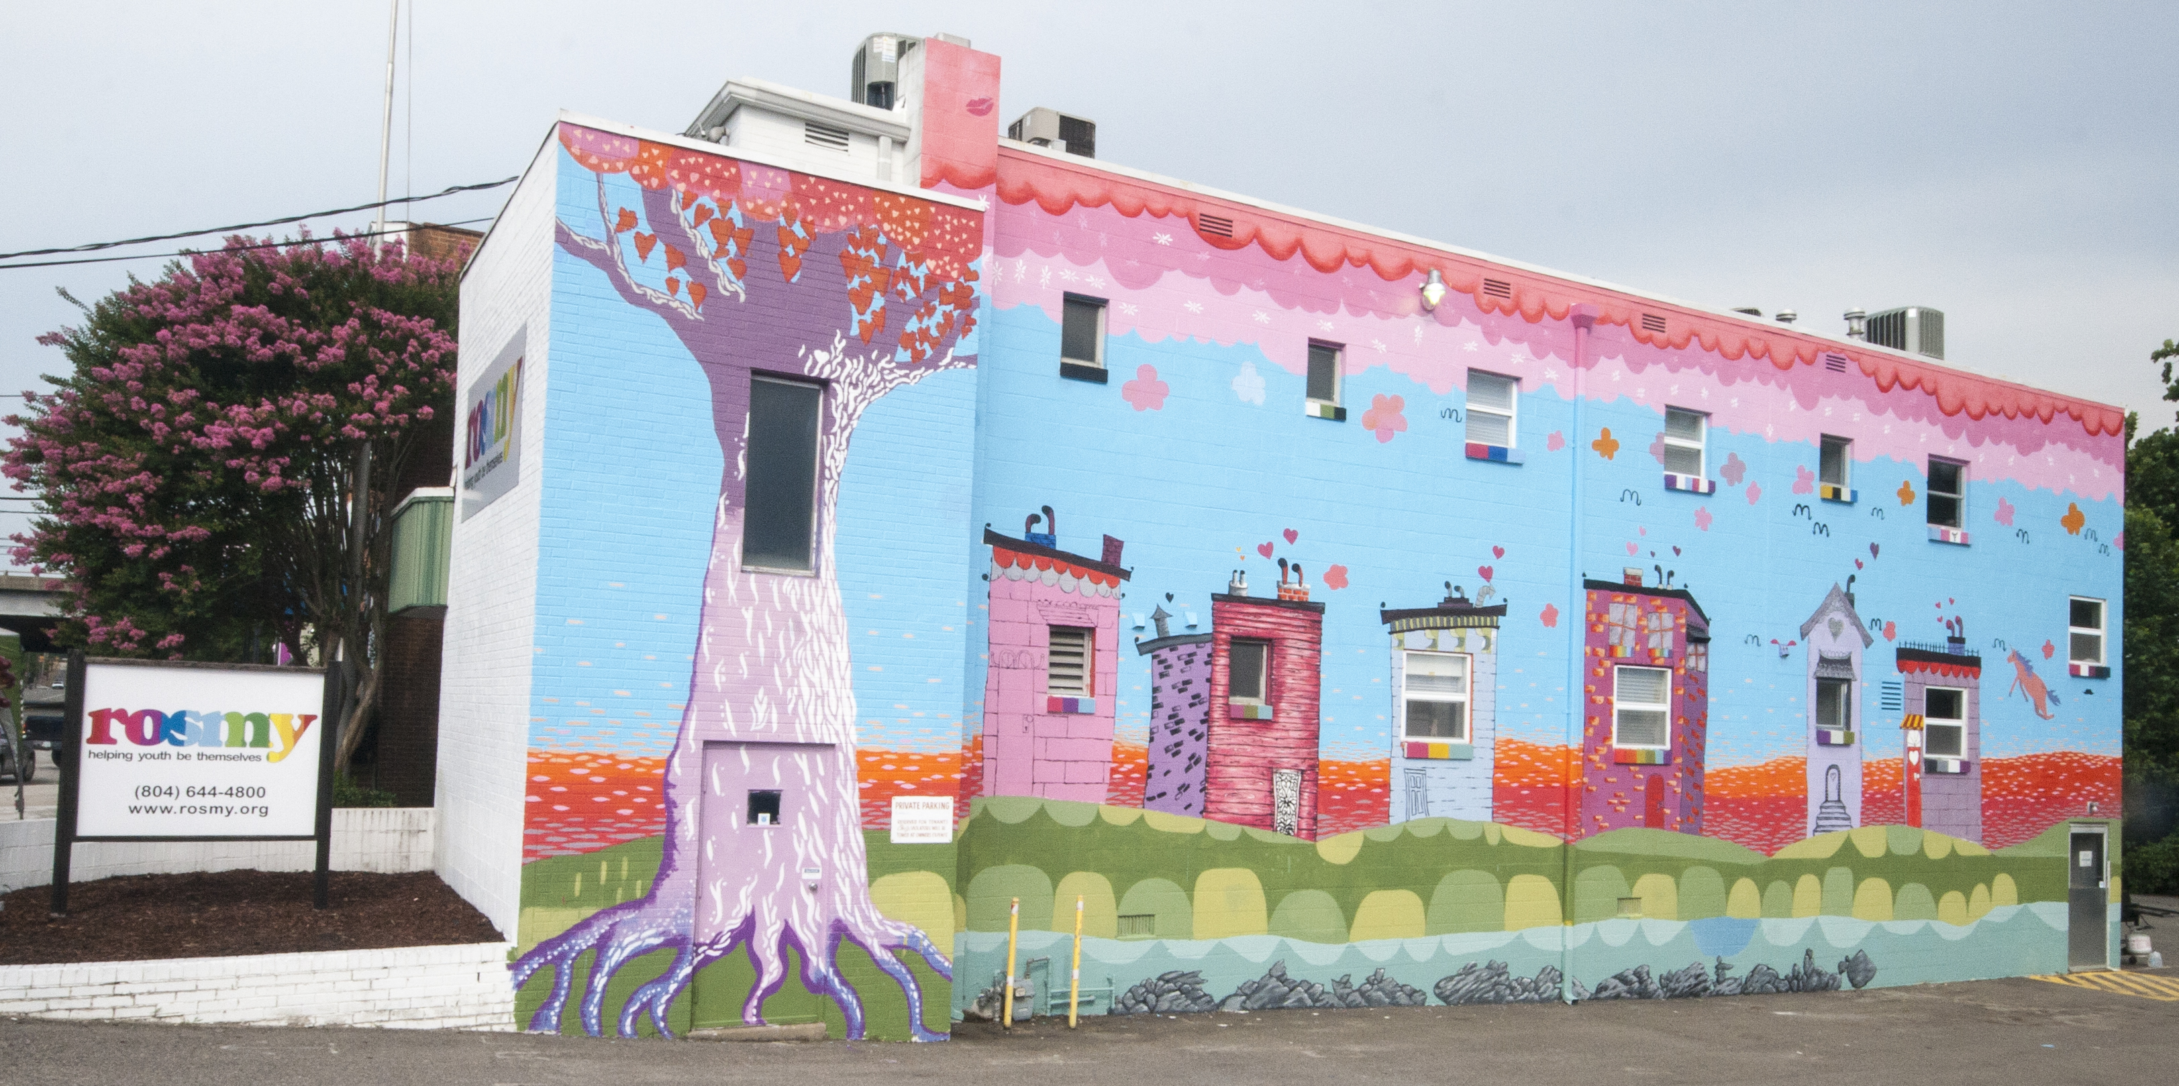
Side by Side
Founded in 1991 as ROSMY
Dedicated to creating supportive communities where Virginia’s LGBTQ+ youth can define themselves, belong, and flourish.
Provide support groups in Richmond, Charlottesville, and at Petersburg High School
Provide homelessness services for LGBTQ+ young adults 18-25 in Richmond
Side by Side Richmond Youth Center
2311 Westwood Ave.

Slide 4
Training & Consultation
Side by Side provides training to educators on how to best support LGBTQ+ youth.
The Basics – Understanding LGBTQ+ Youth – Understanding LGBTQ+ identities, risk and protective factors for youth; and, best practices for supporting LGBTQ+ youth in schools,
The Practice – Putting Allyship into action interactive training: how systemic oppression works against LGBTQ+ youth; positive ally behavior; developing GSAs (Gender & Sexuality Alliances); and, developing policies and practices to support LGBTQ+ youth in your school.
Consultation
Side by Side offers one-on-one consultation with school administrators. We can help answer some of the questions you may be struggling with or can share best practices on how to make your school more welcoming to the LGBTQ+ youth you serve.
Learn more - https://www.sidebysideva.org/school-trainings

Slide 5
Webinar Agenda
Who are LGBTQ+ Students?
Parent & Family Engagement
Bullying & School Discipline
Social & Emotional Learning
Inclusive Policies

Slide 6
Reminders for Our Time Together
Open your mind to something new today.
Prepare yourself for some difficult statistics and realities of LGBTQ+ students.
Everyone makes mistakes, it’s ok to mess up!
Push yourself to ask questions.
Remember you are not in this alone, Side by Side is an on-going partner in this work.

Slide 7
Who are LGBTQ+ Students?

Slide 8
LGBTQ+
L – Lesbian
G – Gay
B – Bisexual
T – Transgender
Q – Queer and Questioning

Slide 9
Identities Abound (+)
agender, asexual, aromantic, bisexual, demiboy, demigirl, demisexual, gay, gender fluid, genderflux, genderqueer, greysexual, homoflexible, intersex, lesbian, non-binary, neutrois, pansexual, polysexual, transgender

Slide 10
Identity Spectrum (The Gender Binary what’s expected)
SEX ASSIGNED
Male
Intersex
Female
Cisgender
(sex assignment aligns with gender identity expectations)
GENDER IDENTITY
Man/Boy
Non-Binary
Woman/Girl
GENDER EXPRESSION
Gender Conforming
(gender expression aligns with gender identity)
Masculine
Androgynous
Feminine
SEXUAL ORIENTATION
Heterosexual
(attraction to the “opposite” gender)
To Women
Bisexual
To Men

Slide 11
Things to Keep in Mind
Sex Assignment, Gender Identity, Gender Expression, and Sexual Orientation are four distinct yet connected parts of our identities
LGBTQ+ students are diverse in their experiences and are not a monolith
Transgender students often face unique experiences due to how they are treated in society as a whole
LGBTQ+ students are a part of every school and every community

Slide 12
Identity is Complex & Intersecting
Ability
Socio-Economic Status
Sexual Orientation
Race
Gender & Gender Identity
Religion & Faith
Ethnicity
Age
Source: Model of Multiple Dimensions of Identity, (Patton, Renn, Guido, Quaye)

Slide 13


Intersectional Approach to Policy Change: Black Lives Matter
BLM’s #WhatMatters2020 will focus on issues concerning racial injustice, police brutality, criminal justice reform, Black immigration, economic injustice, LGBTQIA+ and human rights, environmental injustice, access to healthcare, access to quality education, and voting rights and suppression.
Patrisse Cullors, Alicia Garza, Opal Tometi

Slide 14
LGBTQ+ Youth & Risk
Suicide | Self-Harm | Homelessness
Lesbian, gay, and bisexual youth are 3-5 times more likely to attempt suicide | Lesbian, gay, and bisexual youth are 3 times more likely to engage in self-harm | Nationally, 40% of youth experiencing homelessness identify as LGBTQ+
42% of transgender people will attempt suicide in their lifetime | Between 20-45% of transgender people engage in self-harm behavior | In Richmond, 35% of youth experiencing homelessness identify as LGBTQ+
70% of youth at Side by Side have seriously considered suicide in the last 6-months | 42% of youth at Side by Side report engaging in self-harm behaviors | 29% of LGBTQ+ youth experience homelessness, run away, or are kicked out of their home
Sources: The Trevor Project, National Center for Trans Equality, Side by Side youth Surveys | Sources: Decamp & Bakken 2016, Pardoe & Trainor 2017, Side by Side Youth Surveys | Sources: The Williams Institute, Advocates for Richmond Youth, The Trevor Project

Slide 15
Black Youth & Suicide
Center for Disease Control – Youth Risk Behavior Survey 2017

Slide 16
Black LGBTQ+ Youth Mental Well-Being
80% “usually” feel depressed or down
71% “usually” feel worthless or hopeless
80% “usually” feel worried, nervous, or panicked
46% feel critical of their LGBTQ+ identities
Only 35% received counseling in the past year
Source: Black & African American LGBTQ+ Youth Report 2019, Human Rights Campaign

Slide 17
Parent & Family Engagement

Slide 18
Family Engagement
Family Support
Family Rejection
Engaged and supportive families provide needed understanding, care and resilience.
Supportive families can mitigate other risk factors for LGBTQ+ youth
Lack of family support can lead to conflict, running away, homelessness increasing the overall risk for mental health problems, including depression and suicidal ideation, among LGBTQ+ youth.

Slide 19
Common Experiences of Parents/Caregivers
Parents/Caregivers are processing emotionally, cognitively, and trying to support their children as they catch-up (Unlearning, Learning, Relearning)
Parents/Caregivers use their own lived experiences and identities to prepare their children for the world, and if they aren’t LGBTQ+, they may feel unprepared
Parents/Caregivers need their own space to process of coming out (PFLAG, HSZW)
Divorced/Separated Parents potentially provide uneven levels of support or a complete lack thereof
Reminder: LGBTQ+ people are also parents

Slide 20
What do we do when caregivers and youth don’t align?
Trans student wants to use their chosen name, caregiver against it
Gay student wants to be president of the GSA, caregiver unsupportive
Lesbian student bring a same-gender date to prom, caregiver is angry that school would allow this

Slide 21


Parent/Family Support
www.pflag.org
www.heshezewe.org

Slide 22
Bullying & School Discipline

Slide 23
Bullying in Virginia
Source: 2017 School Climate Survey: Virginia Snapshot GLSEN

Slide 24
Bullying in Virginia
Source: 2017 School Climate Survey: Virginia Snapshot GLSEN

Slide 25
Black LGBTQ+ Youth & School Experiences
40% have been bullied on school property in the last year
Only 35% can “definitely” be themselves in school
67% have been verbally insulted because of their LGBTQ+ identity
Source: Black & African American LGBTQ+ Youth Report 2019, Human Rights Campaign

Slide 26
Black Youth & Bullying
Source: Center for Disease Control – Youth Risk Behavior Survey 2017

Slide 27
What We Know About Bullies
Hurt people, hurt people
Individuals who are the most vocal anti-LGBTQ+ “haters” are often struggling with their own gender or sexuality
The easiest way to “hide” as a closeted LGBTQ+ person is to call out and draw attention to out LGBTQ+ people through jokes and ridicule

Slide 28
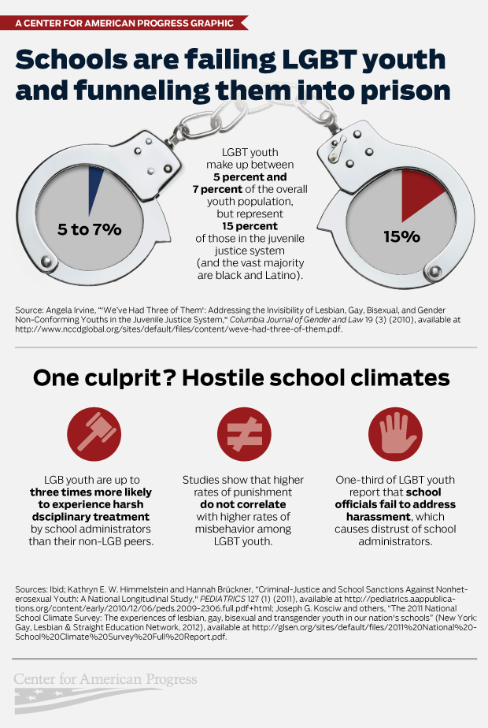
LGBTQ+ Students in the School-to-Prison Pipeline

Slide 29
LGBTQ+ Students in the School-to-Prison Pipeline

Slide 30
Community Blowback
Gavin Grimm v. Gloucester County
School Board meetings with anti-LGBTQ+ rhetoric in front of LGBTQ+ students and families
Fear of parent pushback by simply acknowledging that LGBTQ+ people exist in curriculum
"Culture war" of viewing LGBTQ+ people's existence as "political"

Slide 31
Social & Emotional Learning

Slide 32
Social & Emotional Learning

Slide 33
Social & Emotional Learning for LGBTQ youth
In order to make school a safer, welcoming, affirming environment for LGBTQ youth, we must implement supportive programming tailored to the unique challenges and needs of the LGBTQ population. School based social-emotional learning (SEL) offers an environment for experiential support to take place. SEL programs, implemented by teachers and/or school social workers or counselors, work to grow students in areas such as self-awareness, self-management, social awareness, relationship skills, and responsible decision making through explicit, interactive activities (Haymovitz, Houseal-Allport, Lee, & Svistova, 2018). ASU Center for Child Well Being

Slide 34
AMAZEworks
AMAZEworks’s core programs advance equity and inclusion by combining quality children’s literature and skill-building exercises to spark age-appropriate discussions about difference. Because family is one of the most important and accessible sources of both strength and difference for many children, the program focuses on exploring and appreciating all the ways that families can be different. And by engaging parents, guardians, teachers, and school administrators in reading to children and leading discussions that explore diversity and challenge bias, AMAZEworks builds cultures of acceptance and respect that reach beyond the classroom to impact whole schools and communities.
https://www.amazeworks.org/

Slide 35
SEL: SUGGESTED LGBTQ-INCLUSIVE LEARNING OPPORTUNITIES
Early Elementary: Ensure that family studies show examples and use language that includes a variety of family structures including LGBTQ-headed families. Address identity and reflections around gender stereotypes using Ready, Set, Respect!, inclusive read-alouds, and GLSEN’s lesson I Am Me: Talking About Identity.
Upper Elementary: GLSEN’s Identity Flowers lesson encourages students to explore their own identities and personal experiences with race, culture, ability, family structure, religion or spirituality, and gender identity and expression. Find more lessons for elementary students in our No Name-Calling Week program at www.glsen.org/nncw.
GLSEN – https://www.glsen.org/sites/default/files/2019-11/GLSEN_LGBTQ_Inclusive_Curriculum_Resource_2019_0.pdf

Slide 36
SEL: SUGGESTED LGBTQ-INCLUSIVE LEARNING OPPORTUNITIES
Middle School: GLSEN’s Challenging Assumptions lesson provides students an opportunity to experience what it’s like to be labeled in a negative way, and as a result, develop empathy for those who others label, even though those labels don’t fit.
High School: GLSEN’s Learning Empowerment and Self-Identification encourages students to explore how self-identification can be empowering, and have discussions about what it means to be proud of the labels and identities that we all hold. They will also explore the damage that can be done when someone applies labels to another person without that person’s permission (consent).
GLSEN – https://www.glsen.org/sites/default/files/2019-11/GLSEN_LGBTQ_Inclusive_Curriculum_Resource_2019_0.pdf

Slide 37
Inclusive Policies

Slide 38
Heterocentrism (Ideology)
Heterosexism (System)
Homophobia (Individual)

Slide 39


Example of Heterosexism
Question: On college campuses why don’t we have men and women share bedrooms? What are we afraid might happen?
College Goal: Ensure no roommates ever engage in sexual activity with each other.
Action: All men in the Blue Dorm and all women in the Pink Dorm.
Assumes everyone is heterosexual
Assumes everyone is cisgender
Assumes there are only two genders

Slide 40
VA DOE Transgender Policy Guidelines (HB145/SB161)
Compliance with applicable nondiscrimination laws
Maintenance of a safe and supportive learning environment free from discrimination and harassment for all students
Prevention of and response of bullying and harassment
Maintenance of student records
Identification of students
Protection of student privacy and confidentiality of sensitive information
Enforcement of sex-based dress codes
Student participation in sex-specific school activities and events, excluding athletics, and use of school facilities.

Slide 41
Using a Trans Youth’s Chosen Name is Suicide Prevention​
Transgender youth who were called by their chosen name consistently at school, home, work, and with friends experience…
71% fewer symptoms of severe depression
34% decrease in reported thoughts of suicide
65% decrease in suicide attempts
Stephen Austin, “Using Chosen Name Reduces Odds of Depression and Suicide in Transgender Youths,” Journal of Adolescent Health, March 2018

Slide 42
The Importance of Gender & Sexuality Alliances
Allows LGBTQ+ students to feel less isolated and alone.
Provides education and information to the general student body.
Students at schools with GSAs report lower anti-LGBTQ+ bullying. (1)
Having a GSA in a school reduces suicide risk for ALL students. (2)
1. Toomey et all “High School GSAs and Young Adult Well-Being” Applied Developmental Science, November 2011. 2. Saewyc et. All “School-Based Strategies to Reduce Suicidal Ideation, Suicide Attempts, and Discrimination Among Sexual Minority and Hetersexual Adolescents in Wesetern Canada.”

Slide 43

Resources for Further Education
GLSEN
GSA Network
The Trevor Project
PFLAG
He She Ze and We
Gender Spectrum
Teaching Tolerance
Notes:
AMAZEworks https://www.amazeworks.org/

Slide 44
Questions & Discussion
Facilitated by: Ted Lewis (they/them), Executive Director (ted.lewis@sidebysideva.org) John Taylor (he/him), Associate Director (john.taylor@sidebysideva.org) www.sidebysideva.org Phone: 804-644-4800 Youth Support Line: 888-644-4390

