Slide 1
New VPI Coordinator Training
August 6, 2020

Slide 2
Objectives and Agenda
This webinar will provide an overview VPI program requirements and answer frequent questions that new coordinators often ask.
Agenda:
Early Childhood Impacted by COVID 19
What is the purpose of VPI?
Where are the various guidance documents for VPI posted?
How do I know how many VPI slots our program is allotted for the next school year?
How do I locate the VPI Application (May 15) & Verification Report (October)?
Why is the school division’s Fall Student Record Collection (SRC) so important to funding our VPI program?
Where can I find guidance and resources for external and local CLASS™ observations and professional development planning?
How can I stay up-to-date on state guidance and resources available for VPI and early childhood in general?
How are VPI programs monitored by the state?
What are the VPI program requirements?

Slide 3
EC Impacted by COVID 19
Phased Reopening for Early Childhood Classrooms
VDOE guidance on the phased reopening of schools for the 2020-2021 school year through the document “Recover, Redesign, Restart 2020.
In July guidance was significantly updated to reflect new information for Phase 3. Additional information is available on the VDOE return to school website.
The Office of Early Childhood hosted a webinar on Phased Reopening for Early Childhood in June. A recording of that webinar is available.
Additional guidance for pre-K programs will be included in future VDOE COVID 19 FAQs.

Slide 4
COVID 19 Resources
COVID-19 Resources
The VDOE has online resources that will continue to be updated throughout the COVID-19 Crisis. Checking the FAQ documents and related web pages are the best source for the most up-to-date information from the VDOE.
The VDOE posts all updated information on the COVID 19 Website, including the VDOE COVID 19 FAQs.
The Office of Early Childhood has updated the Office of Early Childhood FAQ and a Transition from Part C to Part B FAQ.
VDSS has posted Child Care Guidance for COVID 19 and Child Care Licensing FAQs. Further updates for child care will be posted on the Child Care Resources COVID 19 website.

Slide 5
EC Impacted by COVID 19 – Cups & Conversations
“Cups and Conversations” Focus Shifts to Reopening ECCE Programs
“Cups and Conversations” - A time for colleagues from across the Commonwealth to informally talk about how they are supporting families through the COVID-19 crisis, these coffee chats are held on Wednesday mornings at 9 a.m., every other week.
Cups and Conversation Recurring Series
Every other Wednesday at 9 a.m., the next session is on August 12 at 9 a.m.
Registration* is required to participate. Upon registration, you will receive a confirmation email including the secure link and password to join. Please keep this email for webinar admittance. If you do not receive a confirmation email within 24 hours, be sure to check your spam folder/junk mail.
*The webinar will be recorded. For questions or assistance with registration, please contact Laura.Heath@doe.virginia.gov.

Slide 6
What is the purpose of VPI and what are the requirements for program implementation?

Slide 7
Code of Virginia Establishing VPI
With such funds as are appropriated for this purpose, the General Assembly hereby establishes a grant program to be disbursed by the Department of Education to schools and community-based organizations to provide quality preschool programs for at-risk four-year-olds who are unserved by Head Start programs and for at-risk five-year-olds who are not eligible to attend kindergarten. (§ 22.1-199.1 (C) )

Slide 8
Purpose of VPI
The Virginia Preschool Initiatives (VPI) provides high-quality preschool education for children that have been identified as at-risk. Through a focus on advancing effective interaction and instruction, VPI programs help ensure all Virginia children enter school fully prepared for success. VPI programs are called to make continuous quality improvements in 1) use of integrated, evidence-based curriculum, 2) assessing teacher-child interactions, and 3) providing individualized professional development.

Slide 9
Where are the guidance documents for VPI posted?

Slide 10
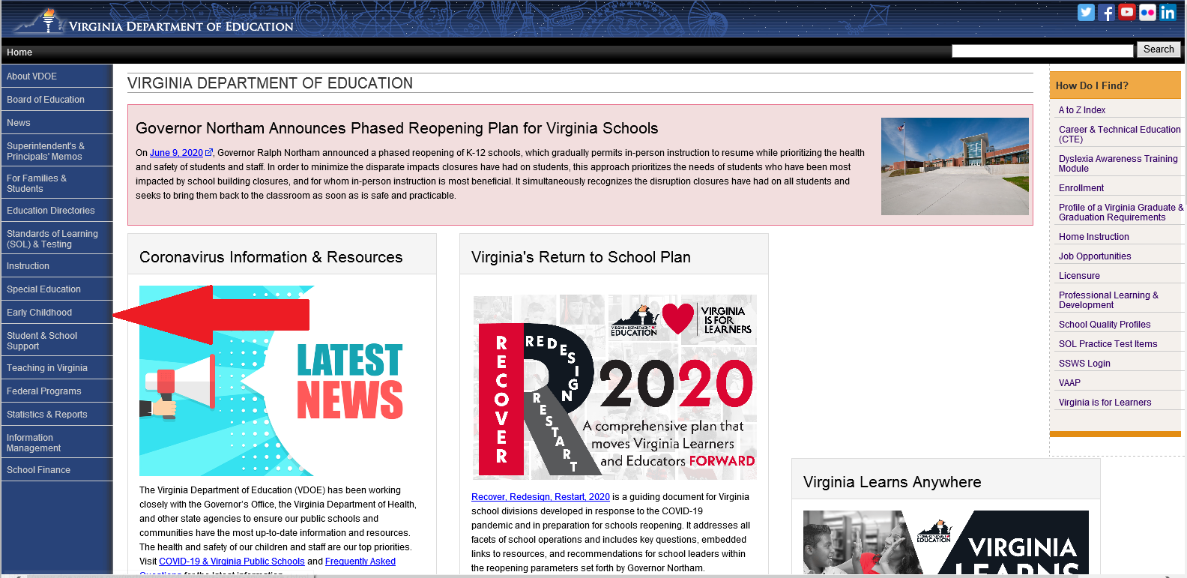
Resources 1

Slide 11
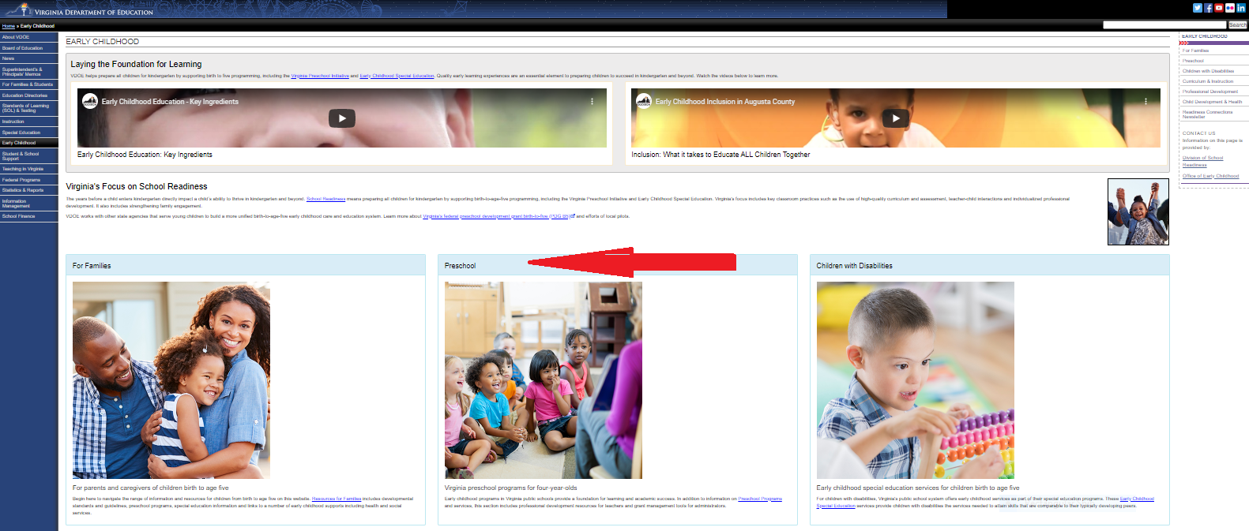
Resources 2

Slide 12
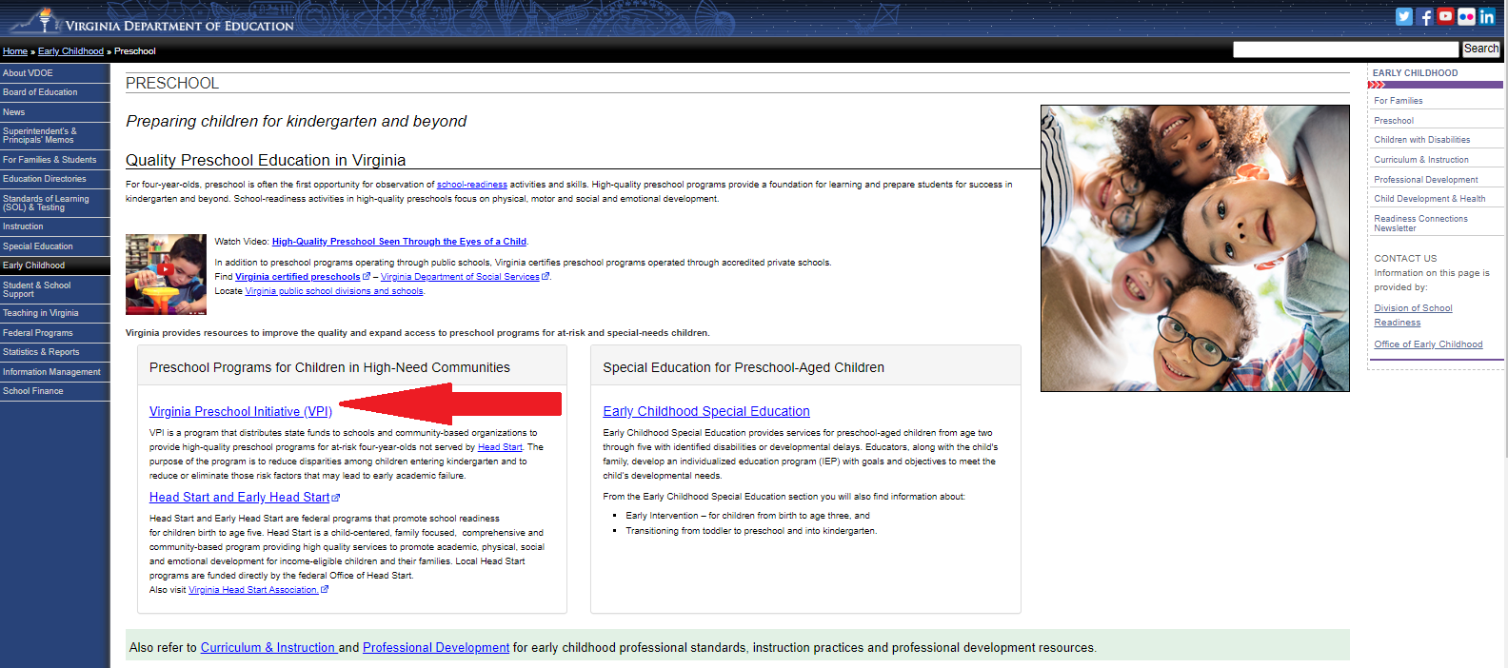
Resources 3

Slide 13
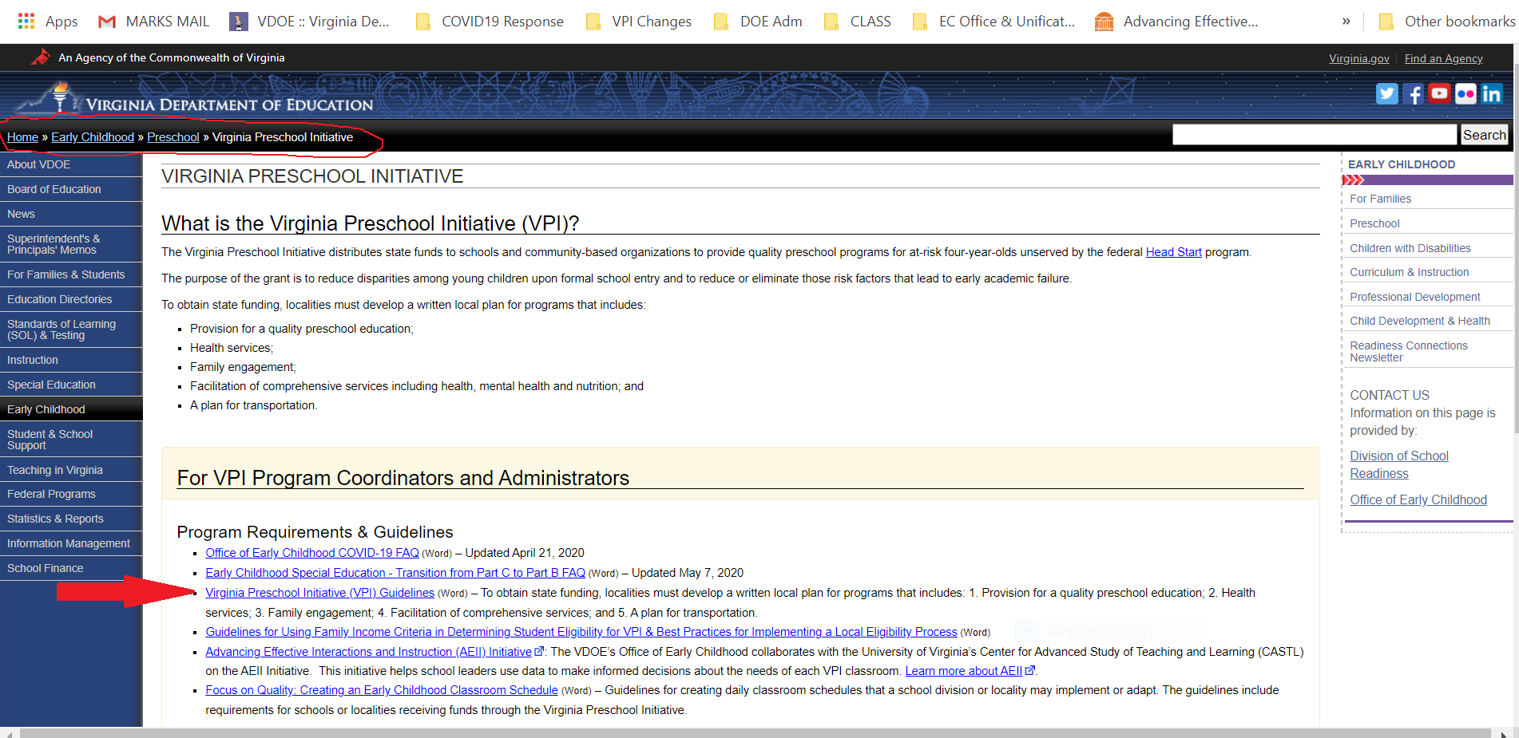
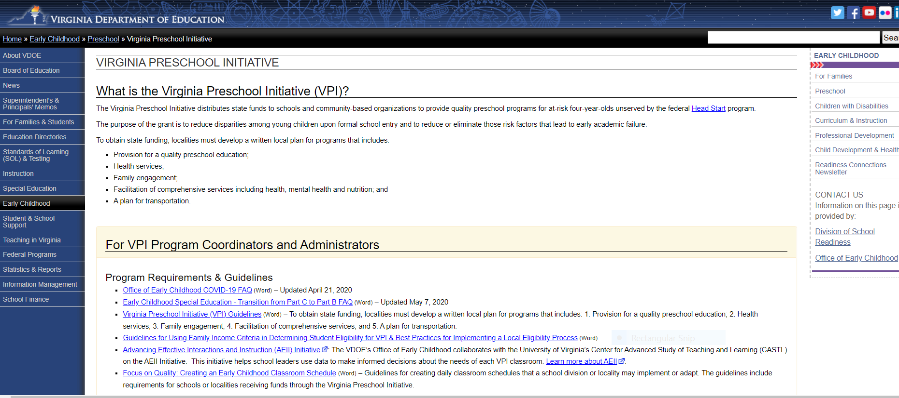
Resources 4

Slide 14
How do I know how many VPI slots our program is allotted for the next school year?

Slide 15
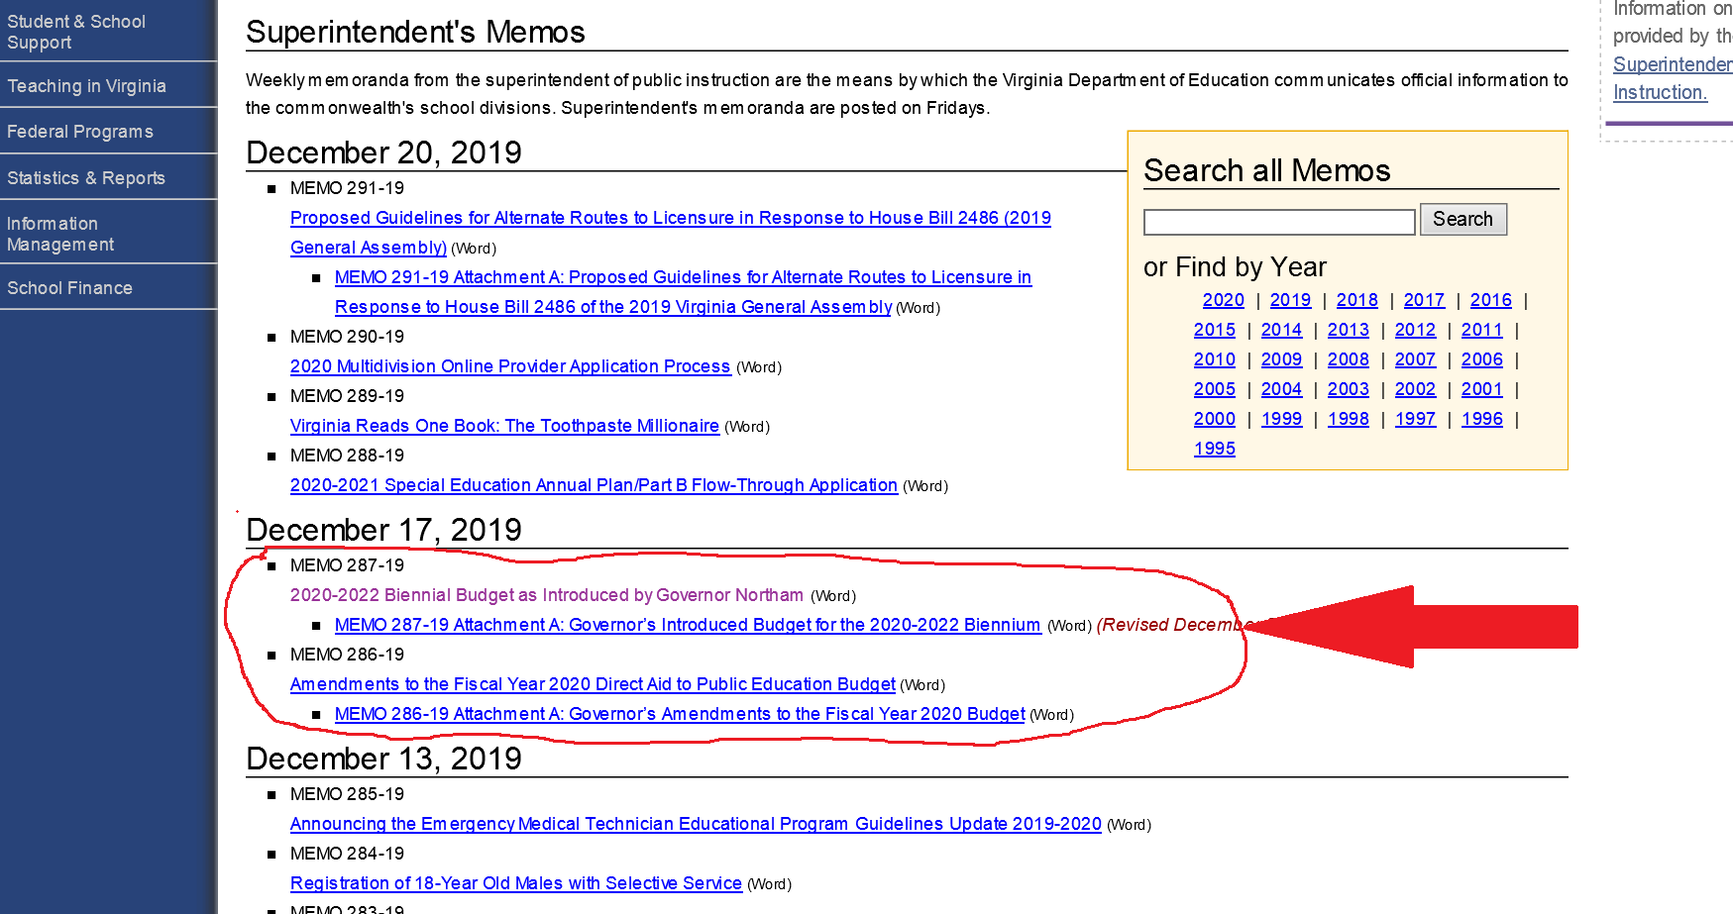
Resources 5
Each December after the Governor introduces the biennial budget or amendments to the current biennial budget a Superintendent's Memo is posted with a link to an Excel document with a VPI tab displaying number of VPI slots for all divisions.

Slide 16
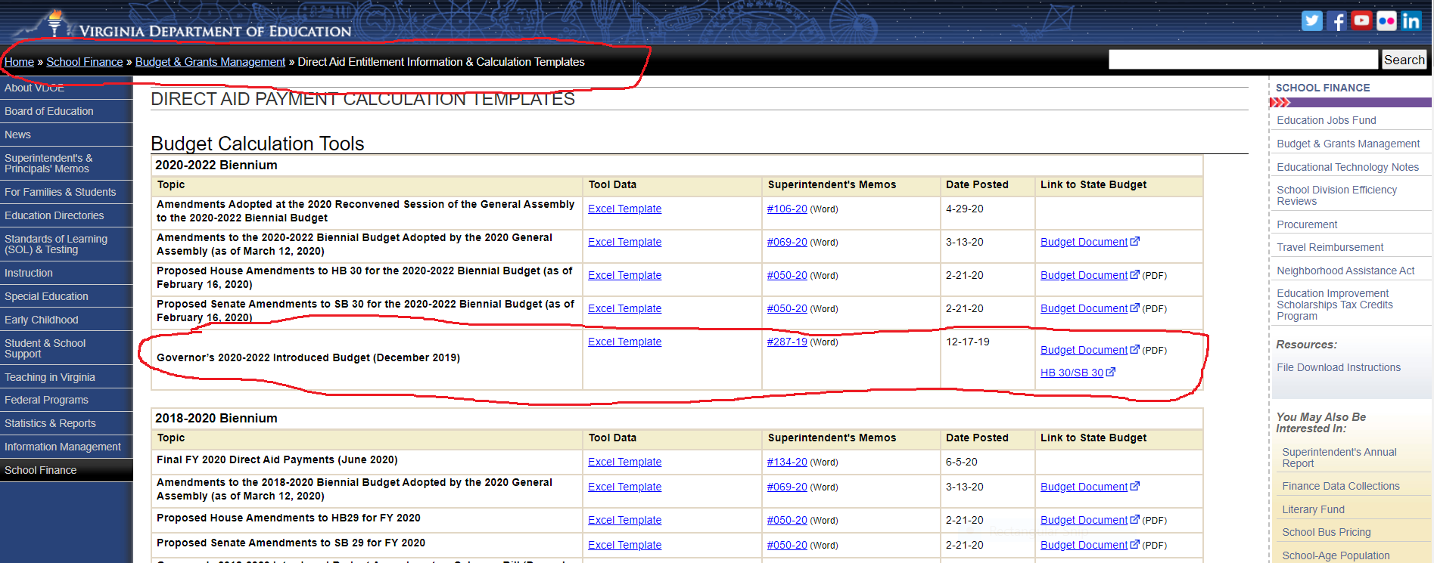
Resources 6

Slide 17
How do I locate the VPI Application (May 15) & Verification Report (October)?
Single Sign-on for Web Systems
(SSWS)

Slide 18
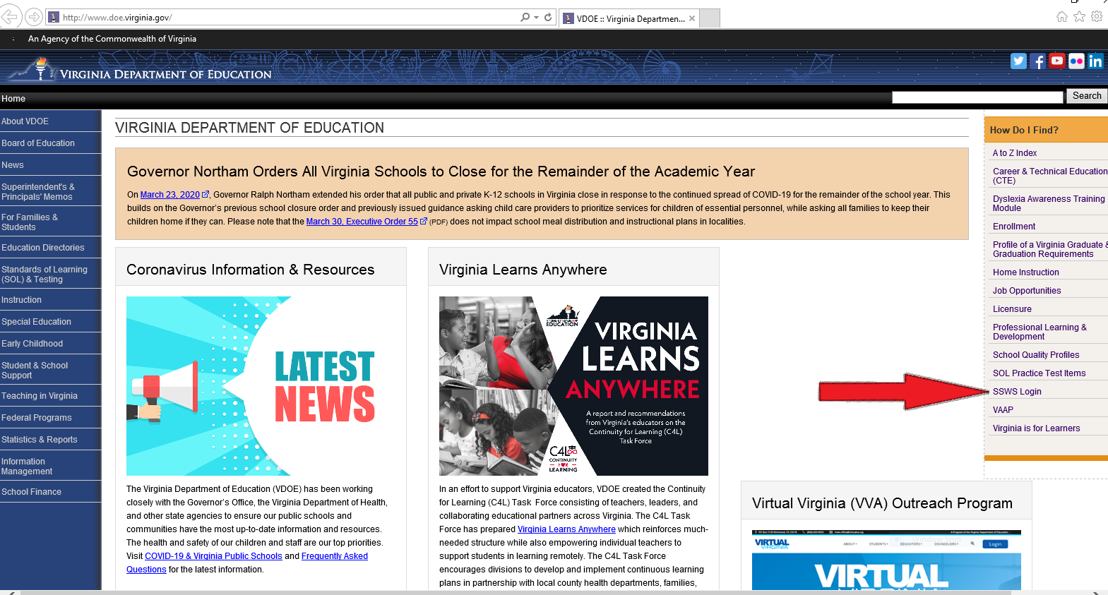
Resources 7

Slide 19
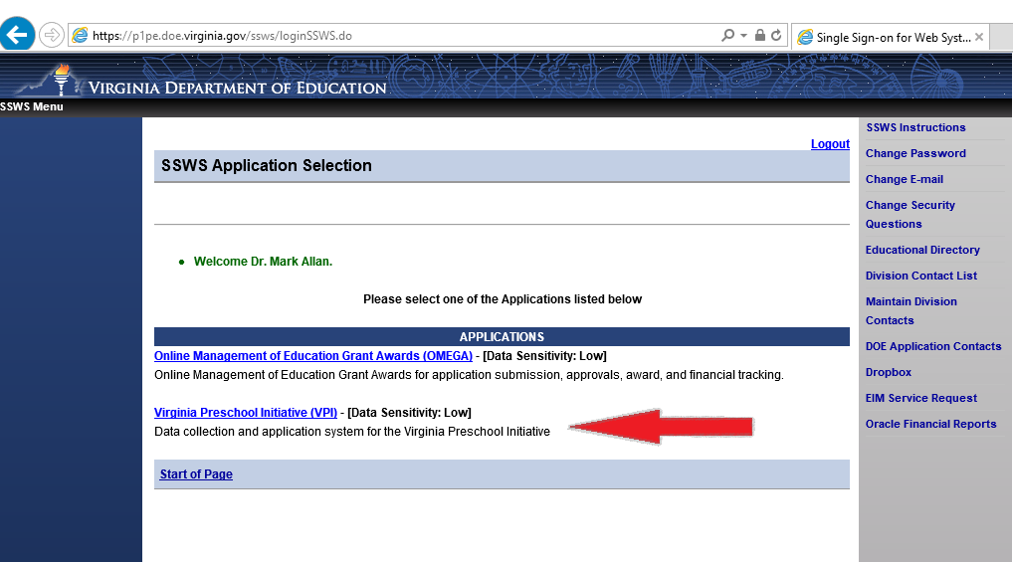
Resources 8

Slide 20
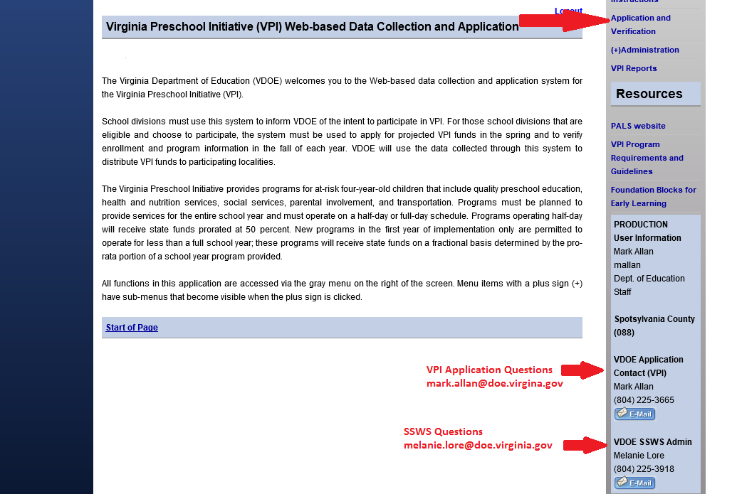
Resources 9

Slide 21
Why is the school division’s Fall Student Record Collection (SRC) so important to funding our VPI program?

Slide 22
SRC and VPI Funding Connections
SRC and VPI Funding Connections
VDOE distributes state funds (using state funding formula) to VPI fiscal agents for enrolled VPI students based on VPI student data collected on the fall SRC each school year. The total number of eligible, preschool students with a VPI funding code, enrolled on October 1, and reported in each school division’s fall SRC will serve as the total number of VPI slots filled by the division, therefore, funded by the state.
The number of VPI enrolled students reported by SRC in the fall, with a VPI funding code, determines the funding the VPI program will receive for the school year. Thus it is important to accurately report enrollment numbers to avoid funding complications.
All public preschool students, where the school division is the fiscal agent, grantee, or sub-grantee, must be reported on the SRC with a funding code and be assigned an STI. The school division must seek out and secure STIs for the students in VPI (regardless of public or community-provider setting), Title I preschool, special education placements, and Head Start programs (only when school division is the Head Start grantee), and where the funding is supported by state or federal grants or programs.

Slide 23
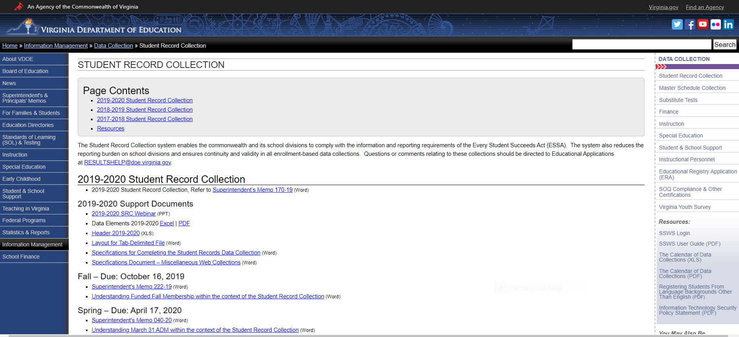
SRC

Slide 24
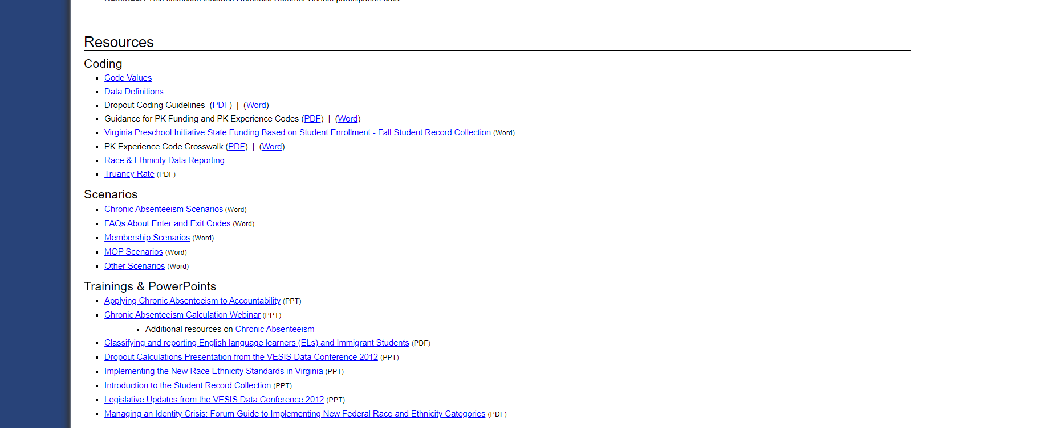
instructions
Scroll down to the bottom of the SRC page.

Slide 25
New EC SRC Funding Codes in 2020-21
Code #12: School division will be required to report VPI Pilot for Three-Year-Olds slots using SRC funding code #12.
Code #13: School divisions will track students participating in Mixed Delivery Grants administered by the Virginia Early Childhood Foundation (VECF) by assigning them an assigned an Student Testing Identifier (STI) with SRC funding code #13. There are limited number of communities with Mixed Delivery Grants.
*Community Provider Add-on Funding: School divisions will report a VPI slot receiving services in a community provider with a serving school code of 9990 in SRC. This is in addition to the reporting the appropriate VPI funding code for this slot.

Slide 26
Where can I find guidance and resources for external and local CLASS™ observations and professional development planning?
Advancing Effective Interactions & Instruction (AEII)
aeiionline.org

Slide 27
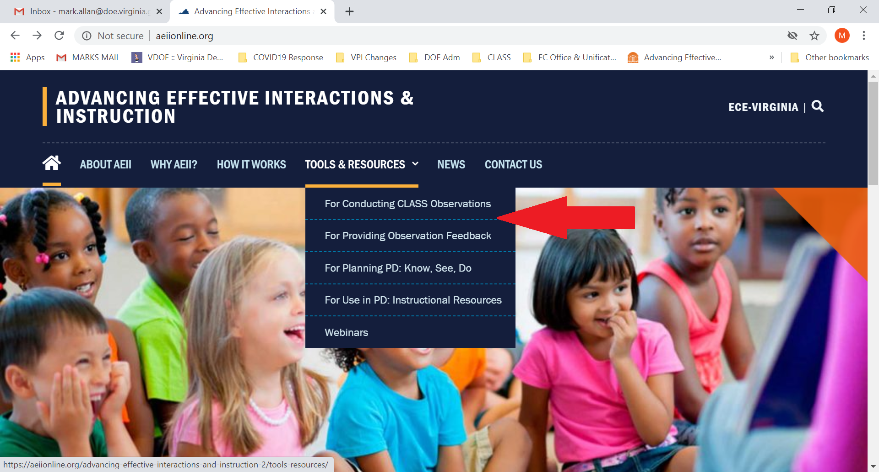
aeii

Slide 28
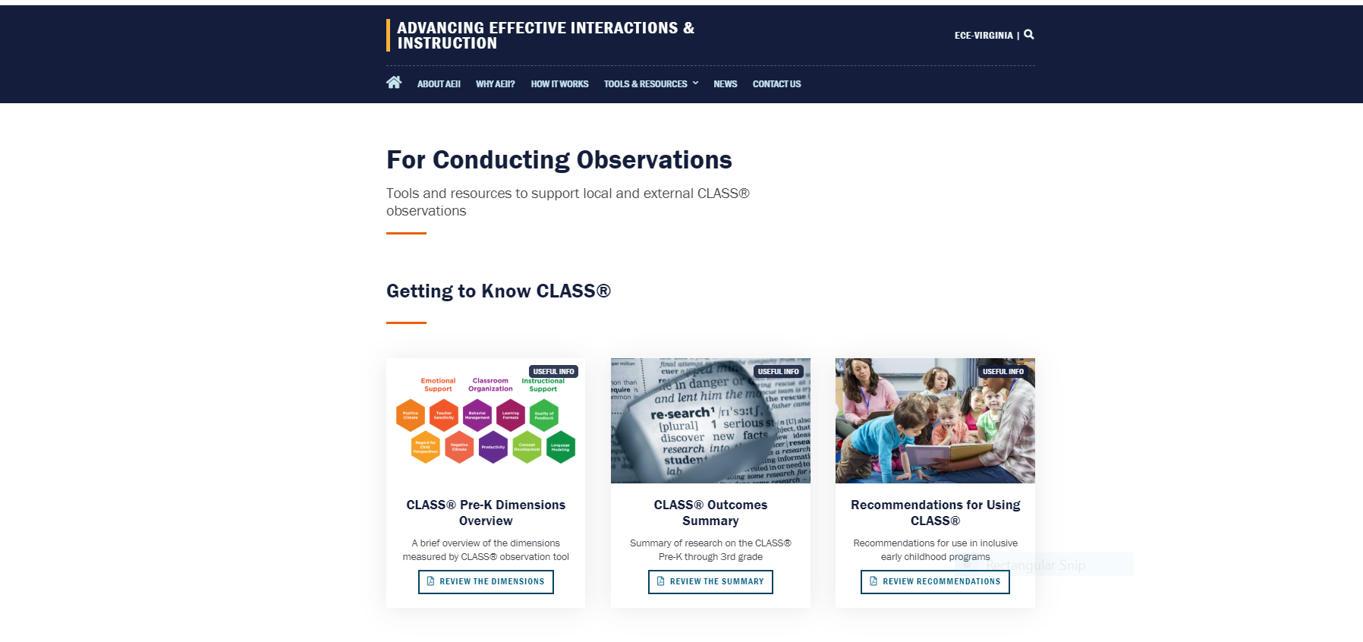
Aeii 1

Slide 29
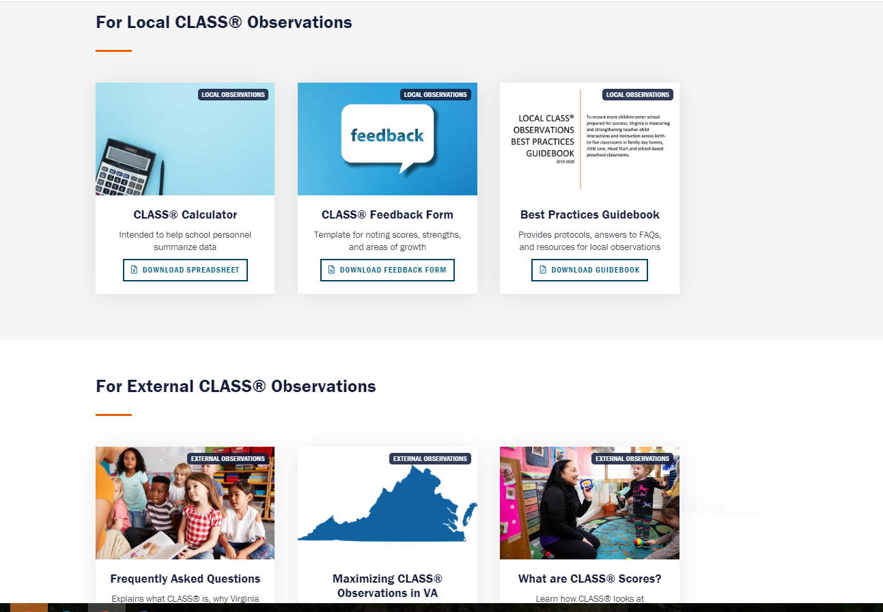
Local class obs

Slide 30
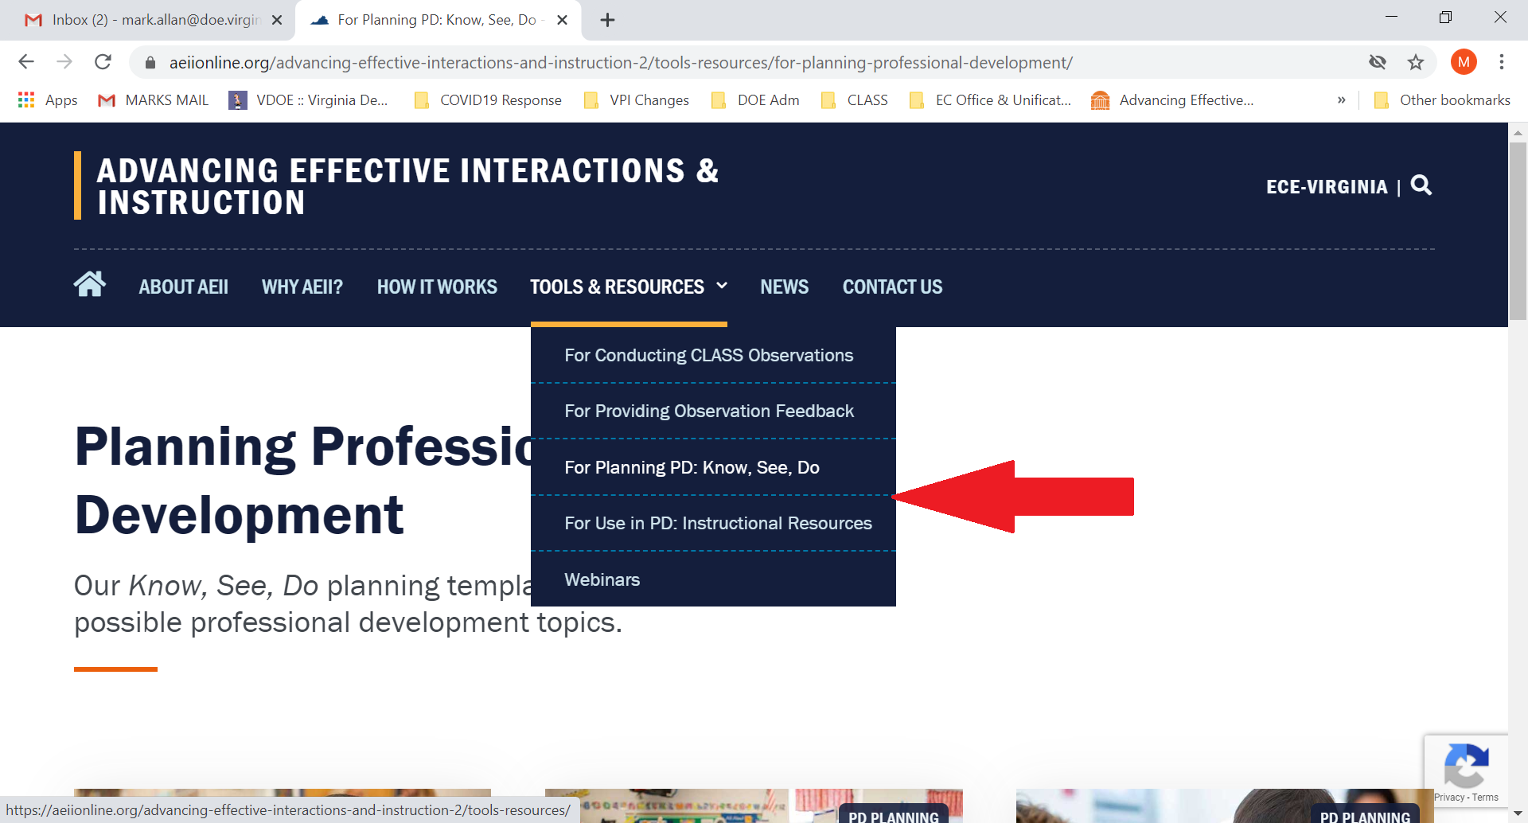
Aeii 2

Slide 31
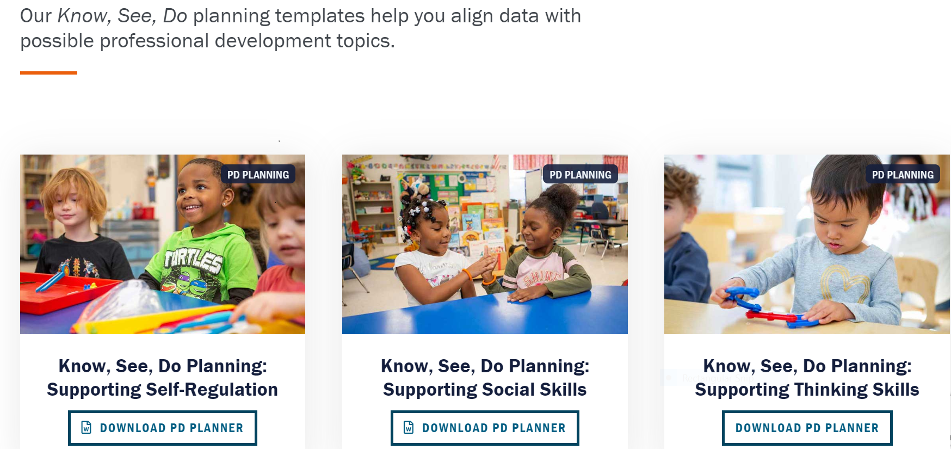
Planning pdfs

Slide 32
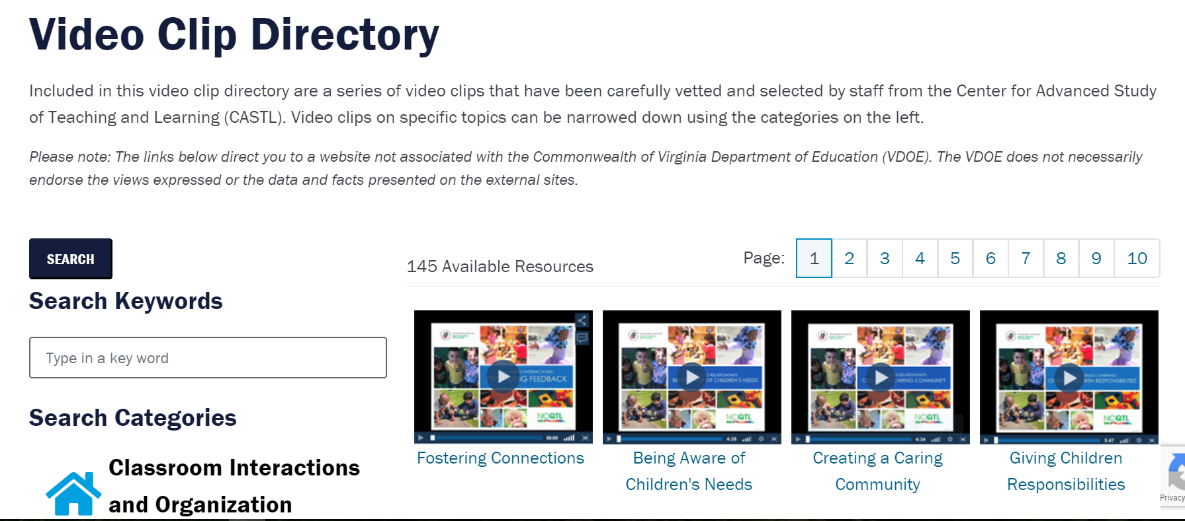
videos

Slide 33
How can I stay up-to-date on state guidance and resources available for VPI and early childhood in general?
Readiness Connections Newsletter

Slide 34
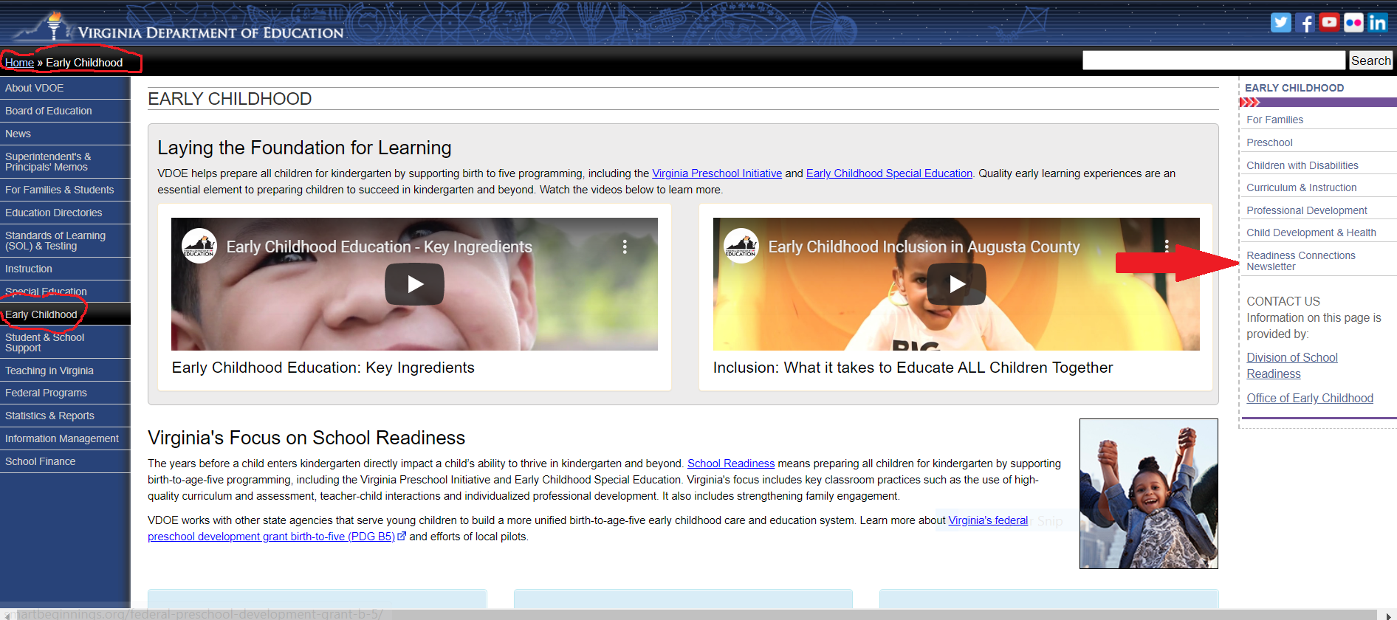
Readiness connections

Slide 35
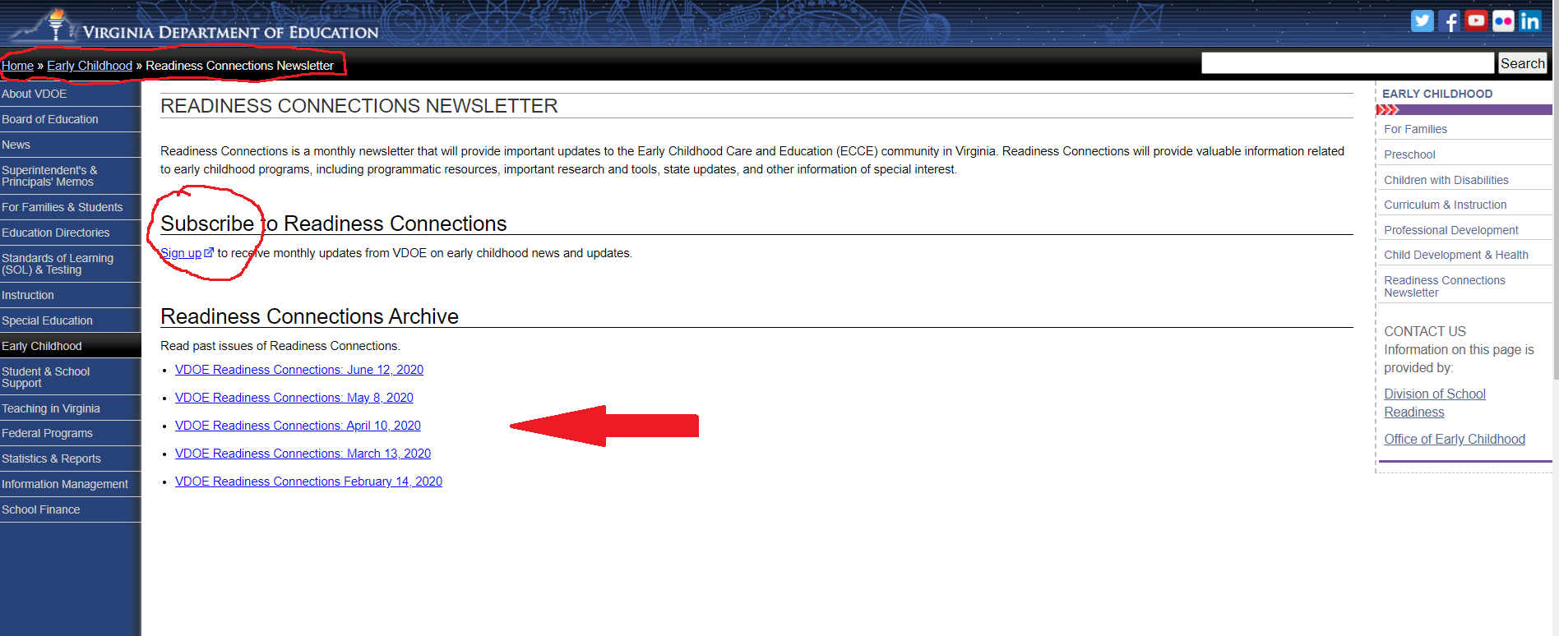
Archives of rc

Slide 36
How are VPI programs typically monitored by the state?*
*See Superintendent’s Memo #185-20 posted on July 24, 2020 for information on unique VPI monitoring during 2020-2021.

Slide 37
Purpose of Monitoring
The General Assembly appropriates funds for VDOE to conduct VPI monitoring to ensure compliance with state guidelines and to provide technical assistance for implementing high-quality programs.
Monitoring provides VDOE with a process for ensuring VPI programs are in compliance with state guidelines and Appropriation Act requirements while also providing technical assistance to leaders of the programs.
Provides a structured continuous improvement process for VPI programs to set goals for raising program quality.

Slide 38
Monitoring & Continuous Improvement Planning
Two-Year Process
Year 1: Desk Review Monitoring and Self-Study
(Continuous Improvement Planning Tool)
Year 2: Onsite Monitoring Visit
Frequency: VPI Programs participate in 2-year monitoring process every 4 years
Monitors: Contracted VPI monitors and Office of Early Childhood staff members conduct desk-reviews and onsite visits.

Slide 39
What are the VPI program requirements?

Slide 40
VPI Guidelines
Each year, the VDOE releases an updated set of program guidelines to set the minimum expectations for meeting the goals for VPI programs, as provided in the state budget approved by the General Assembly.
All VPI programs are expected to follow the guidelines provided.
The VPI Guidelines are always posted on the VDOE website.
This webinar recording from May 2020 includes details and information on each section of the VPI Guidelines.
Considerations for 2020-2021:
Planning for 2020-2021 is being completed during uncertain times.
While programs should plan to follow the VPI Guidelines to the best of their ability, the VDOE does have the ability to waive requirements in case of extreme circumstances resulting from COVID 19.
Specific concerns should be emailed to Dr. Mark Allan, Associate Director of PreK Programs, at
mark.allan@doe.virginia.gov .

Slide 41
2020-2021 VPI Guidelines
The 2020-2021 VPI Guidelines are divided into six key sections.
Section 1 | Providing a Quality Preschool Education
Section 2 | Working with the Community to Provide Health Services and Facilitate Comprehensive Services
Section 3 | Family Engagement
Section 4 | Equity for All Learners
Section 5 | Program Operations and Transportation
Section 6 | Submitting the VPI Application

Slide 42
Section 1: Providing a Quality Preschool Education
To improve kindergarten readiness in Virginia, all publicly-funded children need access to high-quality classroom interactions and instruction. In VPI programs, all teachers should be supported to use a vetted curriculum, receive frequent feedback on effectiveness of their interactions with children, participate in effective PD, implement learning standards, and use assessments to individualize instruction
Key Features of Section 1
Integrated and evidenced-based curriculum
Assessing teacher-child interactions
Providing individualized professional development
Implementing learning standards
Child assessment with PALS Pre-K

Slide 43
Section 1: Providing a Quality Preschool Education
Curriculum: An evidenced-based, integrated, and comprehensive curriculum, when fully implemented, makes it easier and more efficient for teachers to engage in sensitive, responsive, and cognitively stimulating teacher-child interactions.
Beginning in 2020-2021: All school divisions must implement a vetted, comprehensive and evidence-based curriculum, and describe their plan for providing curriculum aligned training and professional development for teachers.
The curricula that have been vetted for use in VPI classrooms as of April 2020 include: Big Day for PreK, Creative Curriculum, Frog Street, HighScope, InvestiGator Club, Kindercare, Opening the World of Learning, STREAMin3, Tools of the Mind, Fairfax County Public Schools Pre-K curriculum, and Virginia Beach Locally Developed PreK Curriculum.
School divisions may contact Dr. Tamilah Richardson (Tamilah.Richardson@doe.virginia.gov) and
request a vetting of a comprehensive curriculum.

Slide 44
Section 1: Providing a Quality Preschool Education1
Teacher-Child Interactions: CLASS™ observations provide essential feedback to teachers and site leaders on the quality of the teacher-child interactions taking place within a classroom. Through both local and external observations, pre-K classrooms are better prepared to support child learning and development
Beginning in 2020-2021:
External CLASS™ Observations: All school-based preschool classrooms (VPI, Title I, ECSE, local) will receive external CLASS observations once every two years.
Local CLASS™ Observations: All school divisions must provide local CLASS™ observations in all VPI classrooms two times a year, provide teachers/assistants with feedback based on their scores, and submit local CLASS™ data to the VDOE as requested.

Slide 45
Section 1: Providing a Quality Preschool Education2
Professional Development: Teachers and instructional assistants must attend at least 15 clock hours per year of professional development that supports their knowledge, skills, and practice to facilitate effective teacher-child interactions and instruction that promotes children’s learning and development towards kindergarten readiness.
UVA-CASTL will provide PD and consultation to division and school leaders to ensure that all VPI teachers receive effective individualized PD to support quality teacher-child interactions and research-based curriculum implementation in their programs.
In 2020-21, CASTL will continue to provide leaders a range of PD and consultation services (individual, group, webinars) differentiated across VPI programs based on their needs as assessed through CLASS™ data, PD Rubric data, feedback from VPI leaders, among
other sources.

Slide 46
Section 1: Providing a Quality Preschool Education
Learning Standards for 2020-2021: The Foundation Blocks for Early Learning are Virginia' set of standards for four-year-olds for implementation in VPI programs in 2020-2021.
The Foundation Blocks outline a measurable range of skills and knowledge essential for four-year-olds to be successful in kindergarten.
New Unified Set of Birth-Five Learning Developmental Standards – For 2021-2022
Revised standards will reflect cultural responsiveness; be pragmatic for families and programs; have a special emphasis on caring for the most vulnerable populations; and be in alignment with Virginia’s kindergarten standards of learning (SOLs).
Opportunities to provide feedback on the New Unified B-5 Learning Standards will be shared in summer and fall 2020.
2020- 2021: VPI programs will align instruction to the Foundation Blocks for Early Learning and prepare for transition to use of the new Birth-Five ELD Standards.
2021-2022: All VPI programs must implement the use of the Birth-Five ELD Standards.

Slide 47
Section 1: Providing a Quality Preschool Educationx
Child Assessment with PALS-PreK: Localities are required to use the Phonological Awareness Literacy Screening instruments for pre-kindergarten four-year-old students (PALS-PreK) for literacy screening during the fall and spring of each school year.
The results of PALS-PreK assessments (four-year-olds), both fall and spring, must be reported to the PALS office

Slide 48
Section 2: Working with the Community to Provide Health Services and Facilitate Comprehensive Services
VPI serves as many children’s first entry into the school system. It is critical to provide effective health and comprehensive services.
Key Features of Section 2
Description of health services and facilitation of comprehensive services provided in close consultation with families.
Description of local VPI Steering Committee that meets regularly and includes representatives from all early childhood partners in the community (required members listed). Encouraged to meet at least quarterly.

Slide 49
Section 3: Family Engagement
Family engagement is an essential component of VPI Programs. VPI Programs must have a plan for intentional family engagement that continues throughout the school year.
Key Features of Section 3
Explanation of intentional plan for family engagement, including minimum expectations and strategies.
Description of meaningful transition strategies that result in a successful kindergarten experience.

Slide 50
Section 4: Equity for All Learners
All children must be provided the same high-quality learning experience regardless of background, home cultures, language, or abilities and skills. VPI programs must focus on equity by ensuring practices and policies that encourage inclusion and advancement of all children who qualify for the program.
Key Features of Section 4
Description of how to include students with disabilities.
Description of how to support Dual Language Learners.
Description of how to provide services to preschoolers experiencing homelessness.
Description of Virginia’s Guidelines for the Prevention of Suspension and Expulsion of Young Children: Supporting Children with Challenging Behaviors in Early Childhood Settings.

Slide 51
Section 4: Equity for All Learners1
VPI Programs must understand the specific requirements, expectations, and best practices for serving all pre-K students.
Supporting Inclusion of Students with Disabilities: Children with disabilities should be included in VPI classrooms along with their peers without disabilities. Additional information can be found in the Virginia Early Childhood Inclusion Guidance Document.
Support for Dual Language Learners: Early childhood programs must be prepared to optimize early learning experiences of Dual Language Learners. Additional information can be found in the English Language Development Standards.
Services for Preschoolers Experiencing Homelessness: Divisions are required to provide services for VPI children experiencing homelessness as part of the McKinney-Vento Homeless Assistance Act.
Exclusionary Discipline for Pre-K students: The Virginia Board of Education approved Virginia Guidelines for the Prevention of Suspension and Expulsion of Young Children: Supporting Children with Challenging Behaviors in Early Childhood Settings to providing guidance for VPI

Slide 52
Section 5: Program Operations & Transportation
A successful VPI program relies on designing effective program operations that meet the requirements from the state. This includes providing a manageable class size, following instructional time regulations, monitoring student attendance, and securing a plan for student transportation.
Key Features of Section 5
Description of VPI student eligibility.
Description of how to verify family income for eligible students.
Description of staffing ratios.
Description of instructional time and operating as a full or half-day program.
Description of student attendance policy.
Description of transportation policy.

Slide 53
Section 5: Program Operations & Transportation2
VPI Programs must understand specific program operation requirements that include student eligibility, verifying family income and staffing ratios.
Student Eligibility: Children must be from a family that meets the following requirements: (i) family income at or below 200 percent of poverty, (ii) homelessness, (iii) student’s parents or guardians are school dropouts, or (iv) family income is at or below 350 percent of federal poverty guidelines in the case of students with special needs or disabilities.
Up to 15 percent of a division's slots may be filled based on locally established eligibility criteria so as to meet the unique needs of at-risk children in the community.
Beginning in 2020-2021: Localities that can demonstrate that more than 15 percent of slots are needed to meet the needs of at-risk children in their community may apply for a waiver from the Superintendent of Public Instruction to use a larger percentage of their slots. Localities must demonstrate that increasing eligibility will enable the maximization of federal funds and will not have a negative impact on access for other individuals currently being served. See Superintendent’s Memo #041-20 for a copy of the Waiver Form.

Slide 54
Section 5: Program Operations & Transportation1
VPI Programs must understand specific program operation requirements that include student eligibility, verifying family income and staffing ratios.
The following income reporting requirement are due from divisions each fall:
The Department of Education is directed to compile from each school division the aggregated information as to the number of enrolled students whose families are (i) at or below 130 percent of poverty, (ii) above 130 percent but at or below 200 percent of poverty, (iii) above 200 percent but at or below 350 percent of poverty, and (iv) above 350 percent of poverty. The Department shall report this information annually, after the application and fall participation reports are submitted to the Department from the school divisions, to the Chairmen of House Appropriations and Senate Finance Committees.

Slide 55
Section 5: Program Operations & Transportation x
VPI Programs must understand specific program operation requirements that include student eligibility, verifying family income and staffing ratios.
Verifying Family Income for Student Eligibility: The VDOE established Guidelines for Using Family Income Criteria in Determining Student Eligibility for the State-funded VPI and Best Practices for Implementing a Local Eligibility Process guidelines provide assistance with implementing and meeting the income-based and locally established at-risk student eligibility criteria and reporting requirements for the state-funded VPI program

Slide 56
Section 5: Program Operations & Transportation3
VPI Programs must understand specific program operation requirements that include student eligibility, verifying family income and staffing ratios.
For 2020-2021, all programs that are meeting the requirements for the 2020-2021 VPI Guidelines will be considered to be meeting and exceeding the benchmarks set by the Board of Education.
Beginning in 2020-2021: VPI classrooms that exceed benchmarks set by the Board of Education are should be staffed as follows:
At least one teacher must be provided for any classroom with 10 or fewer students
If average class size is greater than 10 students (but does not exceed 20) there must be at least one full-time teacher’s aide assigned to the classroom
No class size can exceed 20 students
VPI classrooms that do NOT exceed the benchmarks set by the Board of Education should be staffed as follows:
At least one teacher must be provided for any classroom with 9 or fewer students
If average class size is greater than 9 students (but does not exceed 18) there must be at least one full-time teacher’s aide assigned to the classroom
No class size can exceed 18 students

Slide 57
Section 5: Program Operations & Transportation4
VPI Programs must understand specific program operation requirements that include instructional time and unstructured recreational time, operating full or half-day and student attendance.
Operating as a Full or Half-Day Program: Programs must provide full-day and at least school-year services (180 days or 990 hours). Programs must operate on a full-day (5.5 hours excluding meals) or half-day (3 hours excluding lunch) basis for the entire school year to receive state funds.
Instructional Time and Unstructured Recreational Time: VPI programs may include unstructured recreational time that is intended to develop teamwork, social skills, and overall physical fitness in any calculation of total instructional time, provided that such unstructured recreational time does not exceed 15 percent of total instructional time or teaching hours.
Student Attendance: Clear attendance and communication policies along with collaboration with families, are crucial to improving VPI student attendance and increasing outcomes for students. Every eligible four-year-old enrolled and funded by the VPI program in a public or private setting must have a State Testing Identification (STI) number and be reported in three VDOE Student Record Collection (SRC) reporting cycles: fall, spring and end of year.

Slide 58
Section 5: Program Operations & Transportation 5
VPI Programs must understand specific program operation requirements as it relates to transportation.
Transportation: VPI programs must have a plan for ensuring that VPI eligible students have access to a safe method of transportation to and from the home setting and the VPI program site. Transportation must never be a barrier for recruiting eligible children for the VPI and for providing full VPI services to eligible children and their families.

Slide 59
Section 6: Submitting the VPI Application
School divisions must develop a local VPI Plan, submit an application, and determine a plan for funding in order to offer the VPI program each year.
Key Features of Section 6
Submitting the VPI Application (annually each spring)
Local plan, application requirements
Funding a qualifying program
Local funds (cash/in-kind)
Coordination of funds
Mixed Delivery and community-provider settings
Community-provider add-on

Slide 60
Section 6: Submitting the VPI Application1
School divisions must develop a local VPI Plan, submit an application, and determine a plan for funding in order to offer the VPI program each year.
An annual VPI Local Plan must be created and submitted as a part of the VPI Application each spring. Answers to the following questions must be answered as evidence of each programs local plan for VPI:
Describe how teachers and teaching assistants are provided with ongoing training and professional development to implement the vetted curriculum.
Describe how students are assessed in literacy, mathematics, science, history and social science, physical and motor development and personal and social development.
Provide information on who will serve as certified, local CLASS observers. Describe how teachers and teacher assistants will be supported in improving practice as a result of scores from observations completed.
Each VPI program is working in collaboration with UVA/CATL on a VPI Professional Development Plan. Please provide any significant revisions or updates to professional development for VPI teachers and assistants (at least 15 hours in early childhood topics) for the upcoming school year.
Describe how the program will facilitate linkages to obtain comprehensive services and resources for children and families (i.e., health physical, hearing and vision screenings, and behavioral and mental health screenings).

Slide 61
Section 6: Submitting the VPI Application2
An annual VPI Local Plan must be created and submitted as a part of the VPI Application each spring. Answers to the following questions must be answered as evidence of each programs local plan for VPI:
Describe how often the VPI Steering Committee meets and how community resources and services are coordinated with child care providers, local social services, local health department, Head Start, and other community organizations.
List all members of the VPI Steering Committee by their titles and organizations they represent. Describe how members are consulted to ensure federal funds are preserved and maximized for serving preschoolers.
Describe the intentional plan for implementing meaningful parental involvement and family engagement strategies throughout the school year.
Describe how leaders representing VPI and Early Childhood Special Education programs work together as a team to support inclusive practices of children with special needs in VPI classrooms.
What steps are you taking to ensure more children with special needs are served in inclusive classrooms than are served in early childhood special education self-contained classrooms?
Describe the transportation plan that is in place to ensure eligible VPI children have access to a safe method of transportation to and from the home setting and the VPI program site. Describe how the program will ensure that transportation does not prevent a barrier for providing full services to eligible children and their families.

Slide 62
Section 6: Submitting the VPI Application3
School divisions must provide a local match of funds based on the composite index of local ability-to-pay.
Beginning in 2020-2021: At least 50% of the local match will be cash and no more than 50 percent will be in-kind.
The VDOE Office of Budget and Finance, in consultation with Early Childhood, hosted a webinar for local budget contacts on February 25, 2020. A recording of that webinar is available.

Slide 63
Section 6: Submitting the VPI Application4
Community Provider Settings: Mixed delivery means that school-based preschool program, Head Start programs, licensed child care programs, and community-provider organizations are eligible to partner and work together to provide services
Localities that are looking to increase access for at-risk three- and four-year olds should consider collaborating with community providers to maximize impact.
Beginning in 2020-2021: Add-on funds for VPI slots offered in community-provider settings may be available. The amount of the add-on grants will vary by region with rates of either $3,500, $2,500, or $1,500 per child, if available.

Slide 64
Questions and Answers Mark Allan – Mark.Allan@doe.Virginia.gov Erin Carroll – Erin.Carroll@doe.Virginia.gov

Slide 65
appendix
Appendix

Slide 66
EC Contacts
Topic | Individual
VPI Program & Guidelines VPI Application and Verification Report | Mark Allan Associate Director of PreK Programs Mark.Allan@doe.virginia.gov
Curriculum Early Learning Developmental Standards PreK Pilot Child Behavior Rating Scale | Tamilah Richardson Associate Director of EC Learning Tamilah.Richardson@doe.virginia.gov
External CLASS Observations EC Professional Development Planning | aeii@virginia.edu

Slide 67
Websites
Advancing Effective Interactions & Instruction (AEII)
PALS PreK
VDOE Procurement Site (Request Teachstone State Contract)
Single Sign-on Web Systems (SSWS)
Student Record Collection
Superintendent’s Memos
VPI Website

Slide 68
Recorded Webinars
Webinar Content | Link
Completing the Spring 2020 VPI Application in SSWS | May 1, 2020 May 1 VPI Application Webinar (password: 0f@253F5)
VPI Guidelines. | May 21, 2020 A recording of the webinar is now available

Slide 69
PALS Pre-K Training Resources
Assessment Videos
Certification Tutorial
Notes:
PALS offers two ways to help you learn how to give the PreK PALS assessment: Assessment videos and a more formal certification tutorial.

Slide 70
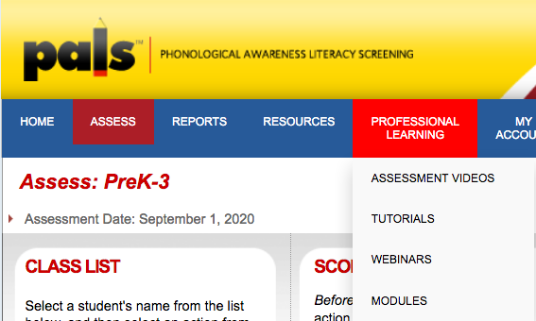
PALS Assessment Videos
Professional
Learning Tab
Assessment Videos
Notes:
Once logged into your PALS Account, the assessment videos can be found on the Professional Learning Tab. From there, simply click on Assessment Videos from the dropdown menu.

Slide 71
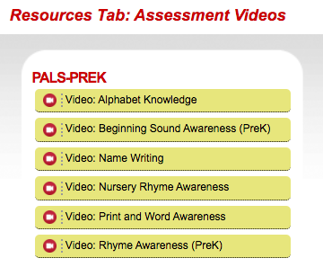
PALS-PREK Assessment Videos
Notes:
The assessment videos are broken down by task, so there are 6 for PreK. Each video models correct administration and is just a couple of minutes long. These videos are a great refresher as well!

Slide 72
PALS PREK Certification Tutorials
Professional
Learning Tab
Tutorials
Notes:
The certification Tutorials are a more formal training. To access the PreK Certification tutorial, go to your Professional Learning Tab and then click on Tutorials from the dropdown menu.

Slide 73
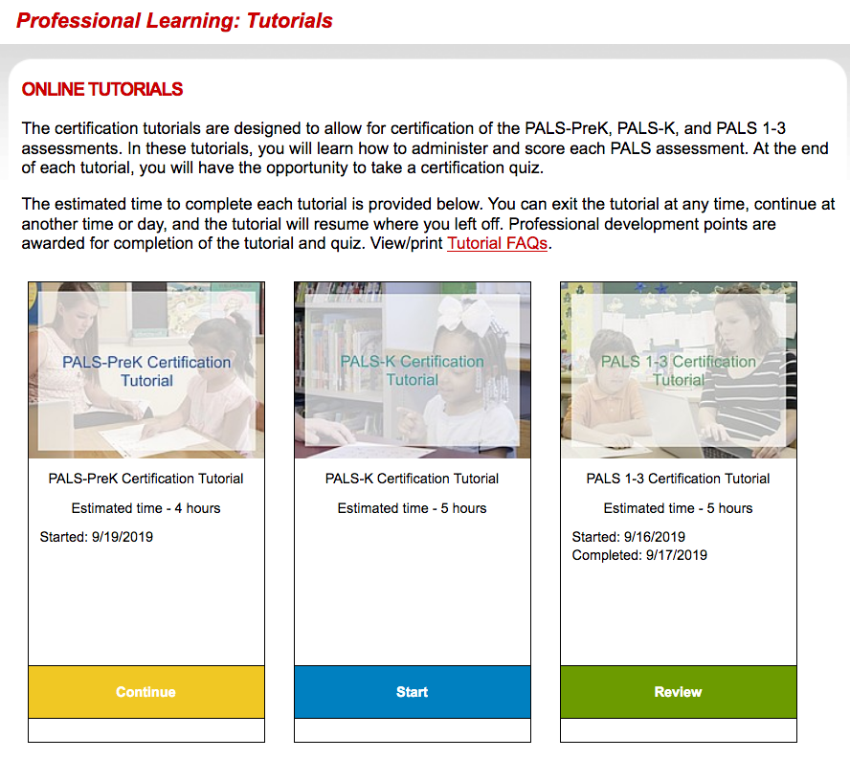
PALS-PreK Tutorial
Notes:
You will be taken to this page where you will see the PreK tutorial. The certification tutorials are designed to allow for certification of the PALS assessments. In this tutorial, you will learn how to administer and score the PALS PREK assessment. At the end of the tutorial, you will have the opportunity to take a certification quiz.
The estimated time to complete the tutorial is approximately 4 hours. You can exit the tutorial at any time, continue at another time or day, and the tutorial will resume where you left off. Professional development points are awarded for completion of the tutorial and quiz.

Slide 74
contact
Notes:
Always feel free to reach out to the PALS office by phone, chat or email if they can support you.

