Slide 1
Office of Early Childhood Cups and Conversations
Re-opening and Operating ECCE Programs During COVID-19, Part III
July 15, 2020
C6: Chesterfield County Preschool Development Grant Pilot Community Perspectives

Slide 2
Good morning- thanks for joining Cups and Conversations!
A few reminders:
•This is a judgement free zone
•Sharing of local perspective, not DOE recommendations
•You are free to unmute your line at anytime to share your thoughts and ask questions
–*Please help us minimize background noise by staying muted if you are not speaking
•This meeting will be recorded and shared with participants
Optional: Please add your name and affiliation in the chat box

Slide 3
Today’s Special Guests
David Williams
Special Projects Coordinator, Smart Beginnings Greater Richmond
david.williams@smartbeginningsrva.org
Yseult “Ise” Vin-Franck
Coordinator of Early Childhood Services, Chesterfield County Public Schools
yseult_franck@ccpsnet.net

Slide 4
Overview of PDG B-5
Virginia’s Preschool Development Grant Birth to Five (PDG B-5) is all about building strong systems at the community level.
In 2019 Virginia was awarded the initial, one year PDG B-5 grant that was used to support three key activities.
Refine and implement a vision for a unified system
Key work: Need assessment and strategic plan
Expand community pilots to statewide capacity
Key work: Support community pilots to create a unified structure for their region that measures and support quality and increased access.
Improve state infrastructure
Key work: LinkB5 data system, standards, and better understand key factors related to teacher workforce and pay (teacher incentive program)
The audience for PDG B5 is every publicly-funded B-5 early childhood provider (child care, schools, family day home, Head Start) in VA.
VDOE is the grantee, but works very closely with VECF and UVA as subrecipients.
The vast majority of funds are spent on supporting community pilots to accomplish goals related to measuring and supporting quality and recognizing early childhood teachers.

Slide 5
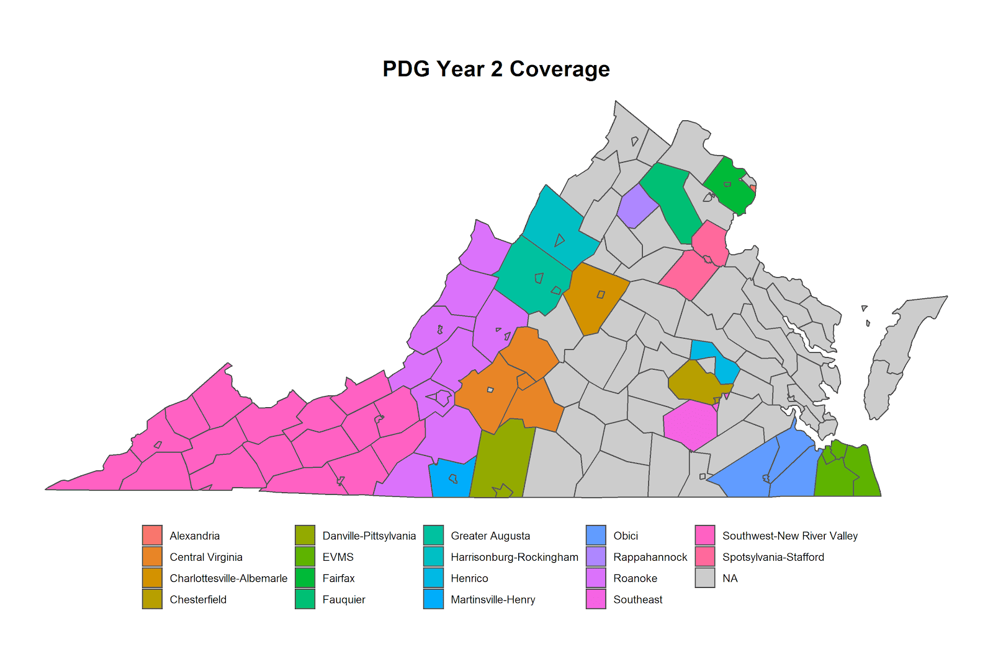
PDG B-5 Renewal Updates
PDG B-5 has been renewed and is now a three year grant (~11 million each year). It will run from January 2020-December 2022.
Now inclusive of 8 new pilot communities (10 pilot communities made up Cohort 1).
Notes:
PDG coverage has expanded to nearly 68% of the state.

Slide 6
Q1: Could you tell us about the Chesterfield PDG Pilot Community and Chesterfield County Public Schools?
Please share details about:
PDG pilot community activities;
The Chesterfield PDG Pilot community footprint;
School division demographics;
Your role as a) lead organization and b) and EC program leaders
Chesterfield County Public Schools
Notes:
Community Pilots (CP) are coalitions of all the publicly-funded EC programs within a region. With Cohort 2 being added, there are now 18 in VA. Each pilot has a lead organization that receives funding to:
Build relationships across programs (routine meetings and info sharing)
Increase access for families and children (coordinated enrollment and linkB5)
Strengthen quality of programs (CLASS observations, PD planning, teacher incentive)
Support family engagement (pilot approaches to engage families)
Why do they matter? Pilots are the foundation of the unified EC system in VA, eventually they will reach statewide. Locally conducted CLASS observations and systems of coordinated enrollment will be critical levers in a unified system.

Slide 7
Q2: What did continuity of care and learning look like in your community?
How have you supported families during COVID-19 school/program closures?
Overall, how successful have family engagement efforts been?
Please share insights on how reopening Child Care has gone?
Please feel free to enter your thoughts and questions in the chat box or chime in when the floor is reopened!

Slide 8
Q3: How have you handled recruitment and enrollment?
What are some of the specific changes that you made in light of the pandemic?
What are some of your successes, challenges and how have you calibrated your action plan?
Please feel free to enter your thoughts and questions in the chat box or chime in when the floor is reopened!

Slide 9
Q4: What about fall re-opening plans?
Could you share what you know about CCPS fall reopening plans?
How involved have you and your teams been involved in informing considerations that relate specifically to Early Childhood/ECSE programs?
The chat box is always open, and we welcome your thoughts and questions upon prompting!

Slide 10
Q5: What are your biggest lessons learned from this very unique planning process and administrative experience?
What top pieces of advice would you offer to divisions and programs about recruitment, enrollment and re-opening this fall?
Do you have recommendations for helpful resources outside of VDOE publications (Recover, Redesign, Restart 2020, FAQs)?

Slide 11
Additional Resources
VDOE Recover, Redesign Restart 2020: A Comprehensive Plan that Moves Virginia Learners and Educators Forward
VDOE COVID 19 Website
–VDOE COVID 19 FAQs, Office of Early Childhood FAQ , and Transition from Part C to Part B FAQ
–Virginia Learns Anywhere (C4L) and #GoOpenVA
Other:
–Child Care Guidance for COVID 19 and Child Care Licensing FAQs, Child Care Resources COVID 19 website
–The Virginia Early Childhood Foundation (VECF) materials, including a guide for child care and a series of webinars

Slide 12
Closing Notes
Next Conversation, July 29
EC Re-opening Considerations, Cont’d
Forthcoming (via email or Readiness Connection newsletter)
Link to this recording
Invitation to complete short survey about your ideas for future conversation topics (we are always looking for volunteer facilitators)
Referenced materials
Information about the Office of Early Childhood’s “Inspiration Board”
Check out this great article for a small dose of inspiration in advance of our launch and be thinking about your future nominations!
Notes:
Divisions "nominate" awesome videos or examples of actual preK content that can "inspire" others

Slide 13
Cups and Conversations Contact Information
Dawn Hendricks- Early Childhood Special Education Coordinator, VDOE
dawn.hendricks@doe.virginia.gov
Tamilah Richardson- Associate Director, Early Childhood Learning, VDOE tamilah.richardson@doe.virginia.gov

