Slide 1





Appointee Transition Information session

Slide 2
Agenda
Welcome and Introductions
Departure Checklist & Timeline
Leave Payout
Workforce Transition Act (WTA)
Agency Head Considerations
Continued Access to Cardinal
Q&A

Slide 3
Departure Checklist
Record all leave taken or planned by end of administration in Cardinal
Submit all Travel Reimbursement requests
Meet with HR staff regarding end of employment options
November 17 –November 21 turn in parking hang, receive temporary tag (Cabinet appointees only)
Last Day of employment, turn in ID badge, phone, laptop/cord

Slide 4
Workforce Transition Act - VRS
Considerations Regarding VRS Plans and Optional Retirement Plan Accounts—Herman and Stephen
Leaving Account Intact v. Withdrawing Funds

Slide 5
Executive Leave
The Executive Leave policy allows for a leave payout of up to 80 hours.
Will be paid as a separate direct deposit the same day as your final pay.

Slide 6
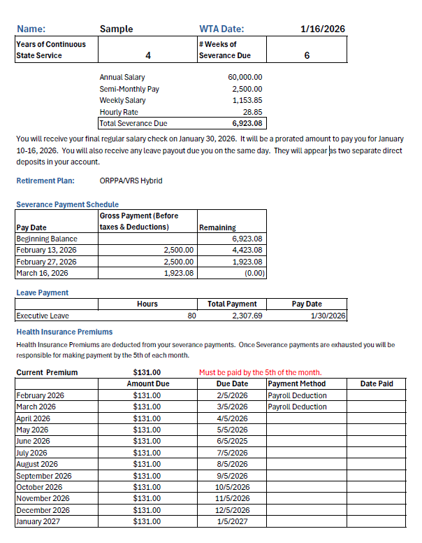
Workforce Transition Act Final Payments Continuation of Health & Group Life COBRA

Slide 7
Agency Appointee Considerations
Work with Agency HR Department
How to apply for classified position and Implications
Leave Policy when going from Appointee back to Classified

Slide 8
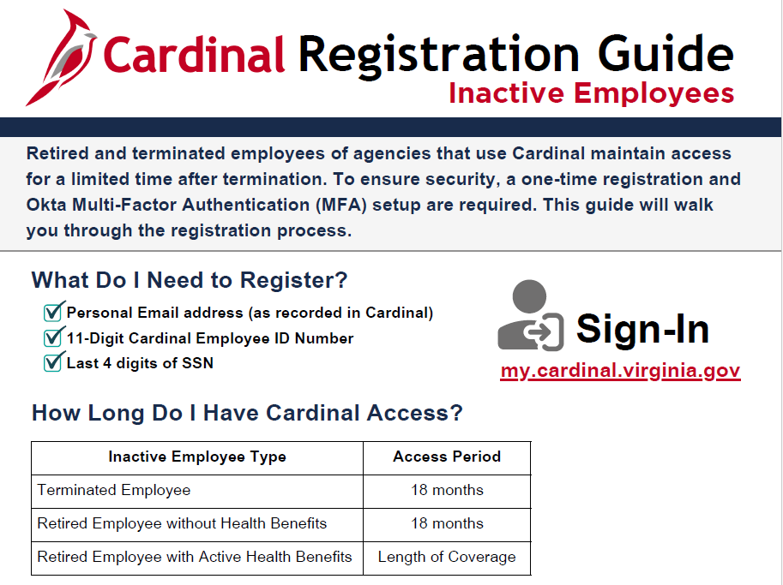
Continued Access to Cardinal - Regina

Slide 9
Resource Links
Executive Leave Policy: https://www.govconnect.governor.virginia.gov/media/govconnect/resources/admin-services/docs/Executive-Leave-Policy-Youngkin-Revised-021825.pdf
DHRM has Executive Resources for off boarding and on-boarding appointees and can be found here: https://www.dhrm.virginia.gov/executiveresources
DHRM WTA Frequently Asked Questions frequently-asked-questions-wta-severance-benefits.pdf
Questions

