Slide 1

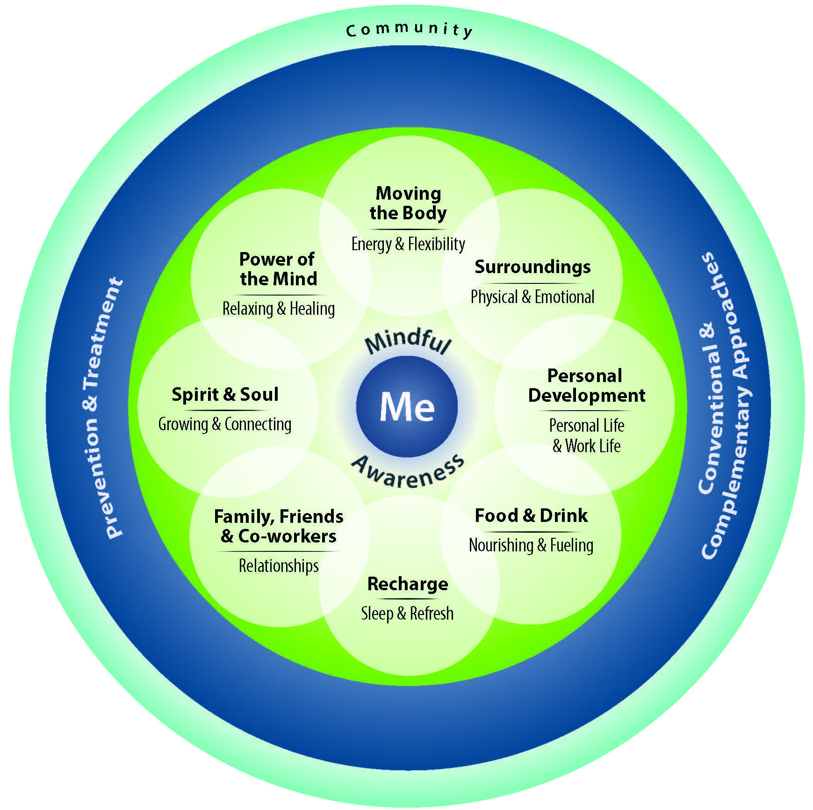

VA ECHCS Annual
Healthy Living Fair
Tuesday, September 8th
9:30am-2:00pm
Lawn next to the Flags entrance
VA Rocky Mountain Regional Medical Center
20+ Interactive VA & Community Partner Booths
All are welcome to attend
Interested in hosting a booth related to HEALTHY LIVING?
Complete the survey by August 31st: https://www.surveymonkey.com/r/2026HLF_ECHCS

