Slide 1
Avaya One-X Agent Dial Pad setup
Opening the Avaya dial pad
Opening the Menu/options
Selecting the favorites button
Select the queue calls option
Expanding the dial pad

Slide 2
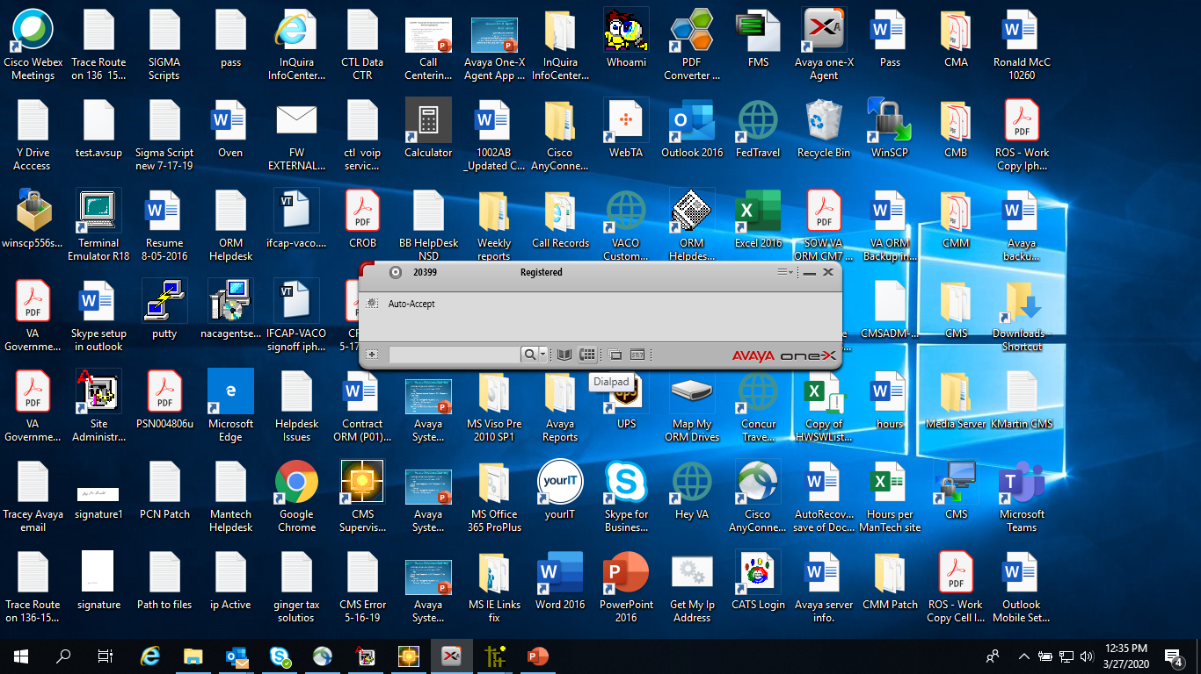
Opening the dial pad
Click on the dial pad at the bottom of the Avaya app

Slide 3
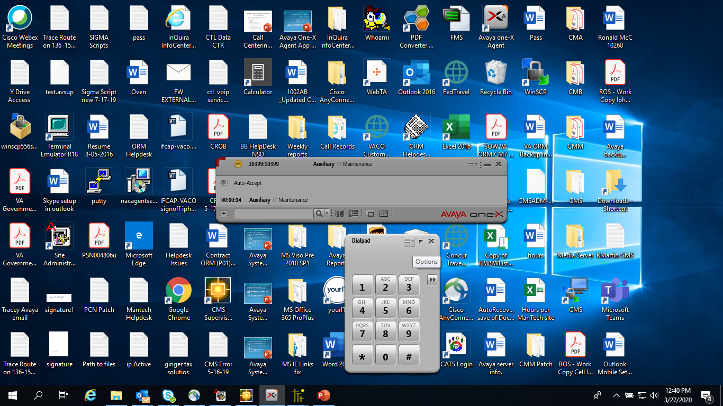
Select options in the upper right hand corner

Slide 4
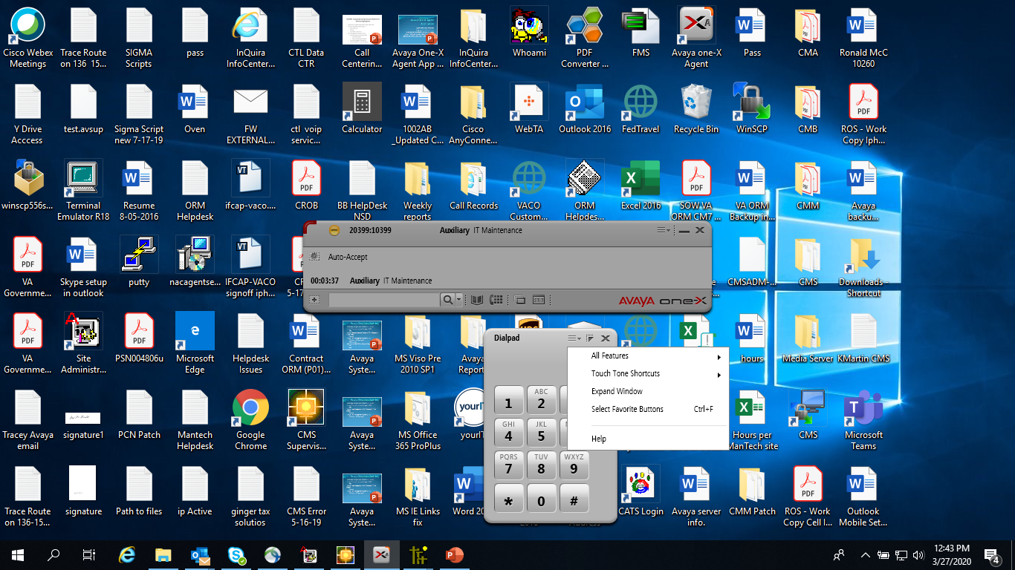
Select favorites button

Slide 5
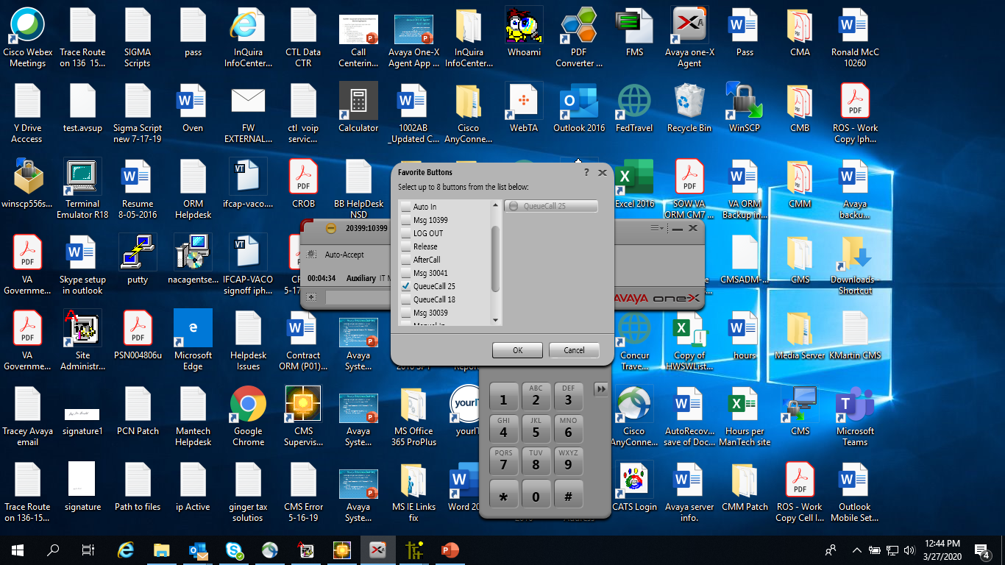
Select queue call

Slide 6

Click on Ok

Slide 7
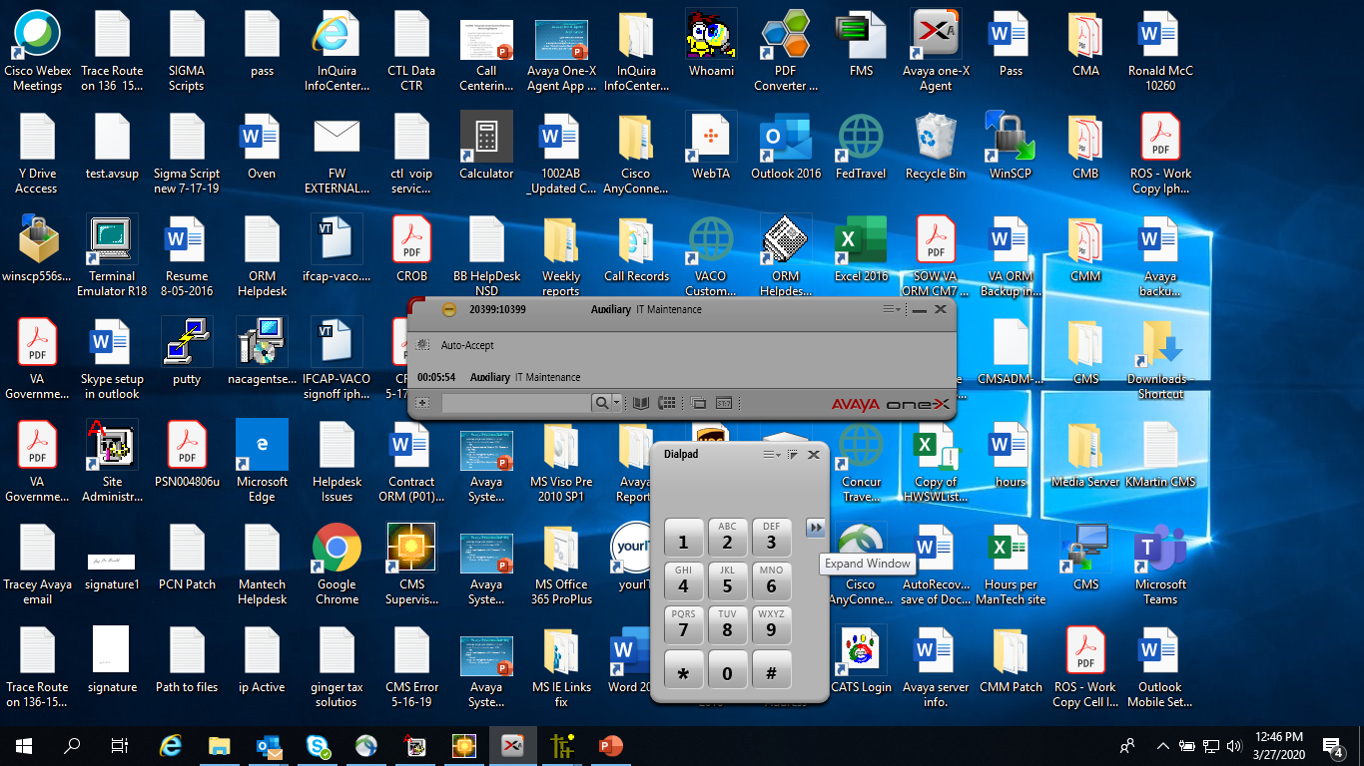
Expand the window/dial pad

Slide 8
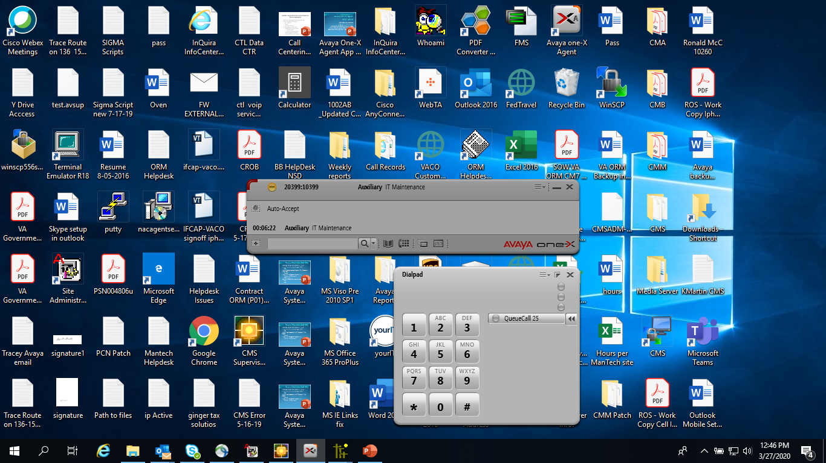
Dial pad will now display the calls in queue indicator

