Slide 1

Fiscal Year 2025 Notice of Funding Opportunity
Resident Opportunity & Self-Sufficiency Program

Slide 2
Today’s Agenda
Program Overview
Award Information
Changes from Previous NOFOs
Eligible Use of Funds and Funding Requests
Eligibility Requirements
How to apply
Other Tips and Resources
Notes:
Today’s agenda will cover the following items major items. Additionally, we will go over a number other pertinent NOFO related matters. As you can see the agenda is pack so let’s jump right into today’s presentation

Slide 3
Award Information
Approximate Funding Available: $40 million
Application Deadline: December X, 2025
Eligible Applicants:
Public Housing Authorities (PHAs)
Resident Associations
Tribes/Tribally Designated Housing Entities
501(c)(3) Nonprofit Organization
Multifamily Owners
Applicants must apply to either serve public housing , RAD PBRA, RAD PBV, or NAHASDA-assisted residents. See NOFO for details on eligibility requirements.

Slide 4
MAXIMUM AWARD INFORMATION
HUD will fund a maximum of 3 ROSS-SC positions per PHA/tribe/TDHE/MF Owner
See Section II of the NOFO for eligible number of positions and applications based on your applicant type.
Number of PHA/tribe/TDHE Units | Max # of ROSS-SCs | Max Grant
50-1,000 | 1 | $272,250
1,001-2,5000 | 2 | $544,500
2,501 or more | 3 | $816,750
Notes:
This slide again covers the max yearly amounts and the number of units that would need to be served and the impact on the number of coordinators.

Slide 5

PROGRAM OVERVIEW
ROSS is a place-based program that targets the entire resident community
It's designed to assist residents with making progress towards self-sufficiency goals.
This funding supports the role of a ROSS-SC.
The ROSS-SC assesses resident needs and links them to supportive services and activities
Notes:
The ROSS program is a place-based program that focuses on the entire community of the project or projects to be served. Your program should address areas of need on both the individual and community level. The ROSS program fund service coordinators work to develop local strategies to remove barriers to self-sufficiency and challenges for residents to age in place

Slide 6
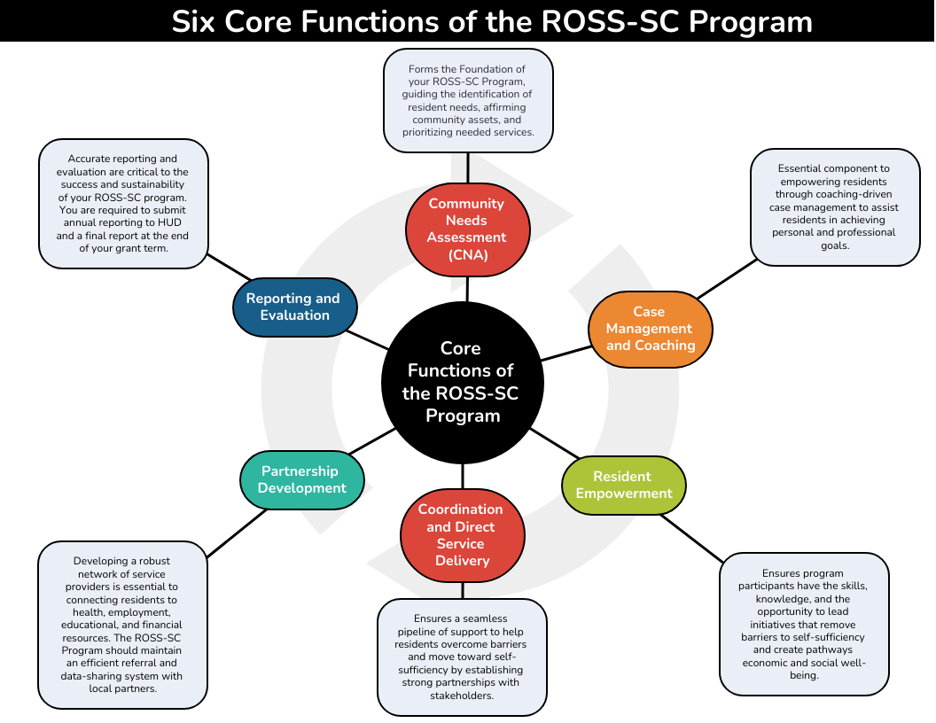

Slide 7
CHANGES FROM PREVIOUS NOFOs
Increased Funding Flexibility for Salary and Fringe Benefits. In prior NOFOs, the maximum amount for salary and fringe benefits was $80,000. Under this NOFO, applicants may request up to the maximum grant amount for salary and fringe benefits.
Salary Comparability Information. Salary comparability information is NOT required to be submitted with your application. Instead, HUD will use the median salary information from the BLS locality pay data, with 30 percent added for fringe benefits. See Section IV.B. in the NOFO for more information.
U.S. Bureau of Labor Statistic Job Title. HUD will use the U.S Bureau of Labor Statistics (BLS) job title “Social Worker: Other” occupation at the median level in your zip code to determine salary comparability information. See Section IV.B. in the NOFO for more information.
Rating Factor Criteria. The rating factor criteria have been revised providing additional guidance on criteria. In addition, HUD adjusted the point maximums for criteria. See Section V.B. for more information.
Renewal Applicant Definition. Renewal applicants are FY20, FY21 and FY22 ROSS grantees
See NOFO for other changes from previous NOFOs
Notes:
Salary Comparability Information. In previous NOFOs, applicants were asked to submit salary comparability information from different sources with their application. Under this NOFO, salary comparability information is NOT required. Instead, salary information will be taken from the BLS locality pay data, plus 30 percent added for fringe benefits.
Salary Location. For this NOFO, your salary location is based upon your agency’s ZIP Code that you submit in your application. You will use this ZIP Code to determine your salary maximum with BLS, per Section I.A.2.b.1. If there is no salary information for your ZIP Code in BLS, then HUD will use the median regional or balance of state information. If there is no salary information for your regional or balance of state information in BLS, then HD will use the United States’ median salary information. BLS may use regional or subdivided state averages to obtain a median salary. NOTE: BLS refers to these averages as median "regional" or "balance of state.“
Under this NOFO, grantees may submit a budget modification request to use anticipated unexpended funds from the salary/fringe budget line item (BLI) to pay for direct services, for up to 20 percent of the grant. The amount allocated for direct services may only exceed 10 percent of salary/fringe and travel/training for grantees if a budget modification has been successfully submitted and approved by HUD.

Slide 8

Funding Requests
Applicants may request funding for the following budget line items:
Salary and Fringe Benefits
Only for the salary and fringe of the ROSS-SC.
Salary and fringe funding request must be supported by BLS data.
Training and Travel
Training and Travel Costs must be for the professional and/or program development of the ROSS-SC.
The maximum amount is $2,500 per year.
Administrative Costs
Funds may only be used to support the ROSS Program.
Request ONLY the amount you need.
The maximum funding for administrative costs may not exceed 10% of the combined salary/fringe and training level amounts per position.

Slide 9
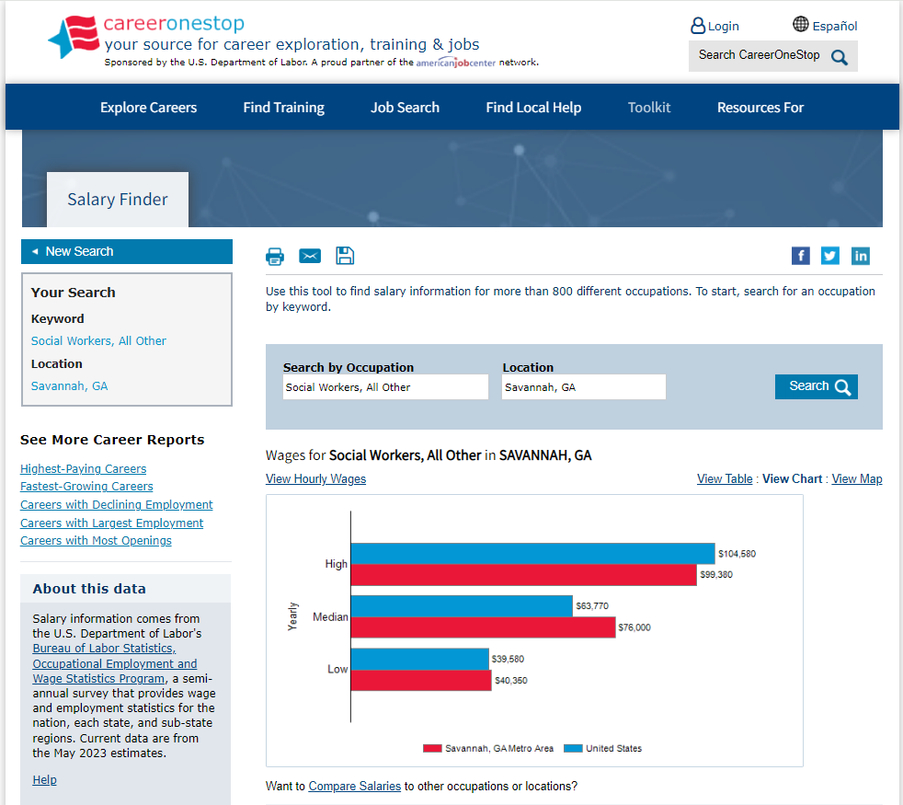
BLS Data for Salary Determination
Screenshot of United States’ median salary information from BLS
Notes:
This slide show you how the bls website appear and how to look up the community and social service occupation

Slide 10
DETERMININING ELIGIBLE AMOUNT FOR ADMINISTRATIVE COSTS
STEP 1
Salary and Fringe Amount, if
STEP 2
Training/Travel Cost Amount:
$2,500 (training cost per year) multiplied by 3 (number years of grant term) = $7,500 (total training cost)
STEP 3
Administrative Cost Amount
10% (administrative cost percentage) of $257,500 (total salary/fringe plus training cost) = $25,750 (administrative cost amount).
STEP 4
Total Award Amount = $272,250
257,500 (total salary/fringe and training cost) plus $25,750 (administrative cost) = $272,250 (total award amount)
$80,000 (salary/fringe per year is requested) multiplied by 3 (number of years of grant term) = $250,000 (total salary/fringe amount)
Notes:
This slide helps you understand how to determine the amount for administrative costs and is hypothetical (because you can use your entire grant amount for salary and fringe as mentioned before. Using $80,000 per year, multiplied by 3 years of grant funding would give you $250,000. Training and Travel costs at $2.500 x3 would give you $7,500. 10percent of $257,500 would give you $25,750. With those numbers your total award amount would be $272,250

Slide 11
Maximum Number of Applications
Applicant type | Maximum Number of Applications | Renewal or New Applicant Category
PHAs | 1 | New or Renewal
PHA Affiliates/Instrumentalities not applying as a Multifamily Owner | 1 | New or Renewal
Tribes/TDHEs | 1 | New or Renewal
Site Based RAs | 1 | New or Renewal
Non-site-based RAs (i.e., city-wide, intermediary, and jurisdiction-wide) applying under the 25 percent RA set-aside | 1 | New or Renewal
Non-site-based RAs (i.e., city-wide, intermediary, and jurisdiction-wide) not applying under the 25 percent RA set aside | Up to 3 | New or Renewal
Nonprofit applicants that are not a RA, PHA Affiliate/Instrumentality, or Multifamily Owner | Up to 3 | New or Renewal
Multifamily Owners | 1 | New
Notes:
This information is covered in greater detail in the NOFO but shows the maximum number of applications you can submit based on your applicant type

Slide 12
Threshold Requirements
Timely Submission of Application: You must submit your application by the application deadline.
Civil Rights Matters: If you have outstanding, unresolved violations, you must resolve by the application deadline.
Match Requirement: You must have match contributions of at least 25% of the amount you are requesting.
Letters of Support: Nonprofit organizations and non-site-based Resident Associations (RA) must include a letter of support from either PHA and/or tribe/TDHE. Additionally, joint applications must submit a letter of support from each joint applicant.
Nonprofit Status: RA, PHA affiliates/instrumentalities, and nonprofits must either a locally incorporated nonprofit or a 501 (c)(3) nonprofit by the application deadline.
Contract Administrator: RAs and Troubled PHA applicants must submit a contract administrator partnership agreement.
Narrative Statement: You must submit a ROSS narrative statement
HAP Contract: Multifamily Owners and PHAs applying to serve RAD-PBV must submit the HAP contract for each RAD PBRA and RAD PBV project listed on HUD-52768.
PBRA Troubled Assets: Multifamily owners must have a risk rating of 4 or higher in IREMS
FY23 and FY24 ROSS Grantees are ineligible for funding under this NOFO.
Notes:
Threshold requirements are application requirement(s) that MUST be met at time of application. We cannot request clarifying information during the application review period for threshold requirements. And your application will be deemed ineligible

Slide 13
Resident Needs Assessment Requirement
You must complete a resident needs assessment for the project(s) included in your FY25 ROSS application.
You are not required (although encouraged) to use the Sample Community Needs Assessment (Appendix A).
There must be at least a 20% response rate of the households that reside in projects included on the HUD-52768.
The results of the needs assessment must be included in the narrative statement and the HUD-52768. See section V.A of the NOFO for more information.
If you don’t use the Sample Needs Assessment, you must submit the needs assessment tool you used.

Slide 14
RENEWAL APPLICANTS – Rating Factor 1
Past Performance & Capacity (50 points): Renewal applicants may receive up to 50 points for this rating factor. HUD will assess your past performance in implementing prior grant activities to determine your capacity to successfully execute an FY25 ROSS grant award.
  Achievement in Serving Residents (up to 20 Points). HUD will assess the number of residents served during your grant term.
  Timely Use of ROSS-SC Grant Funds (up to 10 points). You will receive up to 10 points based on the timely expenditure of FY20, FY21, or FY22 ROSS-SC grant funds.
  Data Availability of Score. HUD will evaluate the completeness of your submitted reports under your FY20, FY21, or FY22 grants
Notes:
2. Capacity to Meet ROSS Program Requirements (15 points)
Achievement in Serving Residents (up to 10 Points).

Slide 15
NEW APPLICANTS – Rating Factor 1
Past Performance & Capacity (50 points): New applicants may receive up to 50 points for this rating factor. HUD will assess your past performance and capacity by evaluating responses to criteria below
  Describe your experience within the past five years in receiving and implementing grants aimed at delivering supportive services to HUD-assisted and/or low-income families. ( up to 5 points)
  Describe your achievements over the past five years in delivering supportive services to HUD-assisted and/or low-income families. (up to 10 points)
  Describe your organization’s experience providing case management to HUD-assisted and/or low-income families. (up to 8 points)
  Describe your experience using a data driven approach to report program activities and outcomes to your organization’s leadership, board members, and funding entities.(up to 7 points)
  Describe your experience engaging in and supporting HUD-assisted and/or low-income families with multiple barriers to self-sufficiency. (up to 10 points).
Notes:
I won’t read all of this be have it here to really highlight we is being requested for the rating factors. Please review the NOFO in this area

Slide 16
Soundness of Approach: Rating Factor 2
Soundness of Approach (45 points total): A narrative response is required for this rating factor from renewal and new applicants. The Narrative must include:
    Needs Assessment and Resident Response (up to 4 point)
    Use data to describe the results of the needs assessment (up to 6 point)
    Describe how your ROSS program will align partners to address each of the selected area(s) of need (10 points)
    Describe how your ROSS program will remove barriers of residents ( up to 5 points)
    Describe how your ROSS program will track the outcomes of residents including Key Performance Indicators (KPIs) for each of your selected areas of need– (up to 6 points)
    Describe how you will empower residents to move along the self-sufficiency continuum ( up to 10 points)
    Describe how the staffing at your agency, including your organization’s leadership, will support the ROSS-SC program (up to 4 points)
Notes:
Applicants will receive 20 points for providing a clear written summary describing the results of the needs assessment conducted in support of the application and how the applicant will address the identified needs. The results of the needs assessment must support the applicant's chosen area(s) of need: Digital Inclusion, Education, Employment, Financial Literacy, Reentry, Health and Wellness, Elderly/Persons with Disabilities, and/or Substance Use. The chosen area(s) of need must be clearly identified on the HUD-52768.

Slide 17
Bonus Points: Rating Factor 3
Bonus Points: You may earn up to 5 bonus points by providing additional information below. To earn bonus points your narrative must
  Alignment of Match contribution with Area(s) of Need (up to 3 points): To receive three bonus points, your match contributions must directly align with the area(s) of need selected in your application.
  Case Management Software for Supportive Services (up to 2 points): To receive up to two bonus points, you must provide the name of the case management software, the year you acquired the software, identify the staff who have access, and confirm software will be used for the ROSS program.
Notes:
TREY

Slide 18
Eligibility Score and Funding Priorities
Minimum Score Eligibility for Funding | 60
Maximum Score Eligibility | 100
HUD will fund eligible applicants as prioritized below
Funding Category 1: Resident Association Applicants 25% set-aside
Funding Category 2: Renewal Applicants
Funding Category 3: New Applicants
Within each fund category, HUD will fund in ranked order starting with the highest review score
Applicants that earn less than 60 points are not eligible for funding.

Slide 19
IMPORTANT APPLICATION REMINDERS
HUD-52768 – The HUD-52768 form continues to be a required document that all applicants must complete and submit.
Project Number and Unit Count - The project must be correct on the HUD-52768 form to determine eligibility.
Unexpended Balance Threshold - Renewal applicants that have an unexpended balance of 60% or more of their FY20-22 funds by the application deadline are ineligible for FY25 funding.
Narrative Requirement – All applicants, new and renewal, must submit a narrative statement. Follow the NOFO outline and answer only what is being asked.
Resident Needs Assessment - All applicants are required to complete a resident needs assessment with a minimum response rate of 20% of the residents living in the project(s) you intend to serve. A sample is provided in the FY2025 NOFO.
SAM Registration: You must have an active UEI and SAM registration to receive funding. Additionally, the UEI and EIN included on the SF-424 Form and HUD-52768 must be for the lead applicant listed on the HUD-52768.
Notes:
The HUD-52768 form is part of the grant application

Slide 20
WORKSPACE AND USEFUL GRANTS.GOV LINK
You are submitting your application through Workspace on Grants.gov.
Go to the following link for a step-by-step guide to applying using grants.gov: https://www.grants.gov/applicants/grant-applications/how-to-apply-for-grants
Workspace: https://www.grants.gov/applicants/workspace-overview/

Slide 21
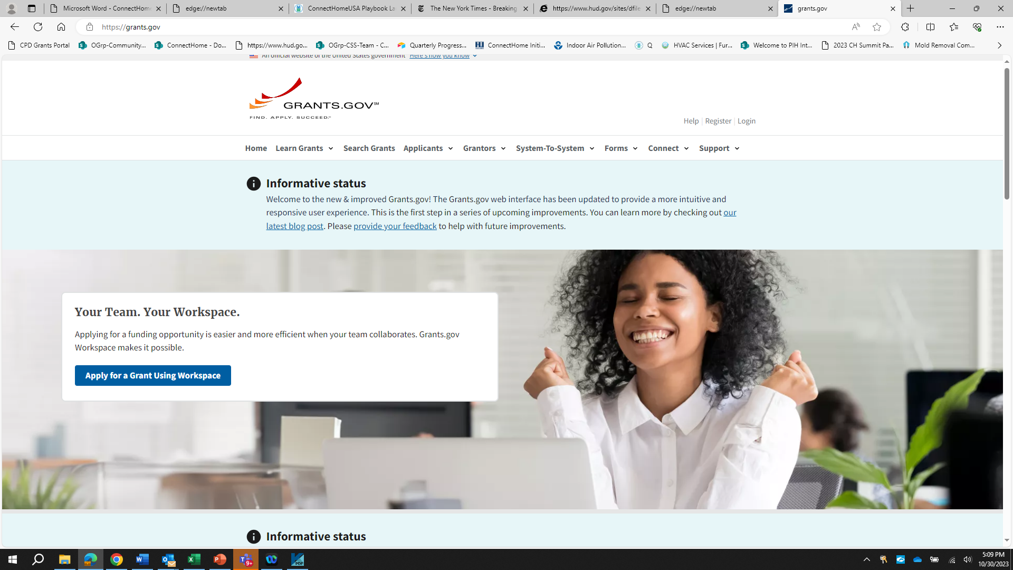
HOW TO ACCESS THE APPLICATION
Go to: https://www.grants.gov/search-results-detail/354625; or
https://www.grants.gov/search-grants and Click on “Search Grants” Tab
  Easiest way to locate the application is by CFDA #: 14.870
Notes:
First in accessing the application. You can use the link here or go to grants.gov and search for

Slide 22
APPLICATION TIPS
1. Read the FY25 ROSS NOFO carefully and thoroughly.
  This will ensure that mistakes are not made.
  Create a checklist!
  Every year, avoidable mistakes are made which lead to ineligible applications.
2. Start Now!
3. Review Your Application Prior to Submission.
  Get a second set of eyes to review your narrative and application.
Notes:
Dina

Slide 23
Contact Information
ROSS-PIH@hud.gov
To join the ROSS Mailing List: https://public.govdelivery.com/accounts/USHUDPIH/signup/32525
About ROSS:
https://www.hud.gov/program_offices/public_indian_housing/programs/ph/ross/about
For Technical Assistance Resources Go to the ROSS HUD Exchange Page:
https://www.hudexchange.info/programs/ross/
Notes:
We have come to the end of the presentation

Slide 24

Thank you for your participation and…
GOOD LUCK!
Notes:
We have some slides in the appendix with important information

