Slide 1
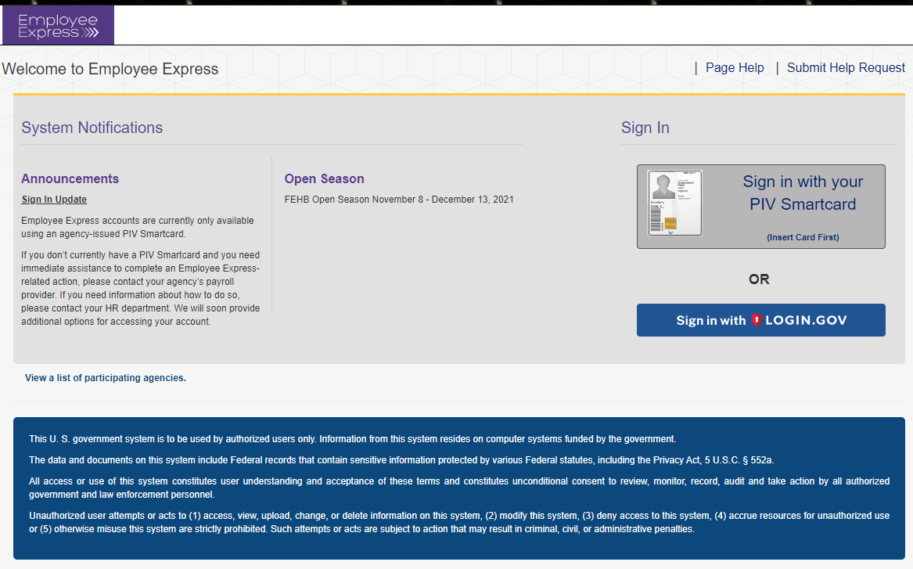
Employee Express The new way of signing in
You will have two methods to sign into EEX
Sign in with PIV Card
Sign in with Login.gov

Slide 2
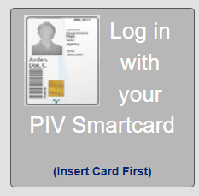
Logging in with your PIV Card
This method will require the use of your PIN Number
Insert your PIV card and then click on “Log in with your PIV Smartcard”

Slide 3
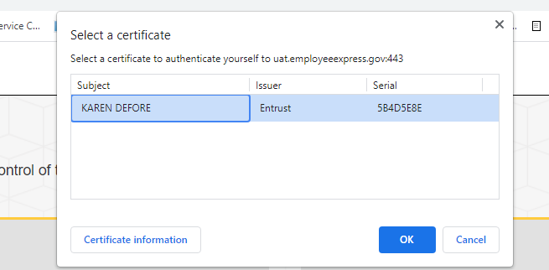
If you select PIV, you will be asked to select your certificate
Select a Certificate
YOUR NAME
Some browsers may show more than one certificate to pick from
Then click OK

Slide 4
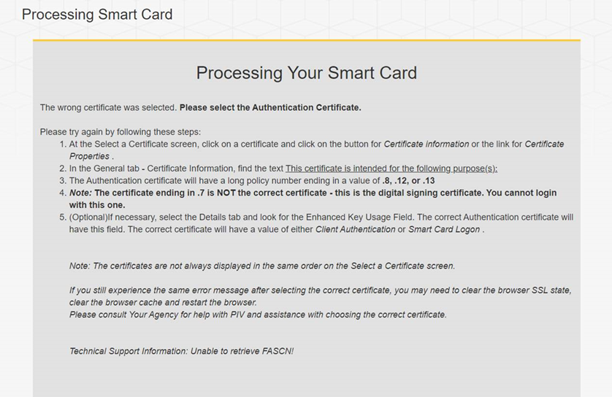
If you select the wrong certificate, you will receive this message

Slide 5
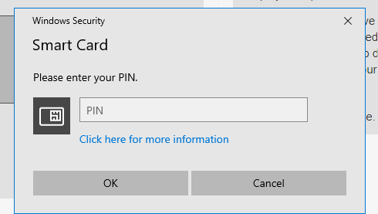
Enter your pin number and click “OK”
Enter your PIN
Click “OK”

Slide 6
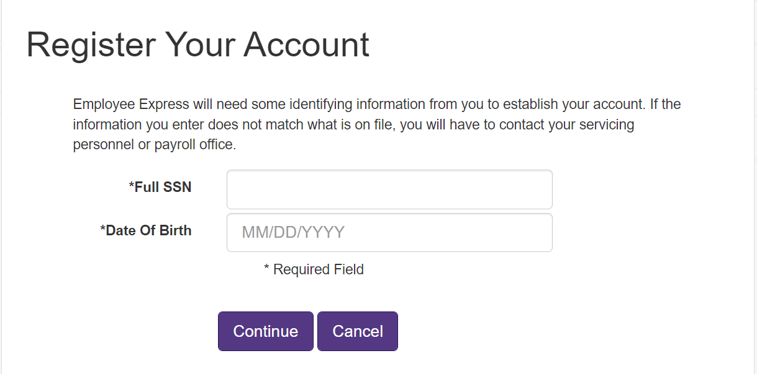
You have to register your PIV/Smartcard to gain access to your EEX Account
If you are currently registered on EEX to use your PIV, you will not see this screen
Enter your full SSN
Enter DOB as Shown

Slide 7
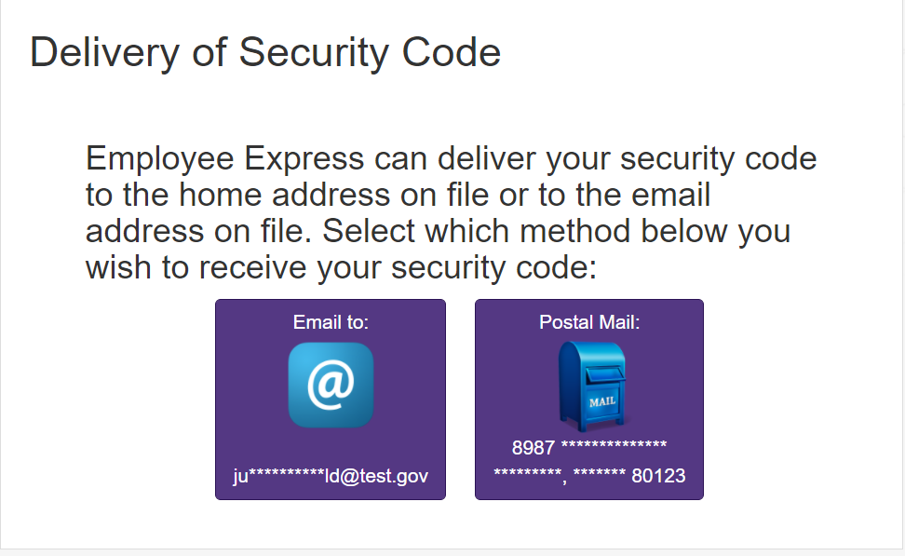
A Security code will be generated and sent to you to confirm your identity
Select your delivery method. If EEX only has an address on file, that will be your only option to receive your security code. This code will expire so please use it as soon as you receive it.

Slide 8
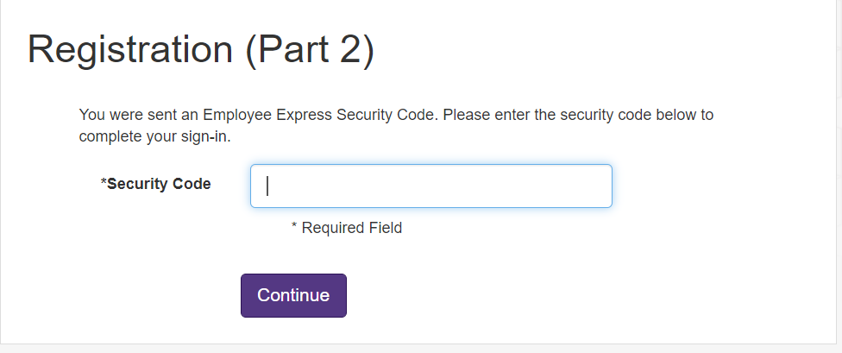
Enter the Security Code sent via email or postal mail – 2nd Security Code

Slide 9
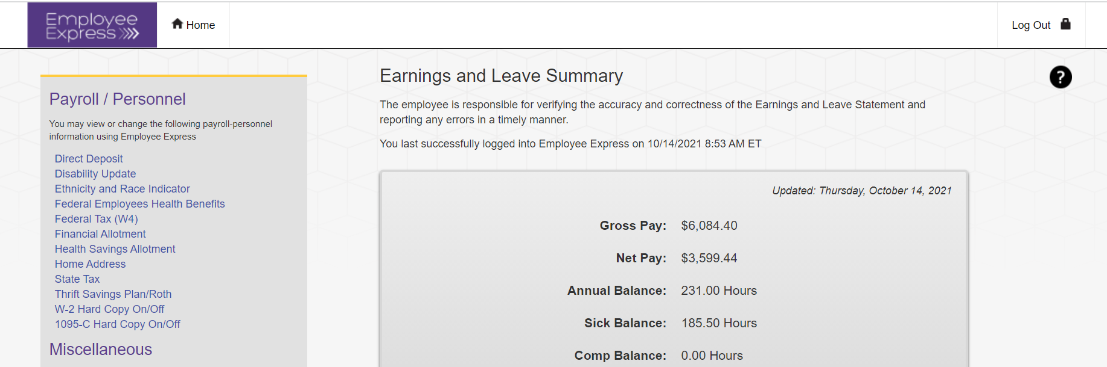
You are now in your EEX Account
Now you are in your EEX Account

Slide 10
Always click the log out link to close your Session and Protect your data

