Slide 1
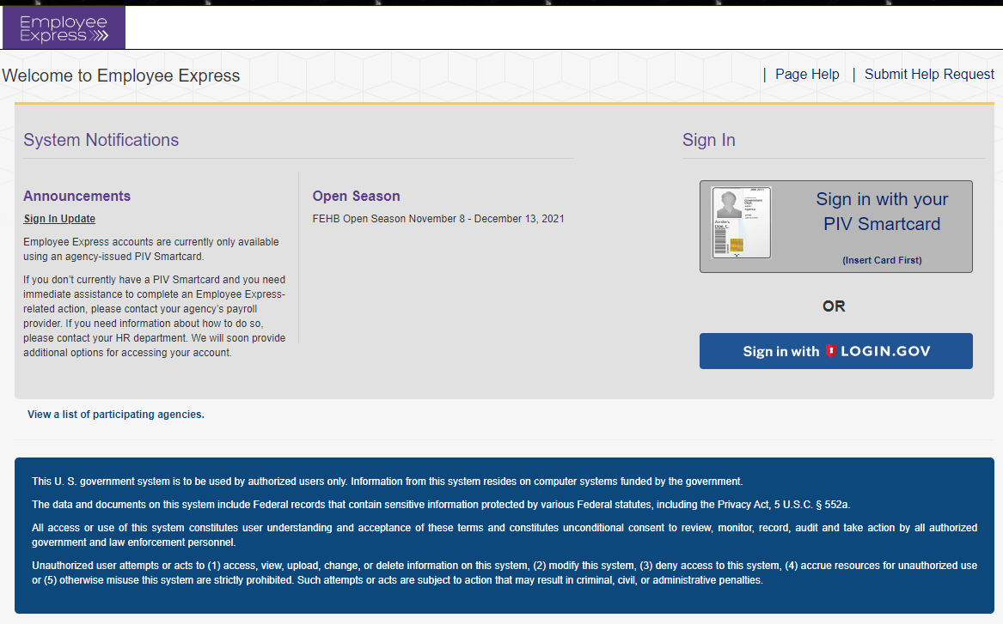
Employee Express The new way of signing in
You will have two methods to sign into EEX
Sign in with PIV Card
Sign in with Login.gov

Slide 2
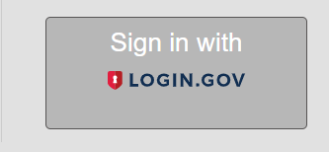
Signing in with Login.Gov
If you select Login.gov ……..

Slide 3
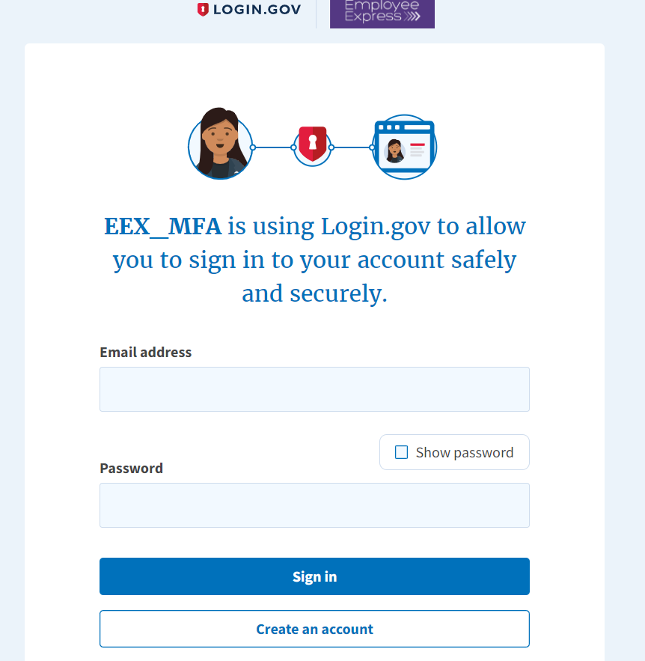
If YOU have an EXISTING Login.gov YOU can use that account and do not have to create a new account. Simply enter that account and sign in.
You will be directed to the “Create An Account” page
Enter your email address
Click create an account

Slide 4
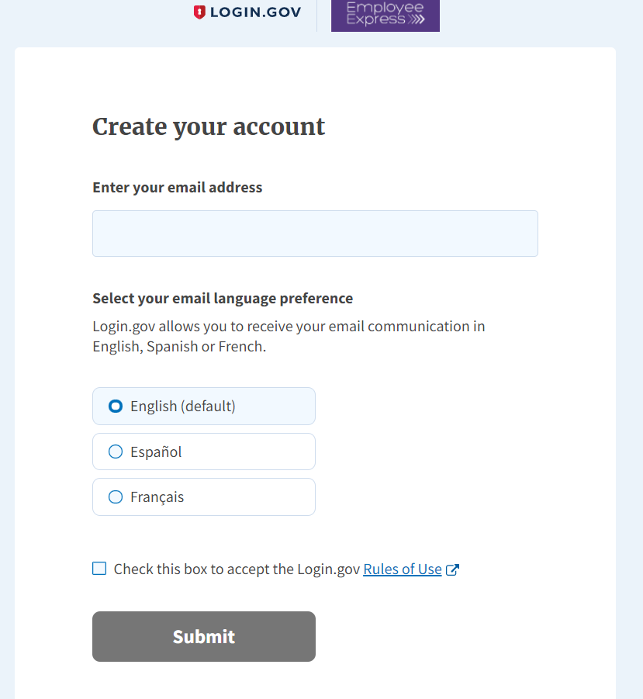
Enter you Email Address
Select your email Language Preference
Be sure to check the box “Accept the Login.gov Rules of Use”
Then click “Submit”

Slide 5
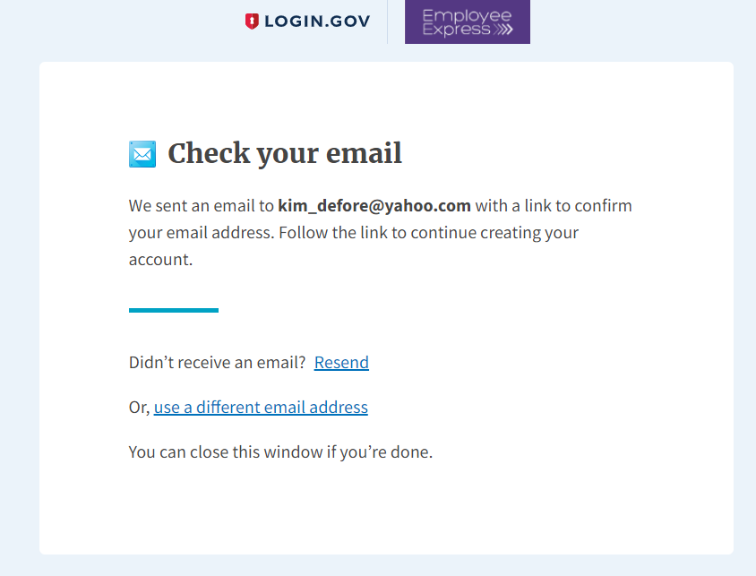
You will receive an email to the email address you entered for your account set-up

Slide 6
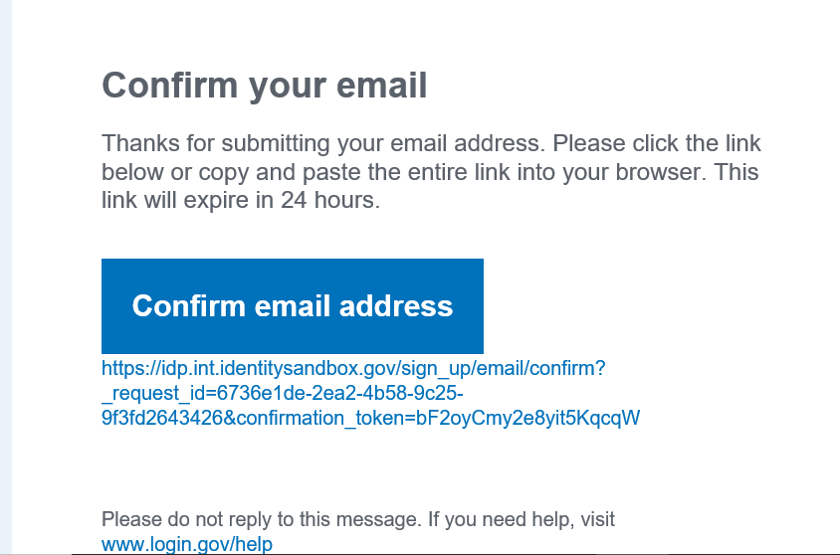
This link is only good for 24 hours
You will need to confirm your email by clicking on the blue “Confirm Your Email” box

Slide 7
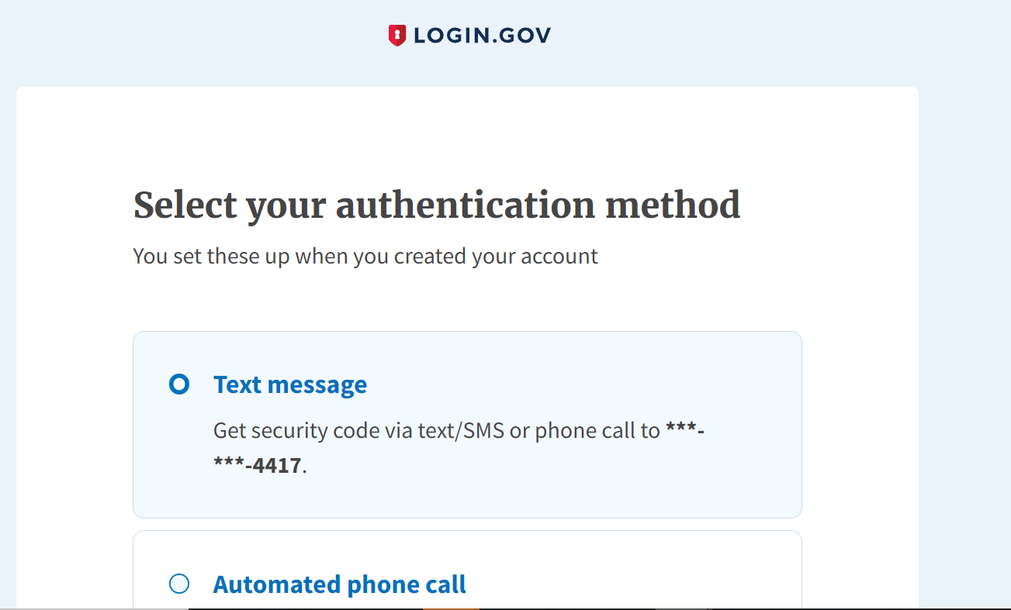
Please choose only one authentication method

Slide 8
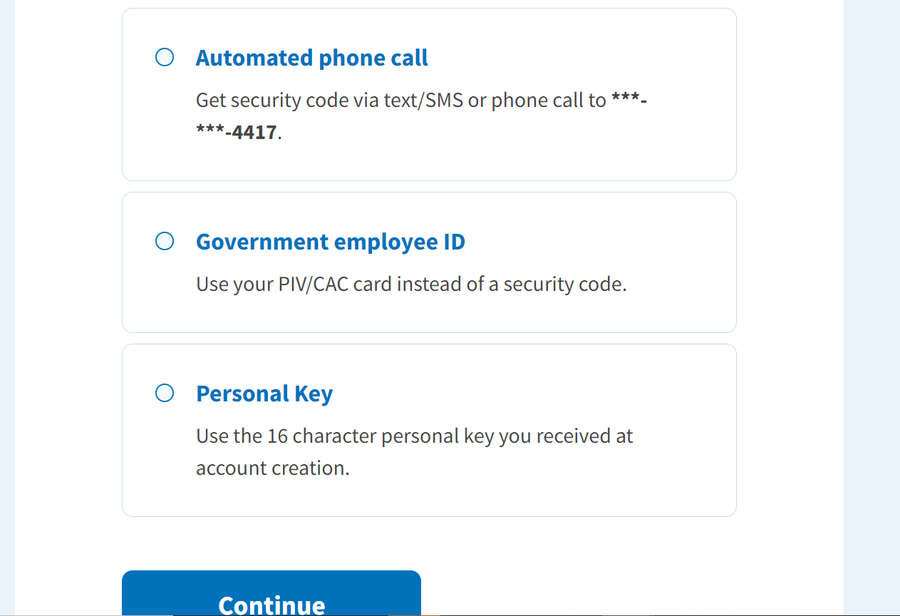
Then click the “Continue” button

Slide 9
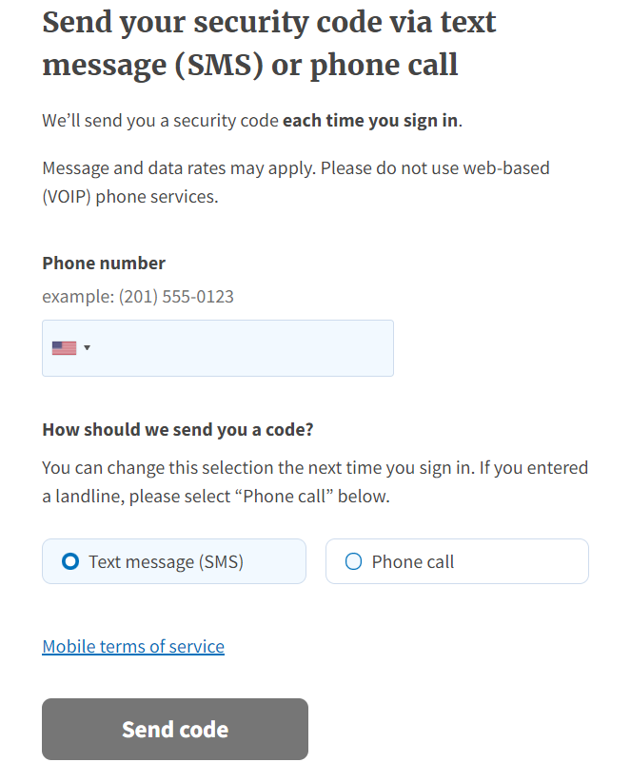
Type in phone number
Click Text Message or Phone call
Click “Send Code”

Slide 10
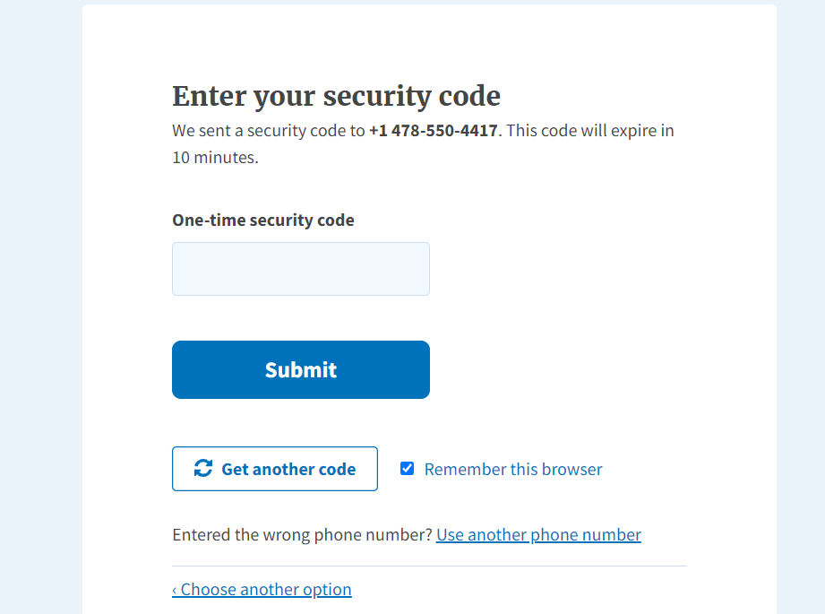
Type in One Time security Code
Click Submit

Slide 11
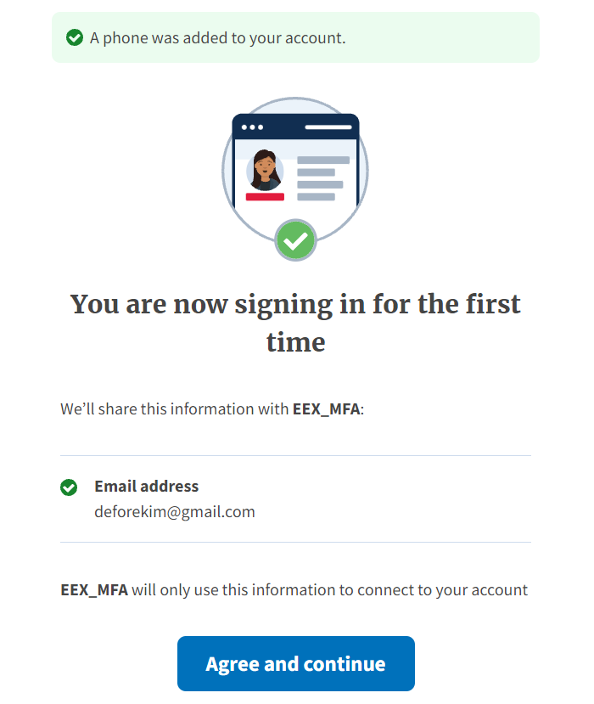
Click “Agree and Continue”

Slide 12
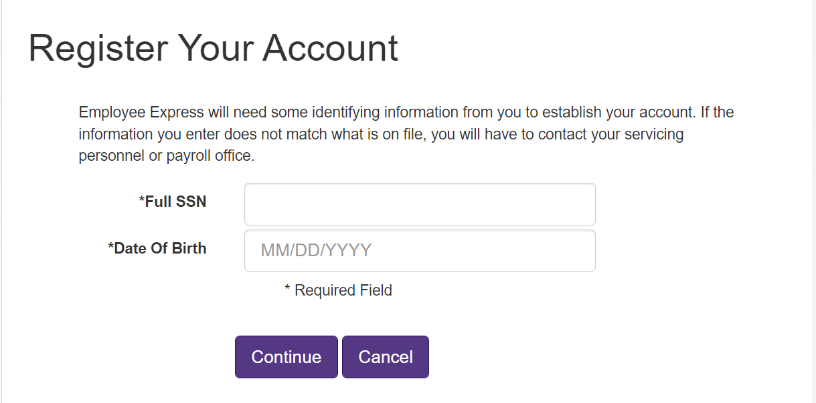
You will now tie the Login.gov account to your EEX Account
Enter your full SSN
Enter DOB as Shown

Slide 13
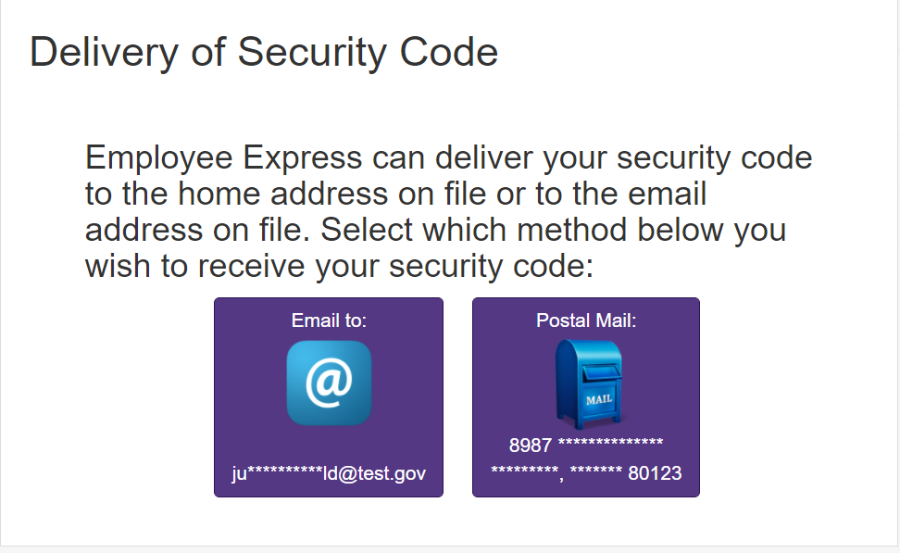
A Security code will be generated and sent to you to confirm your identity
Make your selection

Slide 14
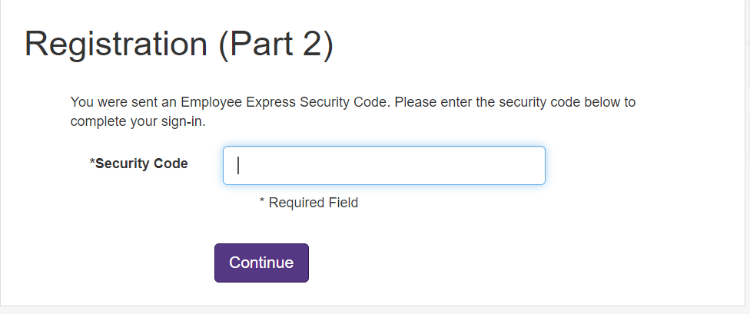
Enter the Security Code sent via email or postal mail

Slide 15
You are in your Employee Express Account
You are now in your account using Login.gov

Slide 16
Always click the log out link to close your Session and Protect your data

