Slide 1
WTTS/EODS Users Group June 17, 2021
Virtually Hosted by the Interior Business Center (IBC)
Lakewood, Colorado
WebEx URL: https://doilearn2.webex.com/mw3300/mywebex/cmr/cmr.do?siteurl=doilearn2&AT=join&username=lorraine_m_manzanares
WebEx Telephone Number:
(415) 527-5035
Access code:
903 081 094 #
(Not needed if the WebEx Call Me or Call-In feature is used)
Lynn Tovsen, Chief, HR Management Systems Division
Jody Elkins, Chief, HR Systems Management Branch

Slide 2
Agenda
11:00 - 11:05 Welcome, Introductions
11:05 – 11:15 Agenda/Review Action Items
11:15 – 11:30 Management Topics
11:30 – 12:00 MuleSoft Update
12:00 – 12:20 Review Release 20.3e & 21.1
12:20 – 12:30 Break
12:30 – 1:00 Preview Release 21.1e & 21.2
1:00 - 1:15 EODS Recertification Update
1:15 - 1:30 AWTS - Affiliate Workforce Tracking System Update
1:30 – 2:00 HRMS Security Update
1:45 - 2:15 Agency/Customer Forum topics
2:15 Review new action items – Wrap Up!

Slide 3
Review Open Action Items

Slide 4
HRMSD Management Topics
Lynn Tovsen, Chief, HR Management Systems Division (HRMSD)

Slide 5
HRMSD Management Topics
Welcome WTTS User Group
HRSIF Updates on MuleSoft
MuleSoft – coming soon!
HRMS Security update
WTTS/EODS
Operations & Maintenance

Slide 6
WTTS/EODS
Operations
WTTS Team Supports System Operations/Maintenance:
Daily system checks
Monitoring of FPPS nightly integration job
Monitoring WTTS Subject Area in OBIEE (data feed, etc.)
Monitoring of eOPF forms sent
Daily help desk ticket monitoring
Monitoring of stopped transactions (RFEs, Send to eRecruit)
Monthly meetings with CSC for Tier 1 training issues
Maintain WTTS Training environment for agency use
Daily monitoring of logging issues with Web Services Interfaces
Continuous WTTS release activities (Analysis, Testing, etc.)
Daily assurance of Systems Operations for 32+ Agency clients is conducted by the same team as CR enhancements and operational maintenance/data requests.

Slide 7


Questions ?

Slide 8
Mulesoft Update
Mark Stover, Chief, Systems Engineering and Administration Branch, Human Resources Management Services Division (HRMSD)

Slide 9
Mulesoft Update
What is MuleSoft?
MuleSoft is a software product that we are using to replace our current BUS
Allows us to build methods to exchange data between additional systems
Allows us to reuse these methods for future projects
Allows us to expose data needed by clients in secure ways
All new APIs (Application Programming Interfaces) go into library for future use in other projects
Decreases the time needed to create an interface

Slide 10
Mulesoft Update
Current Status
Entire current BUS is duplicated in our Test environment
Testing with WTTS staff is ongoing to ensure all services work
Run in old BUS, run in Mulesoft then compare results
Ran stress testing on system utilizing Totara recommended tools
Determined that we have the resources to handle existing load
Determined we will not need to purchase additional licenses
Hope to have remaining testing done by the end of July
Building test bed interface called Behave to connect DOITalent to IdentityIQ for DOI
Testing on-going with DOI but looks good so far

Slide 11
Mulesoft Update
Future Plans
Continuing to Develop Governance Process Documentation
Client onboarding checklists
Agreement documentation
Hope to have this completed by mid Summer 2021
Can begin discussions with clients in late Summer 2021
Looking at possible connections between other internal systems
WTTS to FedTalent
AWTS to FedTalent

Slide 12
Questions ?

Slide 13
Review – WTTS Release 20.3e and 21.1
Jody Elkins, Chief, HR Systems Management Branch

Slide 14
Review Release 20.3e and 21.1
WTTS 20.3e Change Requests (WCRNs)
WCRN-1581 - Add 11/2020 version of the TSP-60 to WTTS/EODS
WCRN-1582 - Add the 1/2021 version of the TSP-1 to WTTS/EODS
WCRN-1588 (TRUNK WCRN-1589) - Add 2021 version of the W-4 to WTTS/EODS

Slide 15
Review Release 20.3e and 21.1
WTTS 20.3e Problem Reports (WPRNs)
WPRN-1416 - Update the Position Sensitivity Drop Downs in WTTS and remove the option for Position Sensitivity Code 0
WPRN-1422 (TRUNK WPRN-1440) - W-4 Extra Withholding amount not arriving in FPPS
WPRN-1424 - W-4 form cannot be sent to FPPS when yes was selected to “Are there more than two jobs?” (Remedy 3652695)
WPRN-1426 - Update the DOT 2730-2 Employee Information Form logic to fix the send to FPPS issue
WPRN-1427 - Update the SF-1199A Direct Deposit (189) Form logic to fix the send to FPPS issue

Slide 16
Review Release 20.3e and 21.1
Continued - WTTS 20.3e Problem Reports (WPRNs)
WPRN-1428 - Update the SF-1199A (25) Employee Information Form logic to fix the send to FPPS issue
WPRN-1430 - Add 20.3 WTTS User's Guide .pdf file to the Help Menu in WTTS
WPRN-1438 (TRUNK WPRN-1439) - Selectee PII Change Report hanging

Slide 17
Review Release 20.3e and 21.1
WTTS 21.1 Change Requests (WCRNs)
WCRN-1546 - Add a New Form for Selective Service Registration in WTTS/EODS
Originally was EEOC agency unique form, has been made available to all
WCRN-1562 - Add the updated NRC Security Ownership Form to WTTS/EODS - Agency Unique Form
WCRN-1564 - Transmit Education Data collected in WTTS to eOPF
Scope adjusted: Transmitting Education Data will be completed via FPPS ENHC0036170 Send SF52s (Request for Personnel Action) to eOPF

Slide 18
Review Release 20.3e and 21.1
Continued - WTTS 21.1 Change Requests (WCRNs)
WCRN-1580 - Adjust WTTS to meet OPM Electronic Signature Block Text requirement (add signee title) [SF-2809 Principle Ticket]
As part of the 2021 EODS Certification, OPM issued a new requirement for signing forms that need to be sent to eOPF. In coordination with the WTTS 21.1 release, beginning Monday April 5, 2021, the Position Title of the HR Representative/Authorizing Official MUST be included next to the electronic signature for future form submissions from WTTS to eOPF. This will affect the following six forms that are sent from WTTS to eOPF:​
FHFA T. Rowe Price 401K Enrollment Form
SF-61 Appointment Affidavits
DG-60 FEHB Premium Conversion Waiver Election
SF-2817 Life Insurance Election
TSP-1 Thrift Savings Plan Election Form
SF-2809 Health Benefits Election Form

Slide 19
Review Release 20.3e and 21.1
Continued - WTTS 21.1 Change Requests (WCRNs)
WCRN-1586 - TECHNICAL WTTS: Update menu and footer with release number/date
WCRN-1587 - TECHNICAL EODS: Update footer with release date
WCRN-1589 (WCRN-1588) - TRUNK Add 2021 version of the W-4 to WTTS/EODS

Slide 20
Review Release 20.3e and 21.1
WTTS 21.1 Problem Reports (WPRNs)
WPRN-1348 - Users are having issues viewing upload docs in Chrome (Remedy 3412104)
WPRN-1431 - Internal Selections and NULL EODS_USERNAME
WPRN-1432 - Disabled forms need to be removed from the system
WPRN-1433/1434/1435/1436/1437 (WCRN-1580) - Adjust WTTS to meet OPM Electronic Signature Block Text requirement (add signee title) [SF-61 / DG-60 / SF-2817 / FHFA T. Rowe Price / TSP-1]
WPRN-1439 (WPRN-1438) - TRUNK Selectee PII Change Report hanging
WPRN-1440 (WPRN-1422) - TRUNK W-4 Extra Withholding amount not arriving in FPPS

Slide 21
Review Release 20.3e and 21.1
Continued - WTTS 21.1 Problem Reports (WPRNs)
WPRN-1441 - TECHNICAL (WTTS): Upgrade to jQuery 3.6.0
WPRN-1442 - TECHNICAL (EODS): Upgrade to jQuery 3.6.0
WPRN-1443 - Cross Service Dialog is Not Appearing Properly
WPRN-1445 - WTTS: Fix irregular cfsqltype values that will prevent the app from working
Reminder: See WTTS 21.1 Release Notes for more details and screen shots for 20.3e and 21.1.

Slide 22
Questions ?

Slide 23
Preview Release 21.1e
Jody Elkins, Chief, HR Systems Management Branch

Slide 24
Preview Release 21.1e
WTTS 21.1e WCRN / WDRN / WPRN
WCRN-1590 - TSP-1 5% Pretax Deduction override option for TSP024 Duplicate Record Exists errors
WCRN-1594 - Update the FEGLI FEHB ... Acknowledgement Form (Form 164)
WCRN-1595 - Add the 2/2021 version of the TSP-1 to WTTS/EODS
WCRN-1596 - Add Aug 2020 version of the OGE Form 450 to WTTS/EODS
WDRN-2655 - Add 21.1 WTTS User Guide .pdf file to the Help Menu in WTTS
WPRN-1448 - W-4 OthAdjDedAmt switched with OthAdjIncmAmt on Web Service

Slide 25
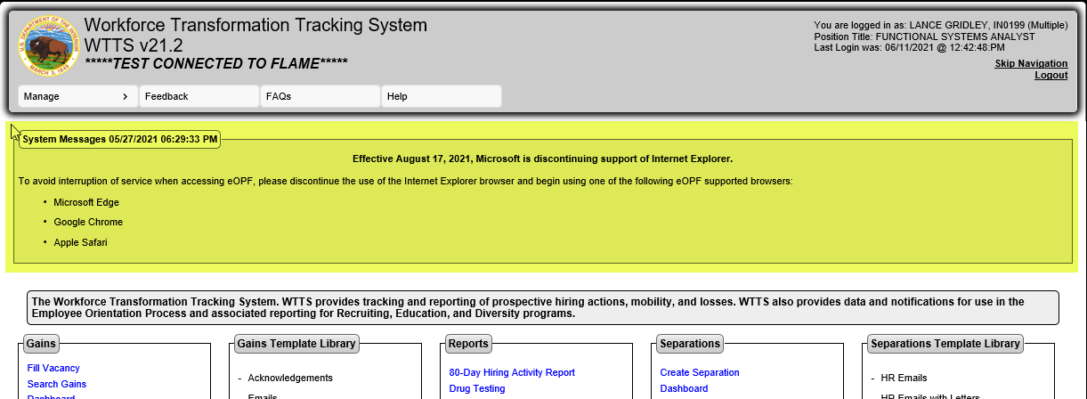
Preview Release 21.1e
WTTS 21.1e WCRN / WDRN / WPRN
WPRN-1451 [WPRN-1452] - Add Custom Notification Message functionality to Main Dashboard in WTTS/EODS
Important Note: Effective August 17, 2021, Microsoft is discontinuing support of Internet Explorer.

Slide 26
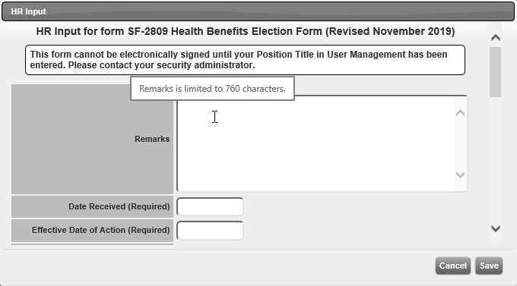
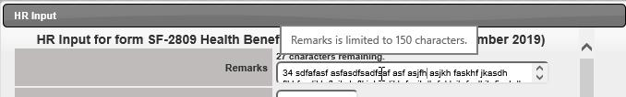
Preview Release 21.1e
WTTS 21.1e WCRN / WDRN / WPRN
WPRN-1453 [WPRN-1454] - Expand HR Input Remarks Field on SF-2809 to align with Fillable PDF
Field has been expanded from 150 characters to 760 (may be helpful for BAL 21-202 if that aligns with Agency business processes).

Slide 27
Preview Release 21.2
Jody Elkins, Chief, HR Systems Management Branch

Slide 28
Preview Release 21.2
WTTS 21.2 Change Requests (WCRNs)
WCRN-1577 - Adjust WTTS/EODS Form retention to be in accordance with NARA and EOD standards (multiple CRs will result from this one CR)
Will discuss in more detail in EODS Recertification Status Update
WCRN-1591 - WTTS/EODS Forms Grid does not reflect current Form status under certain scenarios (where HR Rep and New Hire are using companion systems at same time)
Mulesoft Testing …

Slide 29
Preview Release 21.2
WTTS 21.2 Problem Reports (WPRNs)
WPRN-0991 - Alt Tag for Send RFE to FPPS has a Typo
WPRN-1444 - Extra space in phone numbers in WTTS Template data fields
WPRN-1446 - New Customer Implementation WTTS – Barry Goldwater Scholarship and Excellence in Education Foundation (BGSF)
WPRN-1452 [WPRN-1451] - TRUNK Add Custom Notification Message functionality to Main Dashboard in WTTS/EODS
WPRN-1454 [WPRN-1453] - TRUNK Expand HR Input Remarks Field on SF-2809 to align with Fillable PDF

Slide 30
Questions ?

Slide 31
EODS Recertification - Updates
Lance Gridley, Sr Functional Systems Analyst
HR Systems Management Branch

Slide 32
EODS Recertification
Quick Recap - What is the EODS Recertification?
It is an OPM mandate that requires EOD systems to be recertified every 3 years
The certification is made up of 138 test cases that assure the EOD system is set up to protect the rights, benefits and entitlements of federal employees.
Upon completion, it certifies that the IBC-HRMSD Entrance on Duty System (EODS) complies with all functional, security, auditing, reporting and data retention requirements as defined in the OPM EOD Requirements and other OPM guidance.
This include federal laws and relevant policies (NIST Guidance for Electronic Signatures, 508 compliance, Privacy Impact Assessments, Records Management, System of Record Notices (SORNs), etc.)

Slide 33
EODS Recertification
What is the status of the certification?
The base EODS recertification package was approved by OPM on 2/25/2021 and is active for three years.
Originally, OPM had requested submissions for individual agency packages, with individual signatures, updated forms, updates SORNs, etc. This was to be up to 39 package submissions.
We reached out to OPM on 4/16/2021 to confirm multiple package submissions were still necessary.
On 4/19/2021 we received notice that our base EODS recertification package would act as a blanket approval for all of IBC’s existing and new customers and is good for three years from 2/25/2021.

Slide 34
EODS Recertification
Current Focus
We are actively working on the identified corrective actions
Completed WCRN-1580 (and related WPRNs) with release 21.1
To adjust WTTS to meet OPM Electronic Signature Block Text requirement (add signee title)
Working Part 1 of WCRN-1577 with release 21.1
To adjust WTTS/EODS form retention to be in accordance with NARA and EOD standards
***NOTE: No purging of EODS forms data will be done in Part 1. We will have multiple discussions with the WTTS User Group prior to any form purge activation.
It is expected the full implementation of the data retention standard will be done in 4 parts via 4 WCRNs over multiple WTTS releases

Slide 35
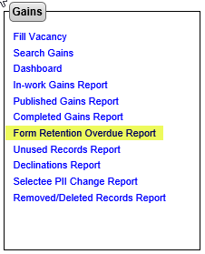
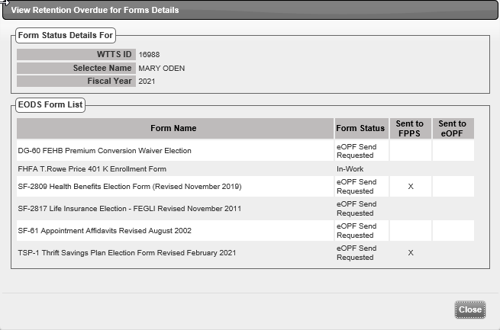
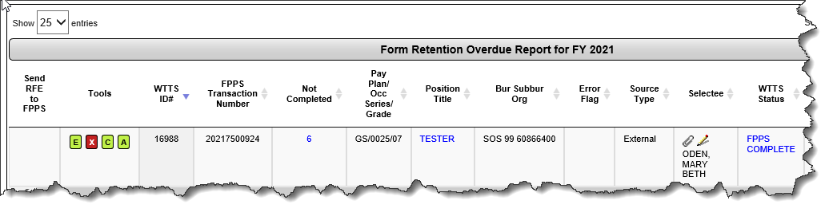
EODS Recertification
WCRN-1577 Details
Part 1 (WCRN-1577) - WTTS UI focus, preparing for the implementation of the data retention standard (and ultimately purging of forms data). Setting up fields in the database to capture future data retention events. Adding basic WTTS reporting for data retention.
Sample Screen Shots (New Form Retention Overdue Report):
Provide a list of records that need to be looked at by HR Reps for moving to a status “B”, based upon form data retention business rules (Current Date > Projected EOD + 90).

Slide 36
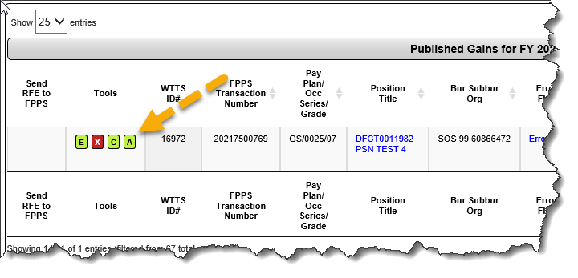
EODS Recertification
WCRN-1577 Details
As Is Recap - Use the Audit/Complete Record icon to complete the action in WTTS. The record must be in Status ‘F’ [release for update (RLUP’d) in FPPS] before it can be audited. Once a record has been audited, it moves from the Published Gains to the Completed Gains report. The status will change from ‘F’ to ‘B’ (Completed). Records in Complete Status CANNOT be updated or modified.
Sample Screen Shots Continued (Audit Record wording / confirmation
changes):

Slide 37
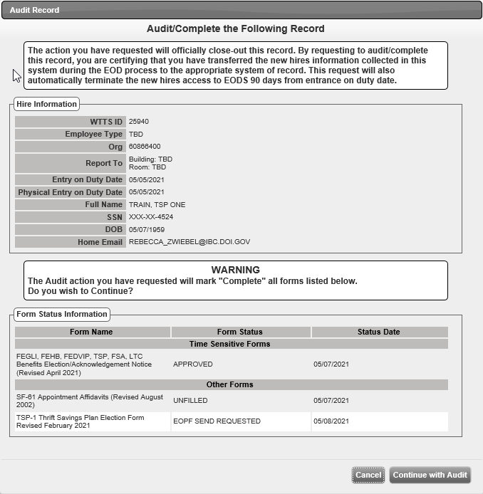
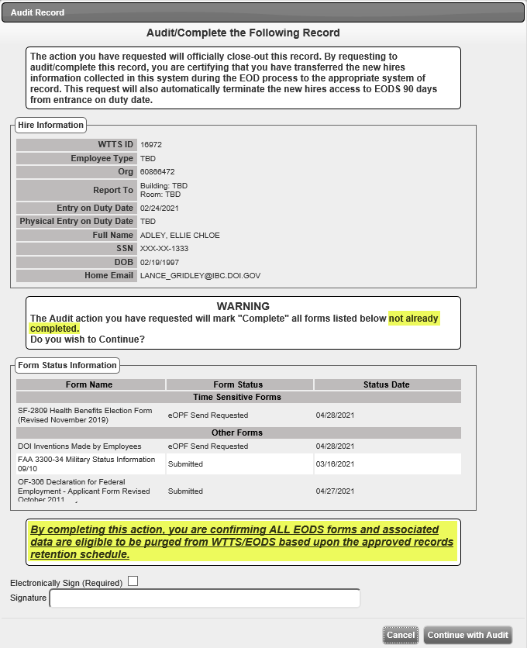
EODS Recertification
WCRN-1577 Details
Sample Screen Shots Continued (Audit Record Wording)
As Is To Be
changes):

Slide 38
EODS Recertification
Data Retention – Additional References
Additional References / Retention Requirements from 2021 EODS Certification package (5.1.2 - Records Retention, 5.7.4 – Temporary Account Termination, 5.8 – Data Export):
[5.1.2] From OPM, the form retention process should be all records (except the audit trail needed for system purposes) are purged 90 days after submission to the system of record. The official records are filed in eOPF and the non-records are not useable for future use of an agency.
“All records” includes all forms sent to the agency’s payroll system, to the agency’s HR system, to the eOPF system, to the agency’s records management system, etc. The filing of each form in their corresponding SOR is determined by the agency’s records manager and must comply with federal laws and regulations.
[5.7.4] Data entered as part of the EOD process may remain in the system at an agency’s discretion.
[5.7.4] Agencies should define a business process to validate that a record has successfully transmitted within 90 days from the official EOD date.
[5.7.4] Documents are purged following reconciliation of transmission. EOD is not used as a long-term system of record.
[5.7.4] All EOD forms must be transmitted to either eOPF or to an alternate system of record prior to account termination.
[5.8] An EOD application is not a long-term system of record. Forms not delivered to eOPF must be transmitted to a system of record, as defined by the agency’s Record Manager, within 90 days from the date of HR office approval.

Slide 39
Questions ?

Slide 40
Affiliate Workforce Tracking System (AWTS) Update
Shawn Tanaka, Sr Functional Analyst
HR Systems Management Branch

Slide 41
Affiliate Workforce Tracking System (AWTS)
AWTS Overview …

Slide 42
HRMS Security Updates
George G. Capan
Project Manager, Interior Business Center

Slide 43
WTTS/EODS
Security Updates
DHS High-Value Asset System Audit
February 22 – 24, 2021
FY21 Annual Security Assessment
103 Controls to be Assessed
Commenced in March 2021
HRMS ATO In-Place
ATO Memorandum signed September 5, 2019
5-year ATO

Slide 44
WTTS/EODS
Security Updates
OCIO Continuous Monitoring and Security Updates
DHS High-Value Asset
Monthly Scanning
Quarterly Data Calls
DHS Reclassification Discussion
MGS FedRAMP Memorandum
Anticipated by August 2021
Agency ATOs are required
IBC will not Govern or Enforce.

Slide 45
Questions ?

Slide 46
WTTS Customer Forum

Slide 47
Customer Forum Topics
Changes in FEHB – BAL 21-202
Benefits Administration Letter 21-202 Family Member Eligibility Verification for Federal Employees Health Benefits Program Coverage requires and provides a process for employing offices to verify the eligibility of family members added to an employee’s enrollment during the initial opportunity to enroll and for relevant qualifying life events. The guidance includes sample letters and the documentation requirements for determining family member eligibility.
For questions, contact your Agency’s Headquarters Benefits Officer. Please go to http://apps.opm.gov/abo/ for a list of agencies and their Headquarters Benefits Officer
WTTS Team has received inquires:
As to whether the actual SF-2809 form would be modified in some form or fashion to handle
Whether WTTS/EODS would be modified to allow a new hire to upload required verification documentation with the SF-2809
Whether WTTS/EODS will allow capturing the details of the verification documents that were inspected (document type, date document was issued, name of the issuing authority, etc.), but not collect the actual documents.]
User group consensus to one unified solution

Slide 48
Questions ?

Slide 49
New Action Items Recap
List new action items

Slide 50
Wrap Up
Thank You - WTTS User Group!

Slide 51
WTTS Team/Staff
WTTS/EODS/AWTS staff:
Jody Elkins Chief, HR Systems Management Branch
Jody_Elkins@ibc.doi.gov
Kona Quewon, Lead, Systems Functional Analyst
KQuewon@ibc.doi.gov
Lance Gridley, Sr Systems Functional Analyst
Lance_Gridley@ibc.doi.gov
Shawn Tanaka, Sr Systems Functional Analyst
Shawn_Tanaka@ibc.doi.gov
Rebecca Zwiebel, Functional System Analyst
Rebecca_Zwiebel@ibc.doi.gov
WTTS Tier II Help Desk
Henry Pyle, Customer Support Specialist
Henry_Pyle@ibc.doi.gov
Andrea Leggett, Customer Support Specialist
Andrea_Leggett@ibc.doi.gov
Elizabeth ‘Liz’ Dwyer, Customer Support Specialist
Elizabeth_Dwyer@ibc.doi.gov

Slide 52
Next Meeting/Upcoming Releases
Next User Group Meeting
September 23, 2021
Location(s) - (host) TBD
Upcoming Releases
Release 21.02 (August 6, 2021)
Release 21.03 (December 2021)
Release 22.1 (April 2022)

Slide 53
We ‘Virtually’ did it!! Thank you!!

