Slide 1
Wednesday, August 21, 2019
8:30 a.m. EDT
Notes:
1
EST FIRST MONDAY IN NOVEMBER
EDT SECOND MONDAY IN MARCH

Slide 2
National Current Operations & Monitoring
Significant Incidents or Threats:
Severe thunderstorms possible – Mid- Atlantic and Central Appalachians to Northeast
Heavy rain and flash flooding possible – Central Plains to Middle Mississippi Valley; Mid-Atlantic to Northeast
McKinley Fire, AK
Tropical Activity:
Atlantic:
Tropical Storm Chantal
Disturbance 1: Low (20%)
Eastern Pacific:
Disturbance 1: High (near 100%)
Disturbance 2: Low (near 0%)
Central Pacific: No new tropical cyclones expected in the next five days
Western Pacific: No activity affecting U.S. interests
Declaration Activity:
Amendment No. 2 to 4435-DR-MO
Amendment No. 4 to 4451-DR-MO
Major Disaster Declaration Request – South Dakota + 2 tribes
Notes:
2
Briefing guidance: This is the opportunity to tell leadership what they DO need to worry about today, and what they DO NOT need to worry about.
Don’t simply cover the blue text and move on. Examples:
“The NWC reports a relatively quiet overnight shift, we are monitoring the weather threat in the mid-west, although given the forecast we do not anticipate significant impacts that would exceed state or local capabilities.”
“The NWC monitored a series of tornado touchdowns overnight in X area. Initial reports were… Any additional impact / damage reports will be delayed until after daybreak. Over the course of the day we will continue to report on the situation. The Region reports a low probability that we will see any requests for FEMA assistance. We show a quiet 5 day outlook for the tropics this morning.”
You want to find a balance between briefing the entire Ops Brief from this slide, and glossing over the slide.

Slide 3
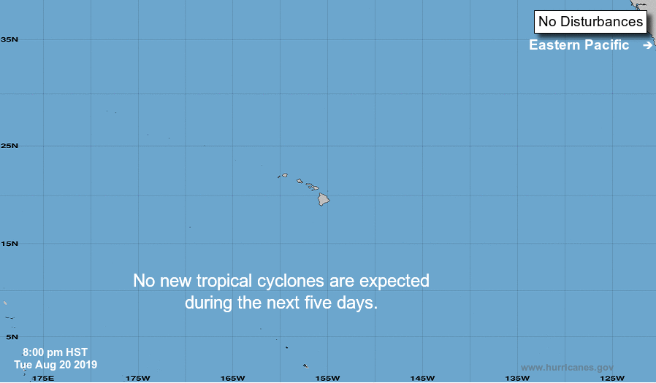
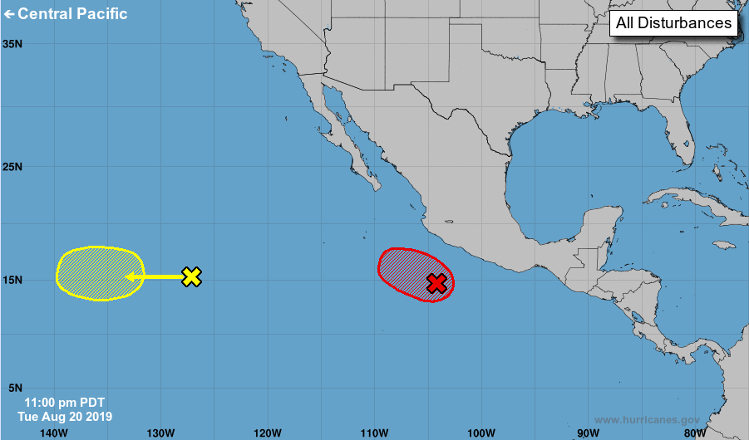
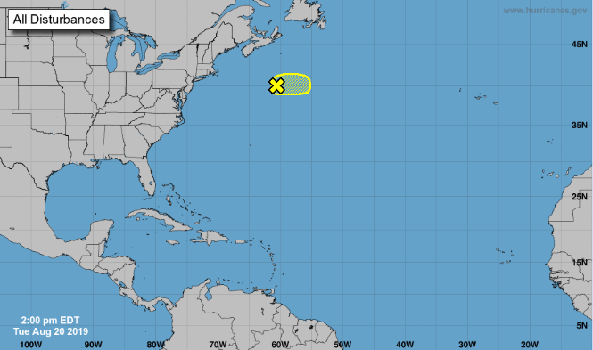
Tropical Outlook – Five Day
If Needed
2
(30%)
97L
(10%)
1
(20%)
1
(90%)
1
(50%)
Central Pacific
Eastern Pacific
Atlantic
1
(80%)
Disturbance 1(as of 2:00 a.m. EDT)
A couple hundred miles S of southern coast of Mexico
Moving WNW at 10-15 mph
Formation chance through 5 days: High (90%)
Disturbance 2(as of 2:00 a.m. EDT)
Located over the western portion of the eastern North Pacific
Moving westward
Formation chance through 5 days: Low (30%)
Tropical Storm Chantal(as of 2:00 p.m. EDT)
400 miles SE of Nova Scotia
Moving E at 15-20 mph away from the U.S.
Formation chance through 5 days: Low (10%)
Current Disturbances & 5 Day Cyclone Formation: < 40% | 40-60% | > 60%
Tropical / Sub-Tropical Cyclone: Depression | Storm | Hurricane | Post-Tropical Cyclone / Remnants
Potential track area: Watches: Warnings: Current wind extent:
Day 1-3 Day 4-5 Hurricane Trop Stm Hurricane Trop Stm Hurricane Trop Stm
Notes:
3
Updated

Slide 4
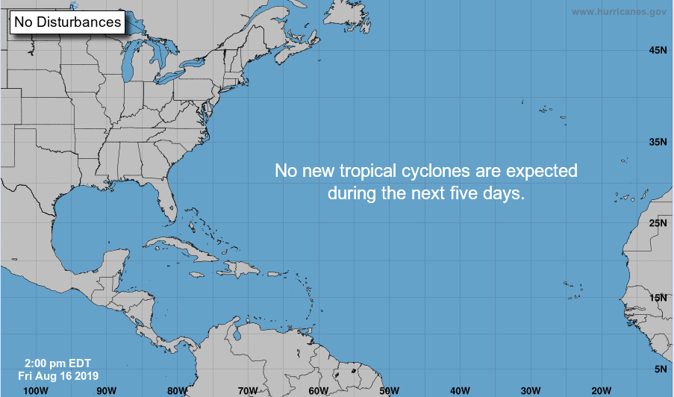
Tropical Outlook – Atlantic
If Needed
1
(20%)
1
(50%)
1
(80%)
Potential track area: Watches: Warnings: Current wind extent:
Day 1-3 Day 4-5 Hurricane Trop Stm Hurricane Trop Stm Hurricane Trop Stm
Notes:
4
Updated

Slide 5
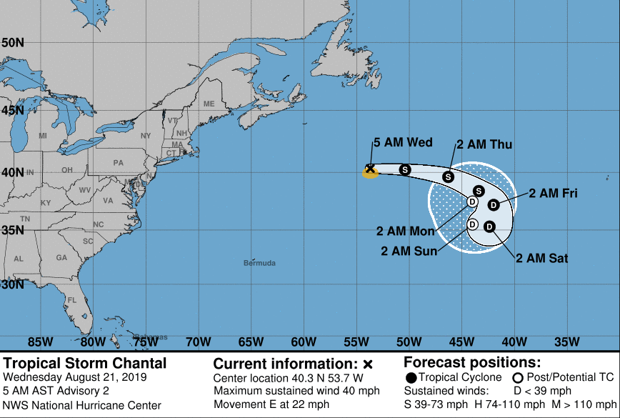
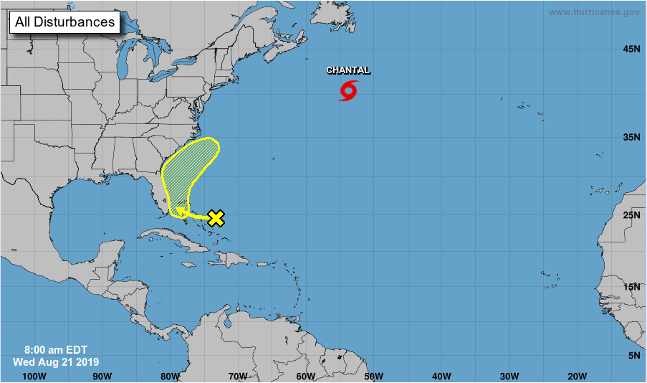
Tropical Outlook – Atlantic
Tropical Storm Chantal( Advisory #2 as of 5:00 a.m. EDT)
445 miles S of Cape Race, Newfoundland
Moving E at 22 mph
Maximum sustained winds 40 mph
Tropical storm force winds extend 60 miles
Forecast to become a tropical depression in a couple of days
No threat to the U.S.
Disturbance 1 (as of 8:00 a.m. EDT)
Located over the central and northwestern Bahamas
Moving towards the FL peninsula and southeastern U.S.
Formation chance through 48 hours: Low (near 0%)
Formation chance through 5 days: Low (20%)
If Needed
1
(20%)
1
(50%)
1
(80%)
Notes:
5
Updated

Slide 6
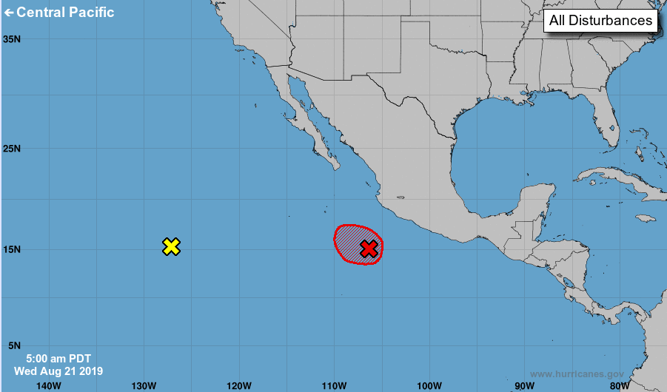
Tropical Outlook – Eastern Pacific
Disturbance 1(as of 8:00 a.m. EDT)
Several hundred miles SSE of the southern tip of the Baja California peninsula, Mexico
Moving WNW
Formation chance through 48 hours: High (near 100%)
Formation chance through 5 days: High (near 100%)
Disturbance 2 (as of 8:00 a.m. EDT)
Located over the western portion of the eastern North Pacific
Moving west
Formation chance through 48 hours: Low (near 0%)
Formation chance through 5 days: Low (near 0%)
If Needed
1
(20%)
2
(0%)
1
(50%)
1
(100%)
1
(80%)
Notes:
6
Updated

Slide 7
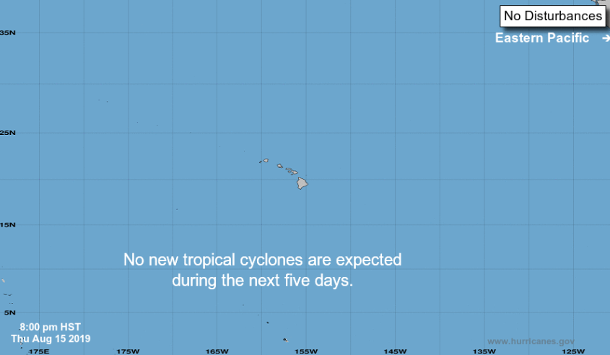
Tropical Outlook – Central Pacific
Disturbance 1 (as of 2:00 p.m. EDT)
1,200 miles SW of Oahu
Moving WNW at 10 mph
Formation chance through 48 hours: Low (20%)
Formation chance through 5 days: Low (20%)
If Needed
1
(20%)
1
(50%)
1
(80%)
Potential track area: Watches: Warnings: Current wind extent:
Day 1-3 Day 4-5 Hurricane Trop Stm Hurricane Trop Stm Hurricane Trop Stm
Notes:
7
Updated

Slide 8
Tropical Outlook – Central Pacific
If Needed
1
(20%)
1
(50%)
1
(80%)
Potential track area: Watches: Warnings: Current wind extent:
Day 1-3 Day 4-5 Hurricane Trop Stm Hurricane Trop Stm Hurricane Trop Stm
Notes:
8
Updated

Slide 9
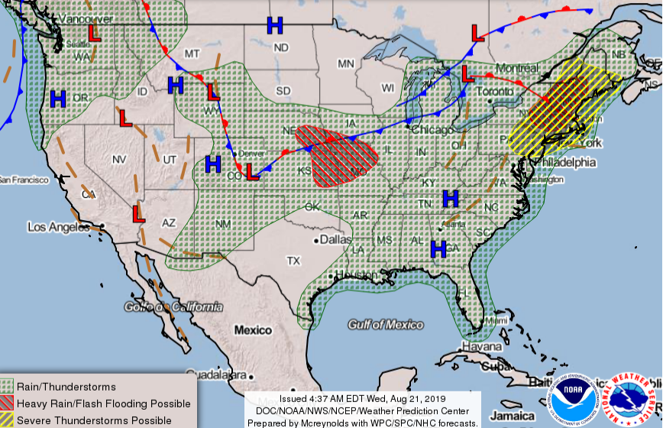
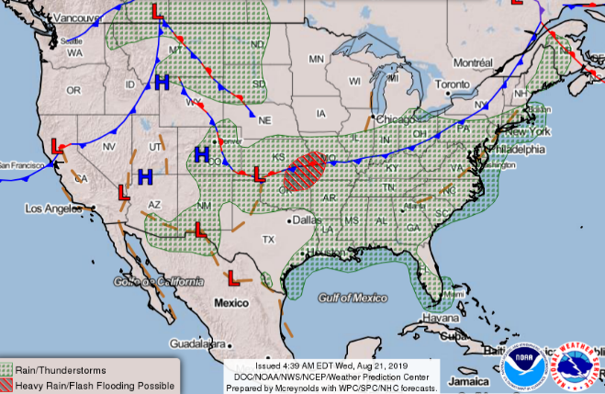
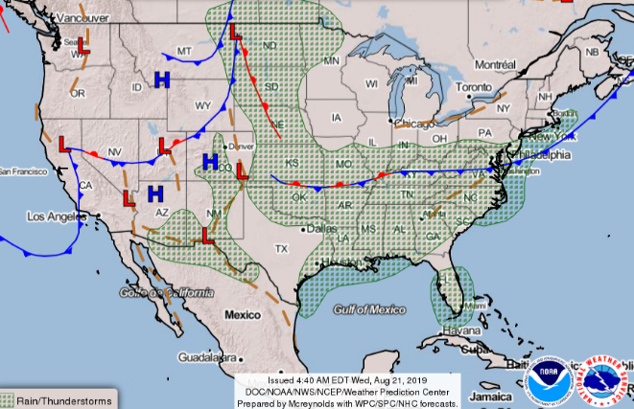
National Weather Forecast
Wed
Thu
Mon
Tue
Wed
Fri
Thu
Fri
Sat
Sun

Slide 10
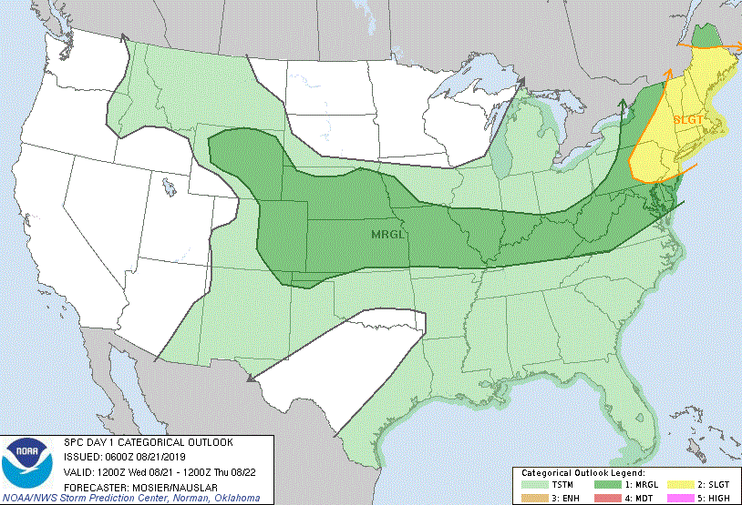
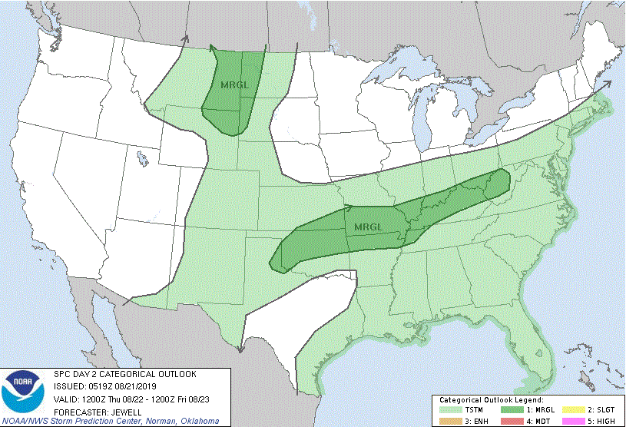
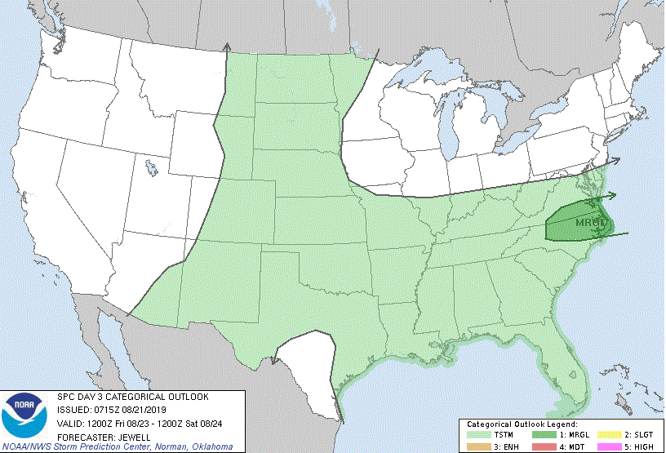
Severe Weather Outlook
Wed
Thu
Mon
Tue
Wed
Thu
Fri
Fri
Sat
Sun
Notes:
Only show if “Enhanced” or worse

Slide 11
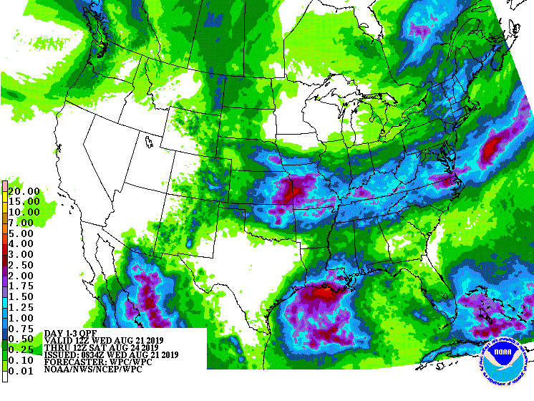
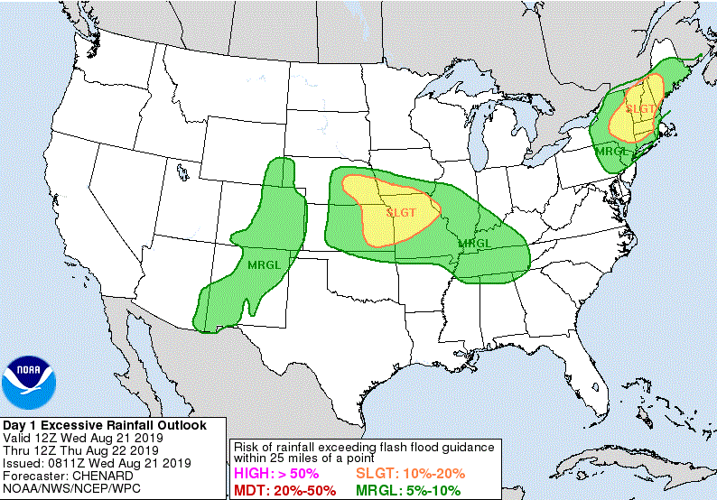
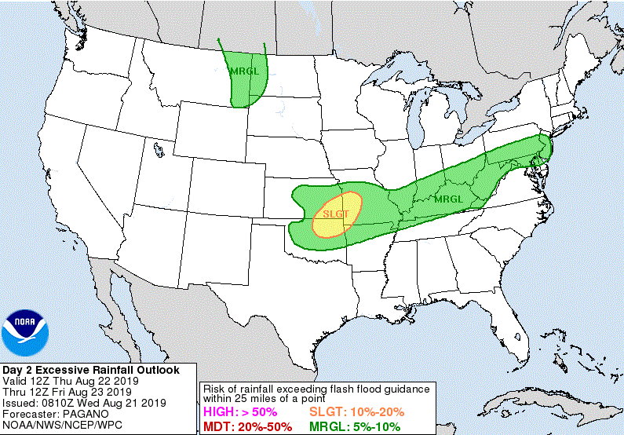
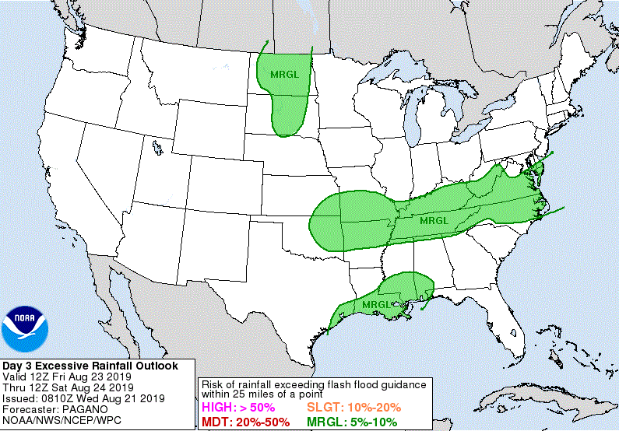
Precipitation Forecast
Wed – Fri
Mon
Wed
Tue
Wed
Thu
Thu
Fri
Fri
Sat
Sun

Slide 12
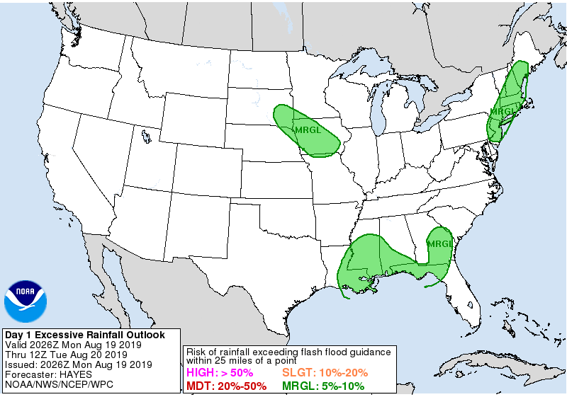
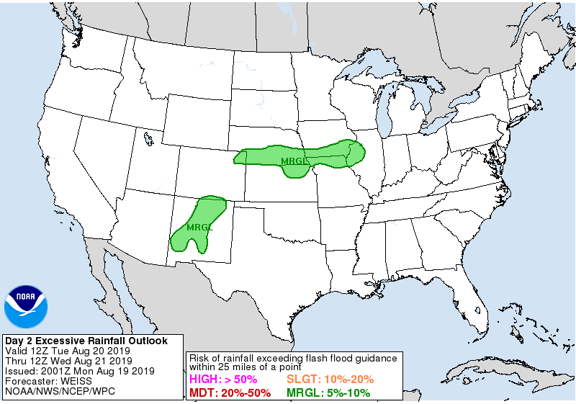
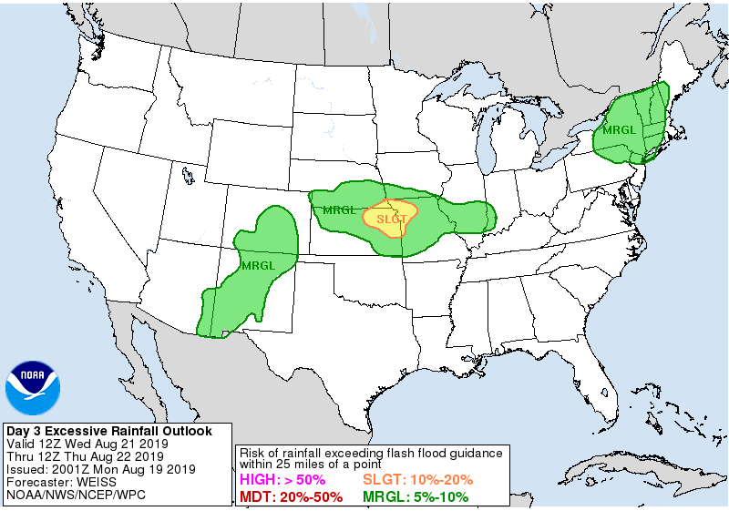
Excessive Rainfall Forecast
Today
Wednesday
Thursday

Slide 13
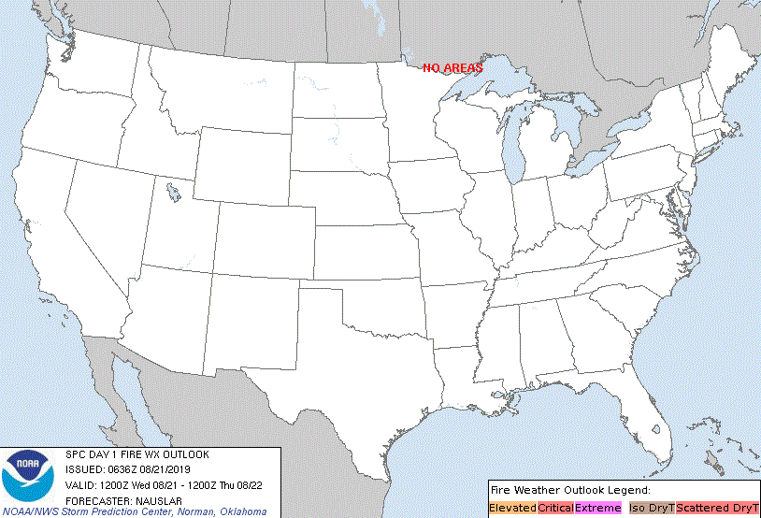
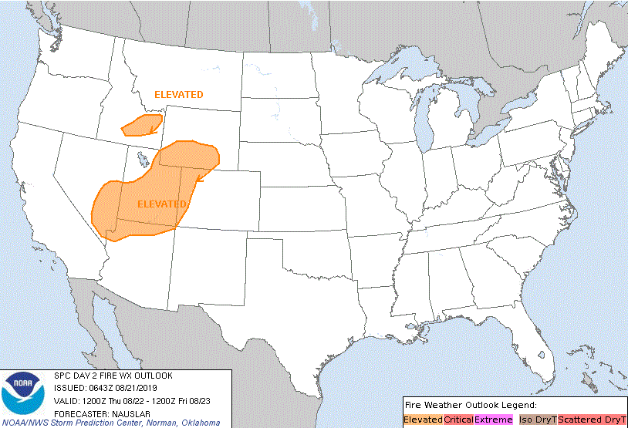
Fire Weather Outlook
http://www.spc.noaa.gov/products/fire_wx/fwdy1.html
Tuesday
Wednesday

Slide 14
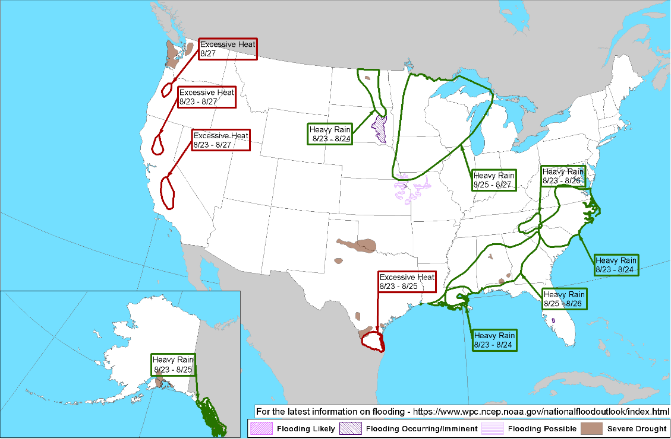
Hazards Outlook – Aug 23-27
http://www.cpc.ncep.noaa.gov/products/predictions/threats/threats.php

Slide 15
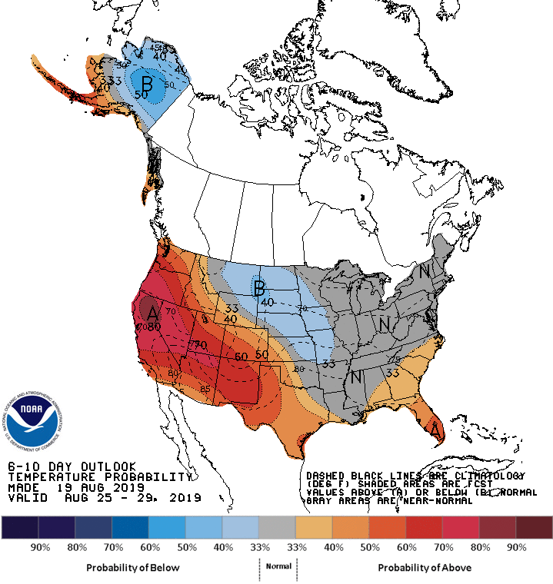
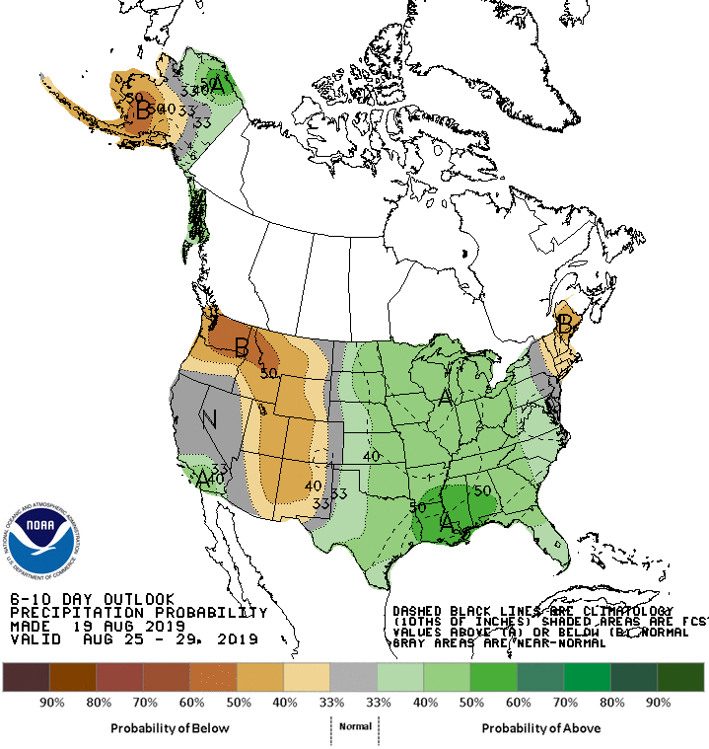
Long Range Outlooks – Aug 25-29
http://www.cpc.ncep.noaa.gov/products/predictions/610day/610temp.new.gif
http://www.cpc.ncep.noaa.gov/products/predictions/610day/610prcp.new.gif
6-10 Day Temperature Probability
6-10 Day Precipitation Probability

Slide 16
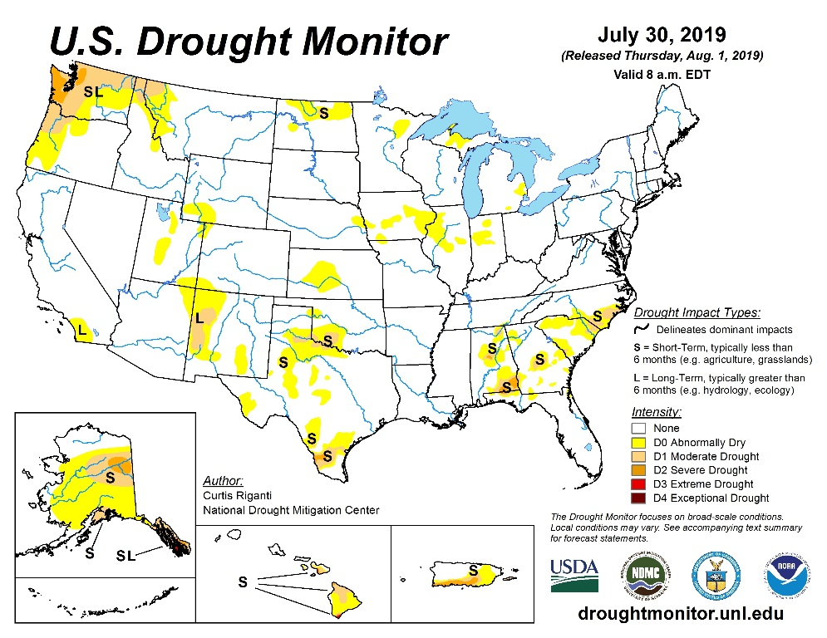
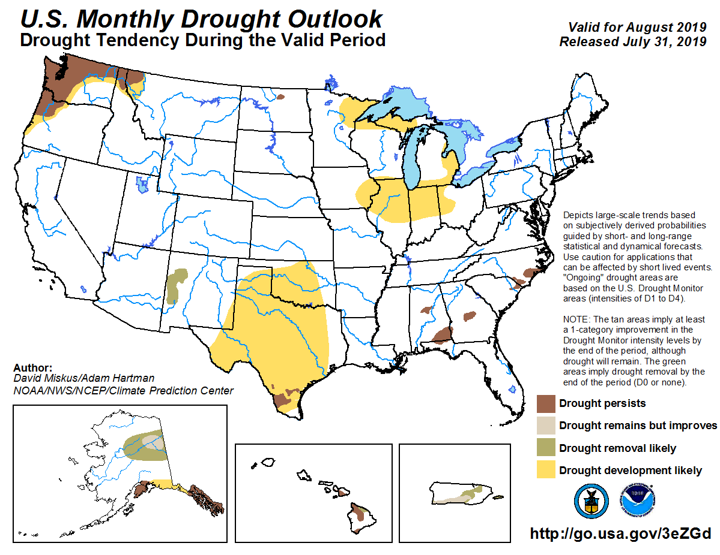
U.S. Monthly Drought Outlook
http://droughtmonitor.unl.edu/
http://www.cpc.ncep.noaa.gov/products/expert_assessment/mdo_summary.php
Notes:
http://www.cpc.ncep.noaa.gov/products/expert_assessment/mdo_summary.php

Slide 17
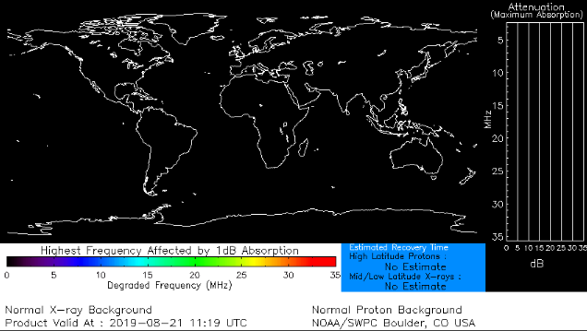
Space Weather
 | Space Weather Activity | Geomagnetic Storms | Solar Radiation | Radio Blackouts
Past 24 Hours | None | None | None | None
Next 24 Hours | None | None | None | None
For further information on NOAA Space Weather Scales refer to: http://www.swpc.noaa.gov/noaa-scales-explanation
HF Communication Impact
Sunspot Activity
Notes:
THE SOLAR WIND IS HERE: A high-speed stream of solar wind is buffeting Earth's magnetic field, causing intermittent G1-class geomagnetic storms. High latitude sky watchers should be alert for auroras, especially in the southern hemisphere where winter darkness favors visibility.

Slide 18
Wildfire Summary
Fire Name (County, ST) | FMAG # | Acres Burned | Percent Contained | Evacuations (Residents) | Structures |  |  | Fatalities Injuries
 |  |  |  |  | Threatened | Damaged | Destroyed
McKinley Fire (Matanuska-Susitna, AK) | 5287 | 4,349 (+2,349) | 5% (+5%) | M/V: 2,056 | 1,028 homes/30 commercial | 0 | 80 | 0 / 0
Notes:
Information derived nightly from ICS 209. When an ICS 209 is unavailable; INCIWEB, Region, & State Official sites are acceptable sources

Slide 19
FMAG Requests and Declarations
Action (since last report) |  |  | Total | FMAG No. and State
Requests DENIED |  |  | 0
Requests APPROVED |  |  | 1 | FEMA-5287-FM; Alaska
Approved FMAG Data
Fiscal Year | Current FYTD | MTD | Monthly Average* | Cumulative Acres Burned FYTD | Cumulative Denied FMAGs FYTD
2019 | 10 | 1 | 10.3 | 47,978 | 1
Fiscal Year | Total Previous FY | Yearly Average** |  | Total Acres Burned Previous Fiscal Year | Total Denied FMAGs Previous Fiscal Year
2018 | 64 | 54.3 |  | 868,840 | 8
* Reflects the three year average for current month
** Reflects three year total average

Slide 20
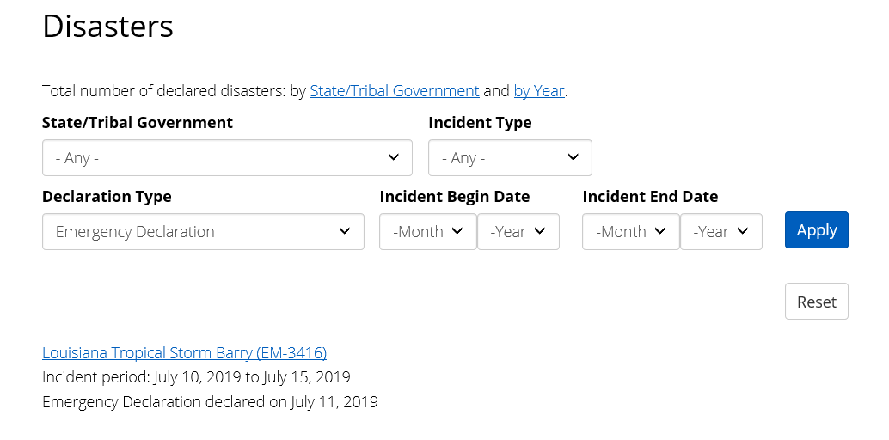
Joint Preliminary Damage Assessments
Region | State / Location | Event | IA/PA | Number of Counties |  | Start – End
 |  |  |  | Requested | Completed
II | NY | Severe Rain Storm Jun 30 | IA | 0 | 0 | N/A
 |  |  | PA | 2 | 0 | 8/13 – TBD
III | VA | Severe Weather and Flooding Jul 8 | IA | 0 | 0 | N/A
 |  |  | PA | 5 (+1) | 3 (+3) | 8/20 – TBD
V | IL | Severe Storms and Flooding Feb 24 – Jul 3 | IA | 22 | 22 (+2) | 8/12 – 8/20
 |  |  | PA | 31 | 31 (+1) | 7/29 – 8/16
https://www.fema.gov/disasters
Notes:
Region 8 is reporting Joint PDAs for SD for a possible second declaration for SD, therefore we are reporting them on our products. The incident period for DR-4440-SD is March 13th to April 26th; the Joint PDA's are for an incident that took place May 21st to Jun 7th.

Slide 21
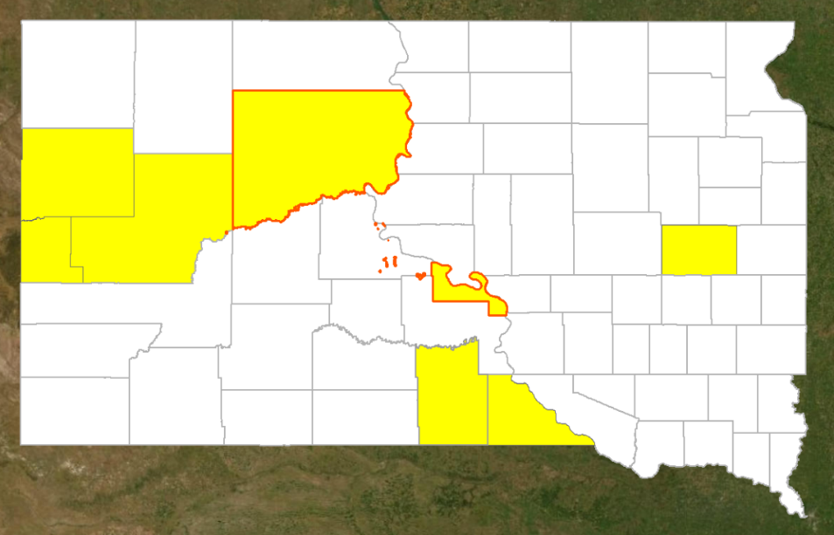
Declaration Request
Declaration: Major Disaster – South Dakota
Requested: Aug 19
Approved: TBD
Incident: Severe storms, tornadoes, and flooding
Incident Period: June 30 – July 21
Includes:
PA: 6 counties and the Cheyenne River Reservation and the Lower Brule Indian Reservation
Hazard Mitigation: Statewide
FCO: TBD
PA
Requested Tribal Areas

Slide 22
Declaration Requests in Process – 4
 | State / Tribe / Territory – Incident Description | Type | IA | PA | HM | Requested
 | LA – Tropical Storm Barry | DR |  | X | X | Aug 14
 | LA – Flooding | DR |  | X | X | Aug 15
 | WI – Severe Storms, Straight-line Winds, Tornadoes, and Flooding | DR |  | X | X | Aug 19
 | SD (+2 Tribes*) – Severe Storms, Tornadoes, and Flooding | DR |  | X | X | Aug 19
*Cheyenne River Reservation and the Lower Brule Indian Reservation

Slide 23
Declaration Amendments
Declaration | Number | Issued | Action
4435-DR-MO | 2 | Aug 20 | Appoints Jon K. Huss as FCO
4451-DR-MO | 4 | Aug 20 | Appoints Jon K. Huss as FCO

Slide 24
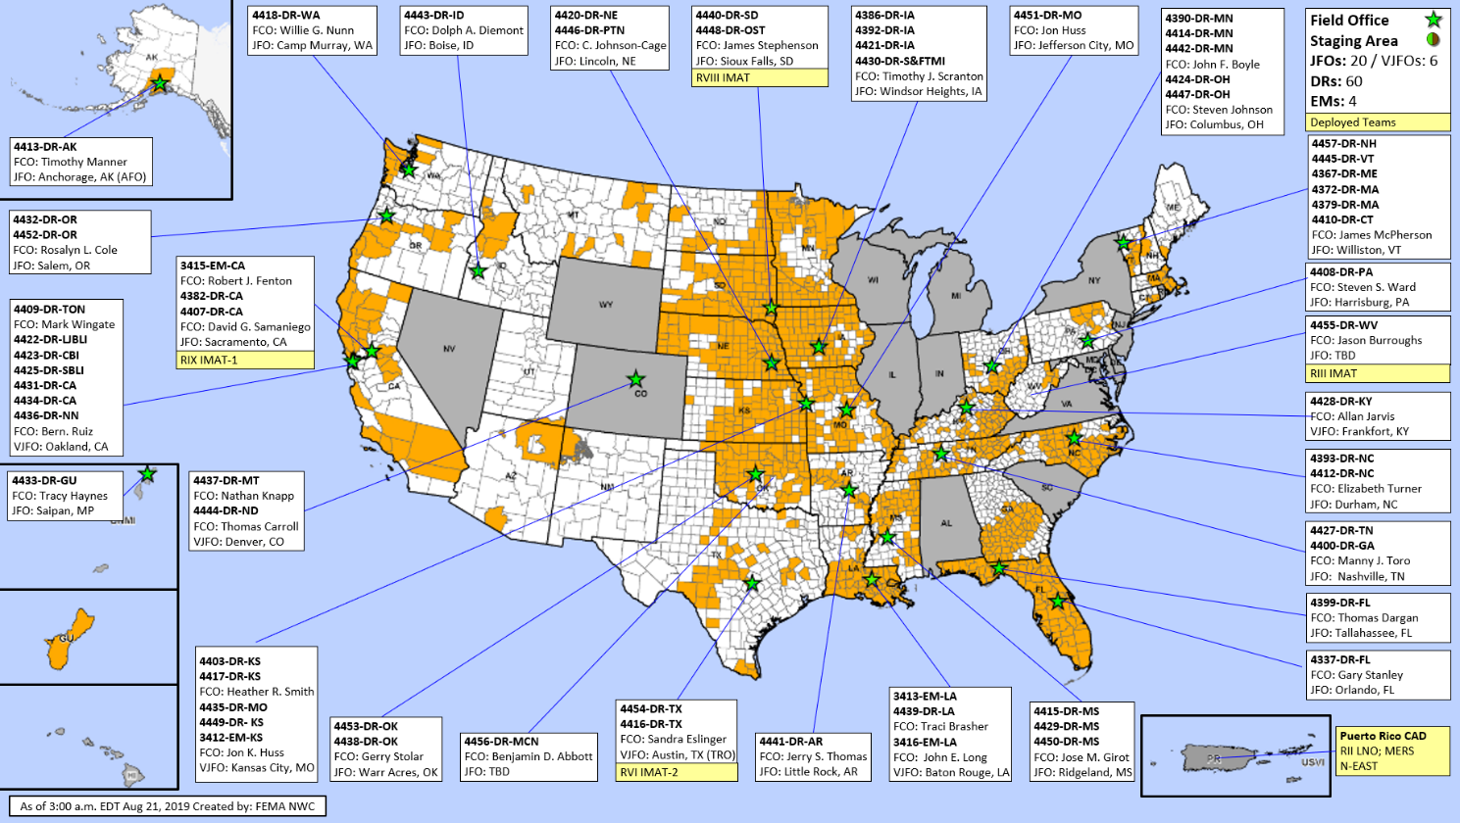
FEMA Common Operating Picture
FEMA HQ
NWC |  | NRCC
Monitoring |  | Blue
FEMA REGIONS
WATCH |  | RRCC
Monitoring | I |  | Rostered
Monitoring | II |  | Rostered
Monitoring | III |  | Rostered
Monitoring | IV |  | Rostered
Monitoring | V |  | Rostered
Monitoring | VI |  | Rostered
Monitoring | VII |  | Rostered
Monitoring | VIII |  | Rostered
Monitoring | IX |  | Rostered
Monitoring | X |  | Rostered
Activation Details
N-IMATs 2 Teams
East | PR (EX)
West
Crisis
R-IMATs 4-6 Teams
I
II
III | WV
IV-1
IV-2
V
VI-1
VI-2 | TX
VII
VIII | SD
IX-1 | CA
IX-2
X
FMC | PMC
NMC | Deployed
Team: Status | US&R (>66%) | MERS (>66%) | FCOs (≤ 1 Type ) | FDRCs (≤1) | IM WORKFORCE |  | IM CADRE AVAILABILITY SUMMARY Cadres with 25% or Less Availability
Assigned: | 28 | 36 | 38 | 12 | 13,695 |  | EA 25% (123/493); EHP 4% (24/544); ER 16% (11/69); FL 9% (14/154); FM 21% (60/283); HM 16%(190/1,200); HR 18% (40/225); IT 20% (129/653); LOG 23% (311/1,335); OPS 24%(68/286); PA 9% (238/2,632); PLAN 10% (40/402); SAF 14% (8/58); SEC 13%(16/124)
Unavailable | 0 | 0 | 2 | 1 | 4,234
Deployed: | 0 | 0 | 31 (+1) | 7 | 5,838
Available: | 28 | 36 | 5 (-1) | 4 | 3,623 / 26%
Notes:
National IMATS:
National IMAT information is received in an email titled “OCD IMAT-Field Leadership Cadre Availability Report 2018” Do not include Crisis IMAT in calculations.
Green: 2 Teams Available
Yellow: 1 Team Available
Red: 0 Teams Available
Regional IMATS:
Green: ≥ 7 Teams Available
Yellow: 4 - 6 Teams Available
Red: ≤ 3 Teams Available
OCD Readiness:
FCO:
STEP 1: Number of TYPE I FCOs –
• If there are 0-1 Type I FCOs, Cadre is RED – text: ≤1 Type I
• If there are 2 Type I FCOs, Cadre is YELLOW – text: = 2 Type I
• If there are 3 Type I FCOs, go to STEP 2
• If there are 4+ Type I FCOs, Cadre is GREEN – text: ≥4 Type I
STEP 2: Number of TYPE II FCOs –
• If there are 0-5 Type II FCOs, Cadre is YELLOW – text: = 3 Type I
• If there are 6+ Type II FCOs, Cadre is GREEN – text: ≥9 Type I&II
FDRC: GREEN: ≥3 YELLOW: =2 RED: ≤1
US&R AND MERS:
>66% GREEN US&R information will come from Fred Endrikat or Michael Davis
33 – 65% YELLOW MERS information comes via email titled “FEMA MERS Deployed”, normally around 2300L. This shows where
<33% RED MERS assets are located (map should match). MERS Availability is found on SharePoint

Slide 25
FEMA’s mission is helping people before, during, and after disasters.
Click here to subscribe to this briefing.

Slide 26
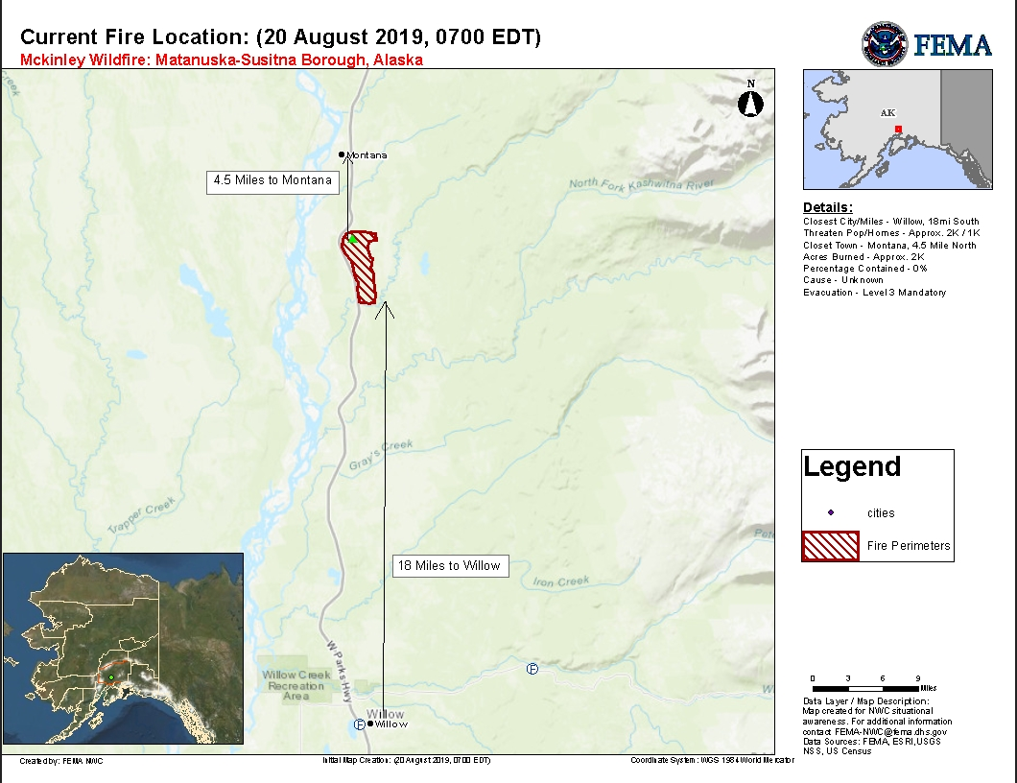
McKinley Fire – AK
Fire Name (County, ST) | FMAG # | Acres Burned | Percent Contained | Evacuations (Residents) | Structures |  |  | Fatalities Injuries
 |  |  |  |  | Threatened | Damaged | Destroyed
McKinley Fire (Matanuska-Susitna, AK) | 5287-FM-AK | 2,000 | 0% | M: 2,056 | 1,028 homes/30 commercial | None | 80 structures | 0 / 0
Evacuations: M = Mandatory / V = Voluntary
Situation:
Began Aug 17 and is burning on private land, 18 miles north of Willow (pop. 2k)
Threatening three subdivisions, state owned Alaska Railroad, and publicly owned power lines
Impacts:
3 shelters open with 95 occupants statewide (ARC Midnight Shelter Count as of 5:48 pm EDT)
Response:
AK EOC at Normal Operations
FMAG approved on Aug 20
FEMA Region X and NWC continue to monitor

Slide 27
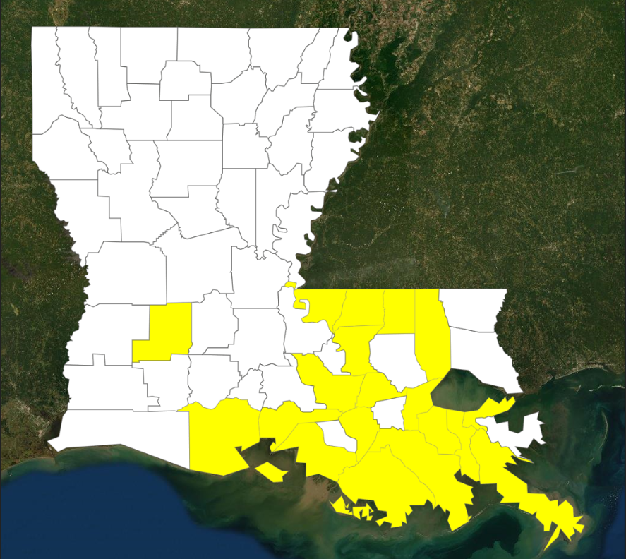
Declaration Request
Instructions:
Copy the legend from here / paste it onto your slide
Highlight any line you do not need and delete it
Don’t change the font or font size
You may make the text white if it is over the water
What is going on? These are bullets… each line is a different bullet level. Only instead of Solid Bullet, Open Bullet, Square Bullet like we use for our products, these are custom made bullets using .png files of the proper shapes and colors.
Declaration: Major Disaster – Louisiana
Requested: Aug 14
Approved: TBD
Incident: Tropical Storm Barry
Incident Period: Jul 10-15
Includes:
PA: 19 parishes
Hazard Mitigation: Statewide
FCO: TBD
Louisiana
IA
PA
IA & PA
Requested Tribal Area
Declared Tribal Area
PA

Slide 28
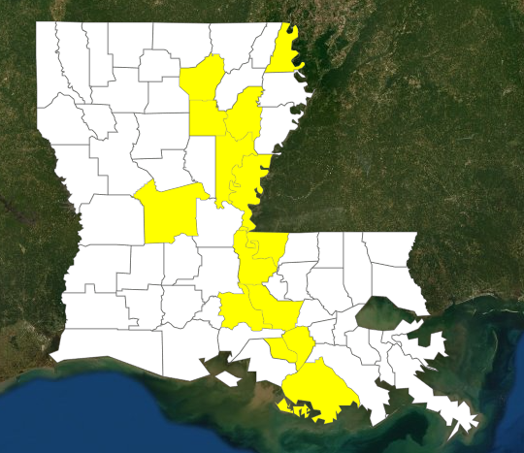
Declaration Request
Instructions:
Copy the legend from here / paste it onto your slide
Highlight any line you do not need and delete it
Don’t change the font or font size
You may make the text white if it is over the water
What is going on? These are bullets… each line is a different bullet level. Only instead of Solid Bullet, Open Bullet, Square Bullet like we use for our products, these are custom made bullets using .png files of the proper shapes and colors.
Declaration: Major Disaster – Louisiana
Requested: Aug 15
Approved: TBD
Incident: Flooding
Incident Period: Feb 26 – Jul 30
Includes:
PA: 13 parishes
Hazard Mitigation: Statewide
FCO: TBD
Louisiana
IA
PA
IA & PA
Requested Tribal Area
Declared Tribal Area
PA

Slide 29
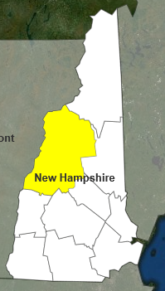
Declaration Approval
Instructions:
Copy the legend from here / paste it onto your slide
Highlight any line you do not need and delete it
Don’t change the font or font size
You may make the text white if it is over the water
What is going on? These are bullets… each line is a different bullet level. Only instead of Solid Bullet, Open Bullet, Square Bullet like we use for our products, these are custom made bullets using .png files of the proper shapes and colors.
Declaration: Major Disaster – New Hampshire
Requested: Aug 8
Approved: August 15
Incident: Severe Storms and Flooding
Incident Period: Jul 11-12
Includes:
PA Only: One county
Hazard Mitigation: Statewide
FCO: James McPherson
IA
PA
IA & PA
Requested Tribal Area
Declared Tribal Area
PA

Slide 30
FEMA OCSO Security Awareness Week
Security is everyone’s Responsibility
FEMA Office of the Chief Security Officer (OCSO) offering multiple opportunities to attend the following training events:
Classified National Security Information
Alert & Accountability (ATHOC)
Foreign Access Management
OPSEC
Counterintelligence and Social Media Awareness
Derivative Classification and Marking
NCP Security Classification Guide
Fraud Awareness and Prevention
Personnel Security Suitability, Eligibility, and Q&As
Duress Buttons, Active Shooter, and Vigilance
FEMA personnel can participate either in-person or via Adobe Connect, find the link and call-in information at Security Awareness Week intranet page
Notes:
FEMA’s Office of the Chief Security Officer (OCSO) is entrusted with the mission of protecting FEMA personnel, facilities, information, and equipment. However, we cannot achieve this mission alone; security is everyone’s responsibility. To facilitate this effort, OCSO is hosting a Security Awareness Week for all FEMA HQ staff.
We are offering multiple opportunities to attend the following trainings either in-person or via Adobe Connect:
Classified National Security Information
Alert & Accountability (ATHOC)
Foreign Access Management
OPSEC
Counterintelligence and Social Media Awareness
Derivative Classification and Marking
NCP Security Classification Guide
Fraud Awareness and Prevention
Personnel Security Suitability, Eligibility, and Q&As
Duress Buttons, Active Shooter, and Vigilance
To participate in any of the Security Awareness Week scheduled events, August 19-23, 2019, using Adobe Connect, find the link and call-in information below:
https://fema.connectsolutions.com/rls476wcjfic/
Conference Bridge #: 1-800-320-4330
Conference Code: 744573

