Slide 1
Friday, October 12, 2018
8:30 a.m. EDT
Notes:
EST FIRST MONDAY IN NOVEMBER
EDT SECOND MONDAY IN MARCH

Slide 2
Significant Activity – Oct 11-12
Significant Events: Tropical Storm Michael response
Tropical Activity:
Atlantic – Hurricane Storm Leslie (CAT 1); Tropical Storm Michael; Tropical Storm Nadine; Disturbance 1
Eastern Pacific – Tropical Storm Sergio; Disturbance 1
Central Pacific – No new tropical cyclones are expected during the next five days
Western Pacific – No activity affecting U.S. interests
Significant Weather:
Heavy snow – Northern/Central Rockies
Heavy rain – Southern Plains in the Lower Mississippi
Declaration Activity:
Expedited Major Disaster Declaration approved – Florida (Hurricane Michael)
Amendment No. 1 to FEMA-3401-EM-NC
Amendment No. 1 to FEMA-4393-DR-NC
Notes:
Only show Earthquake activity when significant (break-out slide)
Only show Space Weather if G-4 or above (break-out slide) but unhide Space Weather slide in transmitted copy

Slide 3
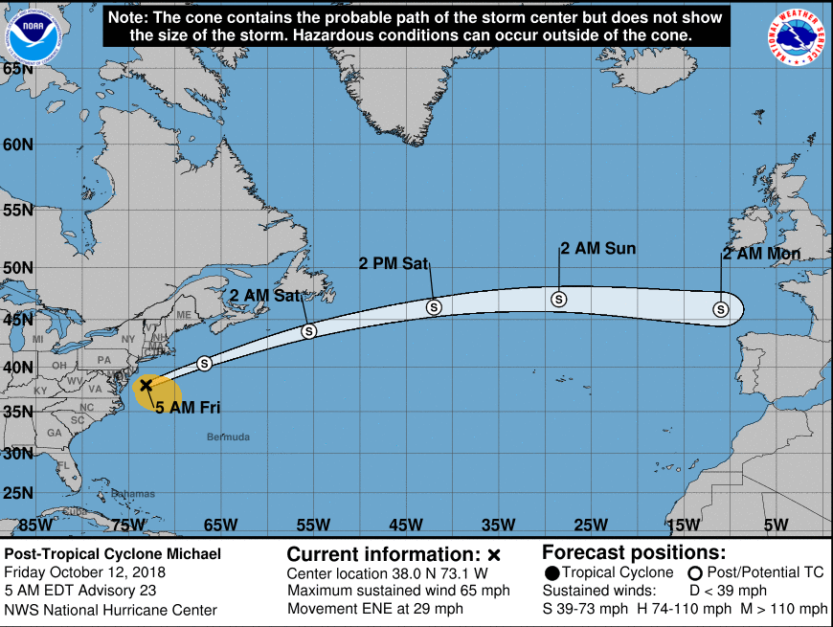
Tropical Storm Michael
Post Tropical Cyclone Michael (Advisory #23 as of 5:00 a.m. EDT)
Located 185 miles ENE of Norfolk, VA; moving ENE at 29 mph
Maximum sustained winds 65 mph
Some additional strengthening is expected today and tonight
Tropical storm force winds extend 275 miles
All Watches and warning discontinued
This is the last public advisory issued
Forecast Impacts
Gale winds may continue for a few more hours over portions of SE VA, the southern Chesapeake Bay and Delmarva Peninsula
Rainfall: Expected to produce 1 to 3 inches from NJ to Long Island to Cape Cod, and 3-5 inches over Nantucket and Martha’s Vineyard. Flooding and flash flooding may continue in the Carolinas and the Mid-Atlantic states. Coastal 1-3 inches expected across northern Mid-Atlantic and Southern New England
Notes:
https://www.nhc.noaa.gov/refresh/graphics_at4+shtml/174338.shtml?mltoa34#contents

Slide 4
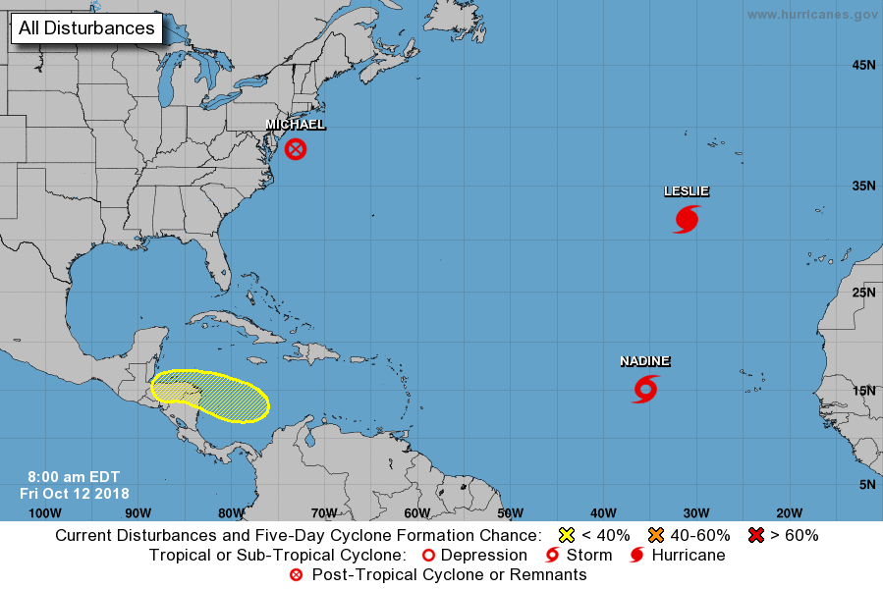
Tropical Outlook – Atlantic
Hurricane Leslie (Cat 1) (Advisory #64 as of 5:00 a.m. EDT)
480 miles SSW of the Azores
Maximum sustained winds of 90 mph
Moving ENE at 28 mph
Hurricane force winds extend 75 miles; tropical storm force winds extend 205 miles
Tropical Storm Nadine (Advisory #13 of 5:00 a.m. EDT)
740 miles W of the southernmost Cabo Verde Islands
Maximum sustained winds 50 mph
Moving WNW at 8 mph
Tropical-storm-force winds extend outward up to 70 miles
Expected to dissipate by Sunday
Tropical Disturbance 1 (as of 2:00 a.m. EDT)
Located over west central Caribbean Sea
Conditions are becoming less favorable for tropical cyclone formation
Formation chance through next 48 hours: Low – (Near 0%)
Formation chance through next 5 days: Low – (20%)
1
(30%)
1
90%
1
100%
1
(50%)

Slide 5
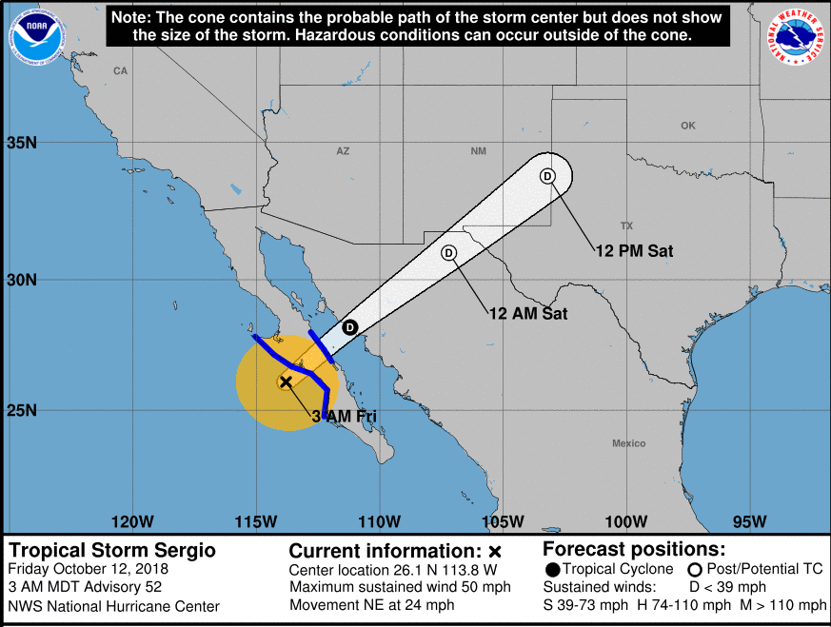
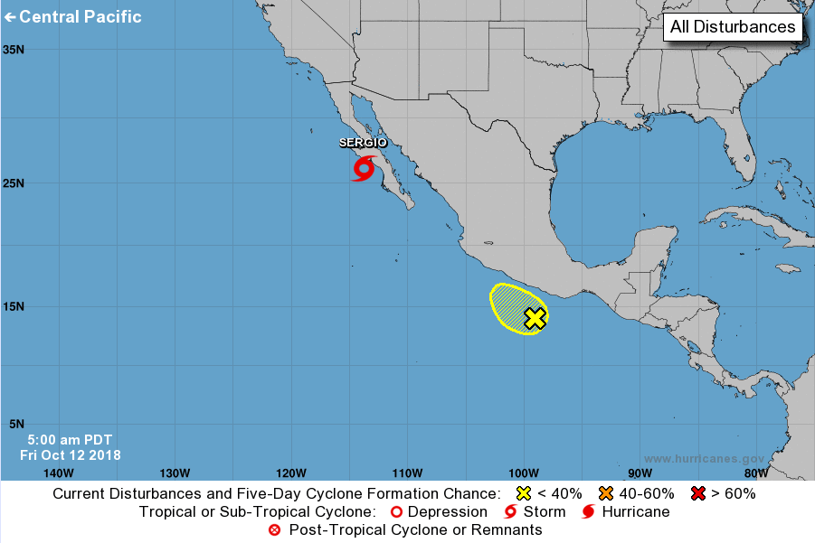
Tropical Outlook – Eastern Pacific
Tropical Storm Sergio (Advisory #52 as of 5:00 a.m. EDT)
130 miles NW of Cabo San Lazaro, Mexico
Moving NE at 24 mph
Maximum sustained winds 50 mph
Expected to continue weakening
Tropical storm-force winds extend 140 miles
Disturbance 1 (As of 2:00 a.m. EDT)
Several hundred miles off the coast of southern Mexico
Development unlikely over next few days
Formation chance next 48 hours – Low (20%)
Formation chance next 5 days – Low (20%)
5 Day
1
20%
Notes:
5

Slide 6
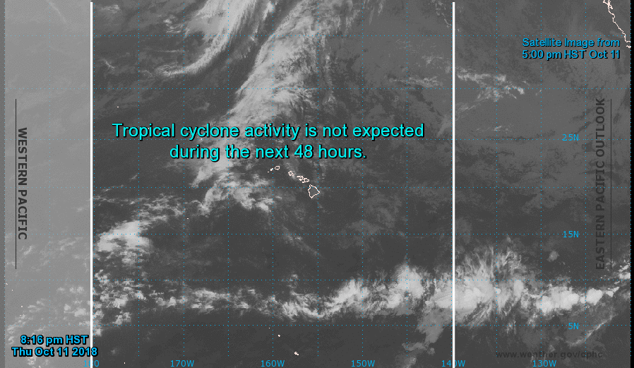
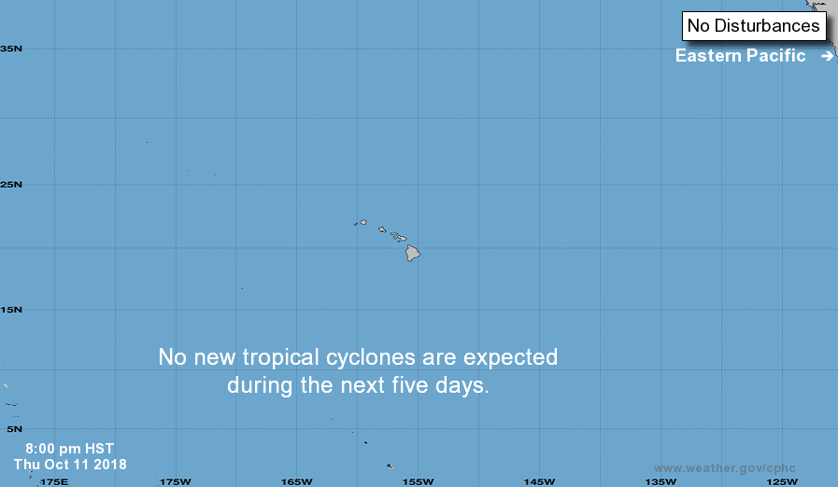
Tropical Outlook – Central Pacific
5 Day Outlook
48 Hour Outlook
Notes:
6

Slide 7
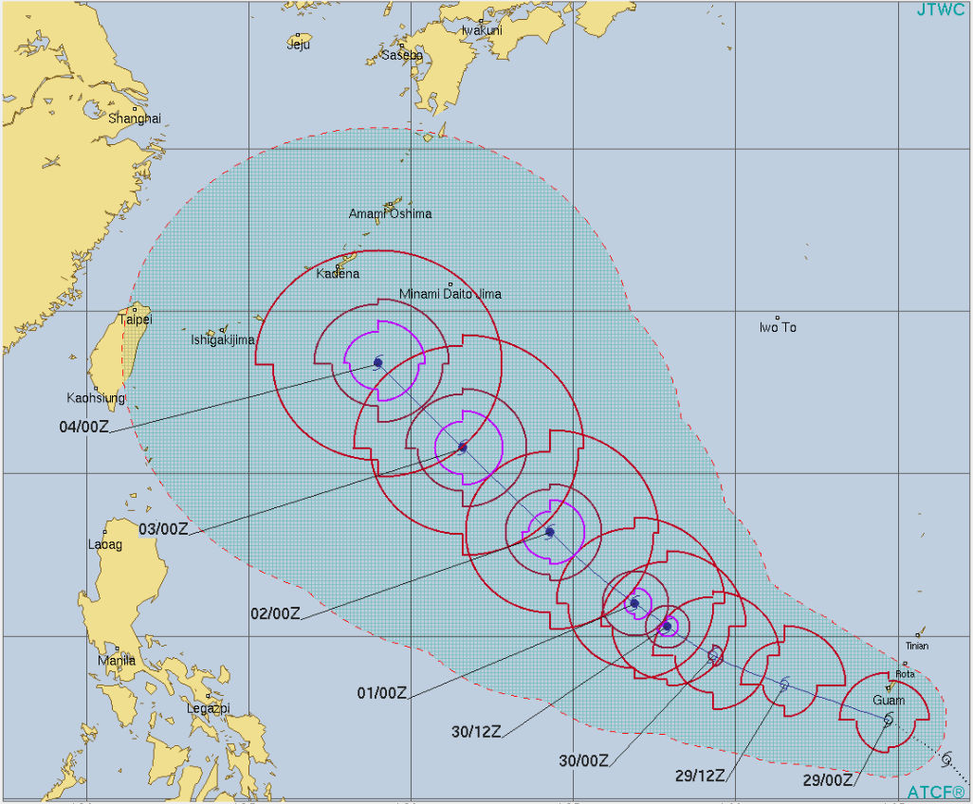
Tropical Outlook – Western Pacific
Tropical Depression 30W (Advisory #6 as of 5:00 a.m. EDT) - FINAL
175 miles WSW of Guam
Moving W at 24 mph, away from Guam and Rota
Maximum sustained winds 40 mph
Damaging winds are no longer a threat but seas and winds are still hazardous for small craft and high surf will linger through Sunday
Tropical Storm Watch has been cancelled for Guam but High Surf and Small Craft Advisories remain in effect
Guam and CNMI EOCs are at Normal Operations
Notes:
7

Slide 8
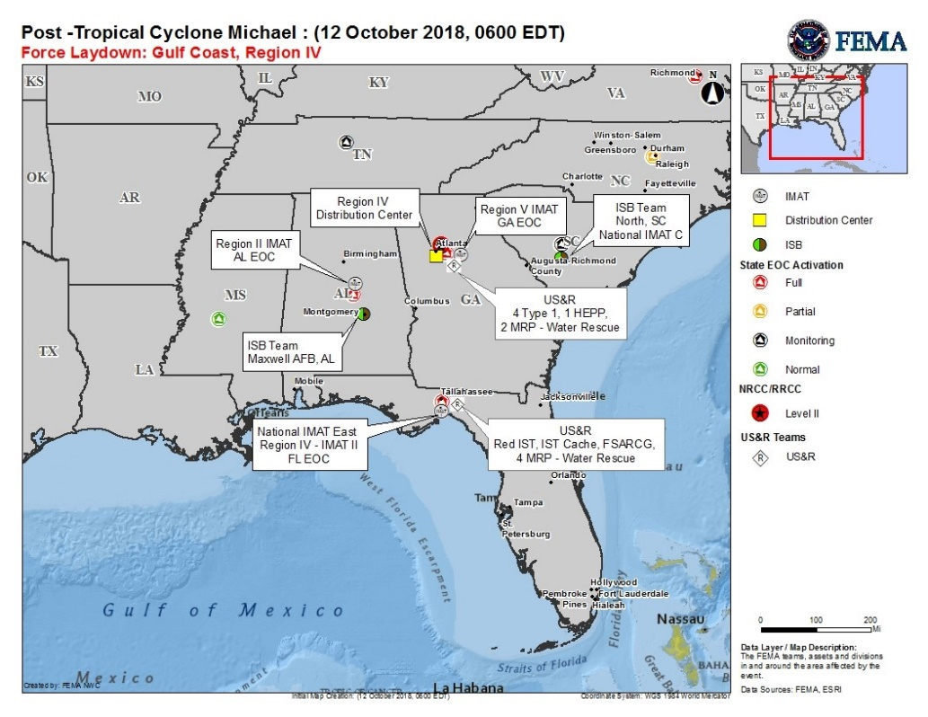
Tropical Storm Michael
FEMA HQ/Federal Response
NRCC at Level I (24/7) with all LNOs and all ESFs
National IMAT East deployed to FL EOC
Region II IMAT deployed to AL EOC
Region V IMAT deployed to GA EOC
ISB Team deployed to Montgomery, AL
Staging areas: Montgomery, AL (Maxwell AFB); Fayetteville, NC (Ft Bragg); North AF AUX, SC
FEMA Region IV
RRCC at Level I (24/7) with all ESFs, DCO/DCE and DHS NPPD
LNOs deployed to FL, GA and AL
IMAT-2 deployed to FL EOC
Notes:
https://www.nhc.noaa.gov/refresh/graphics_at4+shtml/174338.shtml?mltoa34#contents

Slide 9
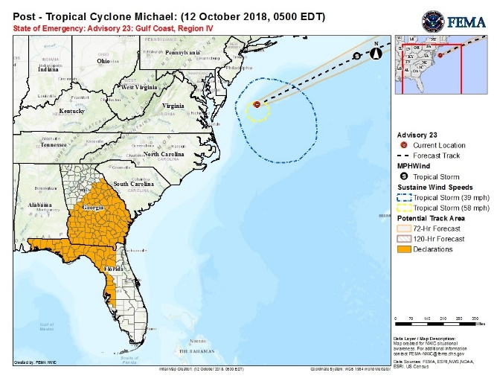
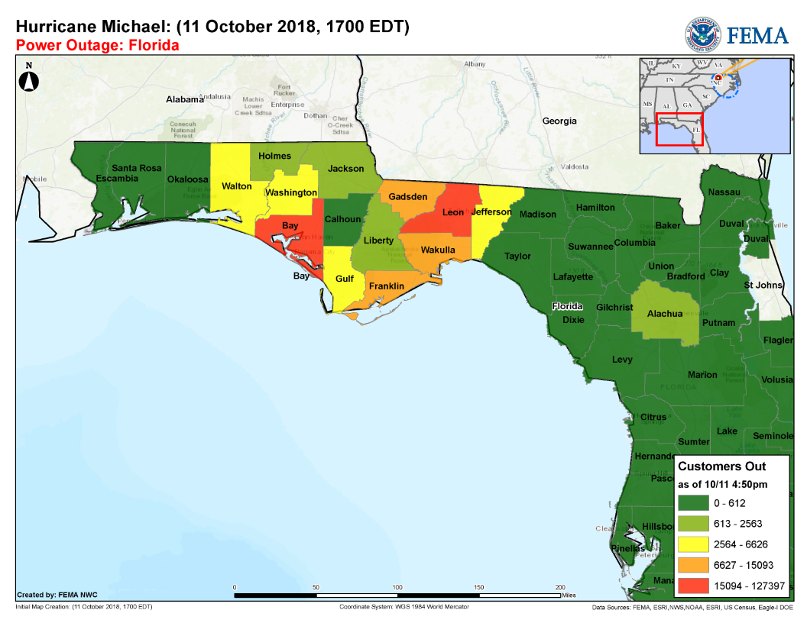
Tropical Storm Michael
State/Local Response
AL EOC at Full Activation:
Governor declared a statewide state of emergency
Governor requested an Emergency Declaration on October 10
FL EOC at Full Activation:
Governor declared a state of emergency for 35 counties
Emergency Declaration FEMA-3405-EM-FL approved on October 9
Major Disaster Declaration FEMA-4399-DR-FL approved on October 11
GA EOC at Full Activation:
Governor declared state of emergency for 108 counties
Emergency Declaration FEMA-3406-EM-GA approved on October 10
NC EOCs at Partial Activation: Governors declared a statewide state of emergency
SC returned to Monitoring
TN EOC at Monitoring (EMAC support)
VA EOC at Full Activation; Governor declared a state of emergency
DE EOC at Monitoring
Notes:
https://www.nhc.noaa.gov/refresh/graphics_at4+shtml/174338.shtml?mltoa34#contents

Slide 10
Tropical Storm Michael
Safety and Security
US&R:
Pensacola, FL: Red IST, IST cache, FSARCG
Maxwell AFB, AL: 4 NIMS Type -1; 2 MRPs – water rescue; 1 HEPP
Panama City, FL: 4 MRPs – water rescue conducting ground based wide area search operations
Food, Water, Sheltering
Shelters/Occupants: FL: 33/3,846; AL: 2/26 GA: 4/53; SC: 16/75; NC: 5/0 (ESF 6)
FL: Mandatory evacuations for 6 counties; voluntary evacuations for 5 counties
Water: FL: Water to Okaloosa Island shut off; Bay county under boil water advisory; GA: 7 counties under boil water advisories
Health and Medical
GA (of 139 medical facilities) 2 Dialysis centers closed
FL: 4 hospitals, 41 dialysis centers, 9 nursing facilities and 14 assisted living facilities closed; 4 Hospitals and 4 nursing facilities evacuated
HHS DMATS: FL: 6; AL 1 (and 1 DMORT); 1 cache staged in Atlanta, GA
Energy
Power Outages: (as of 7:45 am EDT) (Region IV ESF 12)
VA – 517k; NC -497k; FL – 351k; GA – 305k; SC – 700k; AL – 66k
Communications
Cellular networks over 90% available across affected regions with localized outages
Transportation
Hwy:
Multiple roads, bridges and interstates closed
Airports:
FL: All civilian airports in Florida are open
GA: All airports open
AL: Dothan Regional re-opened
Port Conditions:
FL: Cedar Key, Panama City, and all ports from Tarpon Springs north closed (Zulu). Pensacola has reopened
GA: Savannah and Brunswick open with restrictions
AL: All ports open
(*Note: Customer outage data is provided by the Department of Energy’s EAGLE-I system. Comprehensive National coverage of all electrical service providers is not available )
Notes:
http://www.wpc.ncep.noaa.gov/exper/nationalforecastchart/nfc-static.php

Slide 11
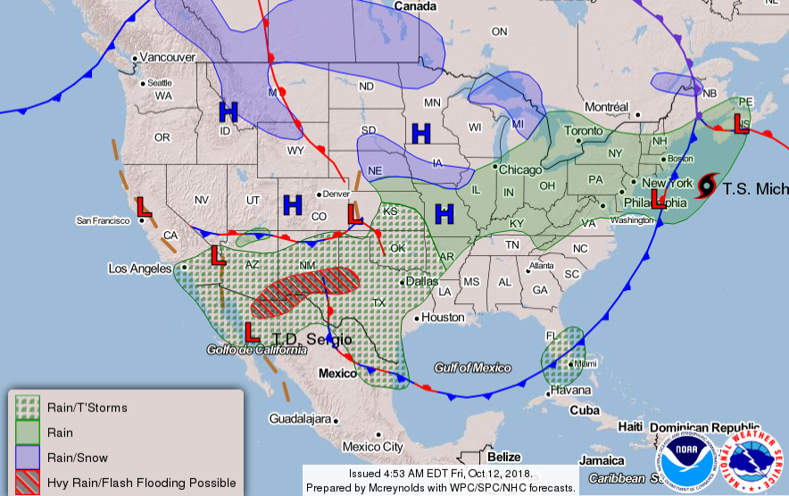
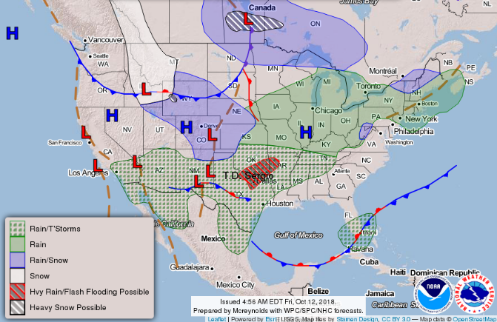
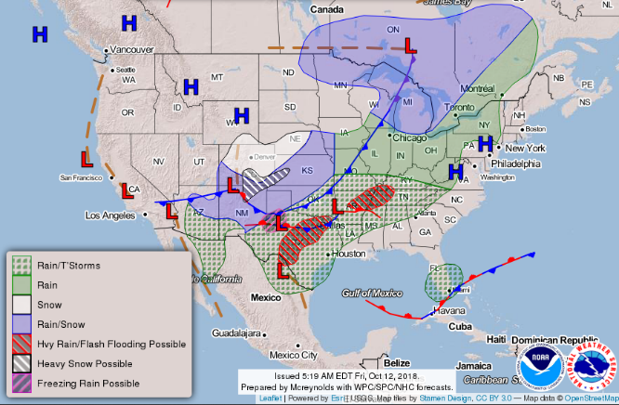
National Weather Forecast
Fri
Sat
Sun
Notes:
http://www.wpc.ncep.noaa.gov/exper/nationalforecastchart/nfc-static.php
Updates approx. 5am/pm

Slide 12
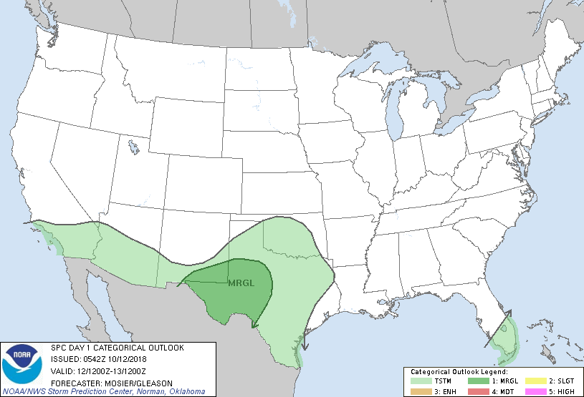
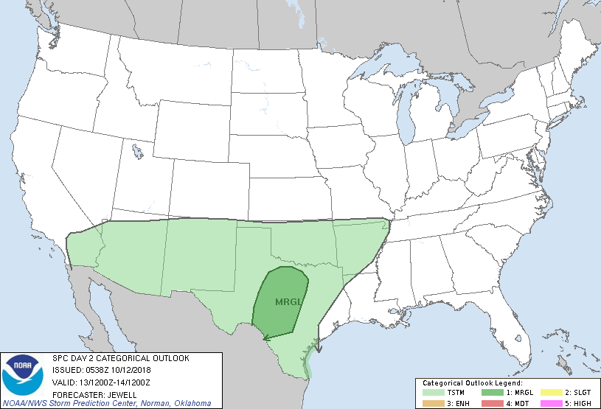
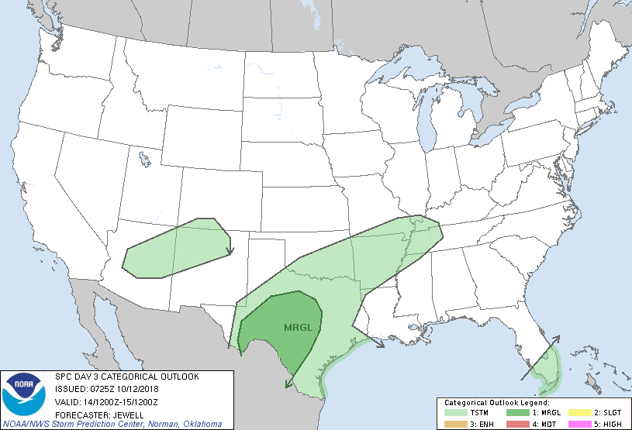
Severe Weather Outlook
Fri
Sat
Sun
Notes:
Only brief when “ENHANCED”, slide is hidden otherwise
http://www.spc.noaa.gov/products/outlook/day1otlk.html

Slide 13
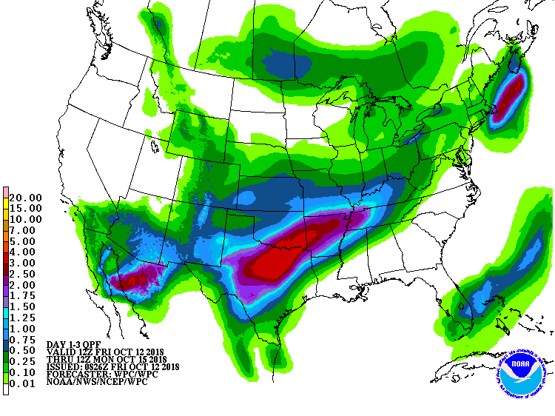
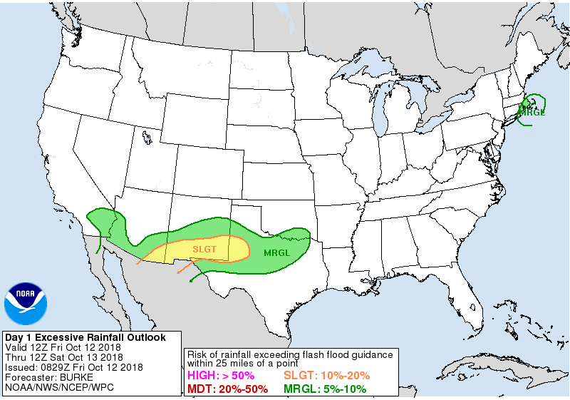
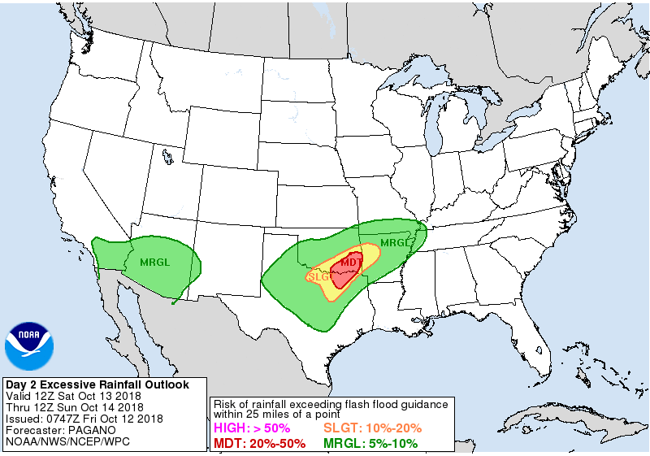
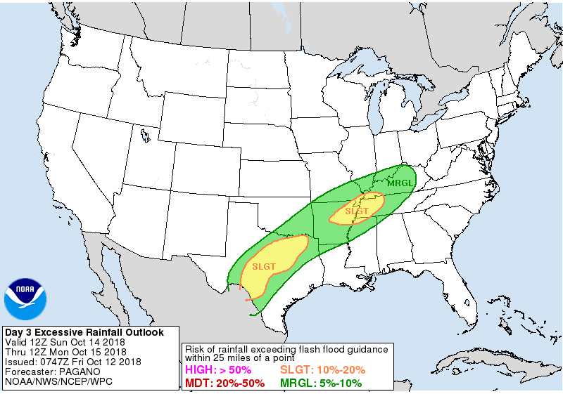
Precipitation / Excessive Rainfall Forecast
Fri - Sun
Fri
Sat
Sun
Notes:
Briefed by exception when “Slight” risk or higher
http://www.wpc.ncep.noaa.gov/qpf/day1-3.shtml
http://www.wpc.ncep.noaa.gov/qpf/excess_rain.shtml

Slide 14
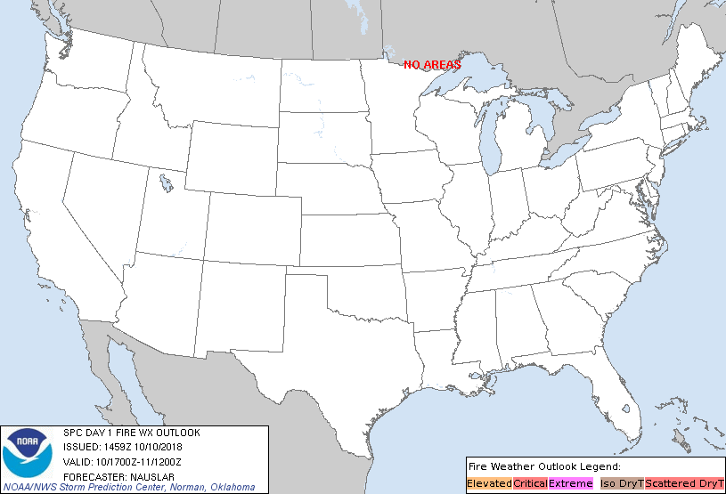
Fire Weather Outlook
Thursday
Friday
Notes:
**Only brief/show when critical or above** but decision is up to NOAA LNO; still unhide in transmitted copy, same as Space Weather
http://www.spc.noaa.gov/products/fire_wx/fwdy1.html

Slide 15
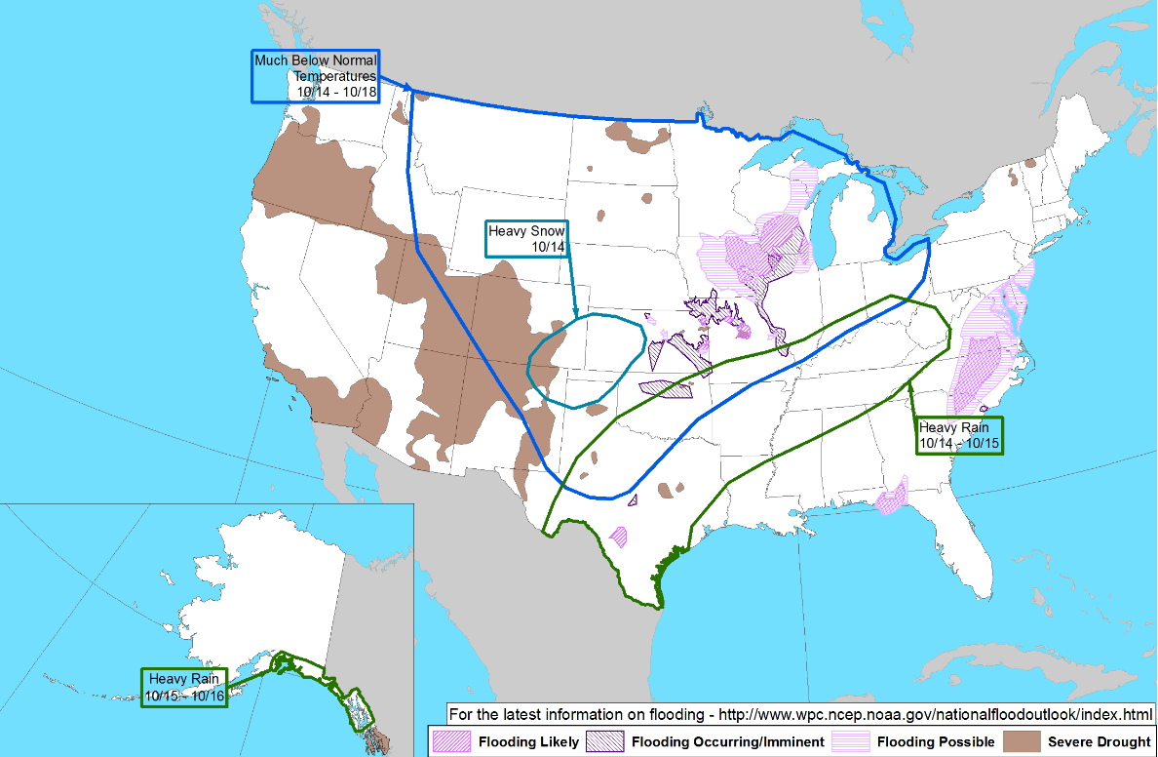
Hazards Outlook – Oct 14-18
Notes:
http://www.cpc.ncep.noaa.gov/products/predictions/threats/hazards_d3_7_contours.png

Slide 16
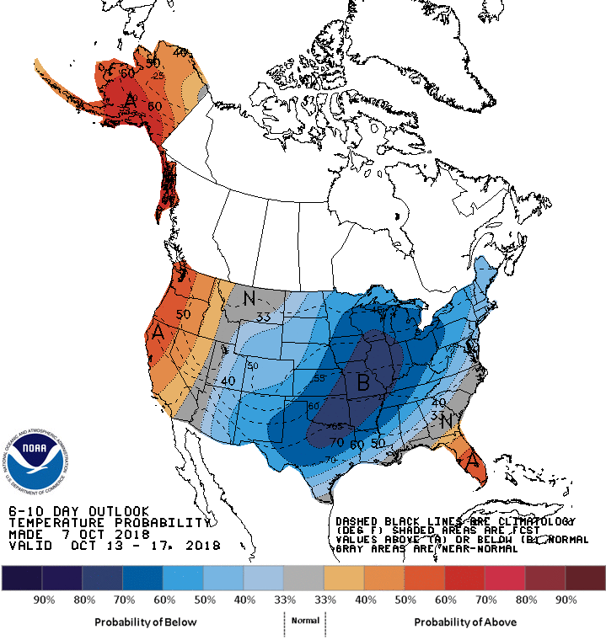
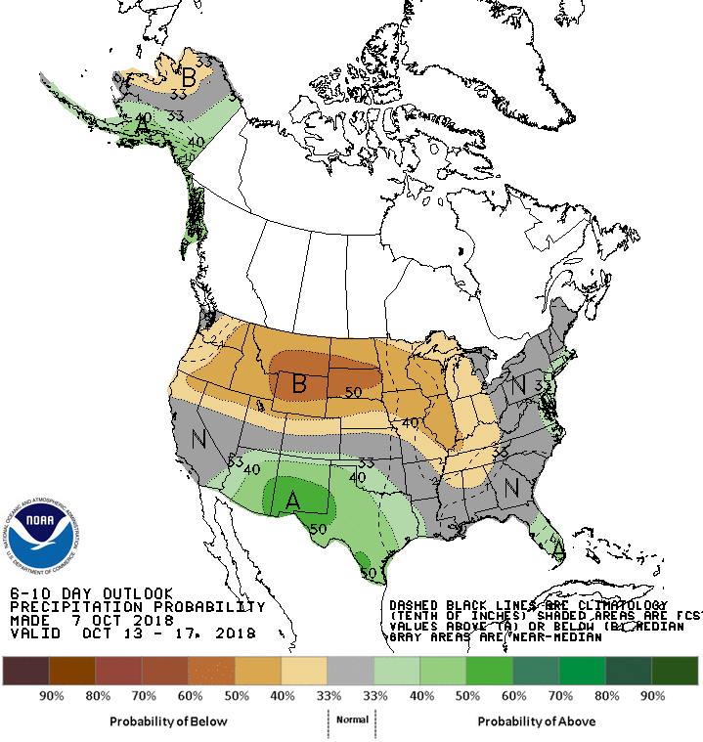
Long Range Outlooks – Oct 13-17
6 - 10 Day Temperature Probability
6 - 10 Day Precipitation Probability
Notes:
http://www.cpc.ncep.noaa.gov/products/predictions/610day/610temp.new.gif
http://www.cpc.ncep.noaa.gov/products/predictions/610day/610prcp.new.gif

Slide 17
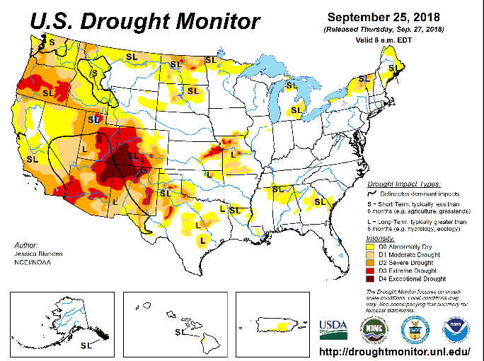
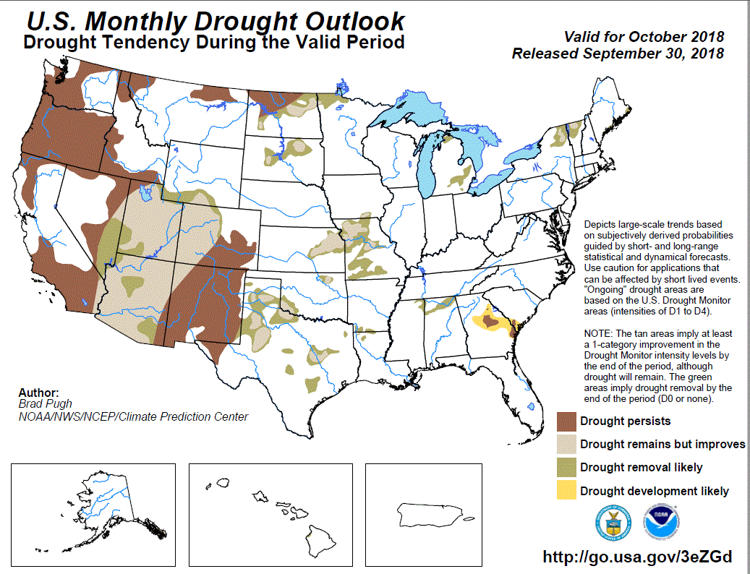
U.S. Monthly Drought Outlook
http://droughtmonitor.unl.edu/
Notes:
http://www.cpc.ncep.noaa.gov/products/expert_assessment/mdo_summary.php

Slide 18
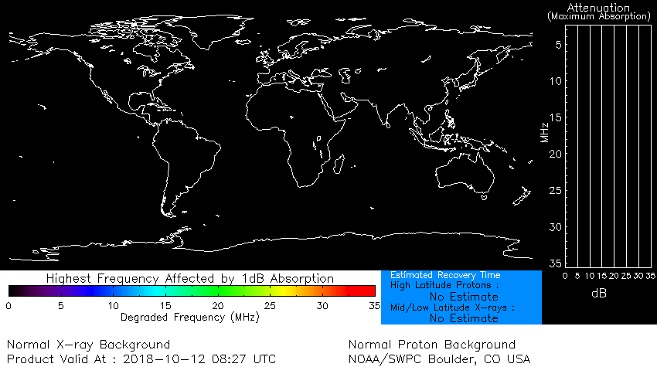
Space Weather
 | Space Weather Activity | Geomagnetic Storms | Solar Radiation | Radio Blackouts
Past 24 Hours | None | None | None | None
Next 24 Hours | None | None | None | None
For further information on NOAA Space Weather Scales refer to: http://www.swpc.noaa.gov/noaa-scales-explanation
HF Communication Impact
Sunspot Activity
Notes:
BLACK MAP: https://www.swpc.noaa.gov/communities/aviation-community-dashboard
TEXT: https://www.swpc.noaa.gov/products/geophysical-alert-wwv-text
SUN: http://www.spaceweather.com/

Slide 19
FMAG Requests and Declarations
Action (since last report) |  |  | Total | FMAG No. and State
Requests DENIED |  |  | 0
Requests APPROVED |  |  | 0
Approved FMAG Data
Fiscal Year | Current FYTD | MTD | Monthly Average* | Cumulative Acres Burned FYTD | Cumulative Denied FMAGs FYTD
2018 | 64 (+2) | 3 (+1) | 6.3 | 858,840 (+18,502) | 8
Fiscal Year | Total Previous FY | Yearly Average** |  | Total Acres Burned Previous Fiscal Year | Total Denied FMAGs Previous Fiscal Year
2017 | 60 | 37.7 |  | 870,016 | 16
* Reflects the three year average for current month
** Reflects three year total average

Slide 20
Joint Preliminary Damage Assessments
Region | State / Location | Event | IA / PA | Number of Counties |  | Start – End
 |  |  |  | Requested | Completed
III | PA | Severe Weather July 21-27, 2018 | IA | 12 | 12 | 9/5 – 9/27
 |  |  | PA | 14 | 12 | 9/5 – TBD
 | PA | Severe Weather August 10-15, 2018 | IA | 14 | 14 | 9/5 – 9/26
 |  |  | PA | 15 | 10 | 9/5 – TBD

Slide 21
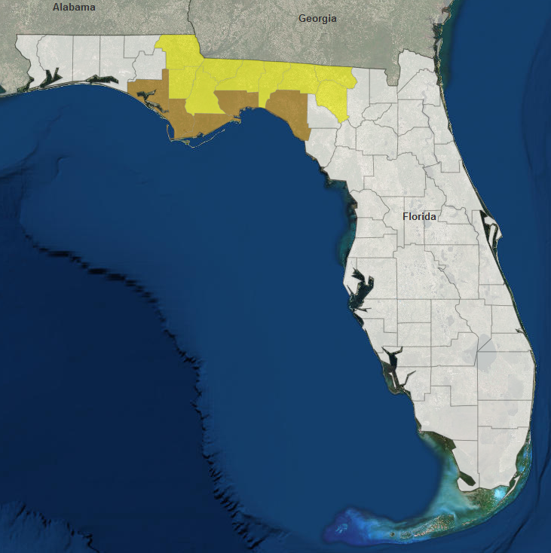
Declaration Approved
FEMA-4399-DR-FL
On October 11, 2018, expedited Major Disaster Declaration FEMA-4399-DR-FL was approved for the State of Florida for Hurricane Michael beginning October 7, 2018 and continuing
Provides:
Individual Assistance for 5 counties
Debris removal and emergency protective measures (Categories A & B), including direct federal assistance, under the Public Assistance program at 75 percent federal funding, for 14 counties
Hazard Mitigation statewide
The FCO is Thomas J. McCool
IA/PA
PA

Slide 22
Disaster Requests & Declarations
Declaration Requests in Process |  |  |  |  | Requests APPROVED (since last report) | Requests DENIED (since last report)
7 | IA | PA | HM | Date Requested | 1 | 0
PA – DR (Appeal) Severe Storms, Flooding, and Landslides |  | X | X | September 7
NC – DR (Appeal) Severe Storms, Flooding, Landslides, and Mudslides | X | X | X | September 19
SD – DR (Appeal) Severe Storms and Flooding |  | X | X | September 25
KS – DR Severe Storms, Straight-line Winds, and Flooding |  | X | X | September 25
VA – DR Hurricane Florence |  | X | X | October 3
WI – DR Severe Storms, Tornadoes, Straight-line Winds, Flooding and Landslides | X | X | X | October 4
FL – DR (Expedited) Hurricane Michael | X | X | X | October 10 | October 11, 2018
AL – EM Hurricane Michael |  | X |  | October 10

Slide 23
Disaster Amendments
Amendment | Date Issued | Action
Amendment No. 1 to FEMA-3401-EM-NC | October 10, 2018 | Closes the incident period effective September 29
Amendment No. 4 to FEMA-4393-DR-NC | October 10, 2018 | Closes the incident period effective September 29

Slide 24
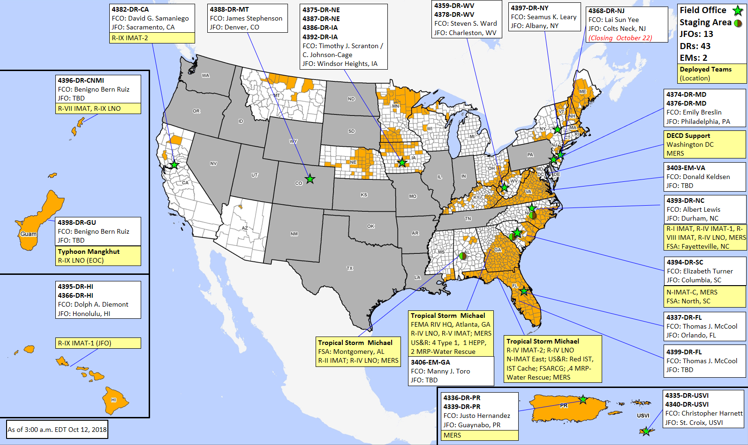
Readiness – Deployable Teams and Assets
Resource | Force Strength | Available |  | Deployed | Other | Cadres with 25% or Less Availability
IM Workforce | 12,219 | 2,488 | 20% | 6,176 | 3,555 | DSA 2% (20/846); EHP 7% (29/426); ER 7% (3/46); FL 22% (34/157); FM 24% (64/270); HM 17% (169/1,013); HR 17% (42/246); IT 15% (94/631); LOG 11% (127/1,189); OPS 18% (50/278); PA 10% (194/1,872); PLAN 21% (71/341); SAF 5% (3/57); SEC 9% (10/116)
National IMATs* (1-2 Teams) | East : | Deployed
 | Composite: | Deployed
 | West: | B-2
Regional IMATs (≤ 3 Teams) | Assigned: | 13
 | Available: | 3
 | PMC / NMC: | 2
 | Deployed: | 8
National ISBs (0 Teams) | Team A | Deployed
 | Team B | Deployed
 | Team C | Deployed
US&R (>33-65%) | Assigned: | 28
 | Available: | 16 (+1)
 | PMC / NMC: | 2 (-1)
 | Deployed: | 10
MERS (>66%) | Assigned: | 36
 | Available: | 26 (-1)
 | PMC / NMC: | 0
 | Deployed: | 10 (+1)
FCO (2 Type I) | Assigned: | 32
 | Available: | 12
 | PMC / NMC: | 0
 | Deployed: | 20
FDRC (≤1) | Assigned: | 13
 | Available: | 3
 | PMC / NMC: | 2
 | Deployed: | 8
* B-2 Status: Assemble ≤ 2-hrs, On Site ≤ 18-hrs; B-48 Status: Assemble and deploy ≤ 48hrs; Charlie Status: No team assemble time requirement
Notes:
National IMATS:
Green: 3 Teams Available
Yellow: 1 - 2 Teams Available
Red: 0 Teams Available
Regional IMATS:
Green: ≥ 7 Teams Available
Yellow: 4 - 6 Teams Available
Red: ≤ 3 Teams Available
National ISB:
Green: 0-1 Team Deployed
Yellow: 2 - 3 Teams Deployed
OCD Readiness:
FCO GREEN YELLOW RED
Type 1: ≥3 =2 ≤1
Type 2: 4 3 2
Type 3: 4 3 2
FDRC: ≥3 =2 ≤1
US&R AND MERS:
>66% GREEN
33 – 65% YELLOW
<33% RED

Slide 25
FEMA Readiness – Activation Teams
Status |  | Activated Team | Activation Level | Activation Times | Reason / Comments
NWC (5 Teams) | Steady State
NRCC (2 Teams) | Activated | Gold | Level I | 24/7 | Hurricane Michael
HLT | Activated
RWC / MOCs (10 Regions) | Steady State
RRCCs (10 Regions) | Activated | Region IV | Level I | 24/7 | Hurricane Michael
Backup Regions: VI, V, & II

Slide 26
FEMA’s mission is helping people before, during, and after disasters.

Slide 27
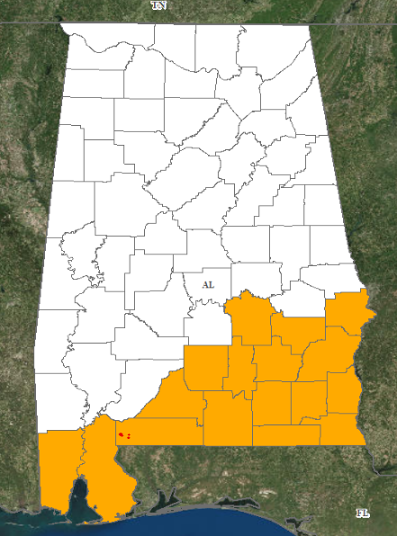
Declaration Request
Alabama
On October 10, 2018, the Governor requested an Emergency Declaration for the State Alabama
For Hurricane Michael beginning on October 10, 2018 and continuing
Requesting:
Debris removal and emergency protective measures (Categories A and B), including direct Federal assistance, under the Public Assistance program for 17 counties, and the Poarch Creek Band of Indians
100% Federal funding for direct Federal assistance for debris removal and emergency protective measures (Categories A and B), including direct Federal assistance, for the first 72 hours
PA

Slide 28
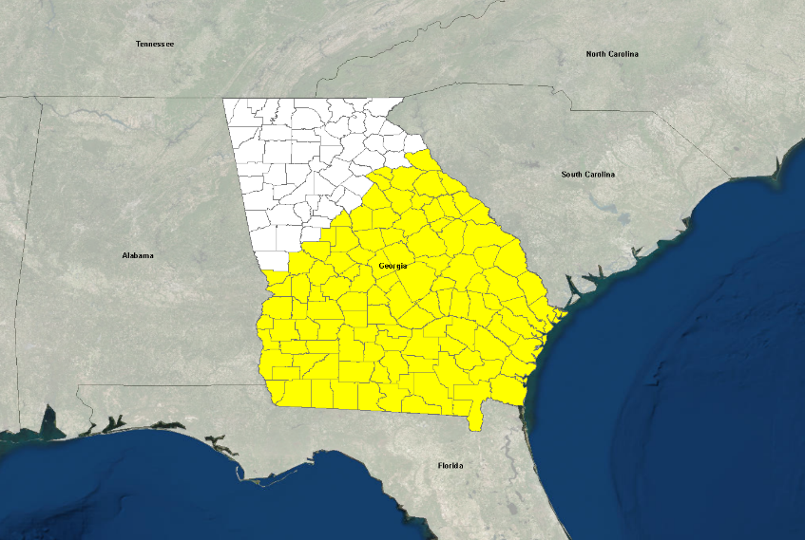
Declaration Request
Georgia
On October 10, 2018, the Governor requested an Emergency Declaration for the State of Georgia
For Hurricane Michael beginning on October 9, 2018 and continuing
Requesting debris removal and emergency protective measures (Categories A and B), including direct Federal assistance, under Public Assistance program at 100% federal cost share for the first 72 hours, for 107 counties
PA

Slide 29
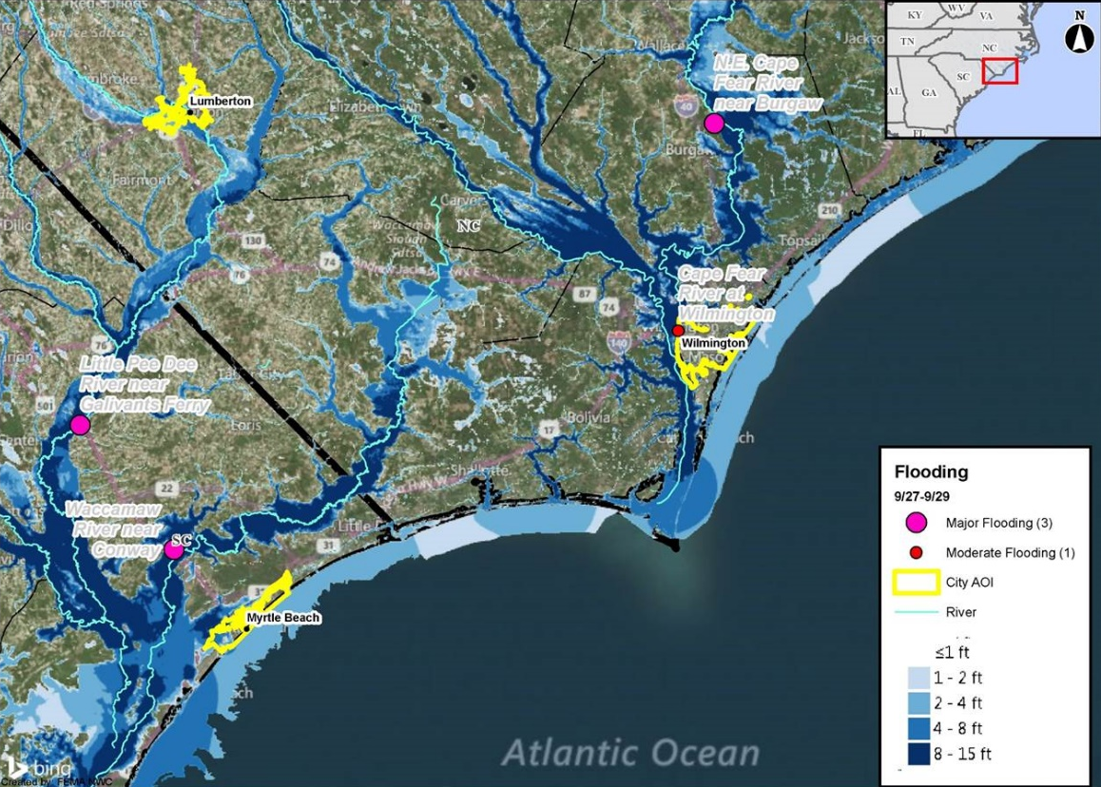
Flood Depth Overview

Slide 30
Disaster Amendments
Amendment | Date Issued | Action
Amendment No. 1 to FEMA-3400-EM-SC | October 9, 2018 | Closes the incident period effective October 8
Amendment No. 5 to FEMA-4394-DR-SC | October 9, 2018 | Closes the incident period effective October 8
Amendment No. 1 to FEMA-4386-DR-IA | October 9, 2018 | Adds one county for Public Assistance

Slide 31
Declaration Request
Kansas
The Governor requested a Major Disaster Declaration on September 25, 2018
For severe storms, straight-line winds, and flooding that occurred September 1-8, 2018
Requesting:
Public Assistance for nine counties
Hazard Mitigation statewide
PA

Slide 32
Nationwide Test of the Emergency Alert System
FEMA, in coordination with the Federal Communications Commission (FCC), will conduct a nationwide test of the Emergency Alert System (EAS) and Wireless Emergency Alert (WEA) on October 3, 2018. More information: https://www.fema.gov/emergency-alert-test
The WEA portion of the test commences at 2:18 PM EDT and the EAS portion follows at 2:20 p.m. EDT.
The EAS test is scheduled to last approximately one minute and is made available to EAS participants including radio and television broadcasters, cable systems, satellite radio and television providers, and wireline video providers.
This is the fourth EAS nationwide test and the first national WEA test. The WEA test message will be sent to cell phones. The WEA test message will read “THIS IS A TEST of the National Wireless Emergency Alert System. No action is needed.”
https://www.fema.gov/emergency-alert-system
https://bit.ly/2PODxVP

Slide 33
Wildfire Summary
Fire Name (County) | FMAG Number | Acres Burned | Percent Contained | Evacuations | Structures |  |  | Fatalities / Injuries
 |  |  |  |  | Threatened | Damaged | Destroyed
Wyoming (1)
Roosevelt (Sublette) FINAL | 5276-FM-WY | 61,511 | 85% | Lifted | 0 (-163) | 1 home | 57 (55 homes) | 0 / 3
Notes:
Briefed before Tropical Weather & National Weather

Slide 34
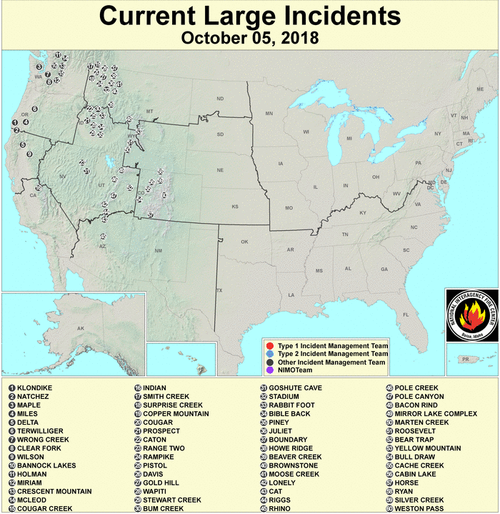
National Fire Activity
National Preparedness Level: 1
Initial attack activity | Light (44) new fires
New large fires | 0
Large fires contained | 8
Uncontained large fires | 12
NIMOs committed | 1
Type 1 IMTs committed | 1 (of 22 teams)
Type 2 IMTs committed | 2 (of 46 teams)
http://activefiremaps.fs.fed.us/lg_fire2.php
http://www.nifc.gov/nicc/logistics/references/Definition_of_PL_Levels.pdf
NIFC lowered the National Preparedness Level to PL 1 on October 4
The change is based on a decrease in national fire activity; the majority of large fires are contained or nearing containment; significant demobilization; and improved fuel conditions as a result of precipitation in the west.
Preparedness Levels range from 1 to 5, with 5 being the highest level.
National Preparedness Level 1: Minimal large fire activity nationally. Most Geographic Areas have low to moderate fire danger. There is little or no commitment of National Resources.
Notes:
Preparedness Level 1: Description: Minimal large fire activity nationally. Most Geographic Areas have low to moderate fire danger. There is little or no commitment of National Resources.
Preparedness Level 2: Description: Several Geographic Areas are experiencing high to extreme fire danger. Wildland fire activity is increasing, and large fires are occurring in one (1) or more Geographic Areas. Minimal mobilization of resources from other Geographic Areas is occurring. There is moderate commitment of National Resources with the potential to mobilize additional resources from other Geographic Areas.
Preparedness Level 3: Description: Two (2) or more Geographic Areas are experiencing wildland or prescribed fire activities requiring a major commitment of National Resources. Additional resources are being ordered and mobilized through NICC. Type 1 and 2 Incident Management Teams are committed in two (2) or more Geographic Areas and crew commitment nationally is at 50%.
Preparedness Level 4: Description: Three (3) or more Geographic Areas are experiencing incidents requiring Type 1 and 2 Incident Management Teams. Competition exists for resources between Geographic Areas. Nationally, 60% of Type 1 and 2 Incident Management Teams and crews are committed.
Preparedness Level 5: Description: Geographic Areas are experiencing major incidents which have the potential to exhaust all agency fire resources. Eighty percent (80%) of Type 1 and Type 2 Incident Management Teams and crews are committed, as well as the majority of other National Resources.

