Slide 1
Conservation Desktop Select Applications Tool (SAT)

Slide 2
Select Application Tool (SAT) Overview
Conservation Desktop - Select Applications Tool (SAT) allows State Program Managers to pre- approve applications from one or more funding pools that have been assessed and ranked in the Conservation Assessment and Ranking Tool (CART).
Allows State Program Managers to pre-approve assessments submitted from CART ranking
Allows multiple pools to be selected for funding for the same application in ProTracts or other funding sources
Pre-approval in SAT must occur before creating Agreement Items in CD to ensure the Items contain the correct funding pool information before submitting to ProTracts
When an assessment is pre-approved, the eligible practices from that ranking pool are selected for funding and only those practices can be submitted to ProTracts
When an assessment is pre-approved no changes can be done in CART. If changes are needed in CART, the assessment needs to be un pre-approved first

Slide 3
SAT Roles – Link to ProTracts permissions
State Roles – Can Pre-Approve & Undo Pre-Approved Assessments in SAT:
ProTracts State Program Manager (State Office and ARCs)
Initial preapproval in CD is done by the SO and then follow-up un-preapproval/preapprovals for minor changes can be done by the ARCs
Do not make changes in CART without ranking been un-preapproved in SAT first
Field Roles - Can view and export data from SAT:
ProTracts- Designated Conservationist (SDC/DC)
ProTracts- Planner (Soil Cons, Soil Con Tech)
ProTracts- Farm Bill Specialist (PA)
ProTracts- Contract Support (Grazing Specialist, Forester, Engineer, Biologist)

Slide 4
Select Applications, Finalize Plan & Contract
CD
Select Applications for Pre-Approval by Ranking Pool- at SO level
Export Report
ProTracts
pre-approve Application- By SDC/DC
CD
Finalize Preapproved Applications
Digitize Practices
Finalize Plan
CD
Agreement Items Tool
Create Items
Submit items to Protracts
ProTracts
Finalize Contract
Pre-Approval updates the following:
CART Ranking Status from Submitted to pre-approved
Assessment and ranking is locked from editing.
Practices are selected for funding

Slide 5
How to export data from SAT
In Conservation Desktop
Go to Programs- Select applications
2. Select State, Program, Ranking Pool, Category (all)

Slide 6
How to export data from SAT
In Conservation Desktop
3. Click search
4. Export – spreadsheet

Slide 7
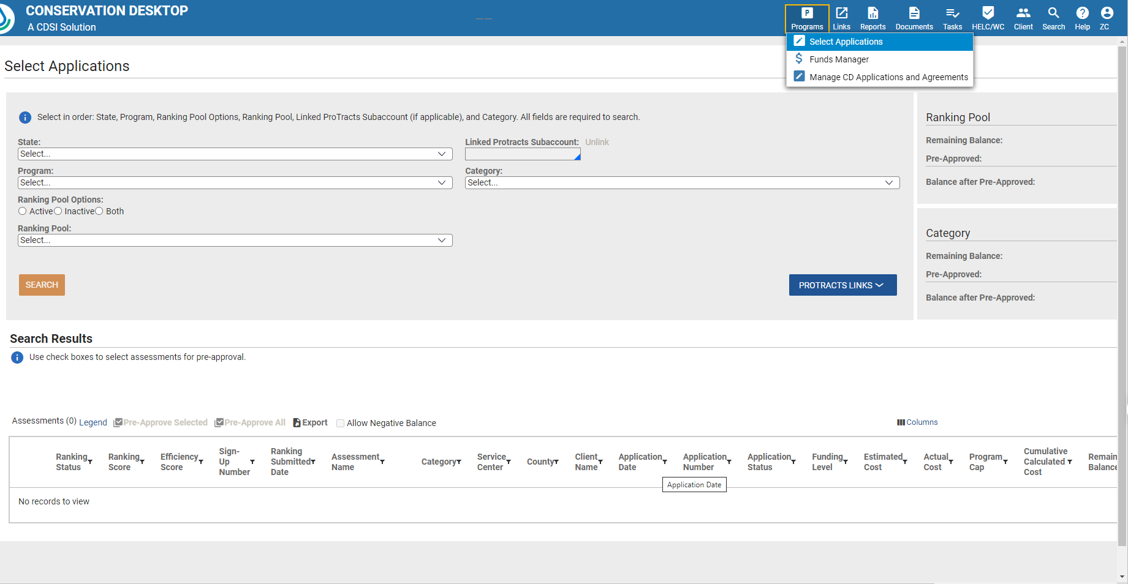
1
2
3
4

Slide 8
Data from SAT report- spreadsheet
Applications will only show in SAT if the ranking has been completed in CART
Information will only be for the selected ranking pool
Need to run report for each fund code
If application was ranked in multiple fund codes, then they will show under those ranking pools in SAT
This is a good way to review if application was ranked in the correct fund code/ranking pool
Ranking status
Completed – ranked but not submitted- application cannot be selected for funding
Submitted – ranking completed- can be selected for funding
Preapproved – selected for funding
Ranking Score
Shows ranking in order regardless of the priority given in Protracts (High, Medium, Low)

Slide 9
Data from SAT report- spreadsheet
Assessment name – shows which practices are included in the ranking pool
Good tool to check if any practice is missing
Estimated vs. Actual Cost
Estimated cost is the one entered in CART at time of application
Actual cost is the one coming from Protracts when plan is uploaded

Slide 10
Notes
Once application ranking is pre-approved in SAT no changes can be done in CART without changing the ranking status
Do not make changes in the assessment with preapproved ranking status
If any changes are needed, application needs to be un pre-approved in SAT
Work with ARC
CD and ProTracts items need to be deleted
Once changes are completed, rank again in CART, then ranking can be preapproved again in SAT
Watch for ranking changes. Compare to initial ranking score
Fund changes (increases, decreases)

