Slide 1
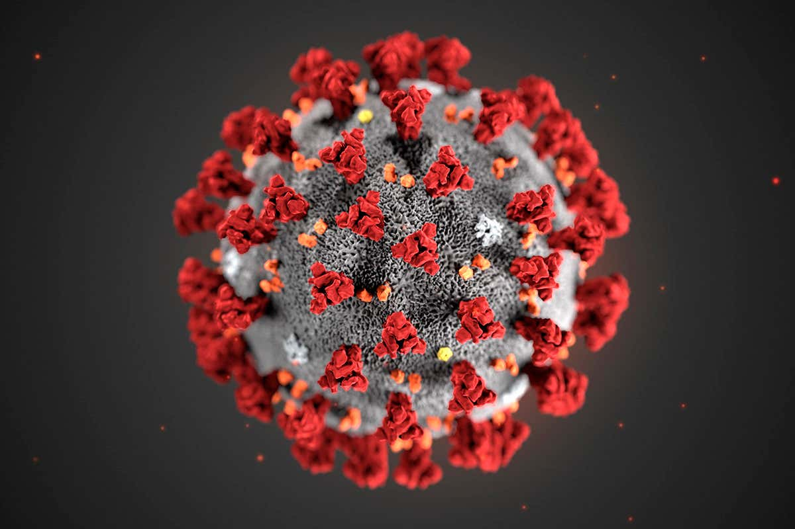
Utah Hospital Association #MaskUpUtah
July 13, 2020

Slide 2
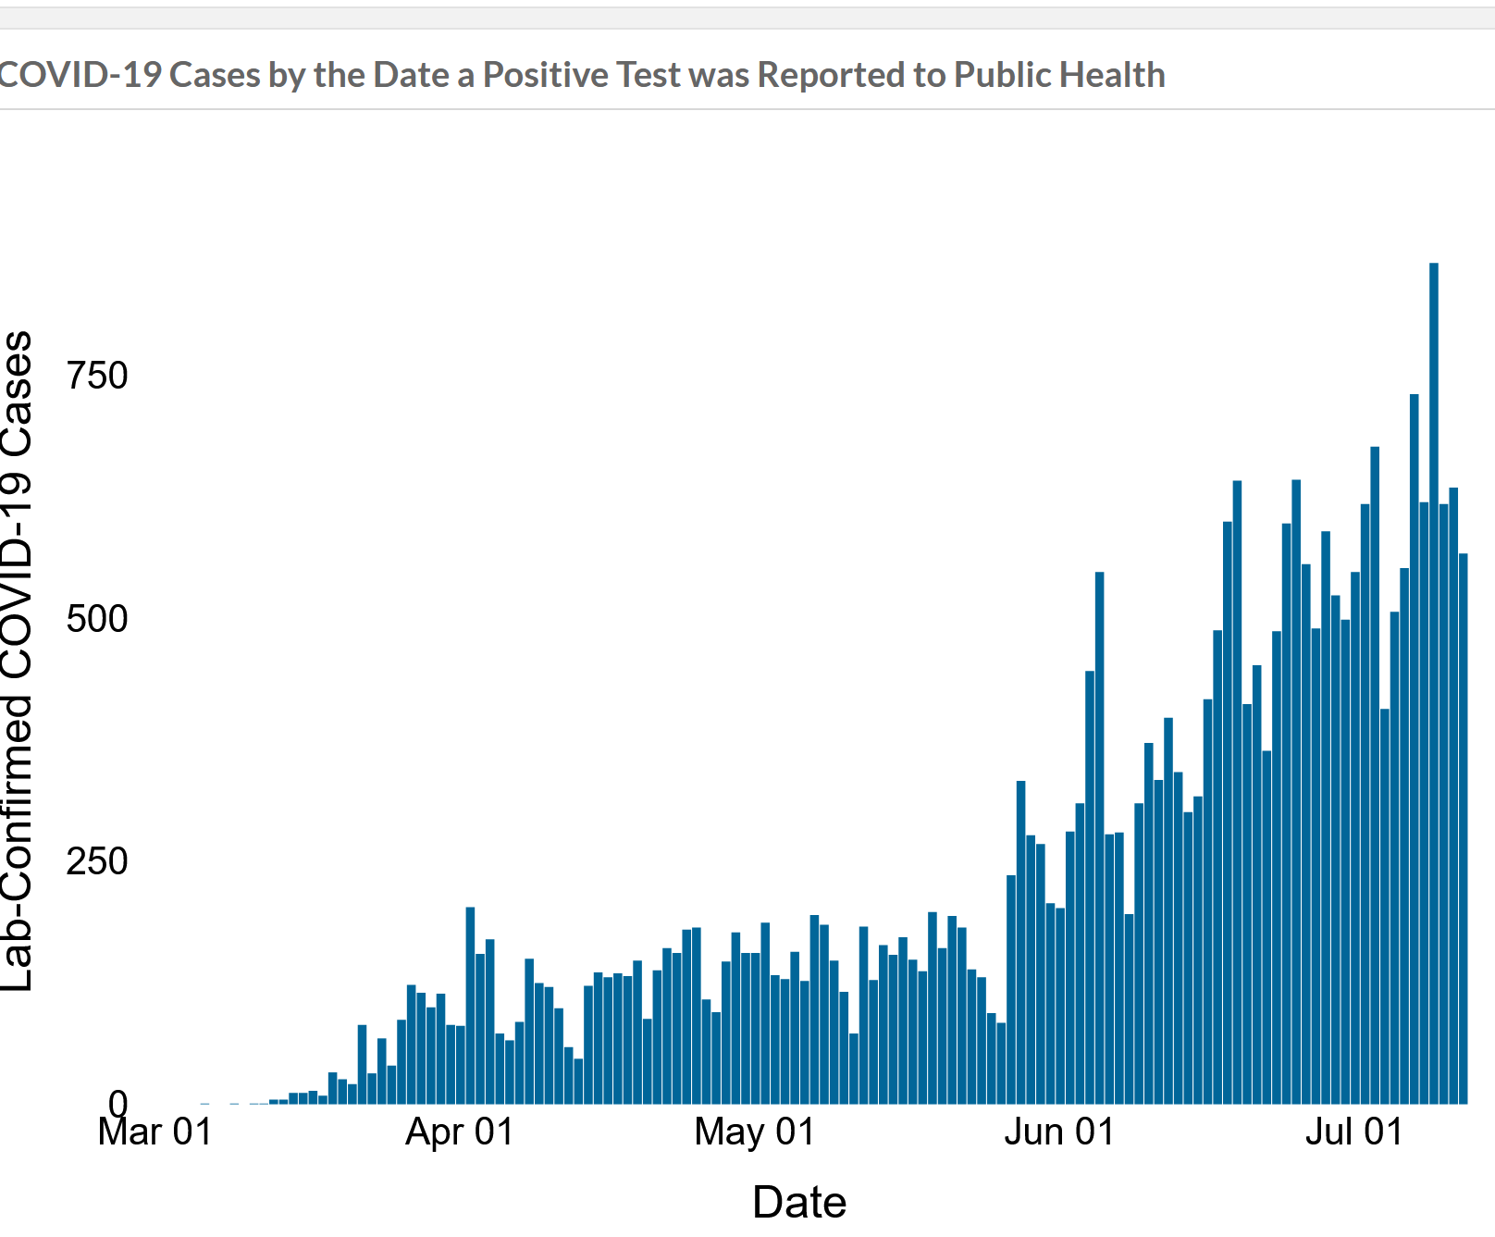
New Cases

Slide 3
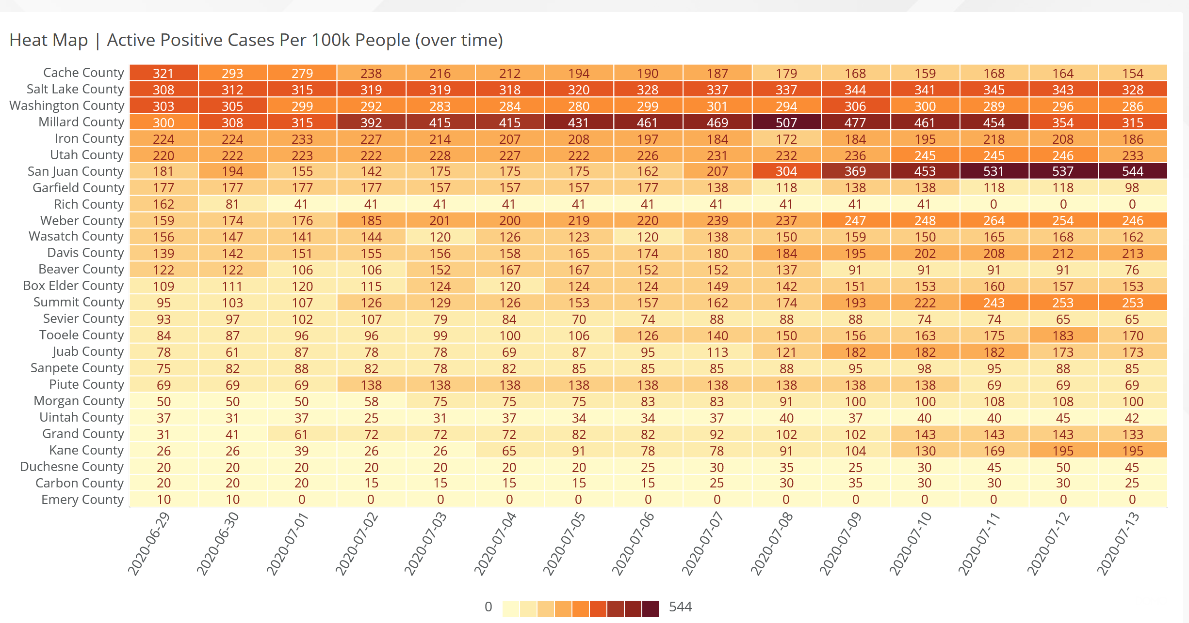
Heat Map

Slide 4
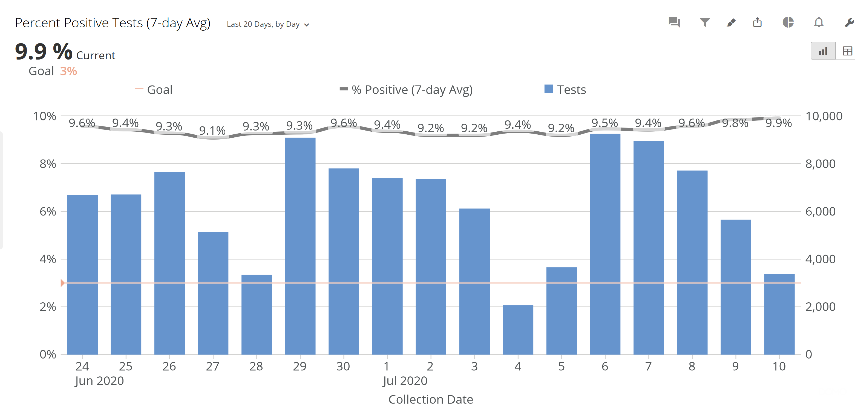
Positive Test Percentage

Slide 5
Goldman Sachs Study On Efficacy of Masking
“Our baseline estimate is that a national mandate could raise the percentage of people who wear masks by 15pp (percentage points) and cut the daily growth rate of confirmed cases by 1.0pp to 0.6%.” GOLDMAN SACHS.
https://www.goldmansachs.com/insights/pages/face-masks-and-gdp.html

Slide 6
Masking vs. Lockdowns Avoids 5% GDP Loss
Their “calculations imply that a face mask mandate could potentially substitute for lockdowns that would otherwise subtract nearly 5% from GDP.”
https://www.goldmansachs.com/insights/pages/face-masks-and-gdp.html

