Slide 1
CARES Act: Local Distribution
Allocation: Population
Under the CARES Act cities or counties with populations over 500,000 could receive a direct allocation from the 45% local allocation based on population.
Utah and Salt Lake Counties were the only two counties that qualified for a direct allocation.
Based on population Salt Lake County received approximately $203 Million and Utah County received $111 million.
That leaves $247 million to be distributed to local governments.
Salt Lake County
$203 Million
Utah County
$111 Million
27 Counties & Cities and Towns
$247 Million

Slide 2
CARES Act: Local Distribution
Distribution in 3 Tranches: To Counties and Cities and Towns outside of SL/UT Counties
June:
  Distribution of 1/3 of allocation based on population
Summer:
  Distribution of 1/3 of allocation based on population or updated formula
Early Fall:
  Distribution of 1/3 of allocation based on population or updated formula
City A: Population 100 (100 X 87.50 = $8,750)
City B: Population 250 (250 X 87.50 = $21,875)
County: Population 400 ((350 X 87.50)+(50 X 175) = $39,375)
Tranche 1
City A: $2,916.67
Tranche 2
City A: $2,916.67
Tranche 3
City A: $2,916.67
City B: $7,291.67
County: $13,125
City B: $7,291.67
County: $13,125
City B: $7,291.67
County: $13,125

Slide 3
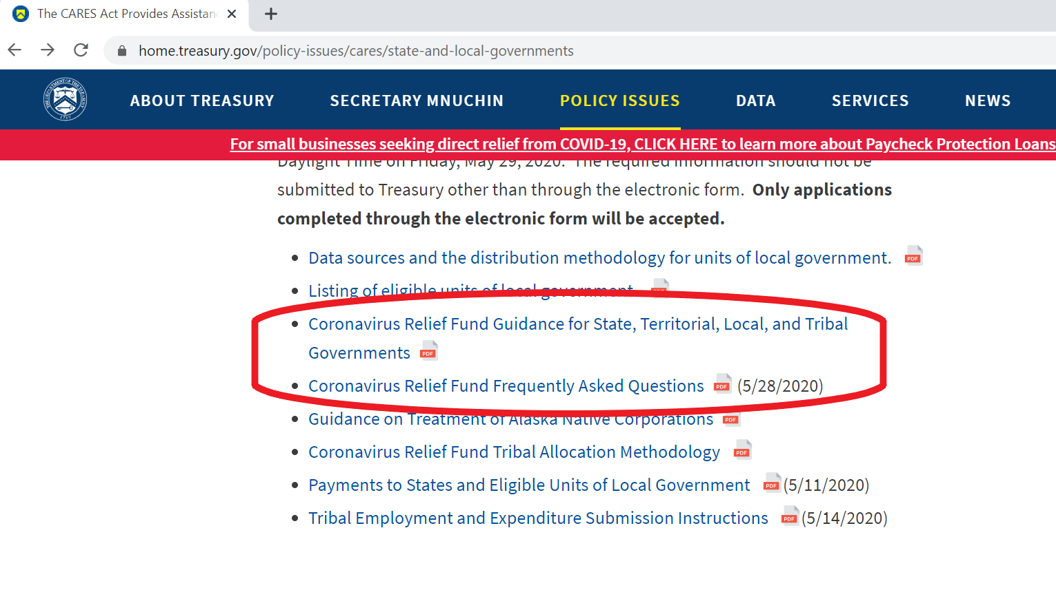
CARES Act: Treasury Guidance
https://home.treasury.gov/policy-issues/cares/state-and-local-governments
FAQs
Guidance for State, Territorial, Local, and Tribal Governments

Slide 4
CARES Act: Treasury Guidance Cont.
To cover unbudgeted expenses directly related to COVID19 expenditures.
Medical
Public Health
Payroll for employees dedicated to COVID19 management
Compliance Costs
Economic Support and revitalization
CARES Act Funding Cannot Cover
  Lost Revenue
  Budget Shortfalls
  Damages
  Payroll for employees not dedicated to COVID19
  Severance Pay
  Workforce Bonuses (Some exceptions)
  Construction projects
  Expenses city/town may have already contemplated

Slide 5
CARES Act: Treasury Guidance Cont.
Payroll expenses: Employees Substantially Dedicated to COVID19
  Public Health, Public Safety, Health Care, Human Services, etc.
    Recommend creating a policy establishing a substantially dedicated
  Federal Family First Act
Reimburse funds used for “substantially different use”
Workers Compensation
  Increased cost between March 1 to December 30, 2020
Grant programs
  Prevent eviction or homelessness, pay rent, funeral costs, emergency needs
  Can’t use grant to pay property tax
Small Business Grants

Slide 6
Salt Lake County and CARES Act: 9 things to know
City chief executive must sign
City must spend by Oct 1
City must adhere to current or future federal guidelines
If Inspector General determines that city spent the $ inappropriately, then the city is liable to repay the fed gov’t
If a city receives funding similar in purpose to the CARES Act, then the city must repay the county
6) The city shall retain documentation of the expenditures
7) The city must post the uses or subgrants on a website or medium available to the public
8) The city must provide a monthly report to the county
9) The city must agree to other standard contractual terms (i.e. indemnity, immunity, etc.)

