Slide 1
Covid19 Response and Reopening

Slide 2
Establishing Guidelines
Govenor’s 4.x Plans
Provo City’s ‘proceed with Caution’ Initiative
Department Operating plan
Staff Training, Communication

Slide 3
Establishing Guidelines
Used 7 Week closure to design plan that best matched our operating practices
Developed early plans on anticipated changes—Forest Fire
Fitness Schedule
Online Membership Sales
Full Department Coordination for staged approach
Focus on amenity access, not programs
Focused on options for residents and not cost recovery rates
Individual activities, not full social experience
Broke our own rules
Released tentative plans to patrons and staff, with caveats
Dynamic and reflexive programs and plans—adapatability!

Slide 4
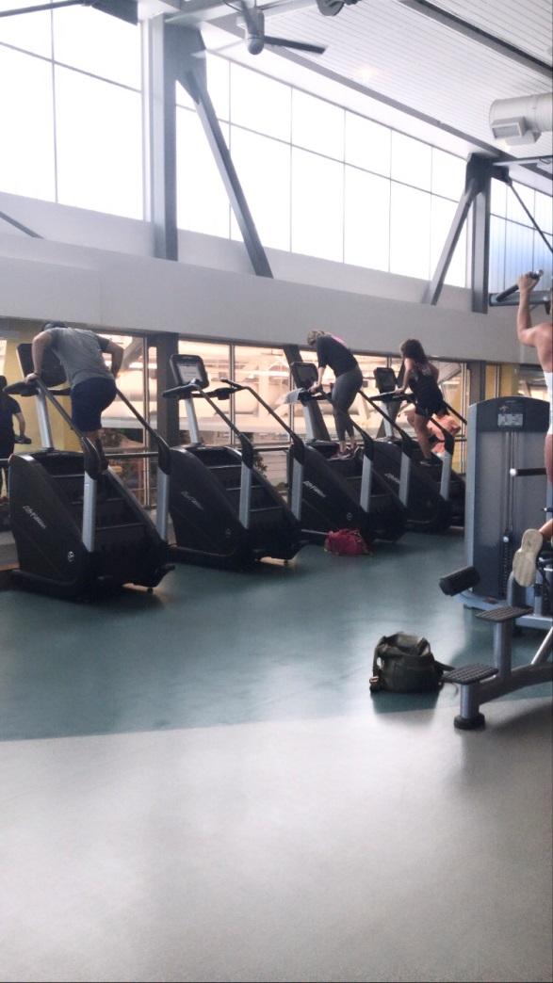
Moderate Operating Plans: Orange
Memberships
Sports
Fitness
Aquatics
Child Watch
Employees

Slide 5
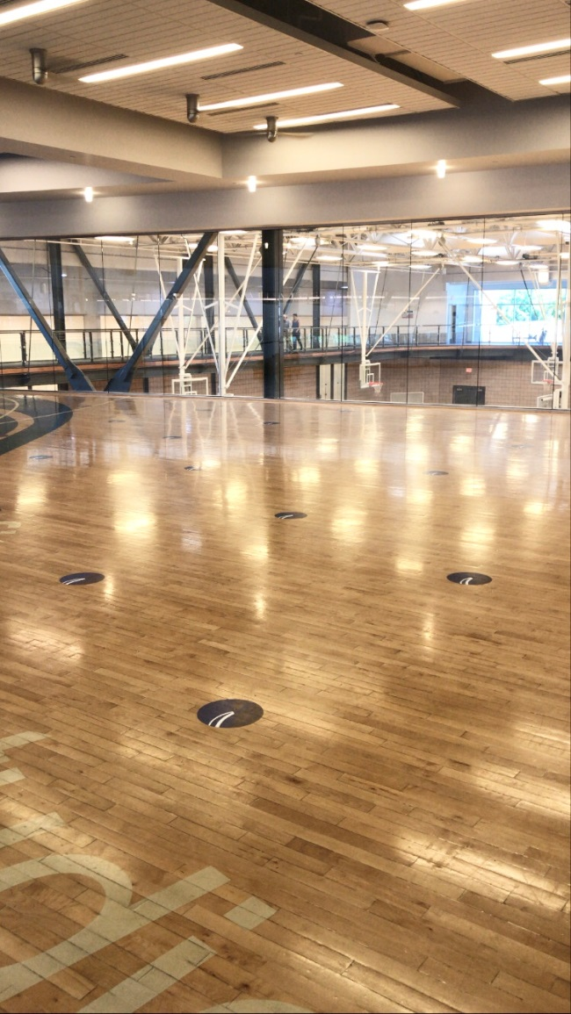
Moderate Operating Plans: Orange
Operating Principles
Education and Opportunity, not enforcement
Protect Relationship, focus long-term
Communicate Shared Responsibility
Stress Front Control Points
Adapt Facility Flow to capacities and control points
Expectation exceeded by experience
Reservations
Lines
Customized Experience

Slide 6
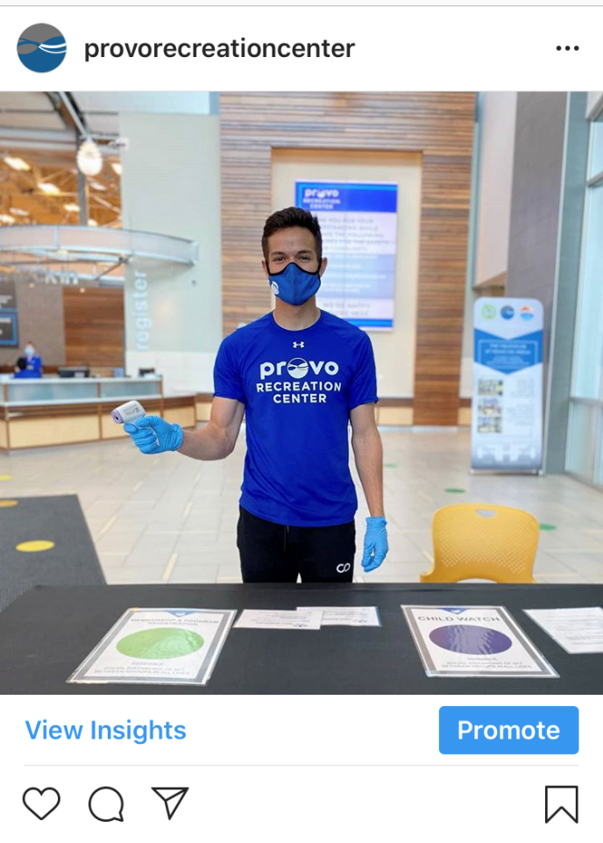
Member Communication
Website Plans
Emails
Social Media, Zoom
In-Facility Signage
City PIO structure

Slide 7
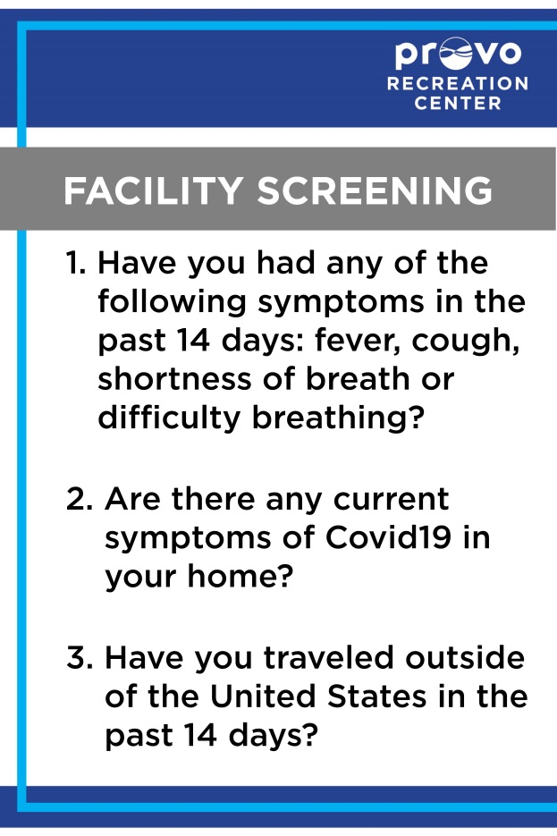
Low Operating Plans: Yellow
Screening in Place
Fitness Capacity
Drop in Sports
Aquatics
Indoor Playground
Senior Amenities

Slide 8
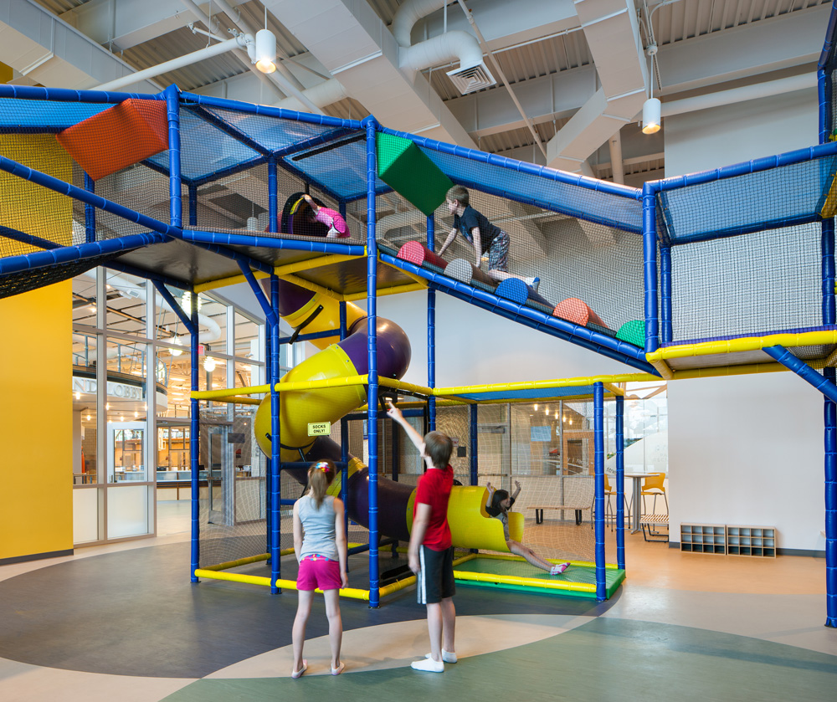
Planning for New Normal: Green
Senior Programs
Sports Leagues
Returning to Events
Staying Flexible

Slide 9
