Slide 1
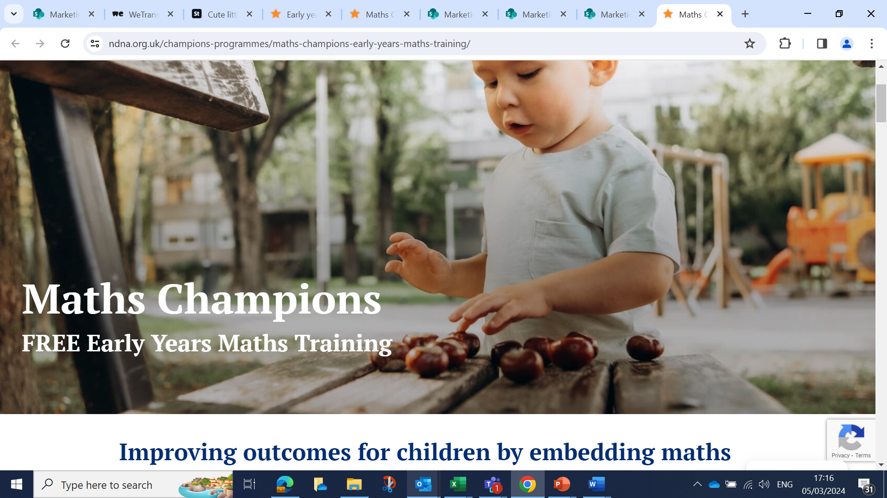
Maths Champions
programme

Slide 2
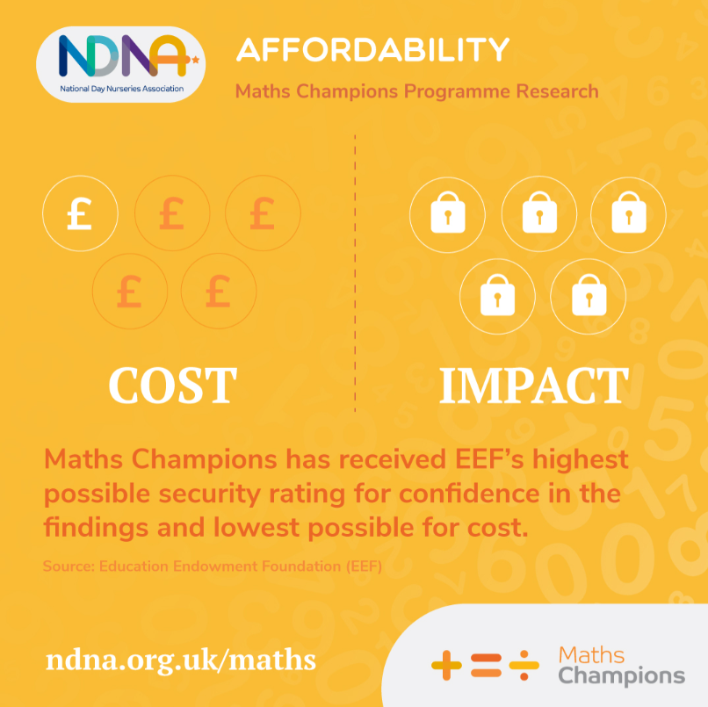
Programme overview
Fully funded Online professional development programme with 12 months’ access
Continuously reviewed to ensure training and resources are based on latest research
Led by Maths Champion with support of Deputy in the setting
Support from an NDNA Early Years Advisor
“My confidence has grown, and I am much more aware of the progression of early number skills, and I feel that I can embed this next year with a new set of children.”

Slide 3
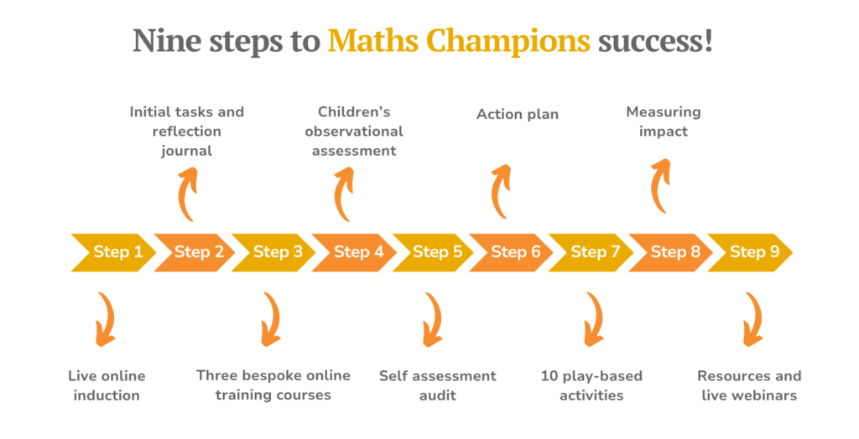

Slide 4


Effectiveness trial and longitudinal analysis
“Having taught in Nursery for over 10 years this programme provided an excellent opportunity for me to review my practice. Very importantly, this included reviewing the environment which impacts greatly on children's learning.”
“My confidence has grown, and I am much more aware of the progression of early number skills, and I feel that I can embed this next year with a new set of children.”
Notes:
This could be removed? I have put the graphic in slide 2

Slide 5
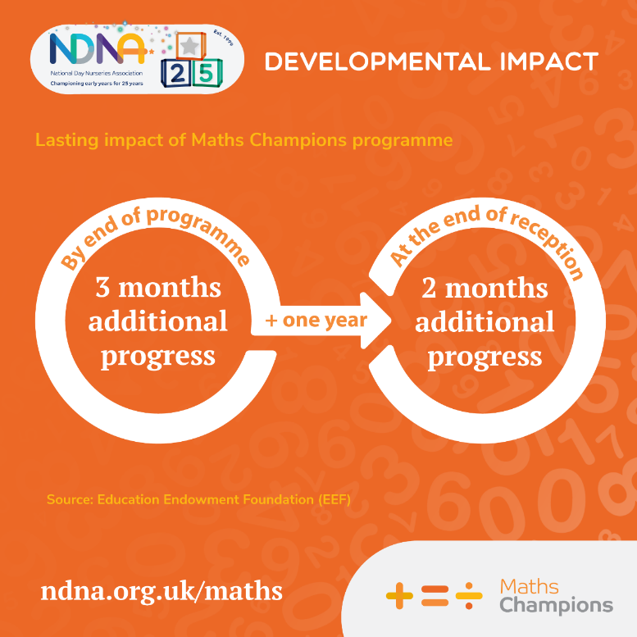

Effectiveness trial and longitudinal analysis
“The majority of children are achieving at least the expected level in Mathematics, and most are achieving well beyond the expected level.” Maintained Nursery Class
Professional development + Improved staff confidence = Better outcomes for children

Slide 6
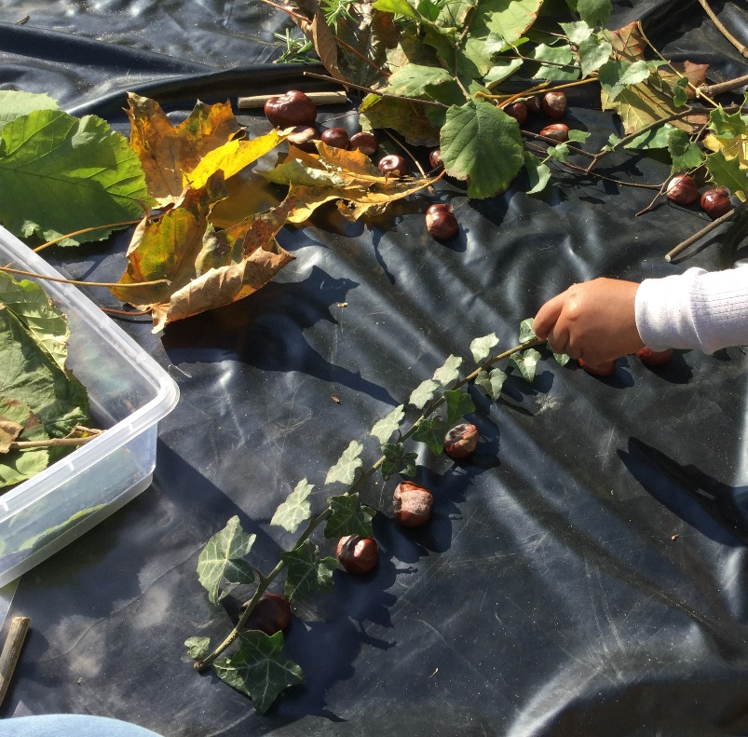
Accessing Maths Champions
PVI, maintained or school-based nursery setting
2 staff members with a Level 3 or higher qualification to act as the Champion and Deputy Champion
Access to a computer
Commitment to complete the programme

Slide 7
Application process
Expression of interest form
(EoI)
Information session
(Optional)
Memorandum of Understanding form
(MoU)
Confirmation email
Next steps call
Induction
Notes:
Maybe this is not needed either?

Slide 8


Slide 9
The difference the Maths Champion programme has made for our setting, our team and the children has been fantastic. The confidence in our teaching has increased and we embraced the programme as a team to provide a maths rich environment.
Who knew we would all become so excited about maths!
Particpating in this programme was so helpful and beneficial to all our children, our parents and our staff. We had amazing feedback from our recent Ofsted inspection as they did a deep dive in Maths, they were so impressed with everything we implemented.
An inspiring and motivating programme!
A really good training opportunity. Helped me gain confidence in mathematical development and share that confidence with others.

Slide 10
“Being involved in the Maths Champions programme has been an amazing experience and one which will impact on the children and staff for years to come.”
PVI Pre-school

