Slide 1
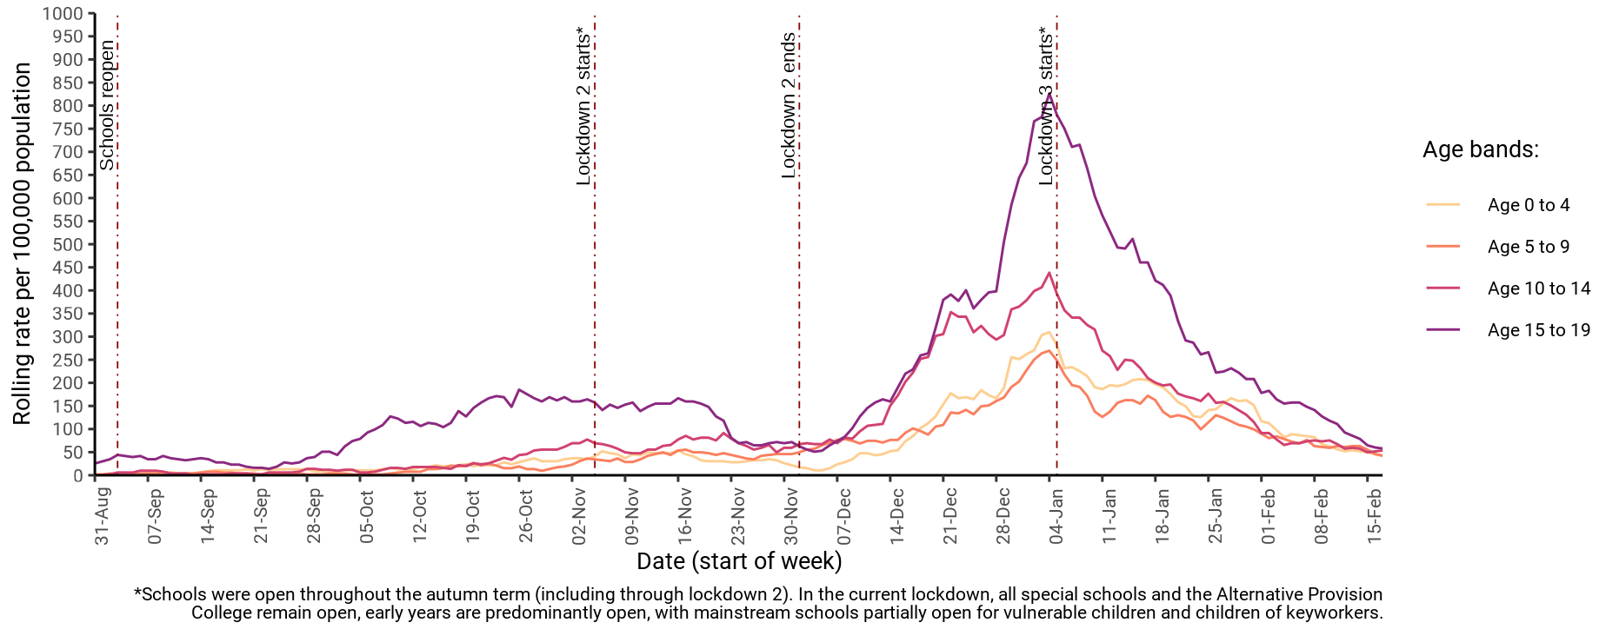
7-day rate of COVID-19 cases among under 20s in West Sussex by age (from 01 Sep 2020 up to 17 Feb 2021)
Number and rate of cases of COVID-19 among children and young people (aged 0 to 19) and all ages in West Sussex to week ending 17-Feb
Area | 0 to 4 years | 5 to 9 years | 10 to 14 years | 15 to 19 years | All ages
Adur | 0 (0 per 100k) | 0 (0 per 100k) | 1 (27.5 per 100k) | 0 (0 per 100k) | 34 (52.9 per 100k)
Arun | 5 (64.8 per 100k) | 9 (104.8 per 100k) | 11 (134.9 per 100k) | 8 (111.8 per 100k) | 217 (135 per 100k)
Chichester | 4 (71.2 per 100k) | 1 (15.2 per 100k) | 2 (30.1 per 100k) | 1 (16.9 per 100k) | 97 (80.1 per 100k)
Crawley | 6 (76.6 per 100k) | 4 (48 per 100k) | 6 (82.6 per 100k) | 4 (66.5 per 100k) | 153 (136.1 per 100k)
Horsham | 2 (27.5 per 100k) | 1 (11.9 per 100k) | 1 (11.3 per 100k) | 1 (13.2 per 100k) | 70 (48.7 per 100k)
Mid Sussex | 3 (35.6 per 100k) | 3 (30.3 per 100k) | 5 (52.3 per 100k) | 10 (124.2 per 100k) | 108 (71.5 per 100k)
Worthing | 0 (0 per 100k) | 4 (62.2 per 100k) | 1 (15.9 per 100k) | 1 (18.6 per 100k) | 83 (75.1 per 100k)
West Sussex | 20 (43.3 per 100k) | 22 (42.1 per 100k) | 27 (53.6 per 100k) | 25 (57.9 per 100k) | 762 (88.2 per 100k)
South East | 251 (48.2 per 100k) | 211 (36.3 per 100k) | 237 (42.2 per 100k) | 363 (71 per 100k) | 7925 (86.3 per 100k)
England | 2152 (65.2 per 100k) | 1915 (54.1 per 100k) | 2041 (60.8 per 100k) | 3229 (104.5 per 100k) | 70422 (125.1 per 100k)

