Slide 1
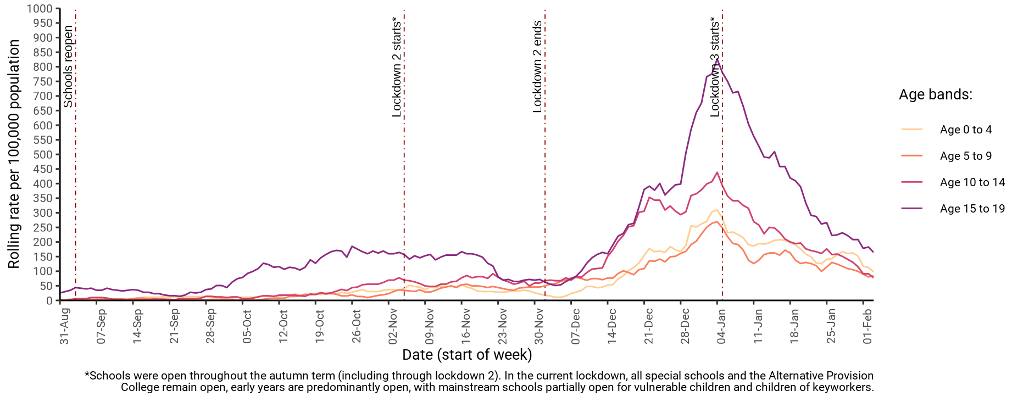
7-day rate of COVID-19 cases among under 20s in West Sussex by age (from 01 Sep 2020 up to 03 Feb 2021)
Number and rate of cases of COVID-19 among children and young people (aged 0 to 19) and all ages in West Sussex to week ending 03-Feb
Area | 0 to 4 years | 5 to 9 years | 10 to 14 years | 15 to 19 years | All ages
Adur | 4 (112.9 per 100k) | 5 (123 per 100k) | 5 (137.6 per 100k) | 8 (261.1 per 100k) | 106 (164.8 per 100k)
Arun | 6 (77.8 per 100k) | 7 (81.5 per 100k) | 14 (171.7 per 100k) | 18 (251.5 per 100k) | 419 (260.6 per 100k)
Chichester | 6 (106.8 per 100k) | 3 (45.5 per 100k) | 3 (45.1 per 100k) | 6 (101.2 per 100k) | 208 (171.7 per 100k)
Crawley | 8 (102.2 per 100k) | 17 (204.2 per 100k) | 6 (82.6 per 100k) | 16 (265.9 per 100k) | 342 (304.2 per 100k)
Horsham | 9 (123.7 per 100k) | 6 (71.6 per 100k) | 2 (22.6 per 100k) | 5 (65.8 per 100k) | 227 (157.9 per 100k)
Mid Sussex | 4 (47.4 per 100k) | 3 (30.3 per 100k) | 5 (52.3 per 100k) | 7 (86.9 per 100k) | 177 (117.2 per 100k)
Worthing | 8 (139.3 per 100k) | 3 (46.6 per 100k) | 4 (63.5 per 100k) | 11 (204.5 per 100k) | 200 (180.9 per 100k)
West Sussex | 45 (97.5 per 100k) | 44 (84.1 per 100k) | 39 (77.4 per 100k) | 71 (164.3 per 100k) | 1679 (194.3 per 100k)
South East | 531 (102 per 100k) | 460 (79.2 per 100k) | 478 (85.2 per 100k) | 757 (148.1 per 100k) | 17221 (187.6 per 100k)
England | 3777 (114.5 per 100k) | 3422 (96.7 per 100k) | 3720 (110.9 per 100k) | 5654 (183 per 100k) | 125341 (222.7 per 100k)

