Slide 1
Starline - *6
Giving Care Homes Priority Access
to NHS 111 Clinicians

Slide 2

NHS 111 Clinical Assessment Service (CAS)
GP’s
Mental Health Nurses
Dental Nurses
Pharmacists
Registered General Nurses
Advanced Nurse Practitioners
Paramedics

Slide 3
The Purpose of Starline
Nationally recognised route to give care home staff priority access to the CAS.
Strengthen clinical support to care homes.
Provide access to a range of clinical staff for advice in a timely manner, including GPs.
Improve patient safety for the frail and elderly.
Improve patient experience.
Not intended to replace existing services.
NHS 111 CAS can escalate to 999 if required.

Slide 4
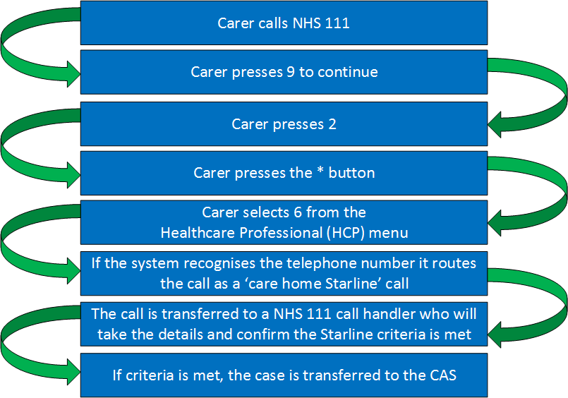
The *6 Process

Slide 5

Memorandum of Understanding
Collaborative agreement which sets out the responsibilities of the NHS 111 CAS and care homes.
Parties working together, acting in good faith and in a transparent manner.
Dedicated/Identifying telephone number.
Starline access, only those homes who sign up.

Slide 6

Accessing Urgent & Emergency Care
SECAmb document intended to provide support and guidance to care home staff who need to call NHS 111/999.
Important points to remember when calling NHS 111/999.
Support care staff to safely assist residents off the floor when it is safe to do so.
Working together ensuring the best possible service for residents.

Slide 7
Questions and Answers
Contact details for Starline initiative:
Colin Simmons
Integrated Urgent Care Programme Director – Sussex CCGs
colinsimmons@nhs.net
07525 303692
Dawn Fourniss
Integrated Urgent Care Business Support Manager – Sussex CCGs
dawn.fourniss@nhs.net
07901 551957
Sean Daisy
Business Support Manager – South East Coast Ambulance NHS Foundation Trust (SECAmb)
Sean.Daisy@secamb.nhs.uk
07393 760366

