Slide 1
Adult Social Care (ASC) settings; West Sussex; COVID-19 summary update

Slide 2
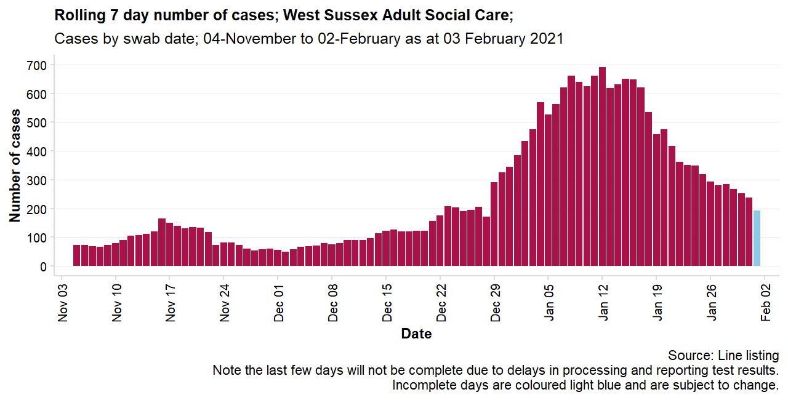




Latest complete 7 days
Previous 7 days
As at Wednesday 3rd February 2021, there have been 4,205 cases linked to a West Sussex Adult Social Care Setting (either as a member of staff* or resident).
7 days to 31/01/2021
7 days to 24/01/2021
Last 7 days:
237 cases
350 cases
Last 14 days:
587 cases
970 cases
*The line listing details cases for individuals who have a West Sussex address. It is possible that individuals who live outside of the county may work in a West Sussex care home. These cases will not be included in this analysis as they will fall under the responsibility of their own residential local authority.
Last 28 days:
1,831 cases
2,069 cases
About 1 in 10 West Sussex cases (11.4%) can be linked to a West Sussex ASC Setting either as a resident or staff member.
Out of 484 settings included, almost three out of four homes (70.2%) have had at least one confirmed COVID-19 case
In the 28 days to 3rd February, 155 homes had two or more cases. Of these, 48 settings have recorded 10 or more cases.
A note on dates:
It can take several days for cases to appear on the line listing and as such the last couple of days cannot be considered complete, as they will almost always show a picture that looks like cases are coming down.
When we talk about the latest 7 days, to consider how cases are changing over time, we mean the time period up to which we think most of the data are in.
In this report we consider data up to Sunday 31st January 2021 as complete.
However, we also want to know about the cases that have been confirmed in the very recent (incomplete) days to respond to new cases as quickly as possible, and to monitor outbreaks (often defined as multiple cases occurring within 28 days of today's date (Wednesday 3rd February 2021).
Table 1 - Summary of ASC cases by service type; 28 days to Wednesday 3rd February
Service | Cases in last 28 days | Settings with cases in last 28 days | Settings with at least two cases in last 28 days | Settings included in analysis
Residential or Nursing | 1,514 | 211 | 140 | 346
Supported living | 33 | 15 | 10 | 124
Extra care | 55 | 8 | 5 | 14

Slide 3
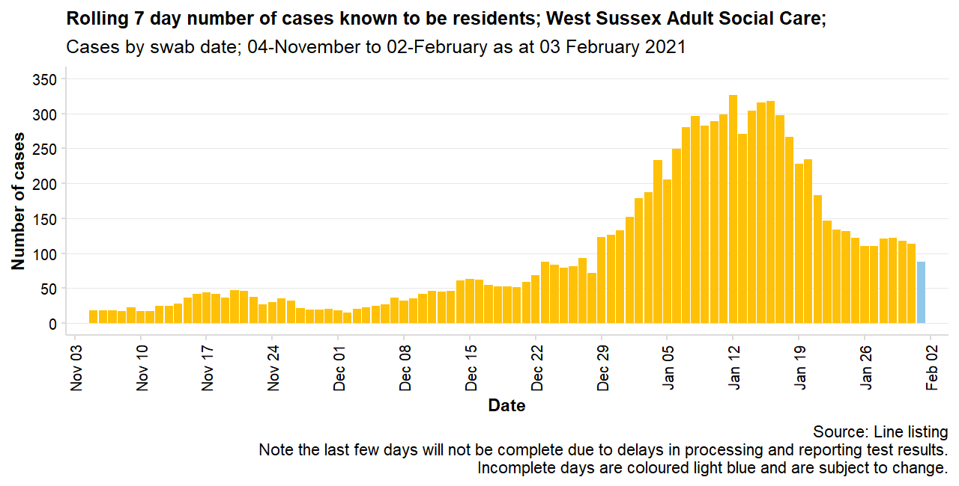
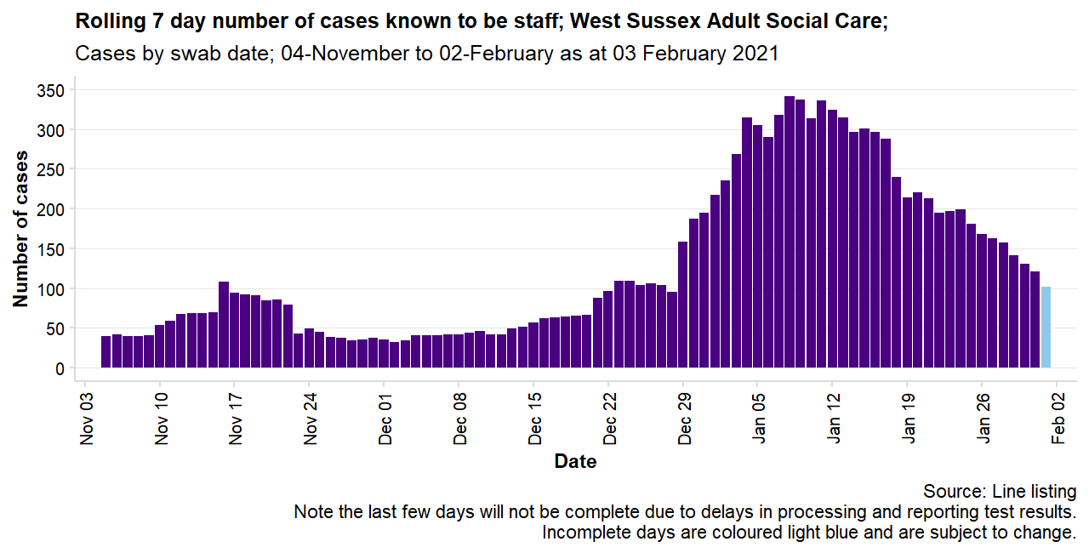
Cases among both residents and staff peaked around the second week of January 2021, before declining.
Staff cases continue to decline, whilst resident cases fell sharply but appear to have plateaued in recent weeks.
In the 28 days to 3rd Feb 2021, there were 739 residents and 789 staff identified as confirmed COVID-19 cases.
Whilst the number of staff with confirmed COVID-19 is higher than the number of residents, the overall trend or pattern of change has been broadly similar with sharp rises towards the end of 2020.
There are estimated to be 12,500 members of staff working across homes in West Sussex and approximately 8,000 adult social care beds in the county. It is likely that COVID-19 positive staff represent a higher proportion of the workforce than COVID-19 positive residents represent the overall resident population.
Table 2 - Summary of all included ASC settings in West Sussex; as at Wednesday 3rd February
Week | Number of settings with at least one new case | Number of new cases | Known to be residents (% of all cases in brackets) | Known to be staff (% of all cases in brackets)
01 Feb to 07 Feb | 18 | 26 | 6 (23.1%) | 19 (73.1%)
25 Jan to 31 Jan | 90 | 237 | 113 (47.7%) | 121 (51.1%)
18 Jan to 24 Jan | 119 | 350 | 132 (37.7%) | 199 (56.9%)
11 Jan to 17 Jan | 134 | 620 | 298 (48.1%) | 288 (46.5%)
04 Jan to 10 Jan | 131 | 624 | 289 (46.3%) | 314 (50.3%)
The number of cases confirmed in the most recent week (1st Feb to 7th Feb) should be considered incomplete and just a total so far.

Slide 4
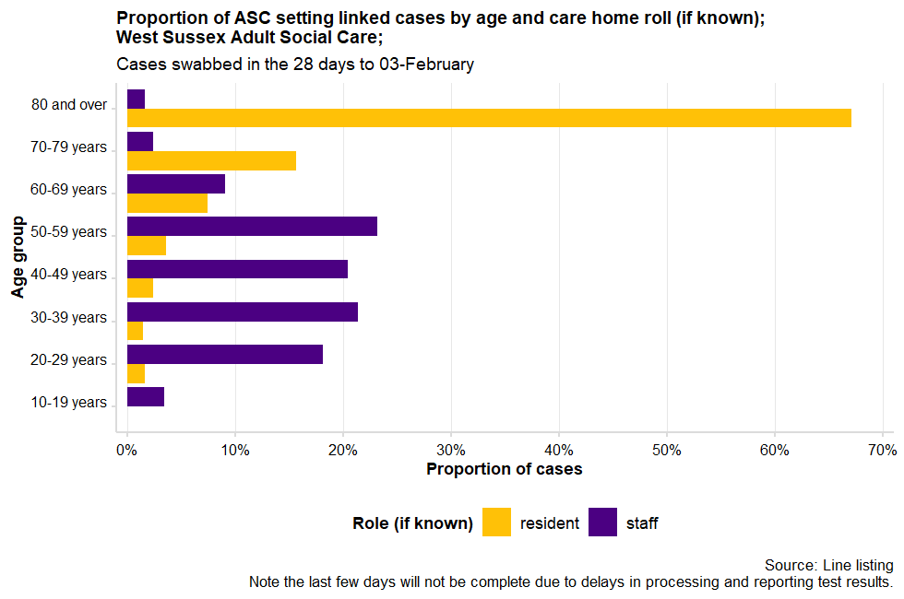
More than half of settings with 2+ cases in the last 28 days have between 2 and 5 confirmed cases.
The table below gives some idea of the scale of outbreaks in ASC settings in West Sussex in the last 28 days.
Table 3 – Scale of cases in ASC settings in the 28 days to Wednesday 3rd February
Number of cases in the last 28 days | Settings | Proportion of settings with 2+ cases | Proportion of all 484 settings
2-5 cases | 86 | 55% | 18%
6-10 cases | 26 | 17% | 5%
11-15 cases | 14 | 9% | 3%
16-20 cases | 7 | 5% | 1%
21-25 cases | 7 | 5% | 1%
More than 25 cases | 15 | 10% | 3%
However, ASC settings vary vastly in the number of people who live and or access services within the setting. Some settings are single residences with two or three residents, whilst others offer services to more than 100 residents.
Note: Age groups where there were less than five cases have been supressed to avoid disclosing any identities
Points to consider:
Not all care home cases are flagged as care homes due to data processing errors or where the information recorded for a test is not sufficient to link it to a care home, this means we do not know the ‘role’ for additional cases identified in this analysis.
As the line listing we get is based on residential address for West Sussex only, it is possible that some flagged cases are for care home staff who live in West Sussex and work outside of the county (these cases are excluded in this analysis).
More importantly though, some care home staff who live outside of West Sussex but who work inside the county alongside those care staff who may work for across multiple homes (e.g. agencies), will also not appear in this reporting unless the case is linked to a single home. As such, staff cases reported here are likely an underestimate.
Recording of role (whether staff or resident) has improved over time.
Since the start of the pandemic
28 days to
3rd February 2021
37% known to be residents
46% known to be residents
46% known to be staff
49% known to be staff
16% unknown
5% unknown

Slide 5
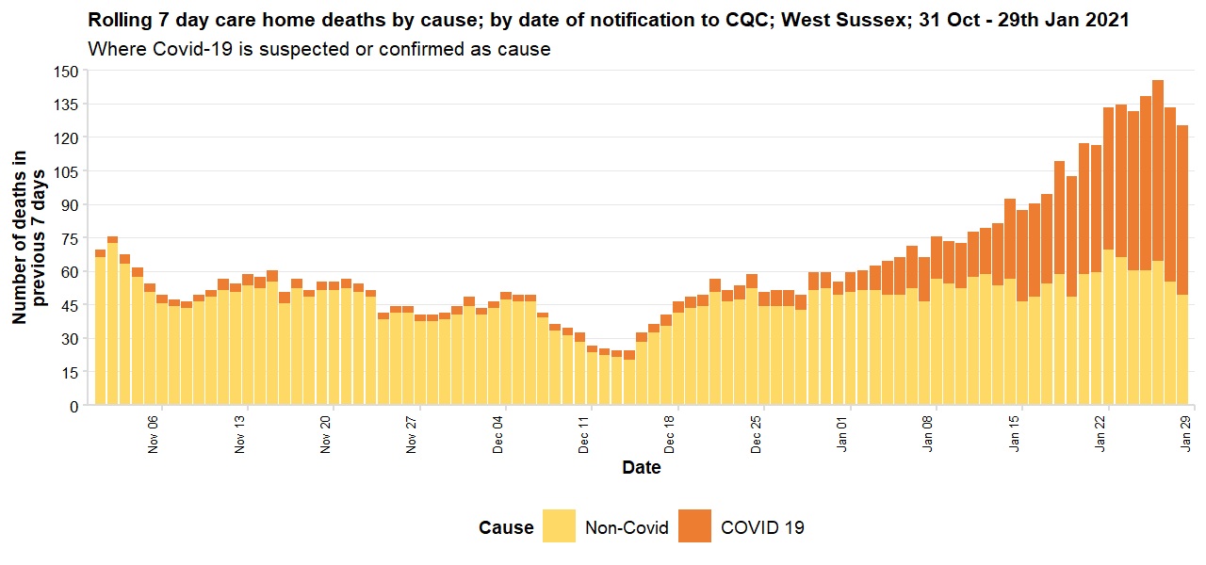
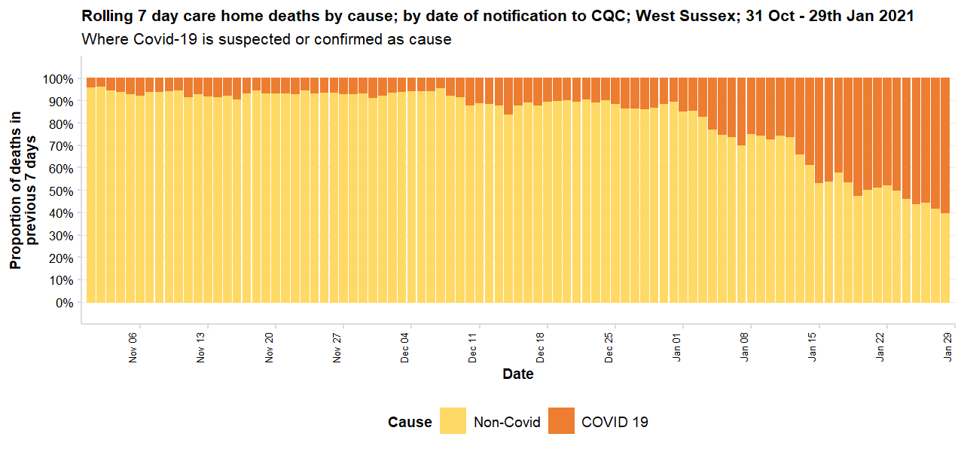
COVID-19 deaths notified to CQC
The processes for registering deaths naturally take time and so the Care Quality Commission, have begun reporting the number of deaths they have been notified as soon as it is practicably possible to support the response to Covid-19.
Death notifications by date of notification are provided weekly at the same time as the ONS release. Death notifications take on average 4 days to receive and process. These are not officially registered deaths and can be subject to revision and verification. Data are for April 10th onwards.
Note: Notifications only include those received by 5pm on 29th Jan.
As at 29th January 2021 there have been 536 Covid-19 deaths notified to Care Quality Commission from West Sussex care homes.
This is 20.3% of the 2,636 deaths notified to CQC between 10th April 2020 and 29th January 2021.
71
COVID-19 deaths notified to CQC in the
7 days to 29th January 2021
It is unclear whether extra care and supported living settings, or any settings which are not CQC registered are included in these mortality statistics, or other mortality data provided by the ONS

