Slide 1
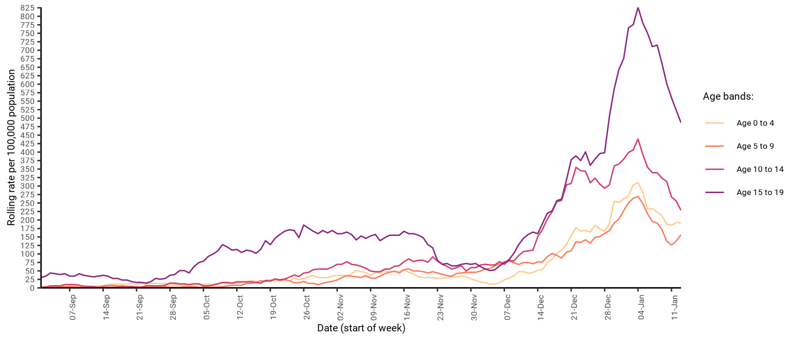
7-day rate of COVID-19 cases among under 20s in West Sussex by age (from 01 Sep 2020 up to 13 Jan 2021)
Number and rate of cases of COVID-19 among children and young people (aged 0 to 19) in West Sussex to week ending 13-Jan
Area | 0 to 4 years | 5 to 9 years | 10 to 14 years | 15 to 19 years | All ages
Adur | 11 (310.4 per 100k) | 10 (246.1 per 100k) | 10 (275.3 per 100k) | 11 (359 per 100k) | 333 (517.9 per 100k)
Arun | 20 (259.3 per 100k) | 18 (209.6 per 100k) | 17 (208.5 per 100k) | 44 (614.7 per 100k) | 940 (584.7 per 100k)
Chichester | 10 (178.1 per 100k) | 8 (121.4 per 100k) | 11 (165.5 per 100k) | 17 (286.8 per 100k) | 565 (466.4 per 100k)
Crawley | 17 (217.1 per 100k) | 14 (168.2 per 100k) | 18 (247.7 per 100k) | 41 (681.3 per 100k) | 893 (794.4 per 100k)
Horsham | 12 (164.9 per 100k) | 14 (167 per 100k) | 22 (248.6 per 100k) | 31 (407.7 per 100k) | 553 (384.6 per 100k)
Mid Sussex | 11 (130.4 per 100k) | 6 (60.6 per 100k) | 21 (219.6 per 100k) | 27 (335.4 per 100k) | 605 (400.6 per 100k)
Worthing | 7 (121.9 per 100k) | 12 (186.5 per 100k) | 16 (254 per 100k) | 39 (725.2 per 100k) | 693 (626.8 per 100k)
West Sussex | 88 (190.6 per 100k) | 82 (156.8 per 100k) | 115 (228.1 per 100k) | 210 (486.1 per 100k) | 4582 (530.3 per 100k)
South East | 1083 (208 per 100k) | 980 (168.8 per 100k) | 1366 (243.4 per 100k) | 2536 (496.1 per 100k) | 48917 (532.9 per 100k)
England | 6164 (186.8 per 100k) | 5937 (167.8 per 100k) | 8145 (242.8 per 100k) | 15295 (494.9 per 100k) | 292905 (520.4 per 100k)

