Slide 1
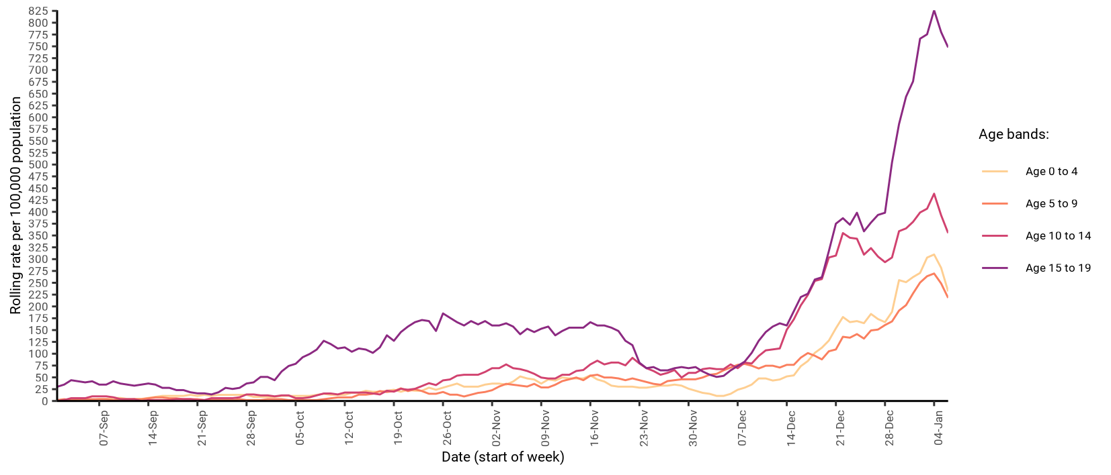
7-day rate of COVID-19 cases among under 20s in West Sussex by age (from 01 Sep 2020 up to 06 Jan 2021)
Number and rate of cases of COVID-19 among children and young people (aged 0 to 19) in West Sussex to week ending 06-Jan
Area | 0 to 4 years | 5 to 9 years | 10 to 14 years | 15 to 19 years
Adur | 8 (225.7 per 100k) | 7 (172.2 per 100k) | 17 (467.9 per 100k) | 30 (979.1 per 100k)
Arun | 15 (194.5 per 100k) | 19 (221.2 per 100k) | 32 (392.4 per 100k) | 67 (936 per 100k)
Chichester | 9 (160.3 per 100k) | 9 (136.5 per 100k) | 12 (180.5 per 100k) | 26 (438.6 per 100k)
Crawley | 31 (396 per 100k) | 40 (480.5 per 100k) | 46 (633.1 per 100k) | 60 (997 per 100k)
Horsham | 20 (274.9 per 100k) | 10 (119.3 per 100k) | 24 (271.2 per 100k) | 52 (683.9 per 100k)
Mid Sussex | 10 (118.5 per 100k) | 16 (161.5 per 100k) | 25 (261.5 per 100k) | 56 (695.6 per 100k)
Worthing | 14 (243.7 per 100k) | 13 (202 per 100k) | 23 (365.2 per 100k) | 32 (595 per 100k)
West Sussex | 107 (231.8 per 100k) | 114 (218 per 100k) | 179 (355.1 per 100k) | 323 (747.7 per 100k)
South East | 1230 (236.2 per 100k) | 1441 (248.2 per 100k) | 2095 (373.3 per 100k) | 3501 (684.9 per 100k)
England | 6807 (206.3 per 100k) | 7979 (225.5 per 100k) | 11231 (334.8 per 100k) | 20101 (650.5 per 100k)

