Slide 1


Coronavirus (Covid-19)
How to keep Safe
Staff often wear a uniform when they are at work.
BHSCT Covid-19/easy read/13/3/20

Slide 2
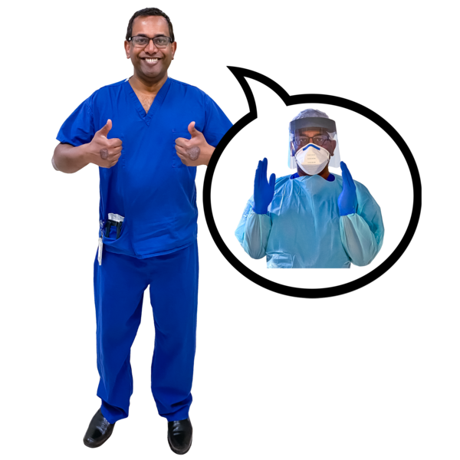
Coronavirus (Covid-19)
How to keep Safe
Staff might need to put on gloves, aprons and masks to keep you safe and keep them safe.
BHSCT Covid-19/easy read/13/3/20

Slide 3
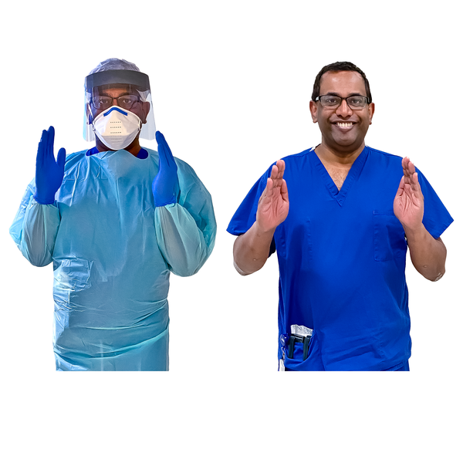
Coronavirus (Covid-19)
How to keep Safe
They might look different. It is still the same person.
BHSCT Covid-19/easy read/13/3/20

Slide 4
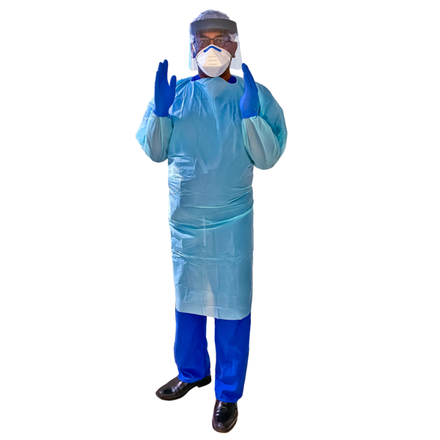
Coronavirus (Covid-19)
How to keep Safe
This is to help stop germs spreading to help make sure you are safe and they are safe.
BHSCT Covid-19/easy read/13/3/20

Slide 5
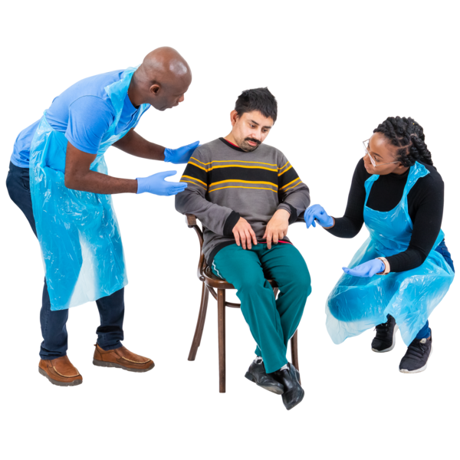
Coronavirus (Covid-19)
How to keep Safe
Staff helping you might look different. They might wear, gloves, aprons and masks.
This is to help stop germs spreading to help make sure you are safe and they are safe.
BHSCT Covid-19/easy read/13/3/20

