Slide 1
Economy Update
Overview and Scrutiny 2
Cllr Nina Jeffries
Feb 2022

Slide 2
Economic snapshot
Average weekly pay for full time workers is lower £531 compared to £642 national average, with job density being slightly lower at 0.83 compared to NA of 0.86
Sectors with the highest employees remain,retail, accommodation and social industries.
Our largest business sectors remain micro businesses – those who employ 0 -9 people.
Notes:
LT

Slide 3
Supporting local business
1.6M UK shared prosperity fund Investment Plan approved
UKSPF Green Business Grant launches this month
Rural England prosperity fund £650k Investment Plan submitted to government, approval awaited
Notes:
LT

Slide 4
Economic Development
This year will see over twenty acres of employment land brought forward in Teignbridge.
2023 will see over twenty acres of employment land coming forward in Teignbridge. Sixteen acres is planned by Commercial Developers, the remaining smaller sites have been purchased by indigenous businesses who are seeking new, bespoke buildings and the opportunity to own the freehold of their workplace.
The Economic Development Team are working closely with Developers and Applicants in an effort to find the right location for both.
Notes:
LT

Slide 5
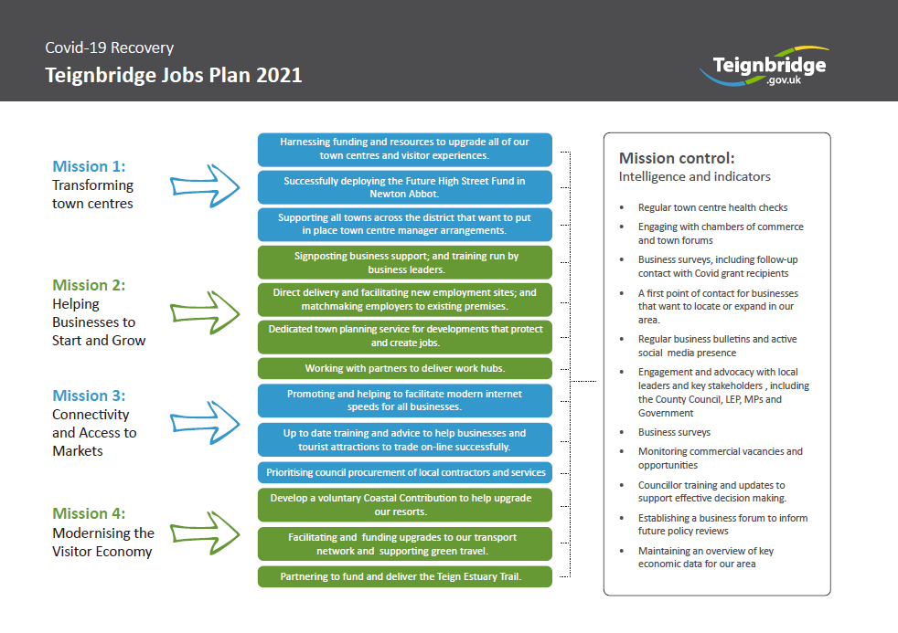
Notes:
FP

Slide 6
What have councillors asked?
Devon County Council, including education and training
Local Enterprise Partnership, including infrastructure and business support services
Colleges deliver training and skills programmes, including for adult learners
Who else provides economic development support?
Much of our data comes from sources like NOMIS and Devonomics
We speak with businesses on a daily basis and keep them up to date through the Business Bulletin.
How does Teignbridge gather key economic development information?

Slide 7

Contributing Economic Factors
Supply chain
Health impacts on staffing/HR processes
Mental health scores of the area
Materials sourcing affect build costs and expansion
Availability of Skilled work
Areas of deprivation vs economic output
Housing and rental costs vs wages
Notes:
LT

Slide 8
Main considerations…
bid requirements -plans had to be transformational, sustainable and financially viable.
The Alex building’s primary use has been as a cinema for 70 + years.
Current leaseholder of The Alex (Scott Cinema)
Without the Future High Street Funding, we would be unable to provide a larger range of activities and cultural experiences to draw people in.
To maintain the market town status we need to create more economic activity through modernisation and vibrancy to attract greater footfall and spend
The £9 million funding award announced in May 2021 was based on the plans approved by the council.
A range of stakeholders from Teignbridge and further afield are working with the Council on the implementation of the plans.

Slide 9

Questions

