Slide 1
Community Mental Health Transformation
VCSE Engagement Event
8th November 2022

Slide 2
Welcome

Slide 3
Housekeeping
Please turn microphones and cameras off during the presentation.
Feel free to ask questions or make comments in the chat function at any time.
We will answers questions in the chat after the presentation, and invite others.
If you are experiencing technical problems, please type the issues into the chat function.

Slide 4
Agenda
Progress to date
Upcoming tender opportunities
Timescales
Overview of Procurement System
Q&A

Slide 5
Overview of Community Mental Health Transformation
The NHS Community Mental Health Transformation - YouTube
The CMH Transformation aims to improve access and outcomes for individuals with Severe Mental Illness. The transformation covers the Integrated Care System and involves all partners involved in the delivery of care including NHS providers, Local Authority and Voluntary, Community and Social Enterprise (VCSE). Three key outcomes for the transformation are:
Service users are able to access mental health care where and when they need it and are able to move through the system easily.
Service users are able to manage their condition or move towards individualised recovery on their own terms.
Service users are able to contribute to and be participants in the communities that sustain them, to whatever extent comfortable to them.

Slide 6
The Story So Far…
Patients as people: holistic lives, multiple factors, prevention & recovery that is most effective for individuals
VCSEs delivering and shaping support and services which are:
Local and asset based, building on what we have and addressing gaps
Integrated and mutually supportive - focussed on the person
Part of broad rehabilitation and recovery pathways

Slide 7
Challenges
DEMAND: everyone agreed that its about more than medication and clinical therapy, and broad themes were identified: housing, money and work, drugs & alcohol, physical health, someone to turn to…
But it has proven hard to triangulate the details of these issues and to say what exactly is needed, by who and where?
SUPPLY: again broadly we are aware of VCSE organisations that are out there
But its been much harder to identify who and what is accessible, the informal networks and very small organisations, or to come to a consensus about what is and is not funded, and by whom it is, or should be funded by
Involving residents with lived experience

Slide 8
What has been achieved?
MPFT teams re-aligned into service areas (North Shropshire, Central Shropshire, South Shropshire and Telford & Wrekin)
Pilot MDTs taking place in North Shropshire and Wrekin PCNs.
Building relationships between Health, Local Authority and Voluntary Sector.
Recruitment of staff working across PCNs and ‘Secondary Care’.
Mobilisation of peer support workforce to develop a strong lived experience practice.
Initial engagement with VCSE colleagues.

Slide 9
What next?
Development of plans for use of funding for VCSE Organisations.
Active exploration of grant funding for smaller and local VCSEs to support in their communities.
Further engagement to understand available provision and where the gaps are.

Slide 10
Dynamic Procurement System
Complies with Procurement legislation
A completely electronic process
Is a two-stage procurement process
Initial setup stage - all suppliers who meet the selection criteria and are not excluded must be admitted to the DPS
second stage - the authority invites all suppliers on the DPS (or the relevant category within the DPS) to bid for the specific individual contracts.
New suppliers can join at any time (must be actioned within 10 days)
No limit on number of suppliers
Streamlined process: suppliers don’t have to demonstrate suitability and capability every time they wish to compete for a contract
Identify Requirement
Develop Specification and Tender Documents
Publish Tender – 30 days
Evaluation and Selection
Contract Award
Contract Implementation & Management

Slide 11
DPS Stage One

Slide 12
What does Stage One mean for you?
A single procurement system for Shropshire, Telford and Wrekin – Community Mental Health Transformation
Engagement with all providers
Simplified Stage One questions - Inclusive process
Unsuccessful bidders can re-apply
Identification of services correctly commissioned
Identification of gaps provision

Slide 13
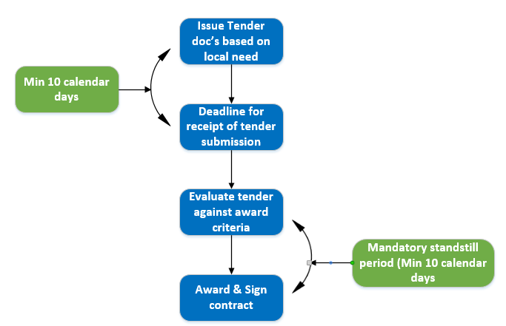
DPS Stage Two

Slide 14
What does Stage Two mean for you?
Dedicated VCSE support with procurement process
Tender documents proportionate to tender value
Localisation of service/support specifications as applicable and appropriate
Flexible and responsive opportunities developing over 3 years as the programme grows and we learn from practice

Slide 15
Timescales
8/11/22
Launch DPS
Evaluate Stage 1
Jan /23
Advertise Contract
9/12/22
Evaluate stage 1 and notify Un/Successful bidders within 14 calendar days
Procurement Portal
Initial close of Stage 1
Commence Stage 2
Portal activated via link:
eu-supply.com
Register at:
BizAlerts (eu-supply)
Quote ID: 61756
Initial Stage 1 close date – this will not preclude VCSE from joining the framework at any time in the future
23/12/22
Issue tender documents for stage 2 based on outcomes of Health Equalities Assessment Toolkit
9/11/22

Slide 16
Upcoming Tender Opportunities
Housing Support (Allocations and Tenancy Sustainment)
Financial Wellbeing Support
Grant Management

Slide 17
Questions

Slide 18
Close
Link to portal :
Portal activated via link:
eu-supply.com
Register at:
BizAlerts (eu-supply)
Quote ID: 61756
Contact us: CMHTransformationSTW@mpft.nhs.uk

