Slide 2
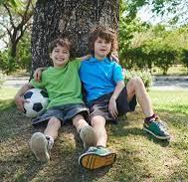
Who is a Young Carer?
Someone who helps a family member or friend who has a long-term illness, a disability, mental health condition or whose drug or alcohol use has a significant impact on themselves and/or others.

Slide 3
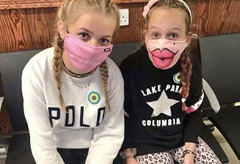
Who might they help?
Mum or dad
Sister or brother
Nan or grandad
Auntie or uncle
Family friend
A neighbour
They could help more than one person

Slide 4
How many young carers are there in the UK?
It’s estimated that there are around
800,000
young carers in the UK aged between 5 and 17.
In Portsmouth there are around
4,300
Lots of young people don’t realise that they are a young carer.

Slide 5
How many young carers are there in my class?
It’s likely that there are 2 to 3 young carers in every class in every school.

Slide 6
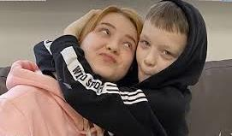
No two young carers are the same
They might live at home with their mum or dad and help lots.
Their mum and/or dad might do most of the caring for a brother or sister.

Slide 7
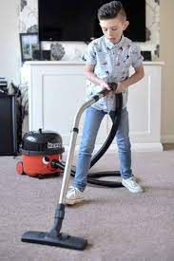
What do you think some young carers might do to help?
Notes:
Talk partner for minute or so – share some ideas

Slide 8
They might help with:
Washing-up and cleaning
Shopping and cooking
Washing and dressing
Medicines
Looking after brothers and sisters
Lots of young carers give emotional support when others at home are feeling sad, frustrated, worried or angry.
Notes:
The amount of responsibility a young carer has can vary greatly. Sometimes young carers live at home with a parent and provides lots of the support. Sometimes they help an adult to care for someone and they don’t have many direct responsibilities.

Slide 9
Being a young carer can be great
Young carers often:
Spend lots of time with their family – and are very close to them.
Learn new skills that will help them when they are adults.
Feel proud of their family – and their families are proud of them.

Slide 10
A young carer may also feel:
Physically tired
Stressed
Worried or Anxious
Embarrassed
Angry
Guilty
Isolated
Notes:
Physically tired – up during the night/ up early or late/ lack of sleep through worry/ lifting and other manual tasks
Stressed, Worried, Anxious, about the cared for and what might happen in the future/ if I’m not there?/ because my school work hasn’t been done/ because I’ll be late as I have to drop off my siblings first/ money…
Embarrassed – About the cared for’s condition (eg if misusing alcohol)/ arriving late at school/ if haven’t been able to wash hair, wash clothes…
Frightened – If something happens to my mum/dad, what happens to me/us? I don’t really understand what’s wrong with my mum/dad/grandpartent/sibling/ What will happen if I say we need help – will I get taken away?
Bullying - A study found that 25% of the secondary school aged young carers who took part had experienced some form of bullying because of their caring role. Maybe it was because the cared for looked or behaved in a different way to the ‘norm’? Maybe they didn’t feel confident to initiate friendships with other young people because they didn’t want to share personal details about their family or they were unable to meet up with other young carers because of their responsibilities?
If you have time you could ask why the young people in the group think this might happen… and what they could do to prevent it happening if they see someone else being unkind – to a young carer or any young person?
Bullying comes from a lack of understanding and awareness. Young Carers do an amazing job and should be recognised for this – not treated unkindly or be disrespected.
Angry – Why me? Why can’t I meet my friends after school?
Guilty – I shouldn’t feel angry… what if something happens? I’m letting my family down…
Isolated – I can’t join Cadets/ make new friends/ meet up with my friends/ go on the school residential trip...

Slide 11
This can then impact on their:
Relationships at home
Friendships
Ability to join clubs and groups and do sport
Education
Notes:
Might feel resentful… or guilty because they feel this way or are angry.
May not feel they can be open and honest with family as it will upset them… they may be worried that if they speak to anyone outside of the family they will be letting their family down/ or as a consequence other agencies will become involved who may feel that the family are not coping…
Might feel shy or embarrassed.
They may have experienced bullying in the past, so don’t want to put themselves in that position again
They need to get home for to the cared for/ go shopping/ collect medication from pharmacy
Unable to invite friends home: Lack of space; parent/young carer may not want visitors at house (embarrassed or anxious)/ the ‘cared fors’ behaviour might be unpredictable…
Groups and clubs: not time as looking after the ‘cared for’ or siblings

Slide 12
School
They may have difficulties:
Getting to school on time
Doing homework
Concentrating (tiredness and/or worry)
Taking part in after school activities and residential visits
Making friends
Their parents/guardians may have difficulties:
Helping with homework
Getting to meetings and events
Notes:
Getting to school on time: Dropping off siblings/ supporting parent to get up/give medication…
Feeling tired: Up late/early helping parent; not sleeping as worried about the cared for/feeling over-whelmed/feeling angry about situation…
Completing homework on time: because of caring responsibilities/ lack of space or low distraction area/ emotions
Being distracted: worry, other emotions…
Parents/carers getting to meetings and events: mobility issues/ severe pain/ no-one to look after siblings…
Taking part in after school activities – need to get home to care for family

Slide 13
It’s important for young carers to let someone know about any challenges they are facing so that they can be supported effectively.
At home
At school
Notes:
Ask for ideas of who a young carer might talk to

Slide 14
Adults at (school)
Teacher?
Teaching assistant?
ELSA?
… they could also ask a friend to help them share with an adult. ☺

Slide 15
It’s also important for young carers to have a ‘break’ from their caring role
Some:
Visit family
Go to a friends for tea or meet friends at the park
Do ‘extra’ activities at school
Join a club: swimming, Cubs/Scouts, Brownies/Guides or St John’s Ambulance…
Join a football team or a dance or boxing academy …
Whatever they enjoy.
They might need some help from adults to make this happen.

Slide 16
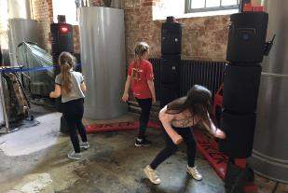
Portsmouth Young Carers Service
A place for young carers to go to have a ‘break from their caring role’
Time to meet other young carers whilst having lots of fun
A chance to talk to other young carers and adults who really understand what it can be like as a young carer.

Slide 17
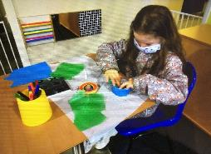
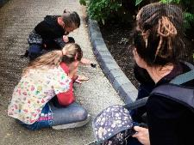
Activities
Regular groups for 8 to 18 year olds across Portsmouth
Holiday activities for 5 to 18 year olds
A half termly email with information and activities to try at home.

Slide 18
Things to think about:
Do you think you might be a young carer?
What are you going to do next?
Do you know someone who might be a young carer?
What could you do next?
Everyone
We don’t always know what’s going on in other people’s lives. It’s important that we are kind and respectful to everyone in our school and wider community.
How can you make sure that you do this?

