Slide 2
Who are Young Carers?
A young person who helps to look after someone who needs some extra help.
They might have:
A disability
A mental health condition that might make them feel sad, anxious or angry sometimes
An illness that they have for a long time

Slide 3
Who do you think young carers might help?

Slide 4
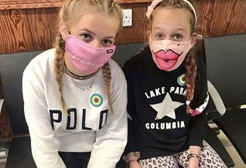
It could be their:
Mum or dad
Sister or brother
Nan or grandad
Auntie or uncle
Family friend
Neighbour

Slide 5
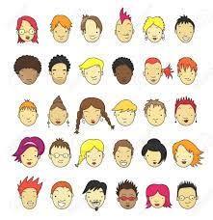
How many young carers are there?
It’s likely that there are 2 or 3 young carers in every class in every school.

Slide 6
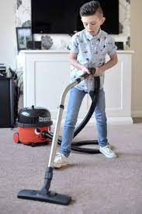
Lots of young carers help their family. What jobs do you think they might do?
Notes:
Talk partner for minute or so – share some ideas
Washing-up, cleaning
Shopping and cooking
Dressing
Helping look after brothers and sisters

Slide 7
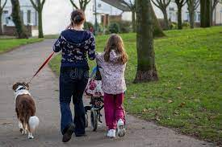
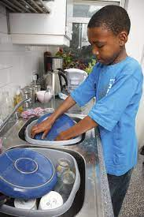
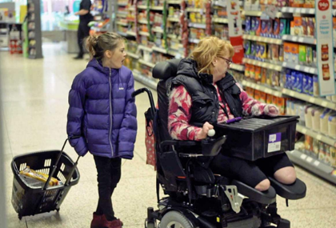

Slide 8
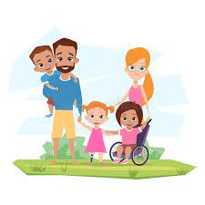
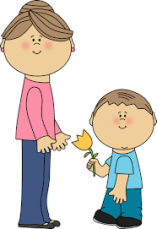
All young carers are different
They might live at home with their mum or dad and help lots.
Their mum and/or dad might do most of the caring for a brother or sister.

Slide 9
Being a young carer can be great
Young carers often:
Spend lots of time with their family.
Learn how to do new things.
Feel proud of their family – and their families are proud of them.
Notes:
Lots of our young carers talk about the positive things about being a young carer.

Slide 10
But sometimes they might feel:
Notes:
Tired – up during the night/ up early or late/ lack of sleep through worry/ lifting and other manual tasks
Worried or anxious - about the cared for and what might happen in the future/ if I’m not there?/ because my school work hasn’t been done/ because I’ll be late as I have to drop off my siblings first/ money…
Embarrassed – Arriving late at school/ if haven’t been able to wash hair, wash clothes…
Frightened – If something happens to my mum/dad, what happens to me/us? I don’t really understand what’s wrong with my mum/dad/grandpartent/sibling/ What will happen if I say we need help – will I get taken away?
Unhappy – if other people are being unkind to them because their loved one looks different/ behaves in a different way to lots of people.
Angry – Why me? Why can’t I meet my friends after school/ have friend’s round?
Guilty – I shouldn’t feel angry… what if something happens? I’m letting my family down…
Isolated – I can’t do an after-school club/ Brownies/ have friends round…

Slide 11
If a young carer is feeling sad, worried, angry or upset it’s important that they talk to someone about how they’re feeling.
At home
At school
Notes:
Ask for ideas of who a young carer might talk to

Slide 12
Slide with information about your schools learning behaviours (or similar)

Slide 13
Slide with specific information about who young carers can go to in your school

Slide 14
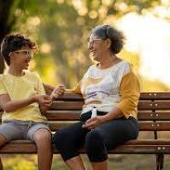

Slide 15
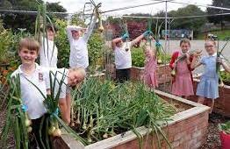
It’s important for young carers to have fun and some time out
Visit their granny/ grandad/ auntie/ uncle…
Go to a friends or meet at the park
Join a school club
Join Cubs or Brownies…
Join a football team or a dance or boxing academy …
Whatever they enjoy.
They’ll need help from their family to make this happen.

Slide 16
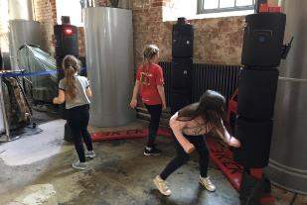
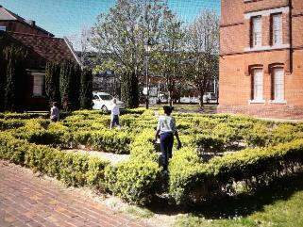
Portsmouth Young Carers Service
Have lots of fun!
Have a ‘break’
Meet other young carers
Talk to a grown up if they want to

Slide 17
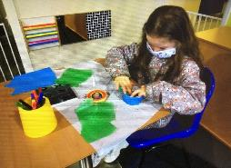
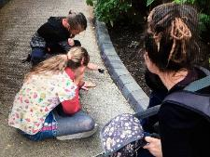
Activities
Holiday activities for 5 year olds upwards
Regular groups for 8 to 18 year olds across Portsmouth
A monthly email for young carers and their families

Slide 18
Things to think about:
Do you think you might be a young carer?
What are you going to do next?
Do you know someone who might be a young carer?
What could you do next?
Everyone
It’s important that we are kind, respectful and take care of everyone in our school and in our local communuty.
How can you make sure that you do this?

