Slide 2
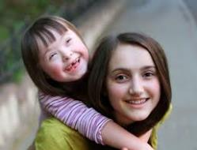
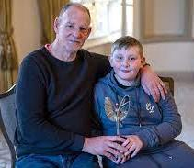
Who are young carers?
Anyone who’s under 18 who helps to look after a member of their family who has:
A physical or learning disability
A long-term illness
A mental health condition
Or
Whose drug or alcohol use impacts them
and their loved ones.

Slide 3
It’s estimated that there are
1,000,000
young carers currently in the UK.
(The Carers Trust and BBC, 2023)
In Portsmouth, the estimate is around
4,300
Notes:
Approximately 10% of young people under the age of 18 have some sort of caring responsibility… that’s 2 to 3 young carers in every class in every school in the UK.

Slide 4
How might a young carer help?
Do practical tasks
Help with physical care
Give emotional support
Help with personal care
Help someone to communicate
Look after brothers and sisters
Notes:
Practical support might include: cleaning, washing, cooking, shopping, paying bills, collecting prescriptions…
Physical care – Help with dressing, ensuring the cared for eats well, exercises…
Emotional support – Reassurance, motivation, comfort… Perhaps they are only other person living at home?
Personal care – washing, applying medical creams and dressings, support with dressing…
Communication – signing, translating – sometimes this can be at important health appointments, where young people hear details of the persons condition first hand and are responsible for communicating key information correctly to health professionals…
Siblings – organising morning routine, taking/collecting from school, support with home-work, support with behaviour management, responsibility for lots of the practical tasks for everyone…

Slide 5
No two young carers are the same
The experiences and needs of each young carer are unique.
The amount and type of care they provide can vary greatly.
This can affect their health and how they feel in different ways.
Notes:
The young carer may be the only other person at home – they may have lots of practical responsibilities and provide the only regular emotional support for the cared for.
They might have minimal practical caring responsibilities – but the emotional impact could be significant, for example, young people with a sibling who has a significant disability. The young carer may have to go to stay with other family members whilst their sibling is in hospital… for significant amounts of time.
All young carers will worry and feel anxious about the cared for’s condition sometimes – and for some, the worry is constant.

Slide 6
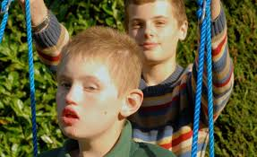
Being a young carer can be very rewarding
“I have a great relationship with my brother… we’re so close. I like cooking his tea and taking him to the park.” (Tom, 13)
“I’m so proud of my mum and all that she’s achieved. It’s been a hard battle for her, but she’s done it and I’ve been with her every step of the way!” (Jayne, 15)
“When I have my own family, I’ll be able to look after everyone.” (Mo, 14)
Notes:
Young carers often talk about:
Close relationships with the cared for and other family members
Pride in what the cared for has achieved. The cared for is usually very proud of their child/grandchild/sibling too
Learning important life skills – these could include being responsible, money management and practical skills

Slide 7
It might make a young person feel…
Physically tired
Stressed
Worried
Embarrassed
Frightened – bullied?
Anxious
Angry
Guilty
Isolated
Notes:
Physically tired – up during the night/ up early or late/ lack of sleep through worry/ lifting and other manual tasks
Stressed, Worried, Anxious, about the cared for and what might happen in the future; when they are not there with them; because schoolwork hasn’t been done; because they’ll be late as they have to drop off their siblings first; money worries…
Embarrassed – About the cared for’s condition (eg if their parent’s behaviour can be unpredictable; if arriving late at school; if haven’t had time to spend on their appearance…
Frightened – What if something happens to their mum/dad, what happens to me/us? I don’t really understand what’s wrong with my mum/dad/grandpartent/sibling/ What will happen if I say we need help – will I get taken away?
Bullying - A study found that 25% of the secondary school aged young carers who took part had experienced some form of bullying because of their caring role. Maybe it was because the cared for looked or behaved in a different way to the ‘norm’? Maybe they didn’t feel confident to initiate friendships with other young people because they didn’t want to share personal details about their family or they were unable to meet up with other young carers because of their responsibilities?
Angry – Because of limited time they have to do their own things…
Guilty – I shouldn’t feel angry… what if something happens? I’m letting my family down…
Isolated – I can’t join Cadets/ make new friends/ meet up with my friends/ go on the school residential trip...

Slide 8
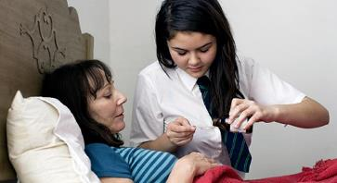
This can impact on the young carers:
Relationships at home;
Friendships;
Ability to join clubs and groups and do sport;
Learning…
Notes:
At home – they might not feel they can say how they’re really feeling because it will upset the family and cared for/ the whole family can be under huge pressure, which in turn can lead to lots of arguments…
Friendships – they might not want their friends to know/ they want to be like everyone else… they don’t have time to develop friendships… they find it difficult to relate to other people/ they don’t or can’t invite friends home…
Clubs and groups – unable to go because they are looking after the cared for/siblings, the family can’t afford the fees/cost of equipment, they don’t have transport/ family members are unable to drop-off and collect
Alternatively you could ask the young people how they think a young carers responsibilities might impact on all of the above.
School… (See next slide)

Slide 9
At school young carers may have difficulties…
Getting to school on time/missing
school;
Feeling tired;
Completing homework on time;
Being distracted/ difficulties concentrating;
With parents/carers getting to meetings and events;
Taking part in after school activities, trips and events.
It’s important for young carers to let someone know about any difficulties they’re having so that school can work with them to find solutions.
Everyone has the right to be happy, to attend
school regularly and reach their full potential.
Notes:
Getting to school on time/ missing school - Dropping off siblings, supporting parent to get up, giving medication at specific times, supporting a parents mental health, accompanying them to health appointments, exhaustion, own health needs…
Feeling tired: Up late/early helping parent, not sleeping as worried about the cared for/feeling over-whelmed/feeling angry about situation…
Not completing homework on time: caring responsibilities leaving limited or no time to do it, lack of space or low distraction area, emotions, inadequate equipment…
Being distracted: worry about person at home/ school work/ friendships… anxiety, tiredness…
Parents/carers getting to meetings and events: transport and/or mobility issues, very unwell, no-one to look after siblings
Taking part in after school activities – need to get home to care for family, cost of activities a barrier, lack of transport/parents unable to collect.

Slide 10
If you think you might be a young carer, who can you talk to in school?
Your:
Form tutor?
Head of Year?
Our Young Carers Lead/Champion
A friend?
Whoever you feel comfortable talking to.

Slide 11
(Schools name) Young Carers Champion/Lead
Insert your Young Carer Lead or Champion’s photo, name and details of where to find them here. ☺
If there’s someone on the leadership team who advocates for young carers their photo, name and details can also be added.
Notes:
Having a lead ensures that young carers is always on the school agenda, and means that young carers, staff and friends know where to go to ask for support and share concerns.

Slide 12
Support for Young Carers at (schools name)
Please add details of any support your school offer young carers here.

Slide 13
Portsmouth Young Carers Service
A service for all young carers living in Portsmouth (PO1 to PO6)
An opportunity for young carers to:
Meet other Young Carers & make new friends
Have a break (from their caring responsibilities)
Have fun!
Access support, if/when the young carer wants it
Notes:
The emphasis is on fun and meeting new people. Support is available from other young carers and experienced workers if the young person would like it.
Newsletters, regular groups, holiday activities, some additional support.

Slide 14
What activities are available?
Regular young carers family emails with information & activity ideas.
Notes:
This is sent to the families of all young carers registered with our service.

Slide 15
Holiday activities
A range of activities for all age groups (5 to 18 years) across the city and beyond.
These include, bowling, swimming, climbing, arts & crafts, cinema, community allotment, museum visits, crazy golf, adventure playgrounds… and more!
Notes:
Some young people like to be involved in lots of activities, others prefer to just come in the holidays.

Slide 16
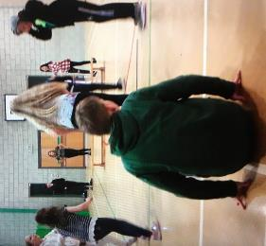
Young Carers Groups
Portsea (fortnightly)
for 8 to 14 year olds
Southsea (weekly)
for 13 to 18 year olds
Paulsgrove (fortnightly)
for 8 to 18 year olds
(Younger & older sessions)
There are currently waiting lists for some of our groups.
Notes:
Groups aren’t for everyone – but if the young person would like to take part, they can. This is discussed during our initial phone call to the family after they’ve been referred.
When they re-open, the groups will be different to how they have been in the past and will initially only be available to some young carers at allocated times.
Once restrictions are lifted we will be able to offer more sessions to more people.

Slide 17
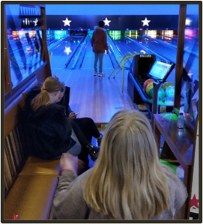
Referral
To access Portsmouth Young Carers Service activities, a young carer must be referred.
Who can do this?
Parent/ guardian
Someone at school
Another professional
Notes:
Our electronic referral form can be found on the Portsmouth City Council Website – search young carers.

Slide 18
Something to think about…
If you think you are a young carer what are you going to do next?
If you think a friend is a young carer, what might you do to support them?
Notes:
Reflection time.

Slide 19
Thanks for listening… have a great day ☺

