Slide 2
Are you a young carer?
Do you help look after someone who has:
A physical or learning disability?
A long-term illness?
A mental health condition?
Or
Whose drug or alcohol use impacts them, you and other members of your family?

Slide 3
Support for young carers in school:
Please add information about your school’s support here, including information about your Young Carers Lead/Champion
Please add a photo/school logo here.

Slide 4
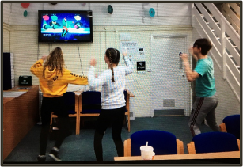
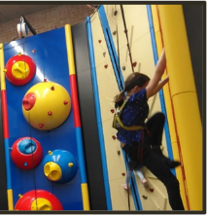
Support from Portsmouth Young Carers Service
Newsletters Holiday activities Regular groups
Information Young Carers Advocacy
For more information search ‘Portsmouth Young Carers’ or email: youngcarers@portsmouthcc.gov.uk

Slide 5
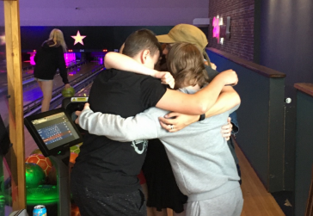
If you think you may be a young carer… who you could talk to in school?
If you think your friend/a student might be a young carer, what could you do to support them?

