Slide 1
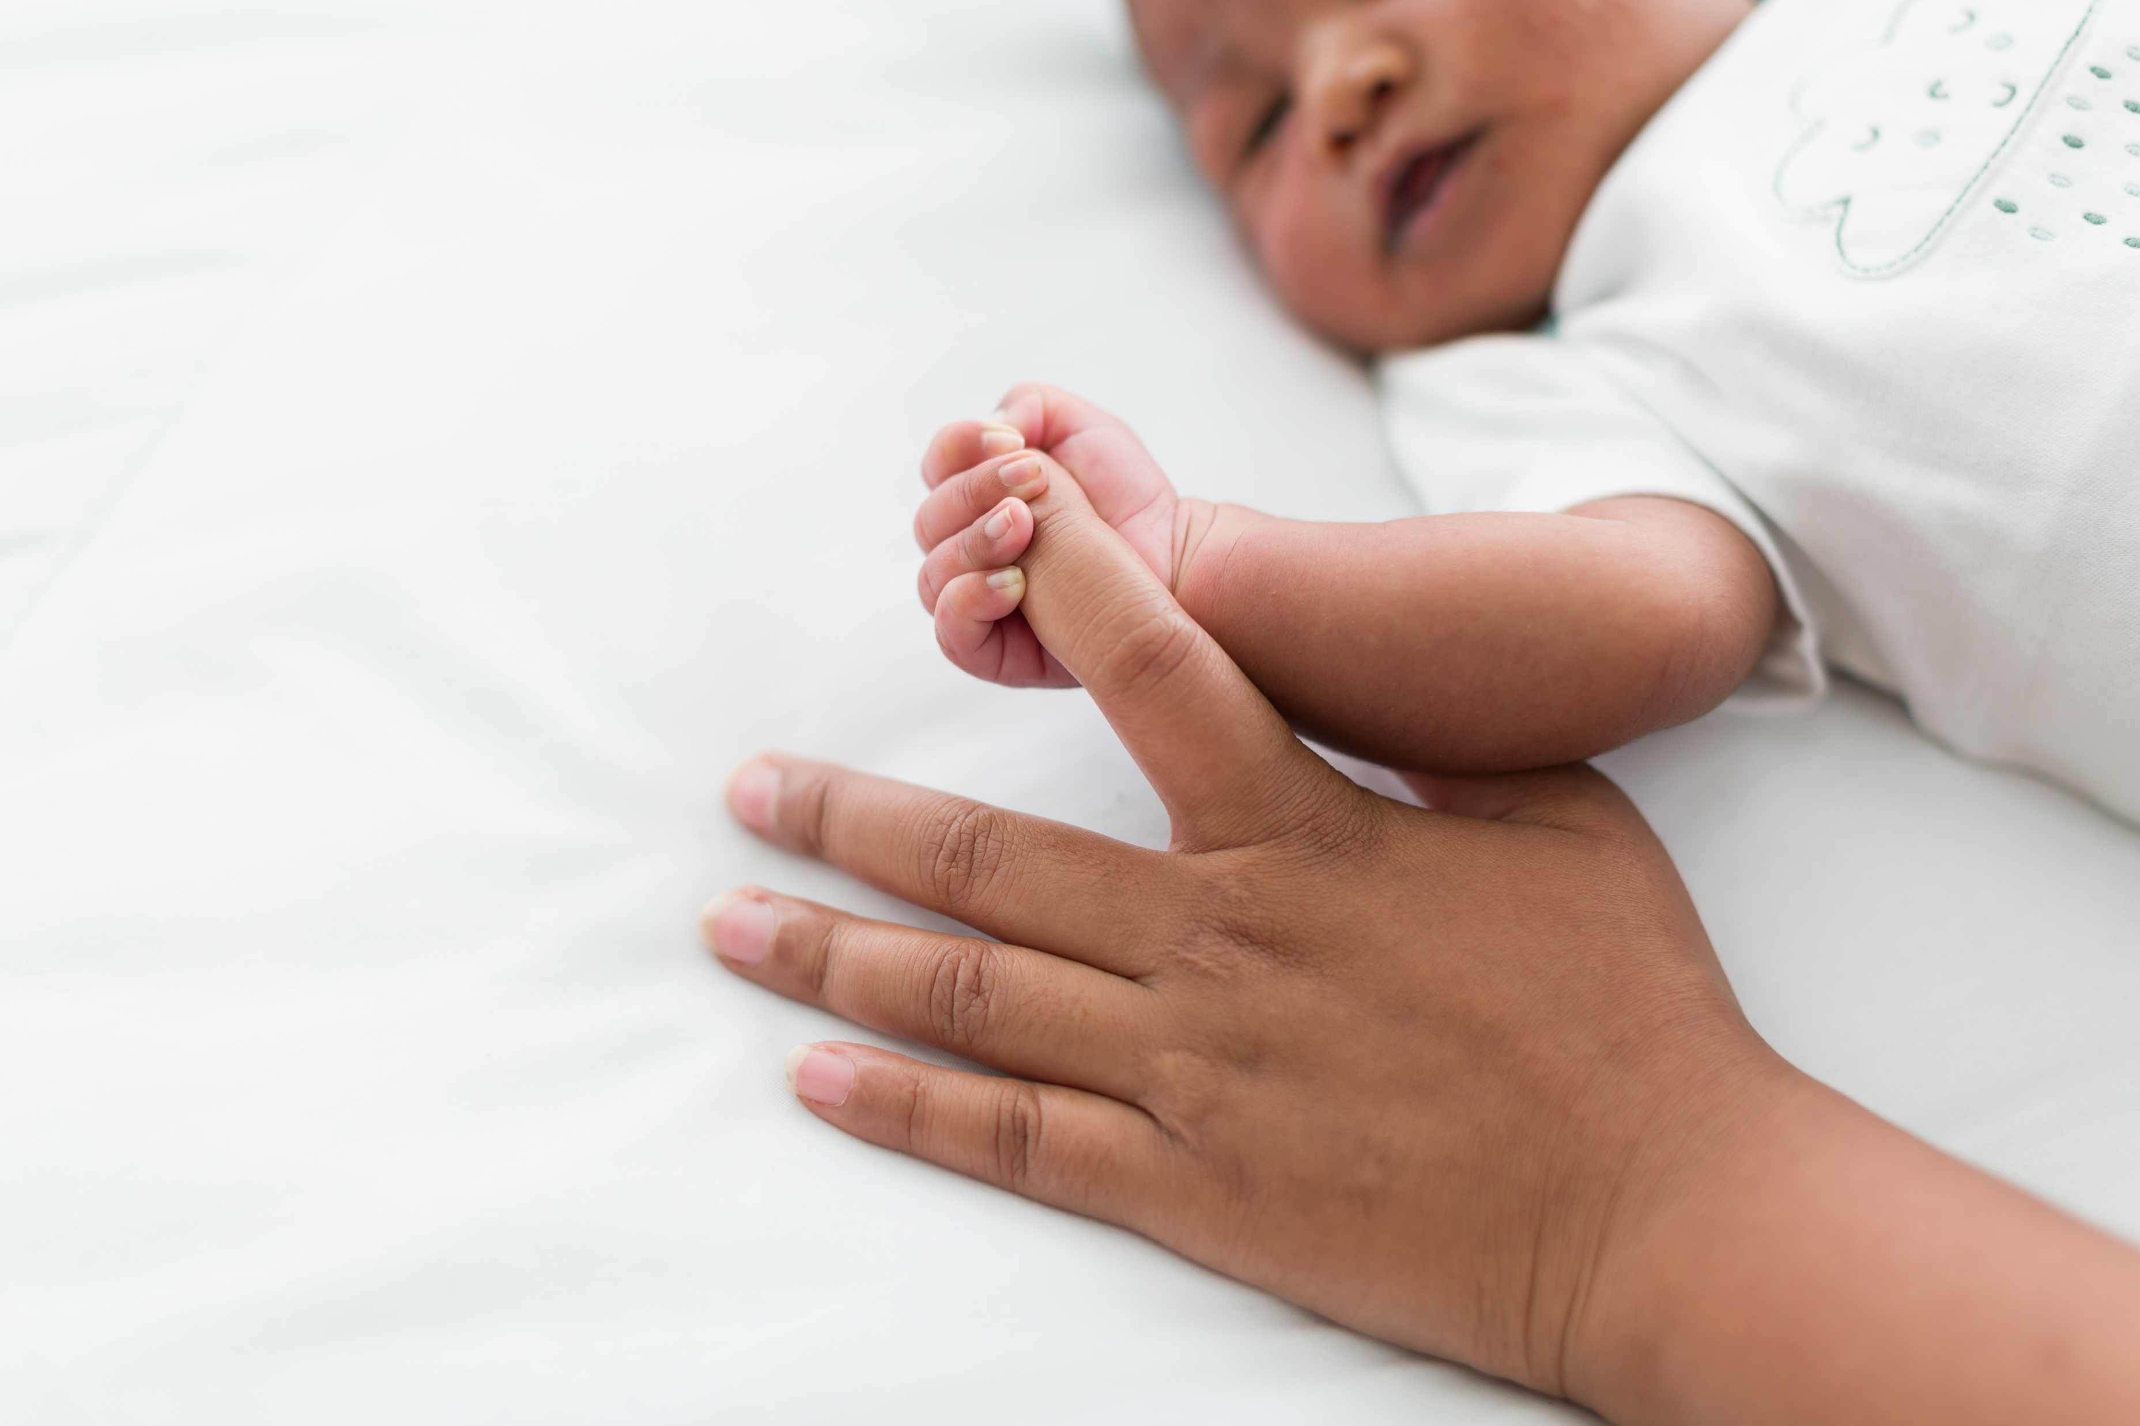
Department for Education Early Years COVID-19 Recovery: Childminder Mentor Programme
The Early Years Childminder Mentor programme from the Department for Education is focused on supporting early years childminders, to address the impact of the pandemic on the youngest children.
This support is free and available across the country.
The programme will offer mostly online support.
Some of the main aims of the programme include:
Supporting childminders:
To identify strengths and areas for development
To improve knowledge of child development
To build confidence following the pandemic
With the implementation of the EYFS framework 2021
And providing advice for supporting children with Special Education Needs and Disabilities (SEND) or English as an Additional Language (EAL)
You can apply for support as an individual, or with other childminders as part of a small group. You could receive up to 4 days of support over one term. The programme will run from May 2023 until the end of July 2024.
We appreciate childminder’s very busy schedules, so as part of the application process, wherever possible, we will match people together with similar availability and preferences.
To submit an application to receive support, or to find out more about the programme, please visit: www.hempsalls.com/covid-recovery-childminders

