Slide 1
Completing a Family Support Plan (word version)

Slide 2
This is to support you in completing Family Support Plan for Portsmouth
It provides a step by step guide to completing the word versions of the tools with a family
If you still have questions then please email FSP@portsmouthcc.gov.uk
This is NOT early help training as it is not going into depth about the early support and safeguarding process in Portsmouth
You can book this training by visiting https://pscptraining.portsmouthscp.org.uk/

Slide 3
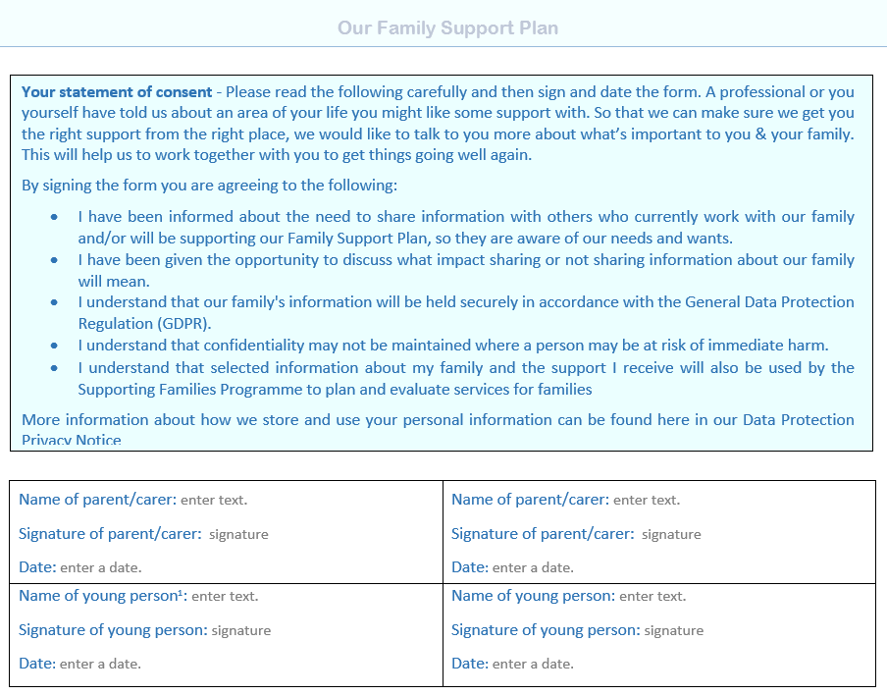
Recording consent – pg. 1
Make sure that parents/carers have a clear understanding as to:
What a Family Support Plan is
Who their information will be shared with and why
What it means if their information can’t be shared
The limitations of confidentiality
The family must give their consent and confirm they understand their decision.
If you are completing the form electronically and are unable to record their signature – you can add the “verbal consent given”

Slide 4
Sharing the FSP with other services– pg. 1
The family have the right to ask for their FSP not to be shared with others – but it’s important they understand the implications of these decisions
This space should be used to record the name of any services, professionals or family members they do not give consent for their FSP to be shared with
This may be easier to revisit once you’ve discussed the families worries and started to identify the support they want.

Slide 5
FSP Coordinator Agreement – pg. 1
This is the professional completing the FSP with the family - at this stage you are committing to helping the family identify their needs, to think through what support they might need and develop a plan as to actions that might help.
You agree to contacting other services working with the family to make them aware of the plan and/or gain their agreement to be part of the plan; and to organizing the first Team Around the Family Review meeting
Please provide your details as other agencies may wish to contact you.
Remember that the Coordinator can change over time as the needs of the family, child or young person can change.

Slide 6
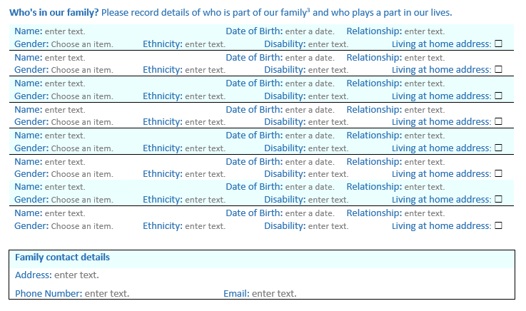
Completing the contact details- pg. 2
This should include all family members AND any significant adults that play a role in the family’s life (step-parents, parents, grandparents, aunts/uncles, significant family friends etc.)
It should also include all children including any unborn babies
If there is shared custody of the child(ren) then consideration should be given to completing the EHA with each parent/carer, as the issues may be different in the different households
Not all agencies may have the family’s most recent contact details on record, so please include these here so there are no delays in them being able to make contact

Slide 7
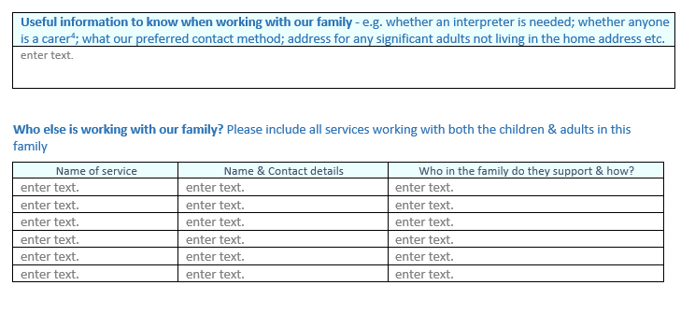
Completing the contact details – pg. 2
It’s important to identify any potential barriers to the family engaging in support as early as possible, so that strategies can be developed to overcome these. These may include:
Do they have English as a second language or known verbal communication difficulties?
Do they have any disabilities, learning difficulties or mental health issues?
Do they have caring responsibilities that make certain times of the day difficult for the family to respond to messages/attend meetings etc.?
A multi-agency approach begins with knowing who is involved and how you can contact them, if needed.
This should include voluntary & community groups the family are accessing, as well as statutory services

Slide 8
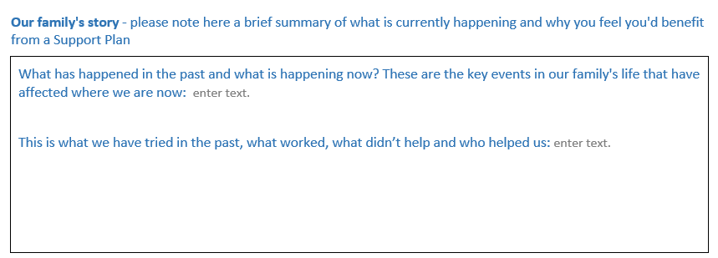
Our family’s story – pg. 3
A space in which to capture what has led to the decision that a FSP is wanted and needed.
To clarify with the family where the current challenges are, and think about what support has been offered previously
This area will be useful to reflect back upon in reviews to all families to reflect on what’s changed and (hopefully) be able to see the impact of the support
It will also help others who are becoming part of the Team Around the Family understand why a plan is being developed

Slide 9
Scaling – pg. 3
When you’ve completed discussing an aspect – help the family articulate on a scale from 0-5 (where 5 is the hoped-for outcome) where they feel they are now on this scale
Remember, 5 does not mean a ‘perfect’ situation
By using scaling it allows us to identify the most important goal
It allows for discussion about differences in opinion between family members and/or between the family and professionals
It helps when developing the plan to identify actions most likely to succeed
It will allow us to measure progress over time

Slide 10
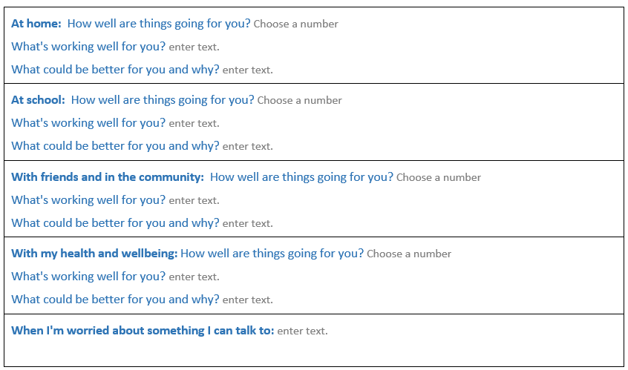
Gaining the child’s view –pg. 3
The voice of the child should be recorded.
The child’s view doesn’t need to be captured before the parent’s – it is most often going to be that you talk to the adults before the children, so you may complete this later but don’t forget to come back to it!
If the child is not able (or not willing) to do this, then the professional can either add their opinion of the impact on the child based upon their observations; or work with the parent/carer to consider what their child would say
Consider who the ‘trusted adult’ is for this child. They can include friends in this space as well, but in order to help build their resilience we want to encourage children to think about the adults they would turn to in a time or worry or crisis

Slide 11
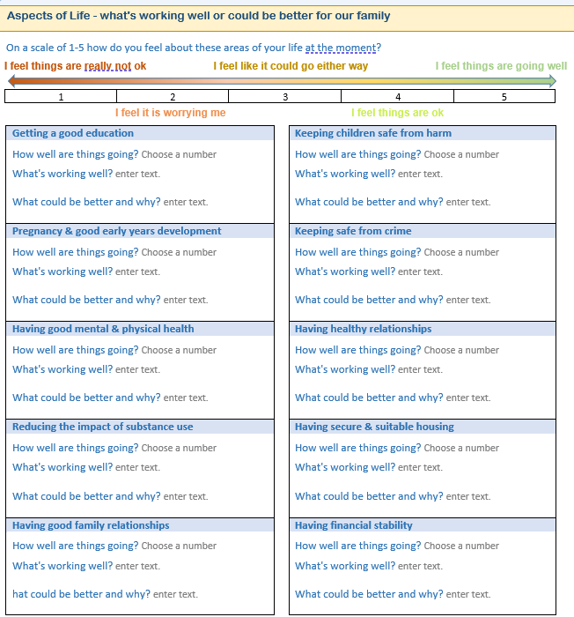
Completing the Aspects of Life – pg. 4
For each aspect the aim is to understand:
What’s working well? What or who helps make this better or stops it from getting worse?
What could be better? What are the current concerns? What are we most worried about?
What do you think is causing this concern?
What is stopping it from improving? Are there any barriers that we need to consider?
What can be done to get things going well again?
If there are joint custody arrangements, you should consider completing this with both parent/carers to establish any disparities in needs between the two households

Slide 12
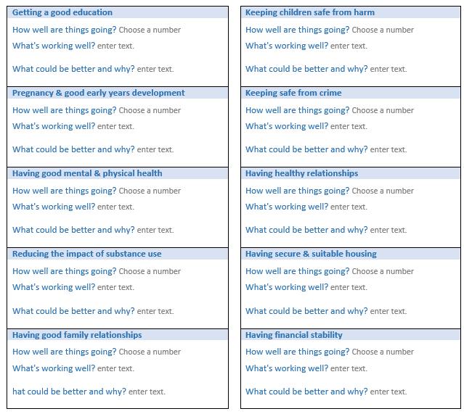
Completing the Aspects of Life – pg. 4
For ALL aspects a record of your conversation should be added to the form. Using the family’s words, avoiding abbreviations, professional terminology and jargon
For each, there are 3 areas to complete:
The scaling number the family given as to how worried they are about this aspect of their life
What they feel is working well for them in this aspect of this life
What could be better for the family in this aspect of their life and why

Slide 13
Your view as a practitioner – pg. 4
This part is for you to record whether you feel the family have identified all of the worries you are aware of, or if there are any aspects where you are more or less worried than the family.
Practitioners should be willing to discuss their concerns with a family and explore where there are difference of opinion why these might be. There should be no surprises - you should discuss this not just write it!
Where there is a difference of opinion it’s important to note which aspect(s) this relates to, the reasons for this and give examples of the evidence for your view
Think about your language when raising your concerns – remember to remain in the ‘working with’ domain

Slide 14
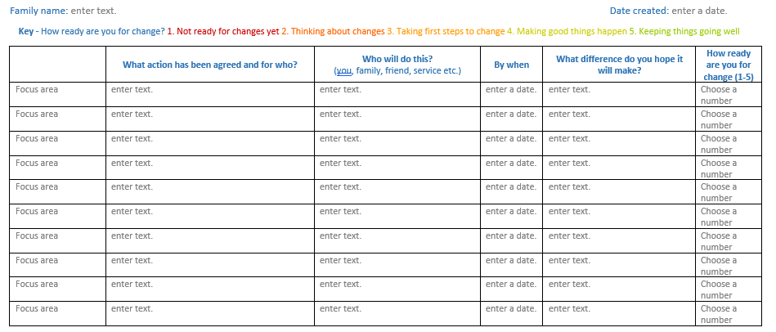
Completing the Family Support Plan – pg. 5
The plan must be:
Specific
Measurable
Attainable
Realistic
Timely
When considering the actions – refer back to the scaling. There may be transferable skills/experiences from aspects that are currently going well for the family for aspects in which they’re currently finding challenging.
Cross reference to draw out any transferable skills by asking questions such as:
How did you manage to get to your current position on the scale?
What has helped to get you there?
Who has helped?
What worked well?
What else has helped?
It’s equally important to agree actions that family members will be undertaking themselves (or with support from relatives or friends) as it is those being completed by professionals

Slide 15
Completing the Family Support Plan – pg. 5
Whilst there is space to record up to 10 actions, a family does not need to record an action for each aspect. You should support the family to identify their priorities and create an appropriate number of actions that is not going to overwhelm them
Use this space to record
the agreed action, and
for which family member this will be to support.
The actions may include those in order to help improve the current situation, or to maintain the current situation, or to support the sustainability of changes recently made
This column should be used to record the aspect of life to which the action refers to
The name of the person undertaking an identified task should be recorded.
Please ensure that if this is from another service you involve them in this decision to make sure it is appropriate and available.

Slide 16
Completing the Family Support Plan – pg. 5
Remember to set realistic timescales, that take into account the current impact on the child’s safety and wellbeing
In order to be clear about why this support is being offered, use this space to record what difference it is intended to make
This will also help to measure the impact and effectiveness of the Support Plan when you come to review it with the family
When thinking about the difference the family are hoping this plan will help them achieve – they may find this difficult to answer. So try referring back to how they scaled this aspect and ask questions like:
What will one step higher on the scale look like?
How will you notice you have reached one step higher on the scale?
How will others notice?
What will be different then?
What will you be able to do then?

Slide 17
Completing the Family Support Plan – pg. 5
Using the ‘readiness to change’ scale with a family:
In order to give effective support, you need to gauge the family’s understanding of their issue and their interest in changing.
Begin by asking what change means to the person you are asking to make it.
You may need to help the family explore the benefits of making a change and find ways around the potential barriers they may face.
The impact of the change itself should also be discussed.

Slide 18
Completing the Family Support Plan – pg. 5
Providing effective family support is not a one off event and so this plan will require a review (Team Around the Family). To avoid drift the date and venue for the review meeting should be recorded at the time of completing the FSP conversation.
The only exception to this is where the FSP is being completed to support an EHCP application and no additional support needs for the family have been identified

Slide 19
Recording a Family Support Plan
As the FSP Coordinator you should keep a copy of the Plan on your records for the family
A copy should be given to all family members and to all professionals involved in supporting the family
Wherever possible you should record this on the FSP Portal
For any questions please email FSP@portsmouthcc.gov.uk

Slide 20
Team Around the Family Meetings to review progress
Review the child and families plan with the family at least every 6 weeks.
Consider if a plan is still required to achieve outcomes or if the family are able to sustain progress without ongoing intervention.
Agree revised plan with family, network and agencies.
Update consent as necessary.
If a plan is no longer required, close the Family Support Plan and refer to universal services if required.

Slide 21
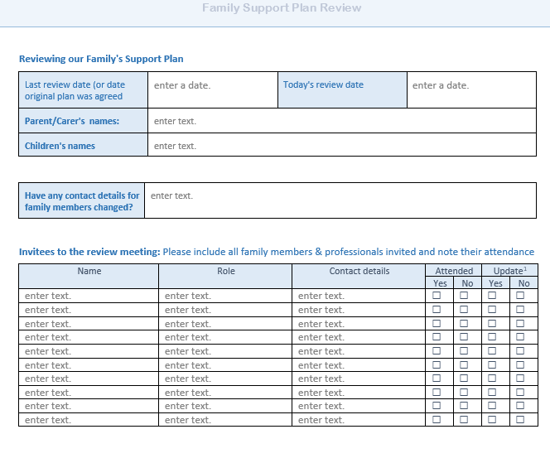
Family Support Plan Reviews – pg. 1
If this is the first review meeting – then enter the date the original plan was completed
Note the names of the family members for whom the plan was created and record if any contact details have changed
All those supporting the plan must be invited to attend
If people can’t attend, then either a delegate should be nominated or as a last resort a written update must be provided
To avoid potential drift, review meetings should be held every 6 weeks

Slide 22
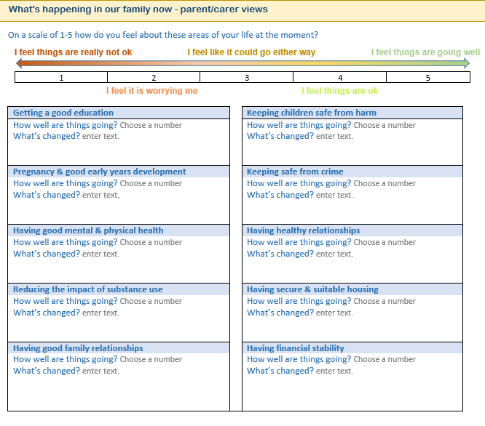
Family Support Plan Reviews – pg. 2
By asking family members (at each meeting) to score how they feel, it acts as a measure of progress and an early indicator of areas requiring more support.
Circumstances may have changed, improved and/or new presenting issues may have arisen – by starting with a review of the 10 aspects it helps all to remain focused
So an updated score should be added to each aspect and a brief summary of what the family feels has changed since the FSP has been in place

Slide 23
Family Support Plan Reviews – pg. 2
The progress summary should focus on what has helped the family; whether there have been any challenges, and what has been the impact on the family’s lived experience
Discussing any challenges should include consideration of whether this was because:
Actions didn’t help in the way expected
Planned support couldn’t be delivered and an exploration as to why
What has been the impact of this on the lived experience for the family

Slide 24
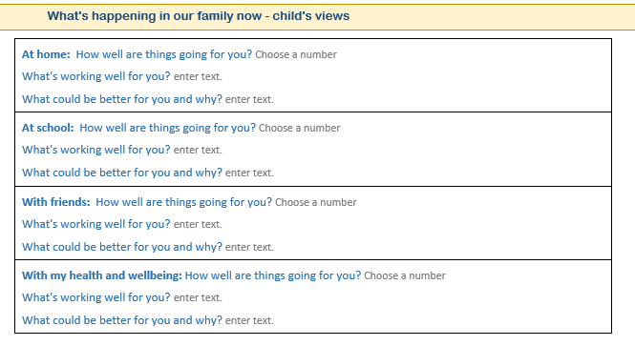
Family Support Plan Reviews – pg. 3
This section should be used to explore the child’s views of the impact of the support on their lived experience
If the child does not attend the meeting, then a professional should work alongside them to help gain their views to be shared at the meeting

Slide 25
Family Support Plan Reviews – pg. 3
This section should reflect your conversation with the family about:
The support you’ve offered,
How effective you feel this support has been,
Any actions you’re aware of that the family have achieved themselves without support,
A reflection on any challenges you’ve noticed (either in delivering the support or new needs that have arisen), and
What impact you’ve noticed

Slide 26
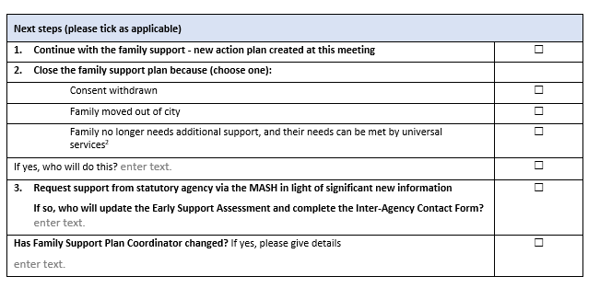
Family Support Plan Reviews – pg. 3
This conversation should conclude with an agreement reached with the family as to the next steps
If the decision is to continue with the Family Support – then update the action plan
If there are actions completed, and the happy they no longer need support with these they can be removed and celebrated with the family
If consent is withdrawn – consider if this escalates your concerns, why was this withdrawn, would a restorative conversation with the family help?
If the family have moved out of the city – (if you have consent) then a copy of the Plan should be included as part of the transfer records to the services supporting the family in their new area
If the family have made sufficient progress then a maintenance plan should be agreed

Slide 27
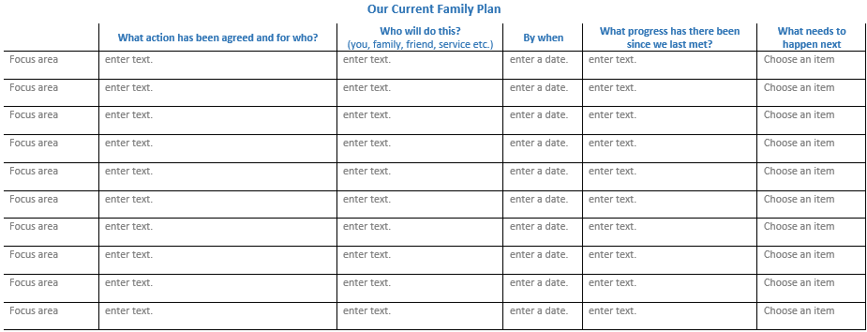
Family Support Plan Reviews – pg. 4
The actions listed should be a direct copy of the previous plan – that which was agreed either at the initial conversation or at the last review meeting
Against each of the actions a brief statement outlining the progress that has been made in relation to each should be recorded here
This column should be used to note whether the action is:
Completed and can be removed;
Is still being worked towards;
Not yet started;
Needs changing; or
Is no longer needed

Slide 28
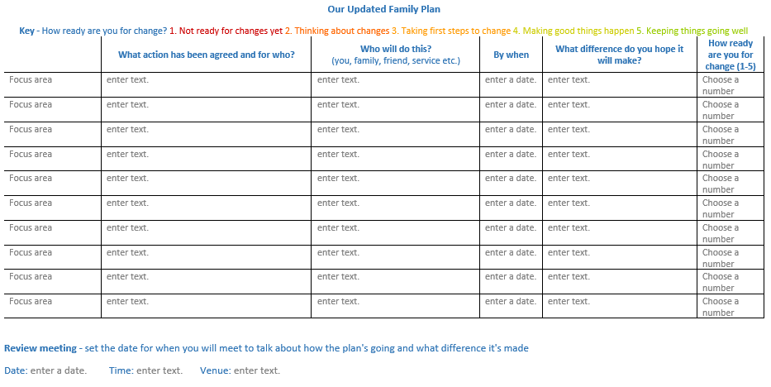
Family Support Plan Reviews – pg. 5
The new FSP should be recorded here.
Copying across actions from the previous plan that are either ongoing or have been amended.
Adding in any new actions that have been agree

Slide 29
Closing a Family Support Plan
What we learnt | enter text.
What was most useful | enter text.
What actions we need to continue maintain progress? | enter text.
Situations we may we find difficult in the future | enter text.
What we can do if things are starting to become challenging | enter text.
Who we can contact if we need support | enter text.
Key contact numbers and names of support: | enter text.
The aim of the maintenance plan is to:
Help the family review the progress to date
Capture what they’ve learnt during their early support journey
Consider what they need to do in order to maintain this
To consider events or situations that they might find challenging, and establish proactive measures they can take
Provide them with details of people they can contact for advice or support if they need help maintaining their progress
If you’re closing a plan, it’s very important to let all those working with the family know. That way they can help monitor whether the family are able to sustain these changes

Slide 30
Additional support
Additional information and guidance on providing Family Support is available:
Information for families, including leaflets explaining what FSP is and what they can expect from an FSP Conversation – PSCP website
Information for professionals, including practice guidance and resources available to support families in each of the 10 aspects of life – PSCP website
Early help training delivered by the PSCP can be booked here
For any additional queries you can email FSP@portsmouthcc.gov.uk

