Slide 1
Portsmouth’s Early Reading Project ‘Read With Me’

Slide 2
Why focus on Reading?
“We now know for certain that children who handle books confidently before they go to school, and have enjoyed being read to, are those who learn to read in school with the most success.” – Margaret Meek
“Research has shown how important reading for enjoyment is, not only for reading outcomes but for wider learning.”
National Literacy Trust ‘Celebrating Reading for Enjoyment’
Just listening is good but … parents who converse and interact with their children while listening to their children read raise the potential value of the activity
Greenhough and Hughes, 1998
Oral language developed from parent/child reading predicts later writing development (Crain-Thoreson, Bloomfield, Anthony, Bacon, Phillips and Samwel, 1999)
Notes:
Nearly a third of UK parents read their children a bedtime story once a week or less, a survey suggests.

Slide 3
‘Read With Me’
The Portsmouth ‘Read With Me’ project is all about partners working together to support young children’s early reading and communication and language skills
If you take part you will be joining with Year R practitioners, The School Library Service, Public Libraries and Parents to expose children to a range of high quality picture books
10 recommended reads have been identified as strong models of language that support children’s understanding of rhyme and alliteration and will help to build their vocabulary

Slide 4
How does the project work?
Summer Term 2022 – Pre-school practitioners can share as many of the 10 recommended reads with their school cohort as they want. Read the stories together, try acting out the stories, provide additional experiences to immerse the children in the stories and most of all have fun with the books!
Summer Holidays 2022 – Parents can carry on sharing these books with their children. They can visit public libraries to find these books. Take a look at the letter we have included in the email that you can send to parents. It explains what the project is all about.
Autumn Term 2022 – Year R teachers can carry on sharing the books with their new class.

Slide 5
Why have we got 10 books?
“Children don’t necessarily need a vast quantity of books, but they do benefit from repeated exposure to those books” Dr Jessica Horst
Children’s reading skills can be supported if they can:
Build up a repertoire of books and stories that they know and love
Take part in repetitive reading experiences - repetition is a key to understanding
See books as fun and if we remember that familiarity is a friend for reading, the more familiar a child is with a book the more chance of developing a love of the story
See themselves as ‘equal storytellers’ to the adults. When children are familiar with the book they will read it themselves and develop reading self-esteem and confidence

Slide 6
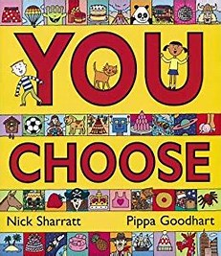
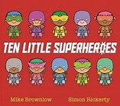
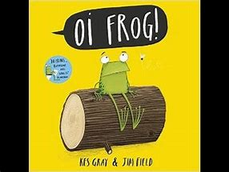
The 10 Recommended Reads

Slide 7
Why have we chosen these books?
They contain:
Rhythm and Rhyme
Repetitive text
Eye catching illustrations
Authors who have a strong back catalogue of other books
Opportunities to develop other areas of learning – maths, counting, UTW
Some of these books are available in dual languages
And we have a couple of ‘old favourites’ – the classics! So that hopefully some parents will remember and relate to them

Slide 8
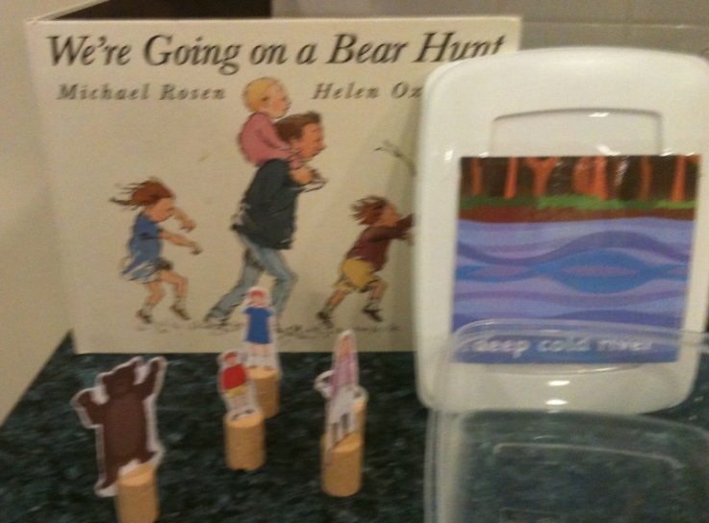
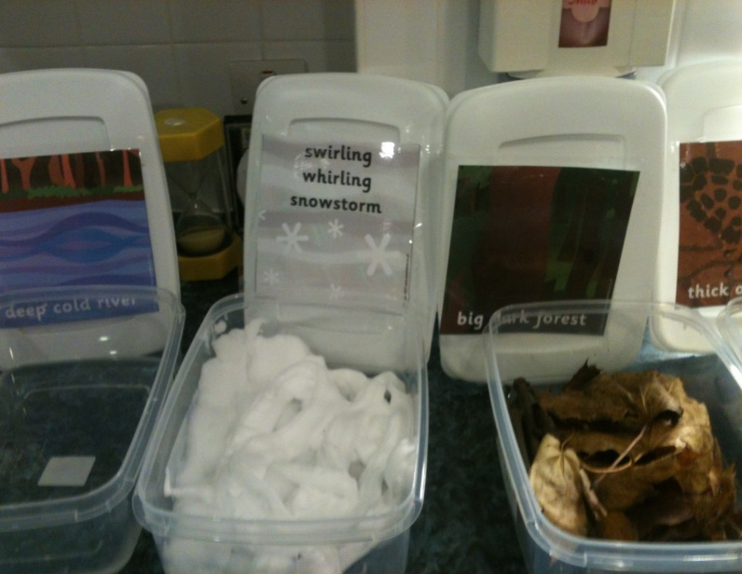
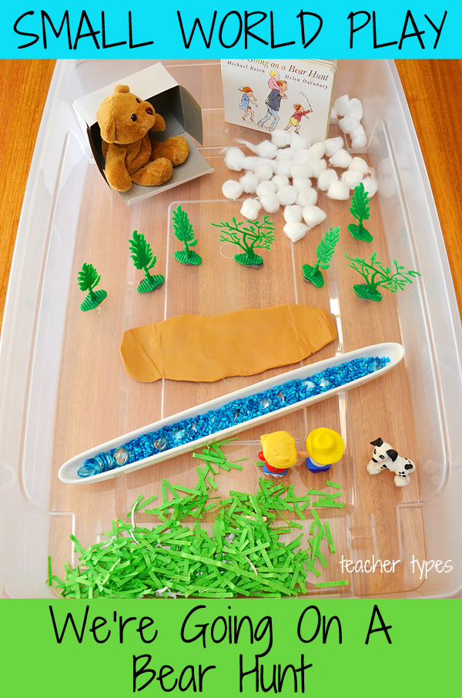
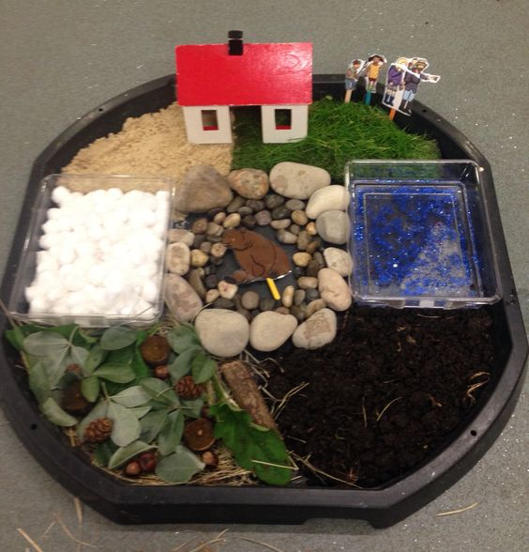
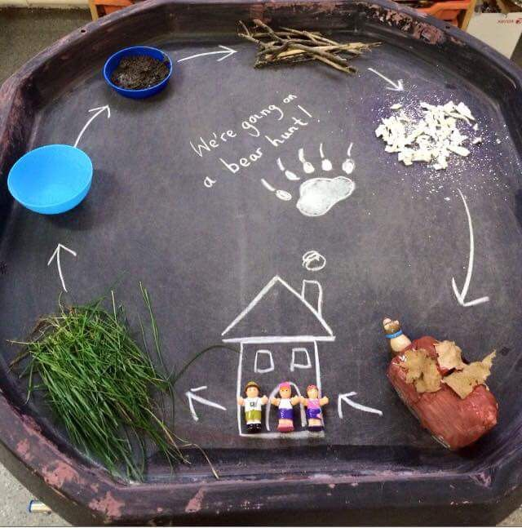
We’re going on a bear hunt – ideas for experiences

Slide 9
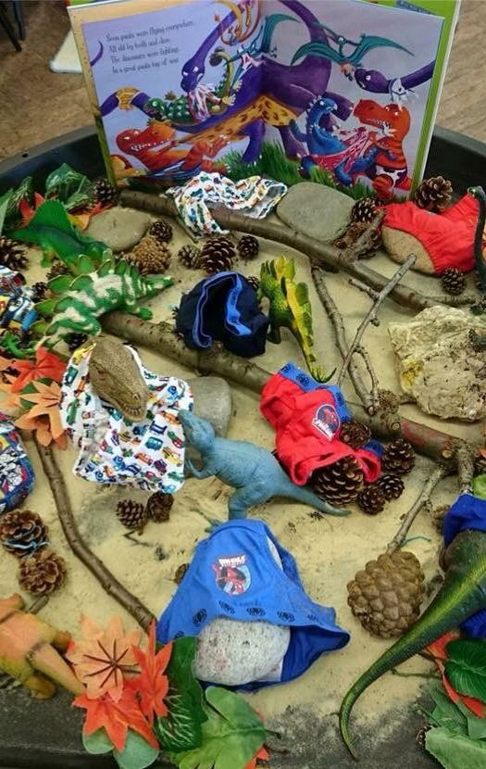
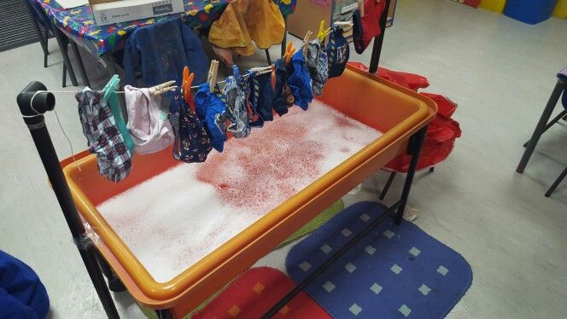
Dinosaurs Love Underpants

Slide 10
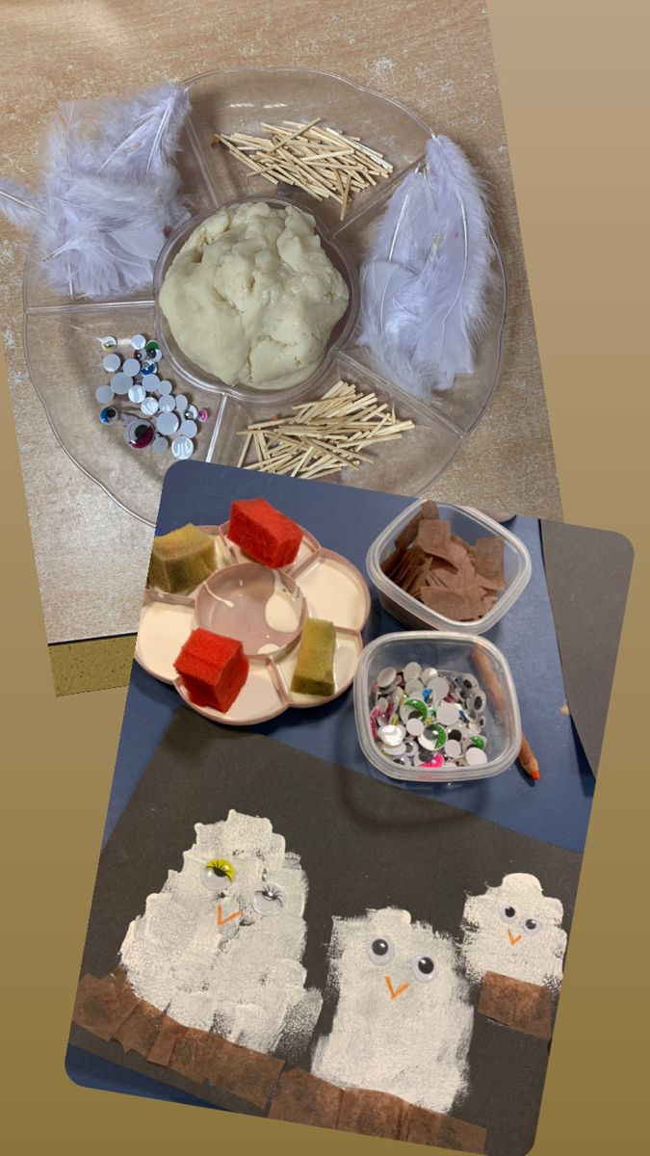
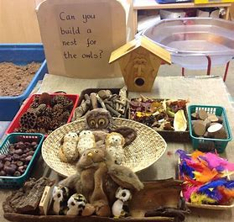
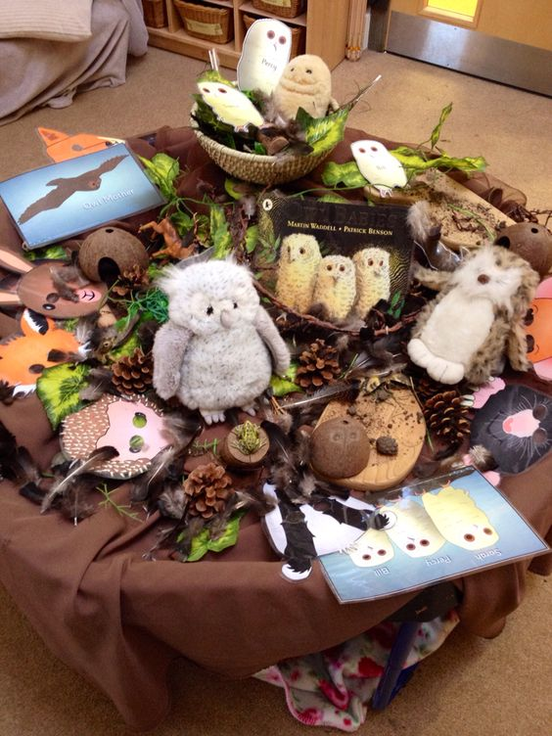
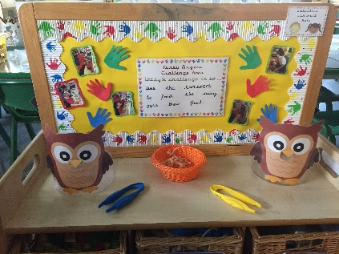
Owl Babies

Slide 11
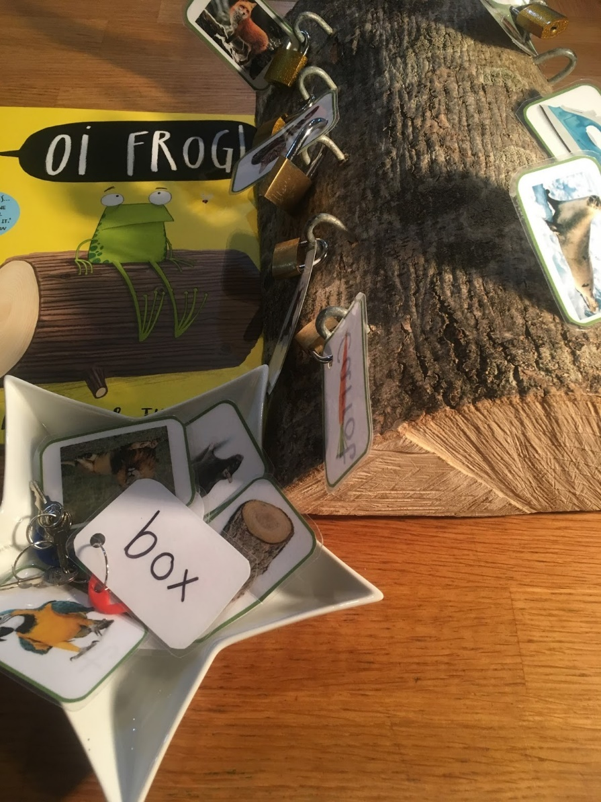
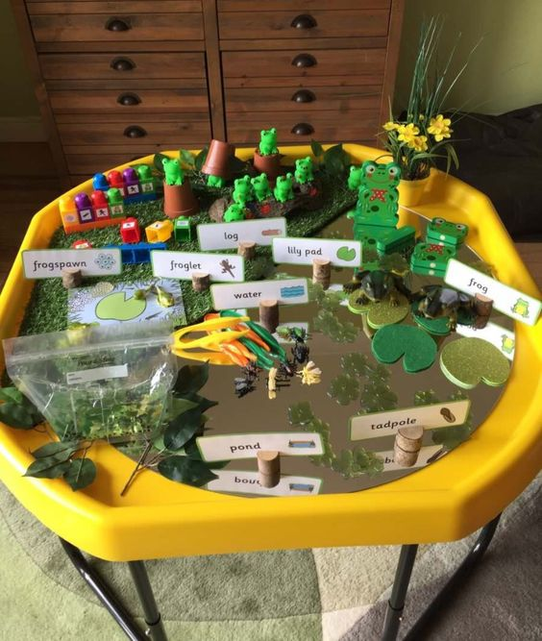
Oi Frog!

Slide 12
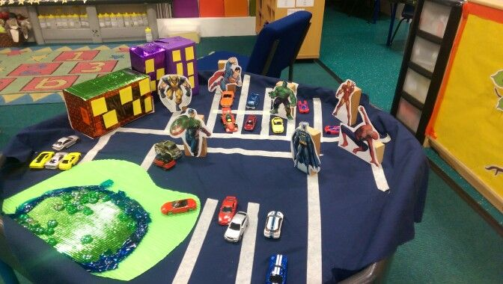
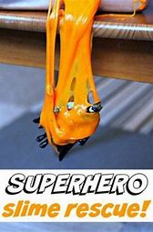
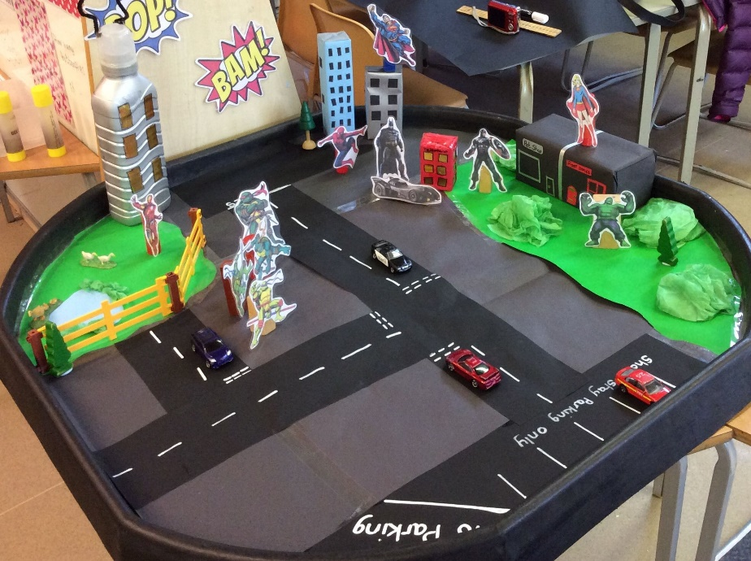
Ten Little Superheroes

Slide 13
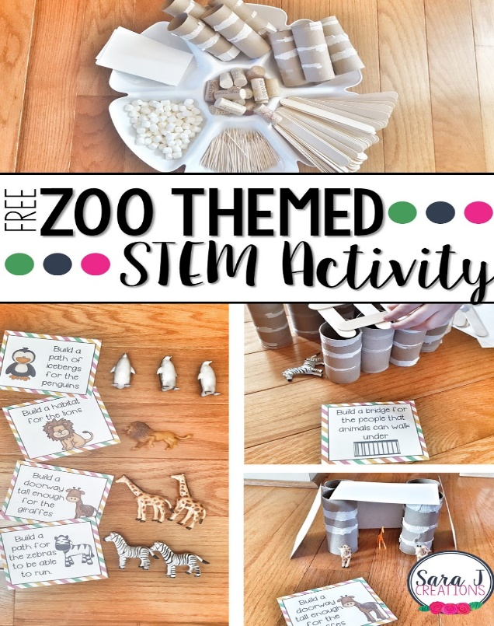
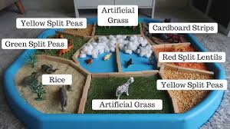
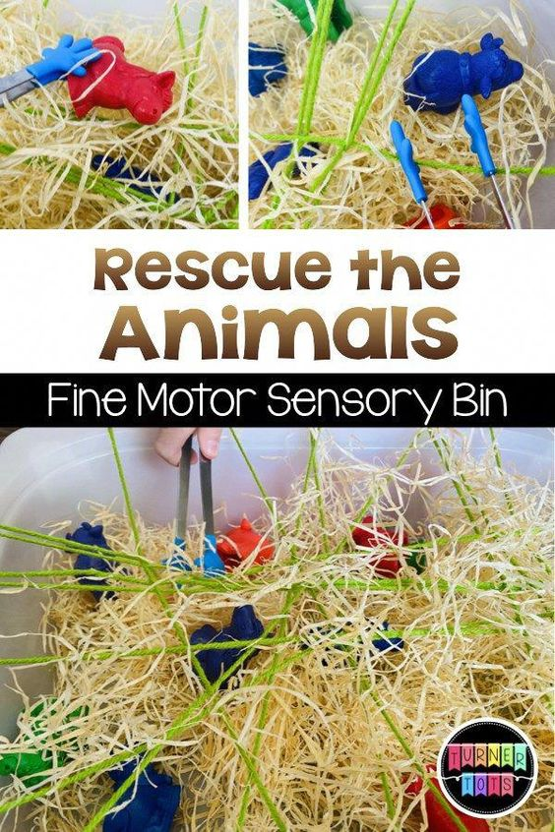
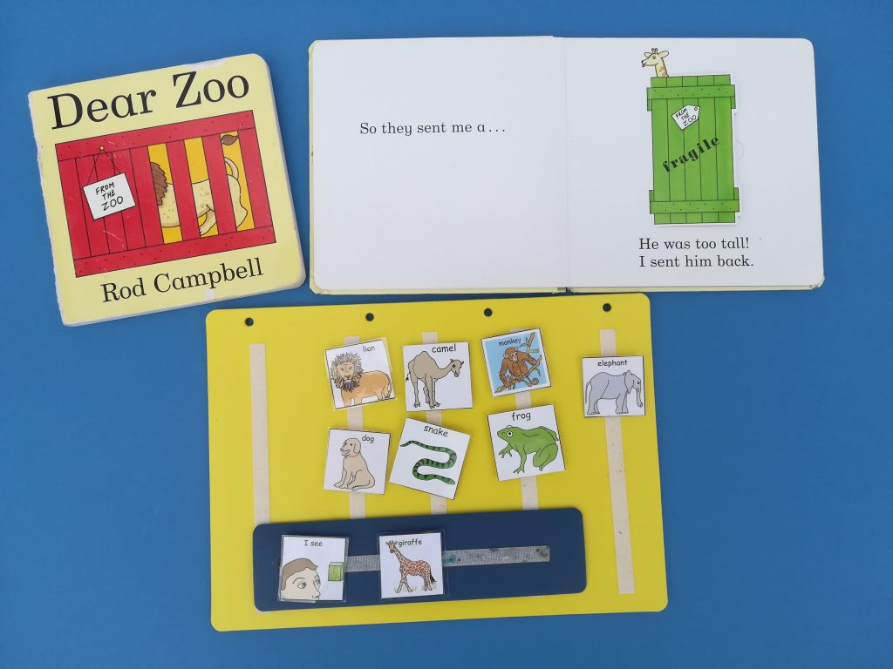
Dear Zoo

Slide 14
References for images
We thank and acknowledge the following websites and people:
We’re going on a bear hunt
Childhood101.com
Pinterest
Dinosaurs Love Underpants
Pinterest uploaded by - Charlotte MW, Natalie Nunn, Rachel Cooper
Owl Babies
The Imagination Tree
Pinterest uploaded by – Janet O’Donnell, Sarah Woolnough, EY Teacher
Oi Frog
Pinterest uploaded by – Sue Baxter, lovehappinesslearning.blogspot.com

Slide 15
10 Little Superheroes
Rockmyclassroom.com
Whatdowedoallday.com
Pinterest – uploaded by Philippa Norris
Dear Zoo
Ponderingparenthood.com
Verymessymummy.blogspot.com
Turnertots.com
Theautismpage.com
SaraJcreations

Slide 16
Bringing books to life…
And finally some top tips for sharing stories aloud with children and taking on the role of the storyteller
The readers voice is the most important tool!!!
Reading aloud involves a level of performance and clever use of elements – vocal pitch, tone, volume, rate of speech
Create drama, suspense, excitement, anticipation through a well timed pause, change of vocal volume or emphasis on certain words or phrases
Engage children in joining in with repeated refrains
Have fun with your storytelling!

Slide 17
And finally … some websites which support early reading
“So please, oh PLEASE, we beg, we pray, go throw your TV set away, and in its place you can install, a lovely bookshelf on the wall”
Roald Dahl, Charlie and the Chocolate Factory
https://www.booktrust.org.uk/
http://www.wordsforlife.org.uk/3-5
www.earlyreadingconnects.org.uk
http://www.literacytrust.org.uk
https://clpe.org.uk/
If you would like to discuss using the ‘Read With Me’ project in your setting, contact ella.harbut@portsmouthcc.gov.uk

