Slide 1
CLICK THIS LINK – Let’s celebrate video
Notes:
This is our branding..

Slide 2
Background
School holidays can be stressful for some families due to increased costs and reduced incomes
Free school holiday clubs and activities can have a positive response (particular during/after Covid)
Grant awarded to PCC = £95,840 for Easter and £857,220 for 21/22 financial year (Summer & Xmas)
Programme = healthy food and enriching activities for children eligible for free school meals (FSM)
Notes:
Particularly during covid where parents have either been furloughed, lost their jobs or working reduced hours
Positive response especially when its consistent alongside enriching activities…

Slide 3
Aims
to find ways of encouraging more healthily eating;
to facilitate more active and enriching opportunities;
to make communities more resilient; create opportunities to promote and support wellbeing and character of the whole family;
to make communities safer, more sociable and combat isolation;
to have greater knowledge of what our communities and our families need; have those conversations with the beneficiaries.
to be more engaged with school and other local services.
Notes:
DfE

Slide 4
HAF Fun Pompey Referrals
Yes
You can book directly with the provider. Go to www.pycportsmouth.co.uk/haffunpompey
Go to the interactive map to find provision near the family or check the listings under the participant’s age. Don’t forget to check out ‘HAF Family Fun’ as the whole family can go along.
Are the family eligible for benefits related FSM?*
Yes, but I am worried about their additional needs
We are working closely with our providers to ensure they are equipped to support SEND and to make sure their capacity is clearly advertised. Go to www.pycportsmouth.co.uk/haffunpompey and ‘SEND SUPPORT’. There is also a SEND SUPPORT section in each provider ‘What’s On’ listing. If you are still unsure please contact us at haf@portsmouthcc.gov.uk
No, they are deemed vulnerable
*All infant school aged children qualify for free school meals – the family have to be eligible through benefits related means. If you are unsure please visit School meals - Portsmouth City Council
Please contact us at haf@portsmouthcc.gov.uk and we can send a non FSM/additional needs referral form
If you would like to use the referral form to inform providers of any additional needs, please do so and send directly to the provider. You can find provider contact details under 'How to Book' on the ‘What's On’ listings.
It is imperative that providers are given as much information in advance as possible to appropriately support the family.
Notes:
DfE

Slide 5
HAF REFERRAL FORM
Notes:
Maps represent some of the key ‘hot spots’

Slide 6
HAF WEBPAGE LISTINGS
Notes:
Maps represent some of the key ‘hot spots’

Slide 7
SEND
Portsmouth Local Offer HAF information was used as best practice during a Childcare Works/DFE bitesize session by Caroline Coady, Assistant Director at the Council for Disabled Children. She particularly highlighted our use of FAQs and the comprehensive information on how HAF Fun Pompey can support 1-to-1s.
We will continue to update this page - HAF Fun Pompey - Holiday Activities and Food programme > Portsmouth Local Offer
We have asked all providers to answer the following SEND questions on their winter provision:
How many SEND participants could you support
What is your experience in delivering support to SEND
How many qualified staff/volunteers do you have
What additional support would you require in this area
We are adding ‘SEND SUPPORT’ to our what’s on booking listings under each provider/offer.
We are adding new sections/tabs to the webpage – it will be easier for all families to
book/find information:
HAF for ages 5-11
HAF for ages 11-16
HAF Family Fun
SEND Support
All About HAF Fun Pompey
HAF Resources
Enableability are circulating the opportunity to work over the Christmas holidays with our HAF winter programme to provide 1-to-1 support. We are hoping we will have some workers come forward – this will be a paid opportunity.
We have invited Mike Bowen, Integrated Commissioning Project Manager (SEND/SEMH Workforce), to the steering group and linking in with his contacts. Please note he is unable to attend 21/10/21 due to Inclusion Conference.
Enableability ‘Confidence in SEND’ Training

Slide 8
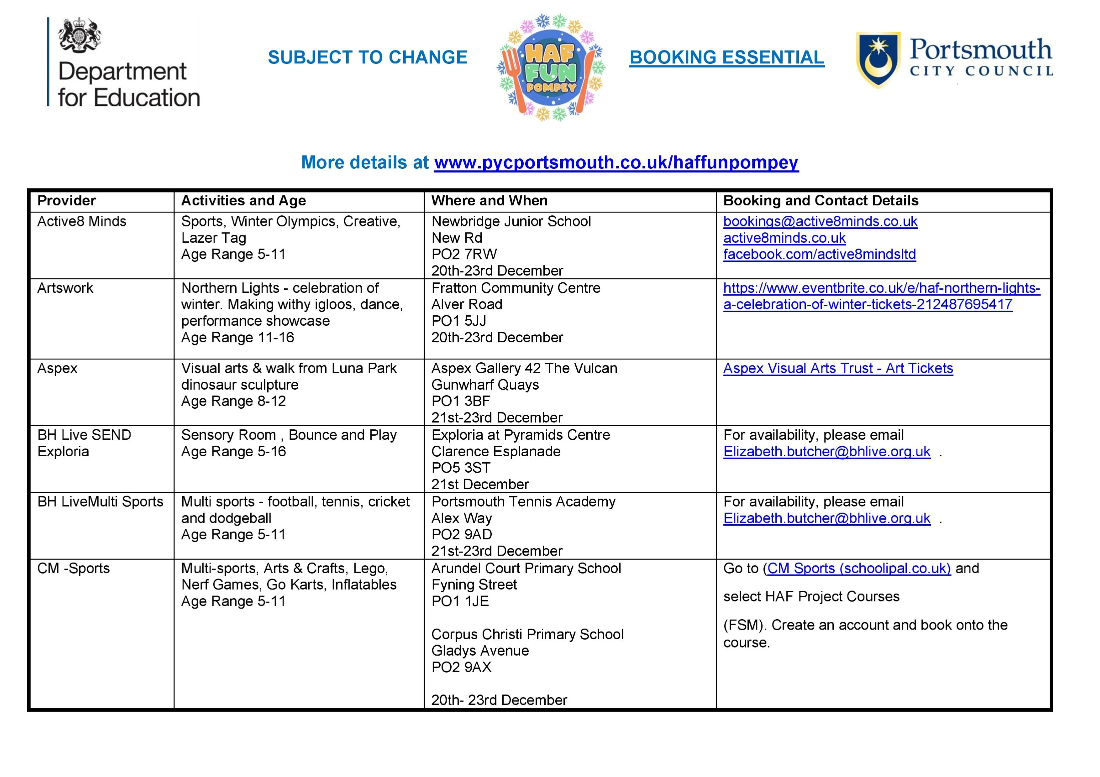
HAF ACTIVITY LISTING

Slide 9
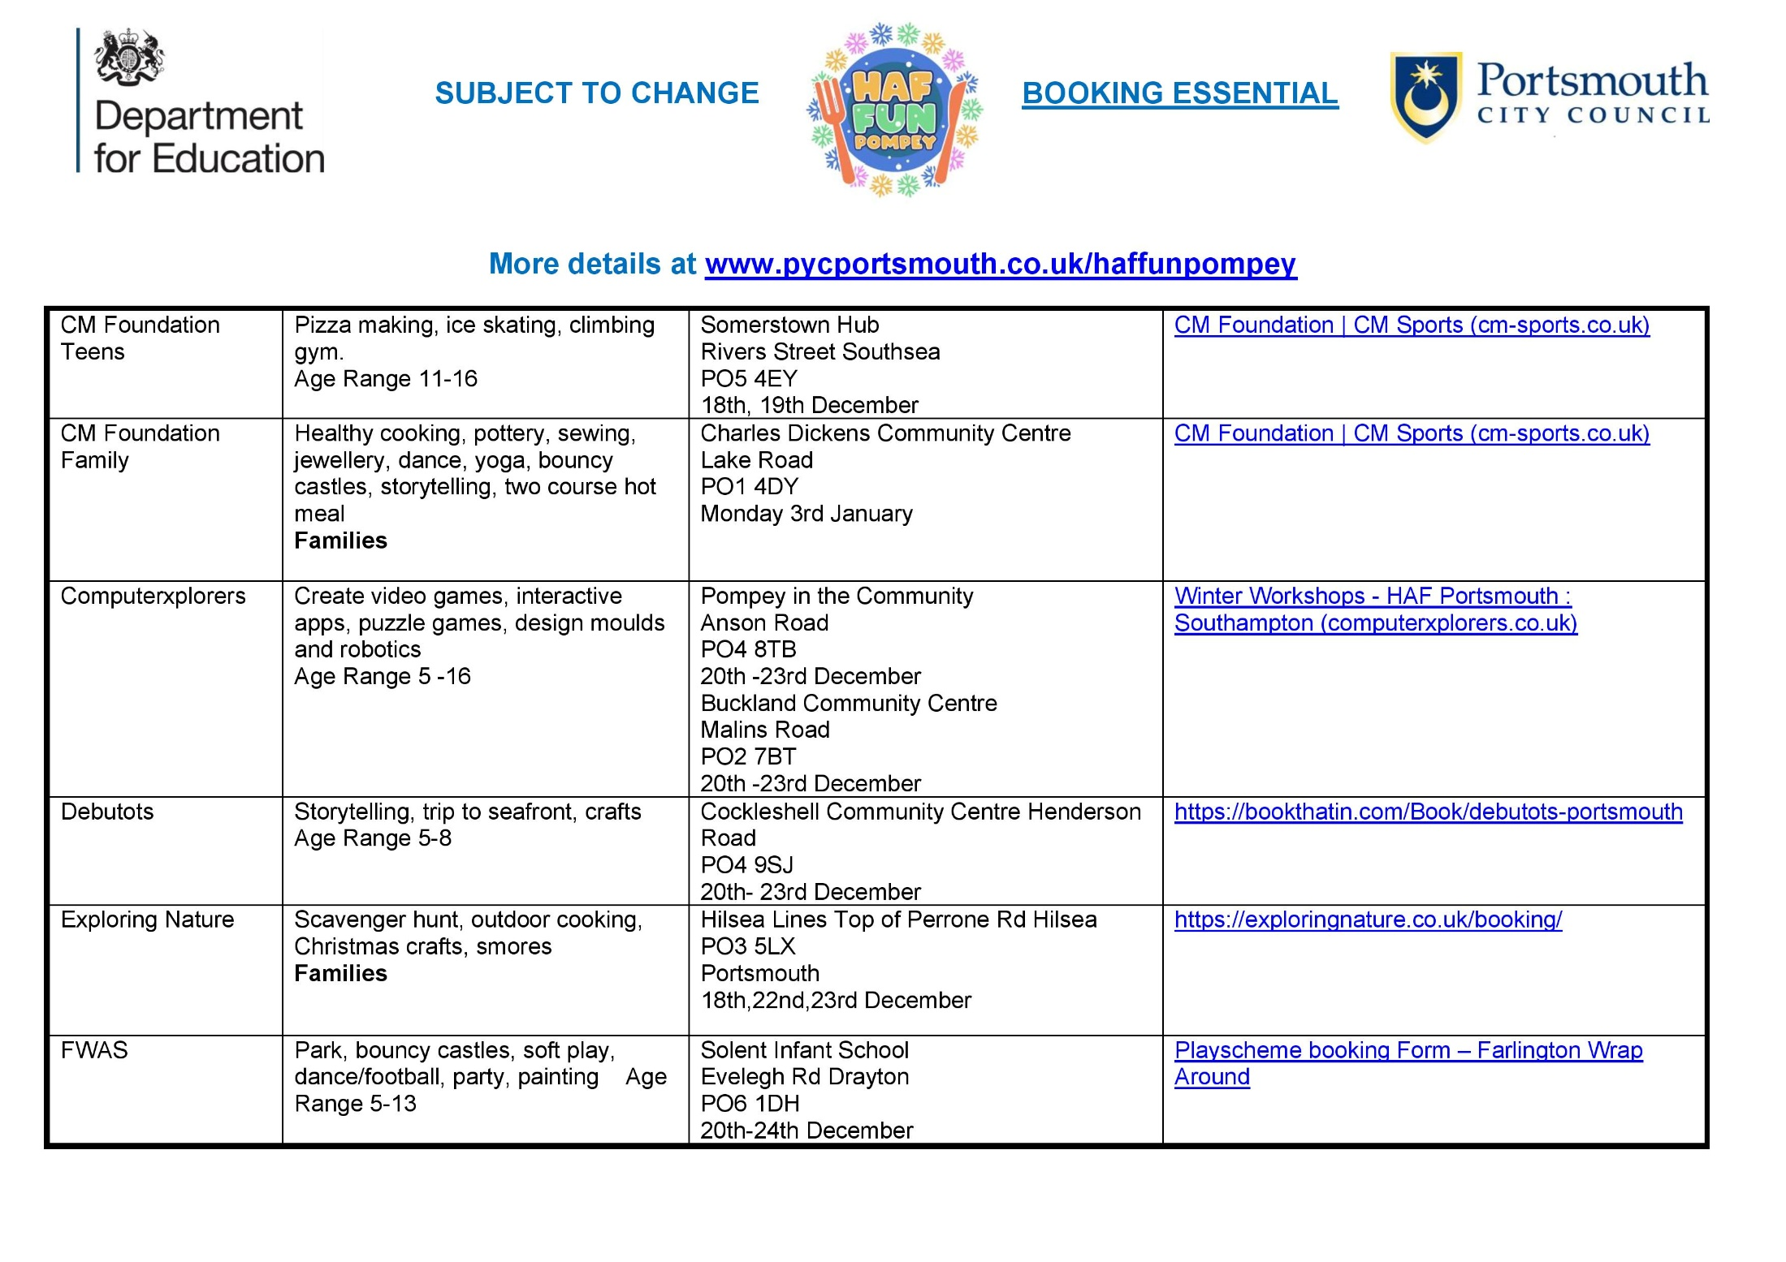
HAF ACTIVITY LISTING

Slide 10
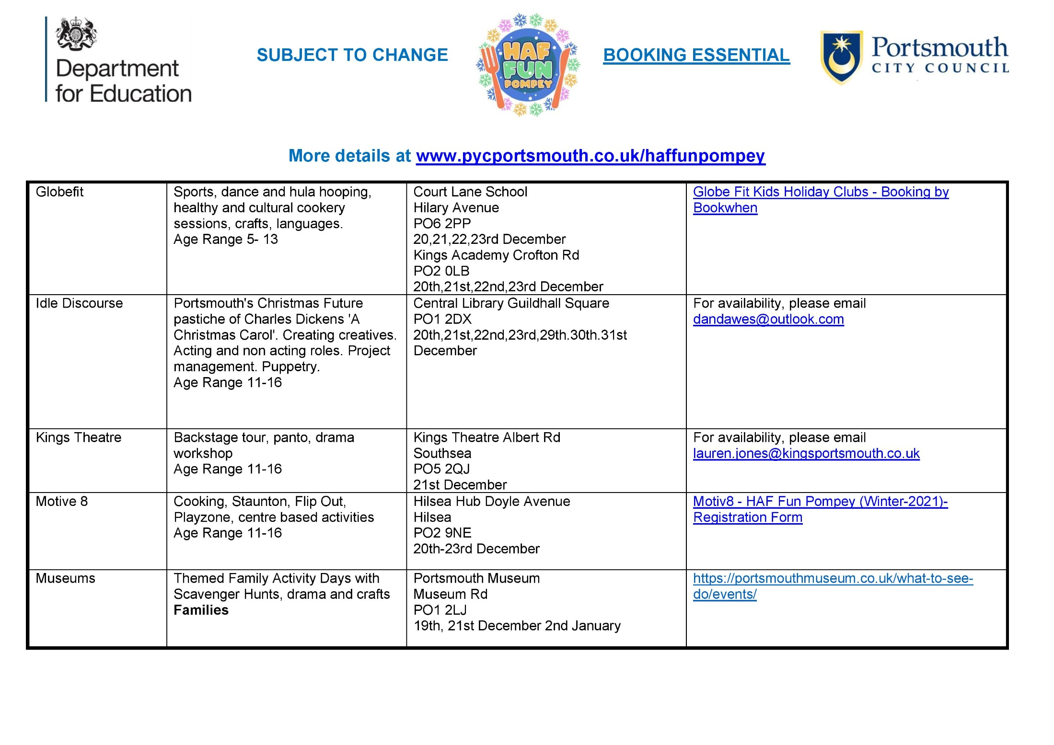
HAF ACTIVITY LISTING

Slide 11
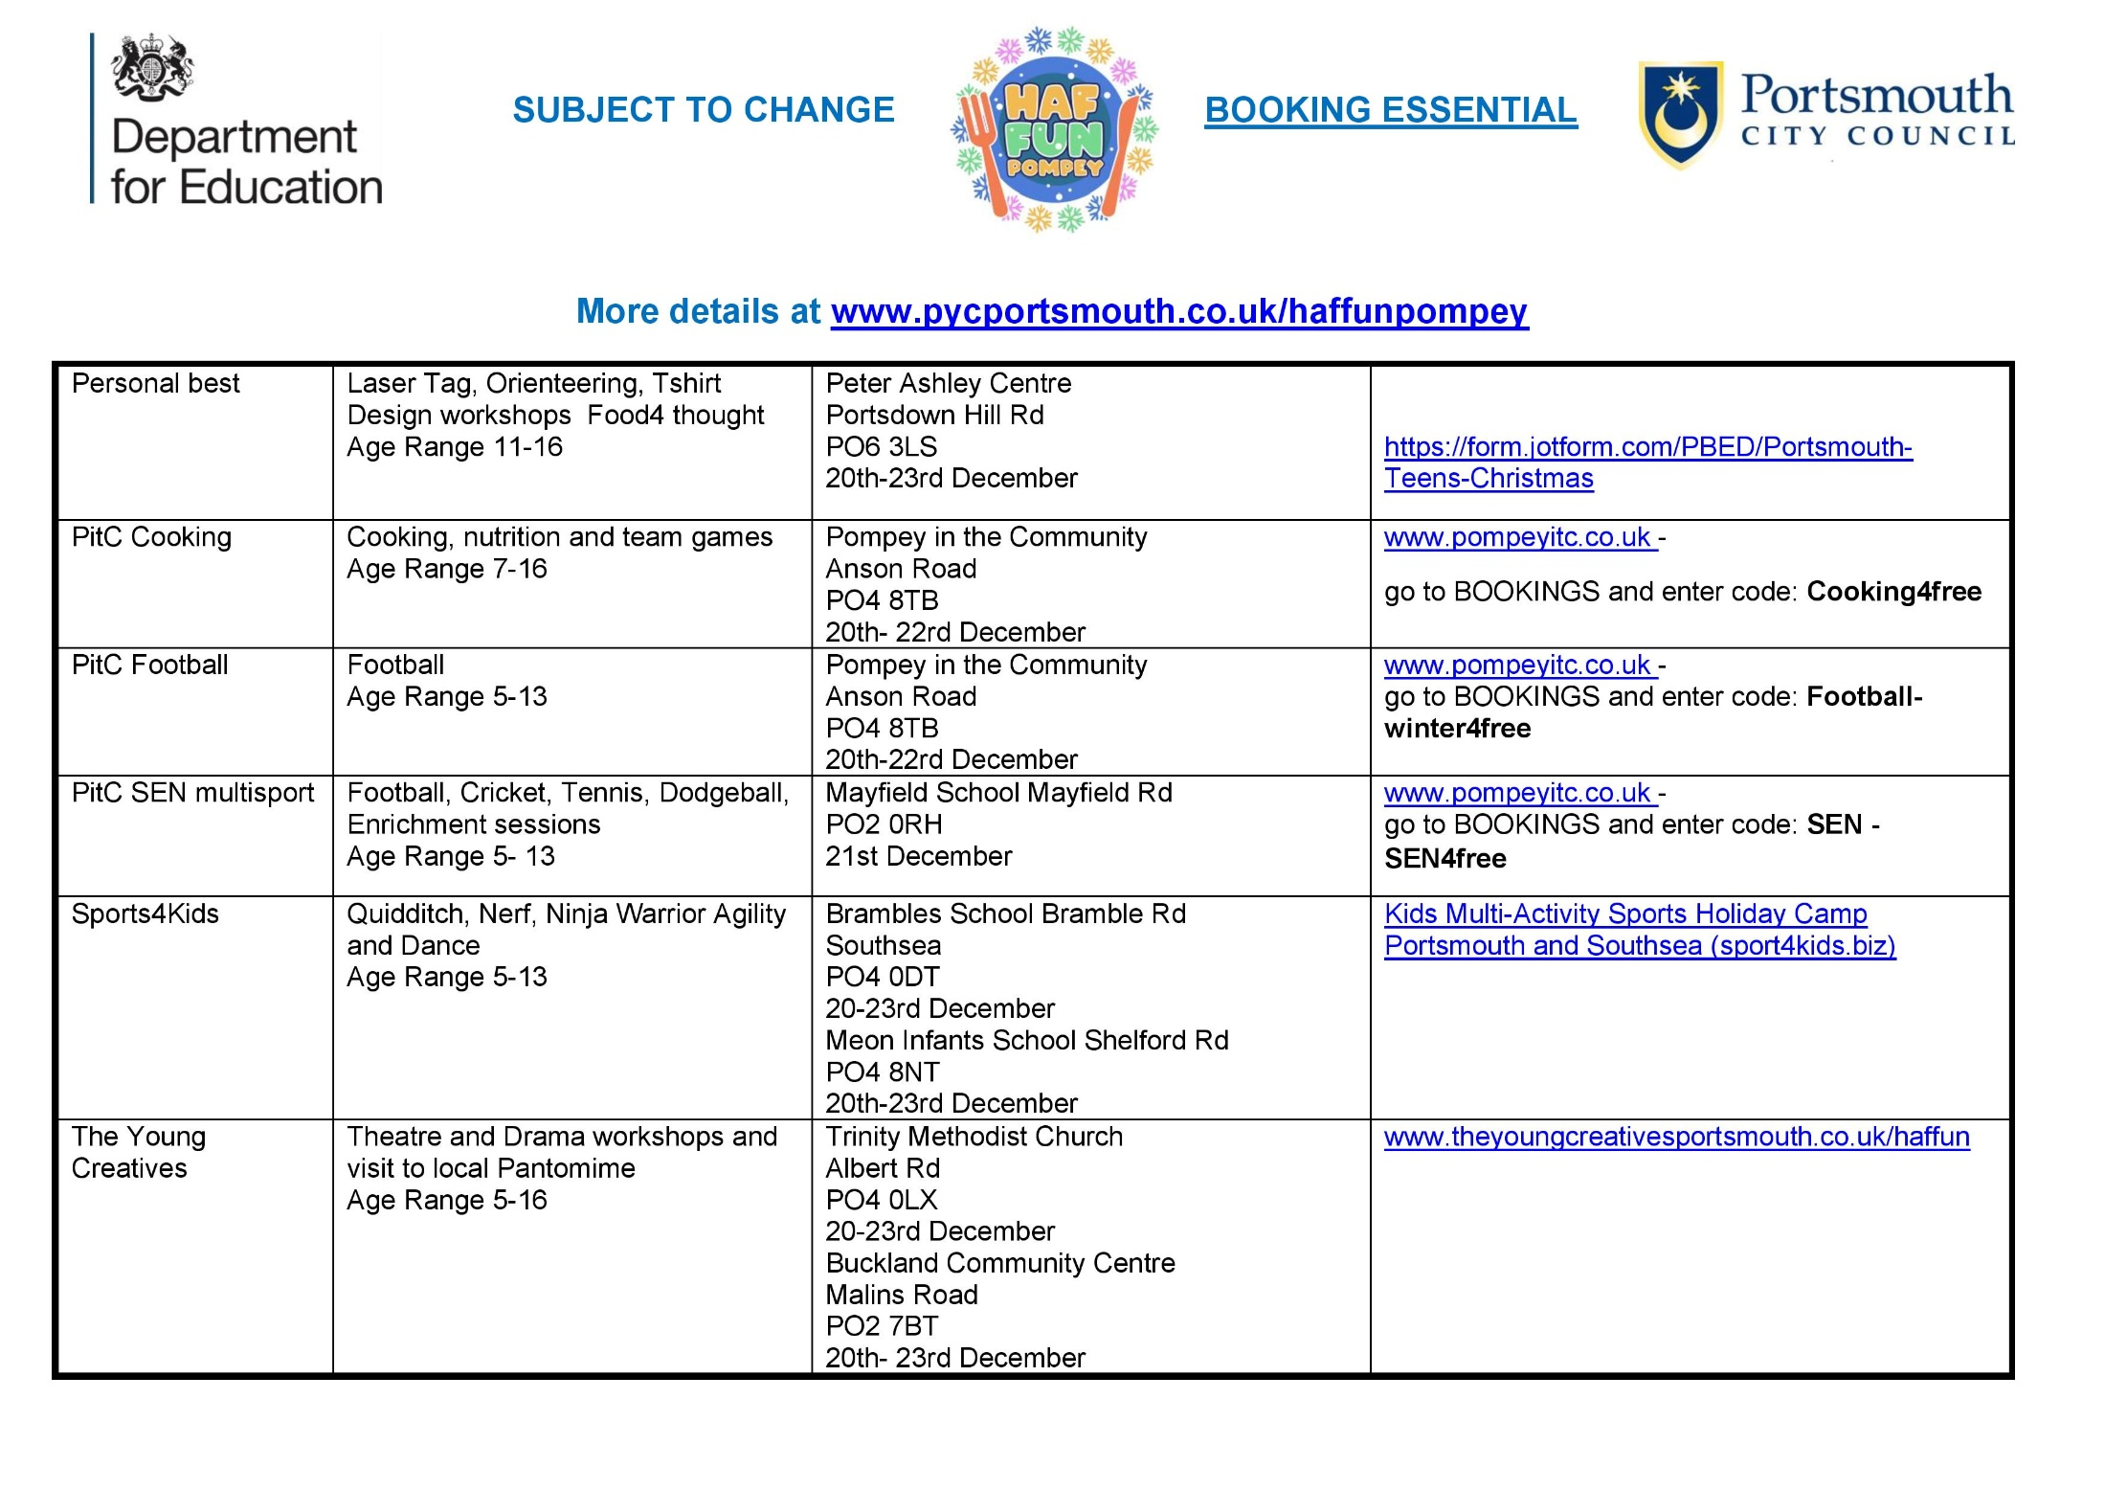
HAF ACTIVITY LISTING

Slide 12
HAF ACTIVITY LISTING

Slide 13
HAF TIMELINE
Public bookings open w/c 22 November
www.pycportsmouthpyc.co.uk/haffunpompey

