Slide 1
Early Years Foundation Stage (EYFS) Transition Toolkit

Slide 2
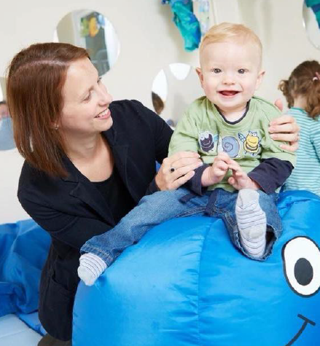
Contents - 1
Early Years Foundation Stage
Transition Toolkit
Page 2
 | Page
Introduction | 4
Purpose | 6
Underpinning principles | 7
Pathway to school – Transition timeline | 9
Activities | 10
Transition – Ready for School | 11
What makes me? me | 14
Template – Child’s Summative Assessment | 15
Children with Special Educational Needs and/or Disabilities | 16
What makes me? me | 17
Transition – information sharing | 18
Children with SEND – Transition toolkit top tips | 19
Transition Audits PVI - Child new to setting and/or childminder | 20
PVI - Setting or childminder for child transitioning to school | 22
School - transition from early years setting/childminder | 24
School – child who has not attended any other setting | 26

Slide 3
Contents - 2
Early Years Foundation Stage
Transition Toolkit
Page 3
 | Page
Supporting transitions – Planning Guidance A Unique Child | 28
Positive Relationships | 32
Enabling Environment | 38
Learning and Development | 42
Resources | 46
Contact Us | 47

Slide 4
Introduction
Early Years Foundation Stage (EYFS)
Transition Toolkit
Page 4
WELCOME to the Early Years Foundation Stage Transition Toolkit.
This Toolkit is intended as a starting point to assist you with thinking about transitions for early years children across the EYFS, ensuring that all early years children and their families are provided with as much support as possible.
The key to the successful use of the ‘toolkit’ and seamless transitions is to keep the child and family central to the whole planning process and ensure good communication between all of those involved.
This toolkit is for all those involved in supporting children’s transitions within the EYFS, including:
Early Years Foundation Stage practitioners and teachers in PVI provision, childminders, school nursery and reception classes.
Specialist support services
Professionals from other agencies or settings
Voluntary and Community sector partners
Please consider the content of the Toolkit in the context of your early years setting or school. There may be issues, particular to the context of your setting or school, which may not have been covered by this document so please make adjustments and additions where necessary to support your children and families.

Slide 5
Introduction – ‘Best Start’
Early Years Foundation Stage (EYFS)
Transition Toolkit
Page 5
The North Lincolnshire Getting the BEST START (northlincslocaloffer.com)
sets out our shared ambitions for young children from conception to five, within the framework of the One Family Approach.
One of our shared priorities is to improve transitions for children in their early years. The principles of effective transition are understood and implemented for all children, but with a particular focus on improving transitions for vulnerable children. This toolkit has been created through consultation with various different stakeholders; PVI sector, schools, health, early years team, portage, EMTAS, behaviour support team and children centres.

Slide 6

Purpose
Early Years Foundation Stage (EYFS)
Transition Toolkit
Page 6
This Toolkit is intended as a starting point to assist you with thinking about transitions for early years children across the EYFS.
The aims of the EYFS transition toolkit are as follows:
All children will have successful transitions, which will enhance their well-being and learning
All children and their families will ‘feel known’ and develop a sense of belonging
All children have positive opportunities to contribute to their transition
Every child’s transition is personalised and tailored to meet their individual needs
Consistent support and advice is given to all staff in early years settings and schools regarding transition planning
The transition toolkit will help to achieve these aims by:
Encouraging a whole setting approach to manage change, transition and inclusion for all children.
Offering information and guidance on achieving seamless transitions
Providing ideas and examples of effective practice to aid thinking and discussion about transition plans.
Ensuring that the correct people are consulted and involved in the delivery and monitoring of the transition process - children, parents and early years practitioners are equal partners in the development and implementation of the transition plan.
Identifying activities and resources useful to support the transition process.
Providing an adaptable audit tool to support the planning process.

Slide 7
Underpinning principles
Early Years Foundation Stage (EYFS)
Transition Toolkit
Page 7
Effective transition within the EYFS should be based upon the statutory underpinning principles:
Every child is a unique child, who is constantly learning and can be resilient, capable, confident and self-assured: Find out about a child’s individual needs, including their interests, their involvement of any other agencies, and any specific details that will help them to settle.
Children learn to be strong and independent through positive relationships: Successful transition rests on effective communication between children, parents and carers, early years setting, school and other people involved with support the child. The child’s and parent/carers views are central to planning for a child’s transition. The child’s key person has an important role in supporting transition and forming a close and trusting relationship with both the child and family.
Children learn and develop well in enabling environments, in which their experiences respond to their individual needs and there is a strong partnership between practitioners and parents and/or carers: Physical environments and routines form an important part of transition and may need to be planned differently depending on the age, stage of development, previous experience and individual needs of the child.
Children develop and learn in different ways and at different rates. Each new stage on a child’s journey builds upon the learning that has taken place, both at home and during the previous EYFS provision. Assessment information about children’s individual stages of learning and development, including their interests and how they learn, should be used as a starting point for planning an effective curriculum.

Slide 8
Thinking about transition
Early Years Foundation Stage (EYFS)
Transition Toolkit
Page 8
Early Years Transition: A Journey
Children may move between several different settings in the course of a day, a week, a month or a year. Children’s social, emotional and educational needs are central to any transition between one setting and another or within one setting. Some children and their parents will find transition times stressful while others will enjoy the experience. Effective communication between settings is key to ensuring that children’s needs are met and there is continuity in their learning.
Early Years Foundation Stage (2008) 3.4 Enabling Environments: The wider context.
‘It is crucial that everyone works together, in the best interests of the child, to make transition as smooth as possible. Each person has valuable information to share about the child’s strengths and areas where help is needed. When practitioners and parents work co-operatively, they can support the child through the process of transition in the best possible way.’
Julian Grenier ‘Working with the revised Early Years Foundation Stage: Principles into Practice (2001)
An ongoing journey rather than a destination
‘Going to a setting for the first time, moving to another, or starting school is a normal part of children’s lives. Yet transitions are milestone events for children and have an effect on their development. They are times of exciting change, new opportunities and growth for every child. They can also be times of uncertainty where surroundings are not the same, expectations and procedures different and unfamiliar faces. Getting transition right is vital for every child and is not a single event that just happens. Transition needs to be a process rather than an event that involves children, practitioners and parents together’. Early Years Matters
Transition is a process, not an event.
High quality transitions recognise the importance of feeling ‘known’. Some children are particularly vulnerable at times of transition. Transitions are opportunities for professional dialogue. The key person makes essential connections. Transition includes moving from EYFS to Key Stage One.
Birth to 5 Matters: Non-statutory guidance for the Early Years Foundation Stage (2021)

Slide 9
Pathway to School
Suggested timeline
Page 9
September
October
January
Applications for children due to start school reception class in September open from the previous September to the following January for admission to reception for pupils who live in North Lincolnshire
Admission to infant, primary and junior schools – North Lincolnshire Council - northlincs.gov.uk
Early years setting can discuss with parents which school they have applied for. Appropriate information shared with the potential school through visits/ discussion, with particular thought given to transition planning for children with SEND or other needs.
Discussions between school and setting regarding previous cohort who transitioned to school for example curriculum decisions, effectiveness of previous transition or assessment information.
January: Schools contact feeder early years settings to discuss individual needs, observe and plan transition particularly for children with SEND.
May
April
Beginning of May – Schools can confirm with settings which children are transitioning to each school. School continue with transition plans for all children including using guidance in this toolkit, for example sending welcome letter / transition pack to families and early years setting with key information, photos/ videos of indoor/outdoor classroom, teachers and other practitioners (including key person) and uniform.
Mid April –
Notification of school place sent to parent
End of April –
Parent to accept the school place
June
2020
May –
Setting key person meets with EYFS lead to discuss children transitioning to school. School EYFS staff can visit setting to discuss / observe all children transitioning.
Home visit from reception staff and opportunity for parents to ask questions
Opportunity for parents / carers to visit school with their child
Beginning of June –
Early years setting key person visits school with children who are transitioning
Mid June –
Transition visit for child to school. School EYFS staff can share activity /reading with those going to school
July
EYFS lead to co-ordinate parent meeting / phone call to give opportunity for questions.
Early years setting continues to support children’s and families’ transition to school, including through using the guidance in this toolkit.
Setting to update and review information with schools for children transitioning.
End of June –
Setting to share 2-year assessment, ELIM, and transition summary of assessment with school. Any EYPP funding accessed and details of impact to be shared with school

Slide 10
Activities
Early Years
Transition Toolkit
Page 10
Transition Activities
What makes me, me? Transition document.
All about me – practitioner information.
Read North Lincolnshire’s definition of School readiness. It is helpful if I can…
Share and display the pathway to school timeline to support parents, settings and schools.
Use transition audits as a reflective tool to further develop transitional arrangements.
New key person to visit the child in their setting or home.
Social stories – What does a day in your setting look like? What will the child see?
Share transition booklet.
Child/family and child/current key person to visit their new setting.
Advance warning of transition visits to the new setting so that children have time to prepare.
Have the new setting or schools uniform and resources to explore in the environment.
Provide further opportunities for children and families to visit on their own if it is required.
Share each child’s Summary of Assessment and integrated two-year old assessment.

Slide 11
Transition – ready for school
Page 11
Early Years Foundation Stage (EYFS)
Transition Toolkit
In North Lincolnshire we want all children to be ready for starting school reception class. There are lots of things that you can do to help this. At the point of starting reception class, it is helpful if I can…
show an interest in my environment and can focus on things for a short period of time
‘have a go’ at new things and keep on trying when things get difficult
make my own choices and follow simple routines
Personal, social and emotional development
feel good about myself and enjoy getting praise
settle when my parents/carers leave me, knowing that they will be back soon
know when I have different feelings like happy, sad or cross and show this using words, gestures and facial expressions
Communication and Language development (This can be in the child’s home language)
let you know what I am thinking, feeling and I am interested n
get help from others when I need it
follow simple instructions
listen and take turns when I am playing and talking
enjoy and join in with some songs, rhymes, and story books that I know
Physical Development
use a range of tools for example a knife and fork, scissors, paintbrush,
put on my shoes and my coat
make marks, using tools such as pencils, pens and brushes, including circles and lines and sometimes the letter(s) of my name
use the toilet, and wash my hands by myself.

Slide 12

Transition – ready for school
Page 12
Early Years Foundation Stage (EYFS)
Transition Toolkit

Slide 13
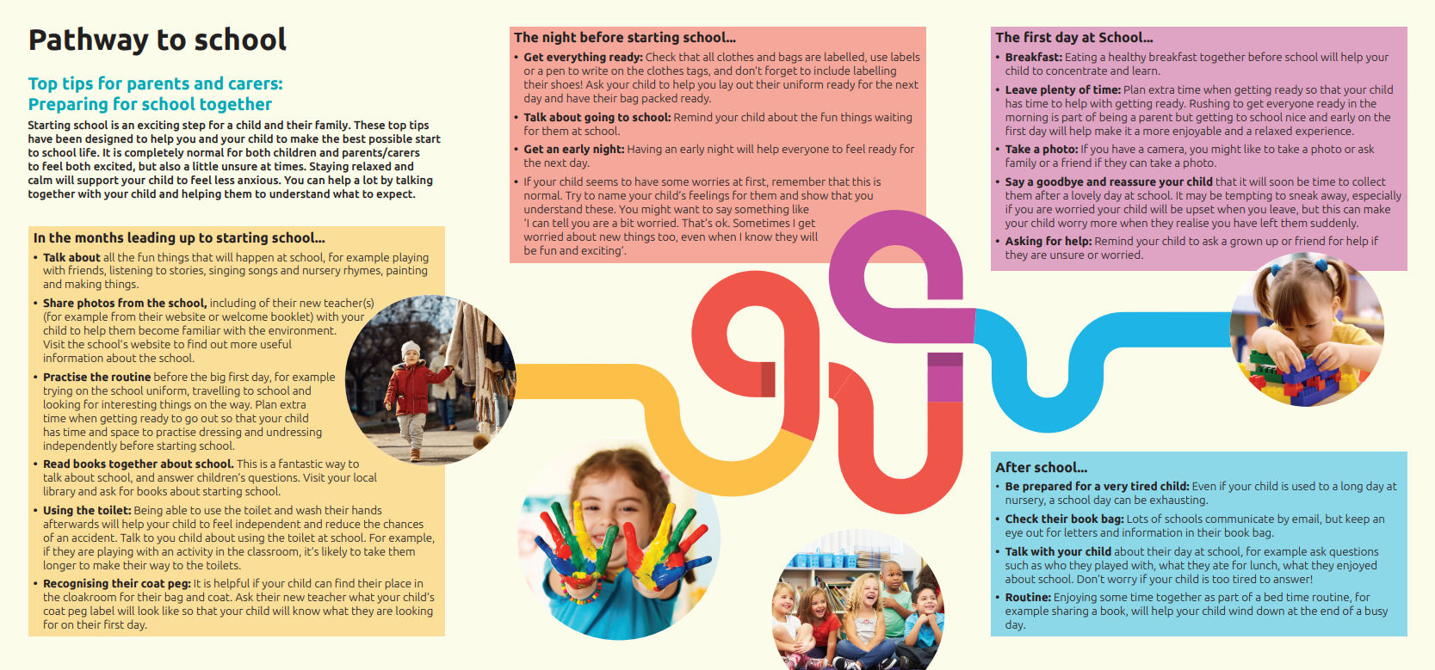
Transition – ready for school
Page 13
Early Years Foundation Stage (EYFS)
Transition Toolkit

Slide 14
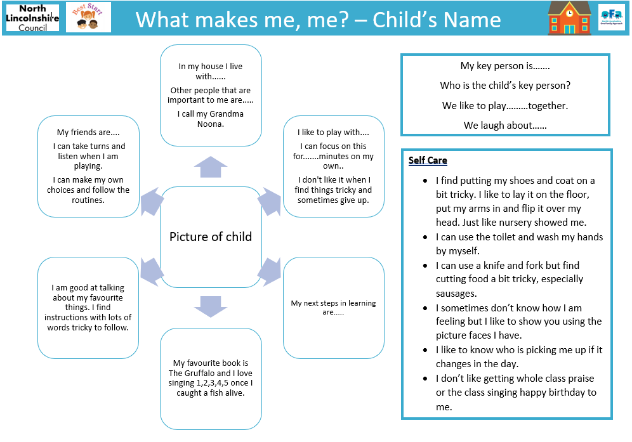
Transition Headlines – ‘What makes me, me?
Page 14
Early Years Foundation Stage (EYFS)
Transition Toolkit
Transition Headlines
The key person has a crucial role to play in supporting a child moving from their secure base to an unknown one with their new key person.
The current key person knows all the unwritten information they have gathered about the unique child. This information no matter how small can be the difference between a child being happy and thriving or stressed, frustrated and misunderstood.
This document can be used to share the child’s strengths, talents, quirks, personalities and preferences. It is an opportunity to share strategies and support that can make the child feel emotionally safe and secure in their new setting.

Slide 15
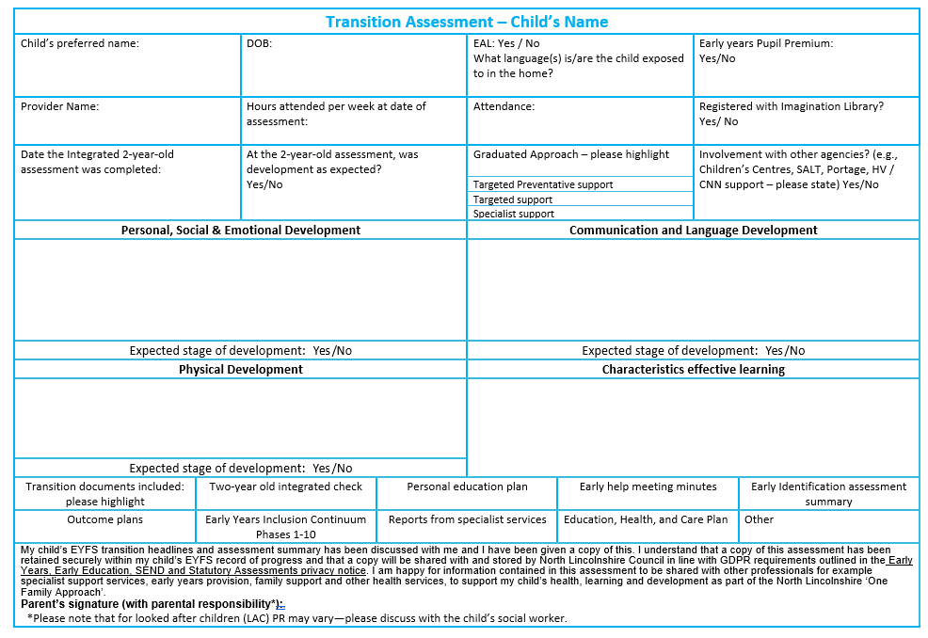
Transition – Child’s Summative Assessment
Page 15
Early Years Foundation Stage (EYFS)
Transition Toolkit

Slide 16
Children with Special Educational Needs and/or Disabilities
Page 16
Early Years Foundation Stage (EYFS)
Transition Toolkit
Transitions are a period of change that can be both a source of excitement and anxiety for children, parents and practitioners. Throughout the transition process, young children need to feel secure and confident that their needs, wants, likes and dislikes will be understood.
The transition from one setting to another (early years to primary) should be seen as a seamless journey. Children with Special Educational Needs and/or Disability need to be given time to adjust and manage new changes, environments, spaces and routines.
At the heart of this journey is the child. It is crucial that children with SEND experience practitioners and teachers who are invested in their emotional wellbeing from the very beginning.
The Special educational needs and disability code of practice: 0 to 25 years states:
SEN Support should include planning and preparation for transition, before a child moves into another setting or school. This can include a review of the SEN support being provided or the EHC plan. To support the transition, information should be shared by the current setting with the receiving setting or school. The current setting should agree with parents the information to be shared as part of this planning process.
DfE (2015) SEN and disability code of practice: 0-25 years, para 5.47

Slide 17
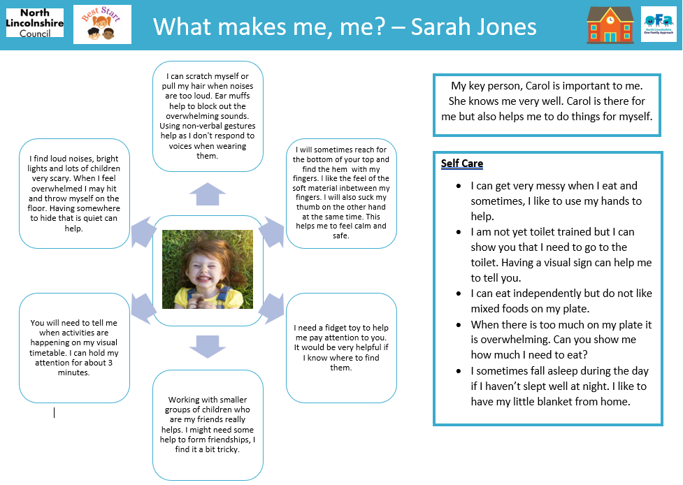
Children with Special Educational Needs and/or Disabilities – ‘What makes me, me? Transition Headlines
Page 17
Early Years Foundation Stage (EYFS)
Transition Toolkit
Transition Headlines
The key person has a crucial role to play in supporting a child moving from their secure base to an unknown one with their new key person.
The current key person knows all the unwritten information they have gathered about the unique child. This information no matter how small can be the difference between a child being happy and thriving or stressed, frustrated and misunderstood.
This document can be used to share the child’s strengths, talents, quirks, personalities and preferences. It is an opportunity to share strategies and support that can make the child feel emotionally safe and secure in their new setting.

Slide 18
Transition – information sharing, including for children on the graduated approach
Page 18
Early Years Foundation Stage (EYFS)
Transition Toolkit
Universal
Statutory information for each child, as required in the EYFS statutory framework)
2 year old EYFS assessment and ELIM assessment (where applicable)
Targeted (as universal plus the following):
Specialist (as universal and targeted plus the following):
Education Health Care Plan (or information about current stage of process)
Risk Assessment, where applicable
Transition assessment of learning and development
Any details of additional funding e.g. EYPP and how used to support learning
Early Identification Assessment Summary (EIAS) and outcome plans
1-10 Early Years Inclusion continuum
Early Help assessment
Care plans and medical needs information (including details of any training needed)
Any information from specialist services (e.g. reports, assessment, guidance and support plans)
Information about inclusion funding and evaluations
‘What makes me, me? Transition document

Slide 19
Children with Special Educational Needs and/or Disabilities
Page 19
Early Years Foundation Stage (EYFS)
Transition Toolkit – Top tips
What to expect:
Who to expect:
Routines and Environments:
Provide the settings with school uniform and resources for the children to explore in their secure base.
Visit the school with my family at a quitter time before the main transition events take place.
Who’s who in school? Provide pictures of the staff who will be working directly with the child. Familiarity with new staff will help to reduce anxiety.
All about me. Key person/practitioner passports to get to know my ‘go-to’ adult.
Record a short video introduction.
Make an ‘All about my new school’ booklet for each child.
Include photographs of the environment.
Video recordings can support children in understanding what is to be expected. Sending videos home to the parents mean that they can help to prepare the child for the new environment.
Take part in the school’s transition events.
Use social stories to explain the daily routines.
Provide a detailed account of the daily routine for parents to identify any challenges that their child may face.
Visit the school accompanied by my current key person. Join in with key routines, playtimes and lunchtimes.
Complete a visit to the child’s secure base, home and the early years setting.

Slide 20
Transition Audit - Into setting and/or childminder - 1
Early Years Foundation Stage (EYFS)
Transition audit
Page 20
Key Aspect |  | No | How | Plan to
1 | How do we know if a child has attended/attends another nursery/preschool/childminder prior to starting our setting?
2 | How do we ensure we gain full statutory information about children, as required by the EYFS?
3 | How do we ensure we are fully aware of children with SEND or additional needs to inform transition and setting provision?
4 | How do we know if a family have EAL? How will we ensure all needs are met at the point of transition? How well prepared are staff to support children with EAL and how well is the provision resourced? What steps have we taken to provide opportunities for children to use their Home Language in the Early Years setting? How do we know the level of the child’s proficiency in English (If child has EAL)
5 | How do we know if the child/family have an Early Help plan in place and ensure we have full details of this?
6 | How do we get to know new parents and become aware of any concerns they may have?
7 | How do we support parents to have the confidence to share what they know about their child?
8 | How do we know how a child plays and learns prior to starting setting?
9 | How do we ensure the child’s integrated 2-year assessment (EYFS assessment, ASQ and ELIM) are used to inform transition?
10 | How do we find out if a child will continue to attend another setting or childminder as well as our own setting?
11 | How we work in partnership and share information effectively?
12 | How do we facilitate discussion with the child’s key person if the child has attended a setting before?
13 | How can we use observation to support our understanding of the child (e.g. observing the child and key person playing in the previous setting both indoor and outdoor?)

Slide 21
Transition Audit into setting and/or childminder - 2
Page 21
Early Years Foundation Stage (EYFS)
Transition audit
Pge 6
Key Aspect |  | No | How | Plan to
14 | How do we know if a child has accessed EYPP funding in a previous setting? How this was used and the impact of this?
15 | How do we know of any anxieties from children and parents / carers about transition and how do we address these?
16 | How do we gather any safeguarding information at the point of transition, including children who have CIN or CP plans?
17 | How do we ensure that safeguarding information and documentation is shared in a secure and safe manner? https://www.gov.uk/government/publications/safeguarding-practitioners-information-sharing-advice
18 | How do we find out any additional information about new starters and their families?
19 | How do we know that our transitional arrangements are effective?
How
Key Aspect |  | Evidence
Plan to develop
Key Aspect |  | Action Required | Lead | Timescale

Slide 22
Transition Audit - for early years setting and/or childminder into school - 1
Early Years Foundation Stage (EYFS)
Transition audit
Page 22
Key Aspect |  | No | How | Plan to
1 | How do we encourage regular communication throughout the year with main feeder or local schools?
2 | How do we know how parents feel about their child starting school the following September?
3 | From the Autumn term do we know which school parents have applied for?
4 | During the Autumn term, have we discussed with the feeder school the potential cohort moving up?
5 | Has school EYFS staff been invited to observe children who are moving up?
6 | Have we given opportunity for discussion with the school EYFS staff for any children moving up with SEND or other additional needs?
7 | How do we know if a child attends another nursery/preschool/childminder prior to starting school?
8 | How do we know if a family have EAL? How will we ensure all needs are met at the point of transition? How well prepared are staff to support children with EAL and how well is the provision resourced? What steps have we taken to share the opportunities given for children to use their Home Language in the Early Years setting with school? How do we know the level of the child’s proficiency in English (If child has EAL)?
9 | How do we ensure the school is aware of any family supported by an Early Help of Family support in the home?
10 | If a child attends another nursery/preschool/childminder prior to starting school, how do we ensure all are involved in informing the transition summary assessment?
11 | Do we ensure any 2-year assessment is forwarded to school at the point of transition with the transition summary assessment?
12 | Do we ensure any EYPP information is forwarded to the school and how it has effectively supported the child’s progression?
13 | Do we request that children and their key person visit school to support transition?

Slide 23
Transition Audit - for early years setting and/or childminder into school - 2
Early Years Foundation Stage (EYFS)
Transition audit
Page 23
Key Aspect |  | No | How | Plan to
14 | Have school EYFS staff been invited into setting to take part in a book sharing/activity with the children?
15 | How have we shared information with school about how the child plays and learns?
16 | How do we know of any anxieties from children about transition?
17 | How do we share information with the school to support children’s transition into school?
18 | How do we gather any safeguarding information at the point of transition?
19 | How do we ensure that safeguarding information and documentation is shared in a secure and safe manner? https://www.gov.uk/government/publications/safeguarding-practitioners-information-sharing-advice
20 | How do we know that our transitional arrangements are effective?
How
Key Aspect |  | Evidence
Plan to develop
Key Aspect |  | Action Required | Lead | Timescale

Slide 24
Transition Audit for school from early years setting and/or childminder - 1
Early Years Foundation Stage (EYFS)
Transition audit
Page 24
Key Aspect |  | No | How | Plan to
1 | How do we encourage regular communication throughout the year with main feeder or local nursery/preschool/ childminder?
2 | How do we know if a child has attended/attends nursery/preschool/childminder prior to starting school?
3 | How are we aware of children with additional needs starting school who have attended/attend a setting?
4 | How do we find out more about any additional needs to inform classroom provision?
5 | How do we know if a family have EAL? How will we ensure all needs are met at the point of transition? How well prepared are staff to support children with EAL and how well is the provision resourced? What steps have we taken to provide opportunities for children to use their Home Language in the Early Years setting? How do we know the level of the child’s proficiency in English (If child has EAL)?
7 | How do we know if the child/family have an Early Help plan or Family Support in place?
8 | How do we get to know new parents and become aware of any concerns they may have?
9 | How do we support parents to have the confidence to share what they know about their child?
10 | How do we get to know how a child plays and learns in setting?
11 | How do we ensure the child’s assessments (EYFS assessment, 2-year assessment, ASQ and ELIM) are used to inform transition?
12 | How can we get to know the child’s key person?
13 | Is there opportunity to observe the child and key person play in setting and in school both indoor and outdoor?

Slide 25
Transition Audit for school from early years setting and/or childminder - 2
Early Years
Transition Audit
Page 25
Key Aspect |  | No | How | Plan to
14 | How do we get to know if a child has accessed EYPP funding in setting?
15 | If yes, how was the funding used to support the child?
16 | How do we know of any anxieties from children about transition?
17 | How do we share school information with the setting to support children’s transition into school?
18 | Ho do we gather any safeguarding information at the point of transition?
19 | How do we ensure that safeguarding information and documentation is shared in a secure and safe manner? https://www.gov.uk/government/publications/safeguarding-practitioners-information-sharing-advice
20 | How do we find out any additional information about new starters and their families?
21 | How do we know our transitional arrangements are effective?
How
Key Aspect |  | Evidence
Plan to develop
Key Aspect |  | Action Required | Lead | Timescale

Slide 26
Transition Audit for school
- a child who has not attended any type of previous early years setting - 1
Early Years Foundation Stage (EYFS)
Transition audit
Page 26
Key Aspect |  | No | How | Plan to
1 | How do we know about the reasons for the child not attending any formal setting in the past (cultural beliefs, socio-economic factors, specific needs of the child and family, etc.)? How aware are we about the impact of such reasons on child’s ability to settle in and participate in school life?
2 | How do we know about the family background (EAL, GRT, etc.)? How do we know about the specific needs of the child and family in relation to their background? How do we know we are appropriately equipped to meet these specific needs?
3 | How will we ensure all needs are met at the point of transition? How will we know the level of the child’s proficiency in English (If child has EAL)? How well prepared are staff to support children with EAL and how well is the provision resourced? What steps will be taken to provide opportunities for children to use their Home Language in the school EYFS setting?
4 | How do we know if parents have the confidence to share what they know about their child?
5 | How do we get to know how a child plays and learns in the home? Is there an opportunity to observe the child in his/her home setting and outdoors?
6 | How do we ensure the child’s ASQ and ELIM inform transition?
7 | How do we know if the child/family have an Early Help or Family Support in place?
8 | How do we know of any anxieties from children about transition?
9 | How do we gather any safeguarding information at the point of transition? How do we ensure that safeguarding information and documentation is shared in a secure and safe manner? https://www.gov.uk/government/publications/safeguarding-practitioners-information-sharing-advice
10 | How do we find out any additional information about new starters and their families?
11 | How do we know our transitional arrangements are effective?

Slide 27
Transition Audit for School
- a child who has not attended any type of previous early years setting
Early Years Foundation Stage (EYFS)
Transition audit
Page 27
How
Key Aspect |  | Evidence
Plan to develop
Key Aspect |  | Action Required | Lead | Timescale

Slide 28
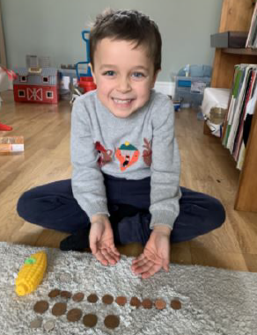
Supporting transition: A commitment to ‘The Unique child’
Early Years Foundation Stage (EYFS)
Transition Toolkit
Page 28
A commitment to ‘A Unique Child’ – what success will look like:
The individual needs of children, and their families, are central to any transition.
Statutory information required by the EYFS is gained.
There is an understanding that children respond differently to transition and this is supported.
Transition takes into account the voice of the child and family, as well as the child’s wider family and home experiences.
Individual statutory, health and care plans in relation to safeguarding, SEND (EHCP, Outcome plan), medical or health need (care plan) are fully communicated and understood.
Other professionals involved with the child and their family are involved in discussions about transition, and all information is used to support transition.

Slide 29
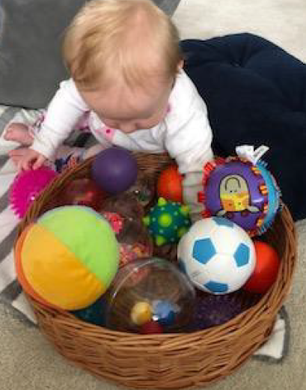
Supporting transition: Planning for ‘The Unique child’
Early Years Foundation Stage (EYFS)
Transition Toolkit
Page 29
Planning for ‘A Unique Child’
Think about how transitional objects or comforters can be used to support the process. For babies and younger children this may be a cuddly toy or blanket that smells like home or their parent. Remember that this is still often important for older children starting school reception class. They may find it reassuring to show you their book from home, or their lunch box.
For babies and very young children, ensure you have full information about routines and care-giving processes.
Find out the different transitions a child experiences within their day for example involving a childminder or out of school provision. Ensure that communication is effective, particularly in relation to children’s personal, social and emotional development.
Ensure children are aware of the organisation of their day, particularly if this changes day to day, for example who is collecting them that day. Consider using a visual timetable available in the Early Years SEND and Inclusion Handbook

Slide 30
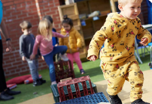
Supporting transition: Planning for ‘The Unique child’
Early Years Foundation Stage (EYFS)
Transition Toolkit
Page 30
Planning for ‘A Unique Child’
Ensure staff are aware of how different children may respond to feelings of uncertainty around transition and that this is likely to be different depending on individual children’s experiences.
Provide time for observing and listening to children throughout the transition process. Tune into their body language and facial expressions as well as verbal communication.
Where applicable, ask the pre-school / nursery / childminder for their views on who may need extra support with transition, for many different reasons.
Ensure all staff are consistent in providing a response to children’s feelings and behaviour during transition, with an understanding of children’s (and parent’s) behaviour being a form of communication.
For children who have English as an additional language, find out about which language(s) they are exposed to at home and make yourself aware of key words in the child’s home language.

Slide 31
Supporting transition: Planning for ‘The Unique child’
Early Years Foundation Stage (EYFS)
Transition Toolkit
Page 31
Planning for ‘A Unique Child’ continued
Where appropriate, make sure that setting SENCOs and designated safeguarding leads have contact details for the new early years setting / receiving school SENCO and DSL and pass on relevant information for specific children.
Arrange and access any training necessary to ensure the safety of individual children (e.g. medication administration, monitoring of health conditions).
Ensure information from other professionals working with the child and family is communicated to new practitioners. Ensure systems for sharing, recording and storing confidential information are secure.
Consider how you will share information for example, have a frequently asked questions section on your website or social media pages to support transition.

Slide 32
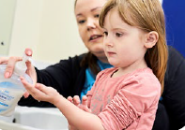
Supporting transition: A commitment to ‘Positive Relationships’
Early Years Foundation Stage (EYFS)
Transition Toolkit
Page 32
A commitment to ‘Positive Relationships’ – what success will look like:
Parents and families are key partners in transition and contribute to decisions about what will happen.
Relationships are central to EYFS practice. All children have an allocated key person who provides a secondary attachment figure for children.
Parents are provided with key information about transition including the statutory information required in the EYFS framework.

Slide 33
Supporting transition: Planning for ‘Positive Relationships’
Early Years Foundation Stage (EYFS)
Transition Toolkit
Page 33
Planning for ‘Positive Relationships’
Involve parents at transition times, valuing what they say.
Allocate a key person (who may be any member of staff in the early years setting or reception class) supports each individual child to become familiar with the new environment, developing a settled, close relationship and helping the child to feel emotionally safe and secure. This is particularly important for babies and toddlers, as well as older children who have additional needs or need support with their PSED.
Ensure that key adults (including lunch time staff in a school setting) are as consistent as possible and minimise staff changes wherever possible.
Prepare children for times when their key adults are not available to them and introduce them to other adults. Ensure that wherever possible alternative adults are consistent and familiar to the children. For babies and toddlers, it is highly advisable to operate a second (or ‘buddy’) key person system. For children in school, consider times such as PPA when staff may be different.
Ensure staff are aware of typical age-related attachment behaviour such as separation anxiety and know how to support parents and carers.

Slide 34
Supporting transition: Planning for ‘Positive Relationships’
Early Years Foundation Stage (EYFS)
Transition Toolkit
Page 34
Planning for ‘Positive Relationships’
Think carefully about how you will support personal care giving times such as changing children and helping with toilet training – ensure this is always staff who are familiar to the child, wherever possible their key person, particularly for very young children and those with additional needs.
Some children may be struggling with issues that are not immediately obvious, such as experiencing loss, separation form a parent/carer or domestic abuse. Be vigilant to children’s body language, facial expressions as well as spoken language, and be ready to address any worries or concerns which may arise. Make space and time for them to discuss their experiences and to express this in their play and ensure staff are available to support children with this.
If parents have concerns about their child’s transition, allow them time to talk about this with their child’s key person.
Discuss with parents how children feel about transition and how they may have
supported them to manage any worries.
Make a list of any particular phrases or terms you use in school for
parents so that they can understand these.

Slide 35
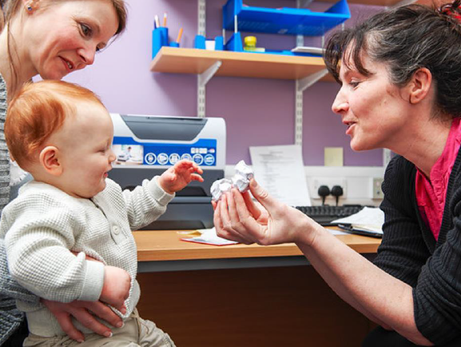
Supporting transition: Planning for ‘Positive Relationships’
Early Years Foundation Stage (EYFS)
Transition Toolkit
Page 35
Planning for ‘Positive Relationships’
Be flexible in terms of expectations and allow time for children to adjust to being with new children and adults.
Where applicable, make reference to children’s experience of being at nursery / pre-school / childminder to support the continuation through the EYFS.
For children starting school, consider using some of the older children to be buddies to help them settle into school. As children settle in, some of the more confident children can support the others, particularly at specific times such arriving in the morning or at lunch time. This may also work for children in out of school provision.
Introduce children to the routines and expectations consistently whilst acknowledging that will need time to understand these. Ensure expectations are age appropriate (e.g. in relation to sharing and taking turns). Provide a high level of praise and encouragement.
Feedback to parents how well the children are settling in, and on their early progress. Parents or settings may be able to support with strategies/ideas to further support the process.

Slide 36
Supporting transition: Planning for ‘Positive Relationships’
Early Years Foundation Stage (EYFS)
Transition Toolkit
Page 36
Planning for ‘Positive Relationships’
Provide a welcome letter and photographs or videos of staff, particularly the child’s key person, introducing themselves to children (for schools including support staff and lunch time staff). Parents / carers and where appropriate, early years settings, can discuss this with the children.
Where a lot of children are starting at once, consider having a staggered opening to allow children to transition more gradually.
Plan settling in sessions or play sessions with parents where children get to know their new setting, their key person and other children. Build up gradually, particularly for babies and very young children, or those who have not had experience away from the home or family before.
Make sure that parents/carers have contact details for the child’s key person and know how they can discuss any concerns.
Make sure your website or social media is up to date. However, be aware that saying ‘please refer to our website’ is not always helpful – people don’t always read it; they don’t know where to look on the website for the right information or they may not have the right technology to be able to access it. Anything really important should always be followed up with a paper copy where possible.
Send as much information as possible to parents / carers so that they can help prepare their child for transition.
Notes:
The key person role is centred on relationships. The primary role of the key person is to act as a secondary attachment figure in the absence of the baby / child’s parents / primary caregivers and to provide the emotional security necessary to facilitate the development of the baby / child. This is rooted in attachment theory.

Slide 37
Supporting transition: Planning for ‘Positive Relationships’
Early Years Foundation Stage (EYFS)
Transition Toolkit
Page 37
Planning for ‘Positive Relationships’ – the role of the Key Person.
The key person role is centred on relationships, with the key person a secondary attachment figure in the absence of the baby / child’s parents / primary caregivers, to provide the emotional security necessary to facilitate the development of the baby / child. This is rooted in attachment theory.
It is a statutory requirement that each child in the EYFS is assigned a key person (EYFS Statutory Framework 2021, sections 1.16 and 3.27)
More information about the role of the key person can be found on page 24 of ‘Working with the revised EYFS: Principles into Practice (Julian Grenier, 2021) and on pages 30 – 31 of ‘Birth to Five Matters: Non-statutory guidance for the EYFS.
The following article on the role of the key person in reception classes by Julian Grenier is also useful: Guidance: the key person in reception classes and small nursery settings.

Slide 38
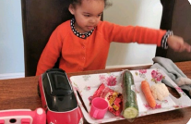
Supporting transition: A commitment to ‘Enabling Environments’
Early Years Foundation Stage (EYFS)
Transition Toolkit
Page 38
A commitment to ‘Enabling Environments’ – what success will look like:
Children are familiar with the physical environment
Expectations about the safe and effective use of the environment are established as part of transition.
Children are able to develop a sense of belonging to support transition and beyond.
The environment is accessible to all children
Children actively use the environment to support their learning and development.

Slide 39
Supporting transition: Planning for an ‘Enabling Environment’
Early Years Foundation Stage (EYFS)
Transition Toolkit
Page 39
Planning for an ‘Enabling Environment’
Recognise that children may have anxieties related to the physical environment and organisation e.g. transitioning into the ‘big room’, worries about going to the toilet, being in a larger group of children or where they will eat their lunch, etc.
Invite children and parents to visit the new room / class and if possible, provide virtual tours using photographs or video. Include indoors and outdoors and other areas such as toilets and for children in school, areas such as the lunch hall. You may wish to use a social story.
Take into account that children’s experiences will be different. For example, if they are transitioning from a nursery / pre-school unit on site into reception class, their familiarity with the building and staff will be different to those transitioning from further afield. Younger children may have accompanied their siblings into nursery, the childminder, or school and will also be more familiar with the surroundings.
Plan extra time for settling in, separating from parents / carers and becoming used to the new environment (children, adults, layout, and resources) and expectations during the early days.

Slide 40
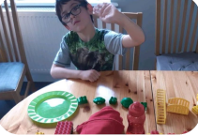
Supporting transition: Planning for an ‘Enabling Environment’
Early Years Foundation Stage (EYFS)
Transition Toolkit
Page 40
Planning for an ‘Enabling Environment’
Risk assess the environment taking into account the individual needs of the children transitioning, including the age of the children and any needs of children with SEND.
Ensure that all staff are aware of any adaptations that are necessary to meet the individual needs of children, these are readily available and staff understand how to use. Be clear about levels of differentiation or adaptions that have been needed in the past to accommodate different children.
As part of the settling in curriculum ensure staff spend time supporting child initiated play and supporting children to select, use and return resources, encouraging all children to be active participants in their own learning from the beginning.
Use visual resources as reminders about expectations such as putting things away or using equipment safely.
Provide simple choices within the environment to support children’s sense of control.

Slide 41
Supporting transition: Planning for an ‘Enabling Environment’
Early Years Foundation Stage (EYFS)
Transition Toolkit
Page 41
Planning for an ‘Enabling Environment’
Consider individual transitions that children may make during the day such as arriving in the morning, moving between rooms, going to sleep / rest and waking up, transitioning between adult led activities and play, indoors and outdoors, at lunch time etc. Ensure these are consistent and predictable. Support routines and transitions by using visual timetables, use of objects of reference and reminders, particularly for younger children and children with SEND.
Recognise that some children will find comfort in transitional objects (such as a toy, book or object) that they can bring from home, particularly after such a different experience and long time at home. Be respectful of this and give thought to how this can be managed (e.g. providing a safe place for these to be kept).
Provide children with their own space (e.g. in the cloakroom, tray, peg, basket) where they can keep their things.
Ensure there are spaces for children to retreat to if needed to support their emotional regulation.

Slide 42
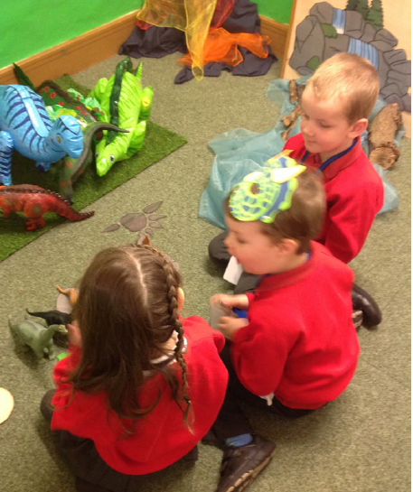
Supporting transition: A commitment to ‘Learning and Development’
Early Years Foundation Stage (EYFS)
Transition Toolkit
Page 42
A commitment to ‘Learning and Development’ – what success will look like:
Information about children from parents and carers, previous EYFS settings and other professionals (including children’s individual stages of learning and development, their interests and how they learn), are used to inform the curriculum intent.
The curriculum builds upon the learning that has already taken place, including in the home and other EYFS provision, to ensure progression across all areas of learning.

Slide 43
Supporting transition: Planning for Learning and Development’
Early Years Foundation Stage (EYFS)
Transition Toolkit
Page 43
Planning for ‘Learning and Development’
Celebrate learning experiences that have taken place at home with parents / carers as well as in EYFS provision.
Ask parents about their views of their child’s learning and development and whether they have any worries. You could make use of the ‘what to expect when’ document or similar to support discussion with parents about children’s development.
Ask the parent and setting about what sorts of activities and experiences the child has at home and what they enjoy doing. Ask parents to tell you how they think their child learns best – you could send them a short online quiz to test this out e.g. ‘My child learns best when there are pictures’; ‘My child learns best when they can work with a partner’; ‘My child learns best when they are only given one task at a time’; My child learns best when they are active’ etc.

Slide 44
Supporting transition: Planning for Learning and Development’
Early Years Foundation Stage (EYFS)
Transition Toolkit
Page 44
Planning for ‘Learning and Development’
Ensure that information from previous EYFS settings that children have attended is used to support transition and plan learning. This can give information about children’s interests, personalities and how they learn (characteristics of learning).
Where applicable, ask for a copy of the child’s statutory EYFS assessment at age 2 (including their ELIM assessment).
Find out information about whether a child was in receipt of 2 year old funding or EYPP and how this was used to support their learning.
Ensure that EHC plans, outcome plans and details of any inclusion funding for children with SEND are shared and discussed in full.
Give priority to the prime areas during transition – PSED, Communication and Language and Physical Development so children regain a sense of belonging, form relationships and develop an understanding of expectations and routines.

Slide 45
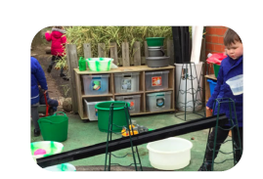
Supporting transition: Planning for Learning and Development’
Early Years Foundation Stage (EYFS)
Transition Toolkit
Page 45
Planning for ‘Learning and Development’
Spend time observing children during their play as well as noting their response to adult led activities. Recognise that play provides an opportunity for children to explore and work through any worries they may have. This is particularly important for children who are less likely or less able to express these verbally.
Use discussions shortly after transition, particularly between early years settings and schools, to support shared decision making about curriculum progression.

Slide 46
Resources
Early Years Foundation Stage (EYFS)
Transition Toolkit
Page 46
Professionals Information
SEND Local Offer | Early Years SEND and Inclusion Handbook for Early Years Providers - SEND Local Offer (northlincslocaloffer.com)
Social Story example
‘What makes me, me?’ document The Local Offer - North Lincolnshire Council (northlincs.gov.uk)
Early Years Foundation Stage (EYFS) Statutory Framework
Development Matters - Non-statutory curriculum guidance for the early years foundation stage (publishing.service.gov.uk)
Birthto5Matters-download.pdf
Article on the role of the key person in reception classes by Julian Grenier is also useful: Guidance: the key person in reception classes and small nursery settings.
Bilingual Children Resources
http://www.mantralingua.com and https://www.beelingualuk.com
Information for Parents
Getting ready for the day - BBC Tiny Happy People
Starting primary school - BBC Bitesize
What to expect in the Early Years Foundation Stage: A guide for parents
Apply for a school place in North Lincolnshire - North Lincolnshire Council (northlincs.gov.uk)
North Lincolnshire Local Offer - Starting School

Slide 47

Contact Us
Early Years Foundation Stage (EYFS)
Transition audit
Page 47
Earlyyearsteam@northlincs.gov.uk
StandardsandEffectiveness@northlincs.gov.uk
Follow us:
@NLCEarlyYears
@NorthLincsCNews
Northlincscouncil
@northlincolnshirecouncil
North Lincolnshire Council
SAFE WELL PROSPEROUS CONNECTED

