Slide 1
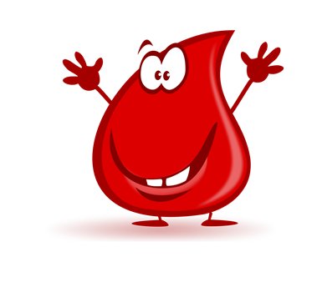
A guide to TACO
What is TACO?
Transfusion Associated Circulatory Overload
Why is it a problem?
TACO is the leading cause of transfusion-related death and major morbidity
We have had 3 cases of TACO in the Trust in the last 6 months!

Slide 2
  Patient 1
  83 year old female with proximal sigmoid tumour admitted from colonoscopy OP appointment due to anaemia.
  No weight recorded.
  Hb 87, MCV 78.3.
  Prescribed 2 units of blood overnight with no diuretic cover.
  Patient became suddenly hypertensive and short of breath with severe crackling sounds approximately half an hour after 1st unit completed.
  Sats dropped to 67% resulting in Peri-arrest call and patient requiring CPAP.
  Post-transfusion Hb 124, Tsat 5.
  Patient made full recovery.

Slide 3
  Patient 2
  50 year old male admitted with Ibuprofen OD.
  No recorded weight, moderate build in description.
  Diagnosed with Decompensated ALD, AKI and Ascites.
  Hb 89 on admission dropping to 69 six days later.
  Had received 1.3 litres of fluid over the previous 24 hours.
  2 units of blood prescribed overnight with no diuretic cover.
  1st unit transfused with no reaction.
  After 2nd unit started sats dropped to 89% with increase in BP, HR and RR. Coarse crackles in all zones of lungs.
  Post-transfusion Hb 79.
  Patient RIP 13 days later from ALD, ARDS and AKI.

Slide 4
  Patient 3
  77 year old female admitted with general oedema, hypercalcaemia and ?Myeloma.
  Weight 44.1kg.
  Was given IV fluid and furosemide to reduce Calcium levels.
  Hb 79 on admission dropping to 68 2 days later.
  Patient identified as being at risk of fluid overload.
  2 units of blood prescribed with no diuretic cover.
  1st unit given, patient then became dyspnoeic, hypoxic and tachypnoeic, Sats 84%, RR 24 with HR 120 and bilateral crackles, hypertension and pulmonary oedema.
  Post-transfusion Hb 93.
  Patient placed on palliative pathway due to underlying problems.

Slide 5
Lessons learned
Patient 1 was the result of an possibly unnecessary transfusion
Patients 2 & 3 did require blood but an adjusted approach may have helped
None of these patients had their weight considered when prescribing 2 units of blood with no review in between.
TACO checklist must be performed for all patients prior to transfusion
If at risk of fluid overload consider delaying transfusion until risk is lower
Consider using body weight dosing for at risk patients to ensure that the minimum amount of blood is transfused

Slide 6
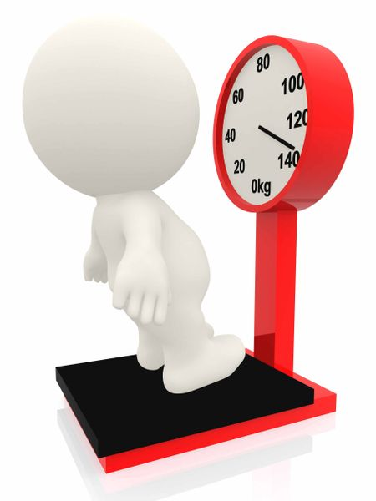
Remember
TACO can occur after just 1 unit of blood
TACO can occur at relatively low Hb levels
4mls per kg will achieve a 10g increment in Hb
  A 50kg patient will only require 200mls for a 10g increment
  A unit of red cells can vary between 220-340ml in volume
  In non-bleeding patients, always recheck the patients Hb and review clinically after every unit of blood transfused.
  Always treat the underlying cause of the anaemia.
  Think 50! If the patient is over 50 years of age or under 50kg in weight a TACO risk assessment MUST be completed prior to transfusion.

Slide 7
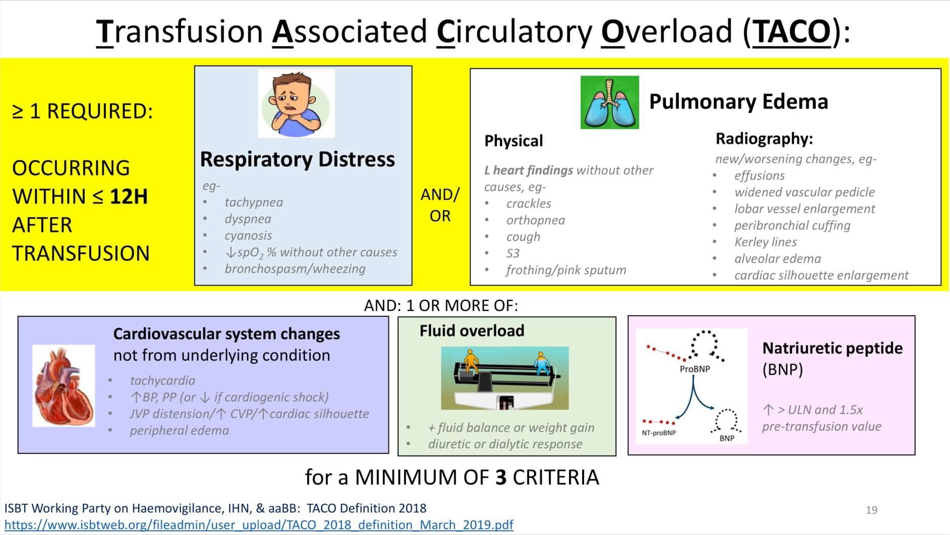

Slide 8
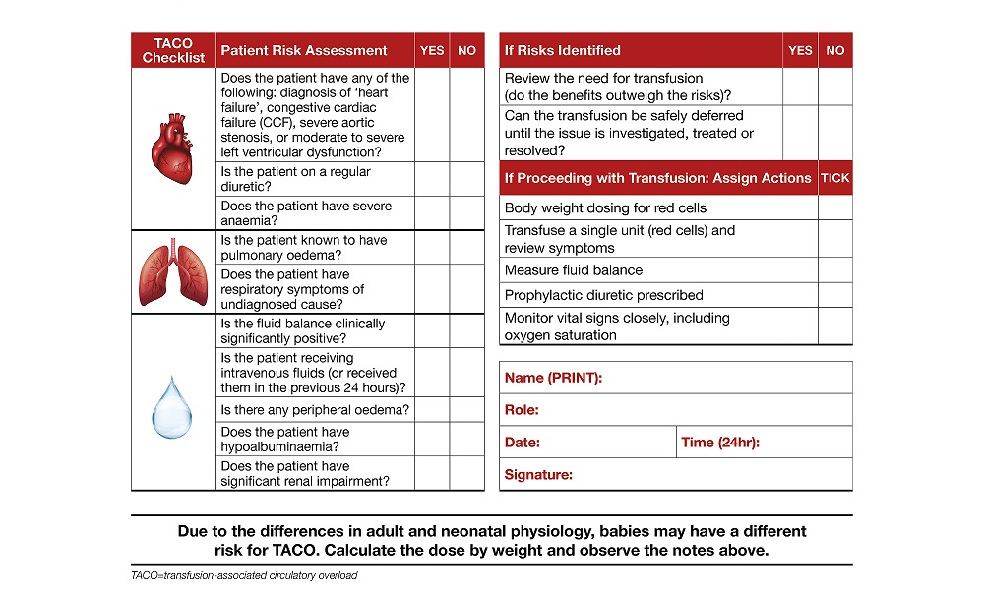

Slide 9
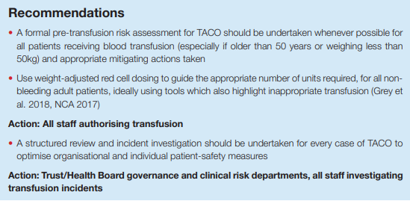
Recommendations from TACO Chapter in 2021 SHOT report

Slide 10
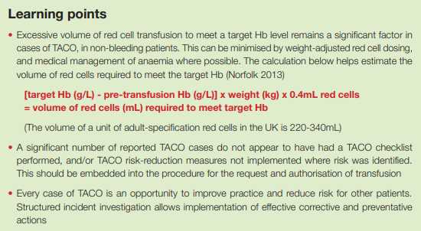
Learning points from TACO Chapter in 2021 SHOT report

