Slide 1


Logistics Training Courses Overview
The Manchester College

Slide 2
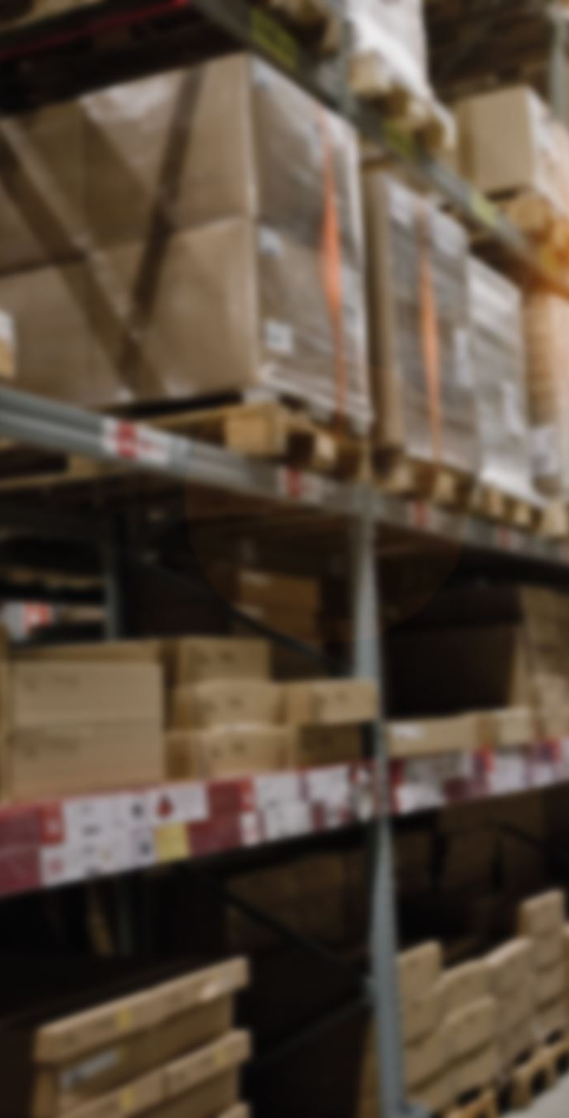
Logistics Training Programmes
Target Audience: Unemployed individuals
Eligibility: Claiming JSA, ESA, Income Support under £20,888, Housing Benefit, Council Tax Benefit, or Universal Credit
LGV, Taxi, FLT & Reach, Freight Forwarding & Basic Warehouse Essentials
Duration: 4 weeks
Power pump truck
Duration: one week
Cost: Free (if eligible)
Extras: English, math (terms apply)

Slide 3
FLT/Reach Course Content
Both courses include:
- Daily pre-use checks
- Health and Safety
- Safe loading and unloading
- Written theory test
- Practical operating test
Free Programme includes additional topics:
- Introduction to forklifts
- Time management
- Legislation

Slide 4
Power Pump Truck Course Content
- Daily pre-use checks
- Health and Safety
- Safe loading and unloading
- Written theory test
- Practical operating test
Free Programme includes additional topics:
- Introduction to forklifts
- Time management
- Legislation

Slide 5
LGV Course
• Basic First Aid
• Customer Service
• Interpersonal Skills
• Health and Safety
• Time Management
• Vulnerable Road Users
• Legislation
• Drivers Hours (European)
• Digital Tachograph Use
• Mod 1/2/3/4 Training
Course Content

Slide 6
Taxi Course Content
• Customer Service
• Interpersonal Skills
• Health and Safety
• Time Management
• Motorways
• Legislation / Bye-Laws
• Compellable Areas
• Walkabouts in the city

Slide 7
Freight Forwarding Course Content
• Logistics Coordination: Plans efficient transport routes via air, sea, rail, or road.
• Documentation Handling: Prepares shipping documents (bills of lading, customs forms, etc.).
• Customs Clearance: Ensures compliance with import/export regulations.
• Cargo Insurance: Arranges insurance for goods in transit.
• Warehousing & Storage: Coordinates temporary storage solutions.
• Tracking & Updates: Monitors shipments and provides updates.
• Problem Solving: Handles delays, rerouting, or damaged goods.

Slide 8
Basic Warehouse Essentials
Conduct a hazard analysis
Identify critical control points (CCPs)
Establish critical limits
Monitor CCPs
Establish corrective actions
Verify that the system is working
Keep detailed records
Basic First Aid
Manual handling training

Slide 9
Contact Information
Location: The Manchester College
Address: A Block, Brownley Rd, Wythenshawe, Manchester M22 9TG
Website: www.tmc.ac.uk
Contact: Darren
Email: doleary@tmc.ac.uk
Phone: 07568 117044

