Slide 1
Year 11 Transition and NEET Prevention 2022
We've got your back
2022
Notes:
NEET – Not in Education, Employment or Training

Slide 2
Why a focus on transition
To ensure all young people have the information and support to make a smooth transition to their Post 16 destination.
To enable Year 11 students to become independent learners.
To reduce the negative impact of covid on this year's school leavers
To reduce the risk of a spike in Neet and unknown
Notes:
The transition between high school and post 16 is a significant event and a right of passage for young people.
Transitioning for some young people can be challenging and can impact on their attendance, progression and outcomes at the next stage of their education or training.
Having a focus on transition can provide students with the information and support to make a smooth transition.
Covid has meant that this year’s school leavers have been disadvantaged in not having the same level of preparation as previous cohorts, we need to do what we can to redress this imbalance, by getting them ready for their next step.

Slide 3
Impact of Covid on Current Year 11's
Missed education
Inequality & Poverty
Mental health
& wellbeing
Social Media
Strained
relationships
Rise in NEET or Unknown
Notes:
The impact that the global pandemic has had on young people, is well known
Missed education – the class of 2021 has had two academic years of disrupted education and for many no exposure to a post 16 setting.
Inequality and poverty - The numbers of children and young people living in poverty has risen since the pandemic, over 40% of children are growing up in poverty across Manchester. There is a strong link between food poverty and digital poverty. Inequality is a key issue that impacts on life chances of young people.
Mental Health and well being - There has also been an increase in demand from young people for mental health and well being services to help them cope with feelings of stress anxiety and depression.
Media – Young people have become even more reliant on social media to maintain contact with their friends. Many young people fall victim to exploitation, bullying, and misinformation from the misuse of social media that can lead to threatening their safety.
Strained Relationships – Since the start of the pandemic there has been an increase in the numbers of reported incidents of domestic violence across the City often in families where there are children and young people residing. There has also been an increase in the numbers of young people involved in serious violent crime, organised crime and gang activity.
All of these factors can increase the risk of young people leaving statutory education and becoming NEET or Unknown (where abouts and NEET status unknown.)

Slide 4
What are young people are telling us
Life is on hold
My friends have been there for me
I feel worried, anxious, stressed
I miss my friends
I'm bored
Everyone is saying Covid will ruin my life chances
I've enjoyed being with my family
My friends have been there for me and me for them.
No jobs
No motivation and low aspirations
Notes:
There has been a lot of reporting about the impact that Covid-19 has had on young people and their futures.
As well as feeling the negative impact of the last year young people have shown how resilient they are and recognise how the support from family members and friends has helped them to cope and believe they still do have a future.

Slide 5
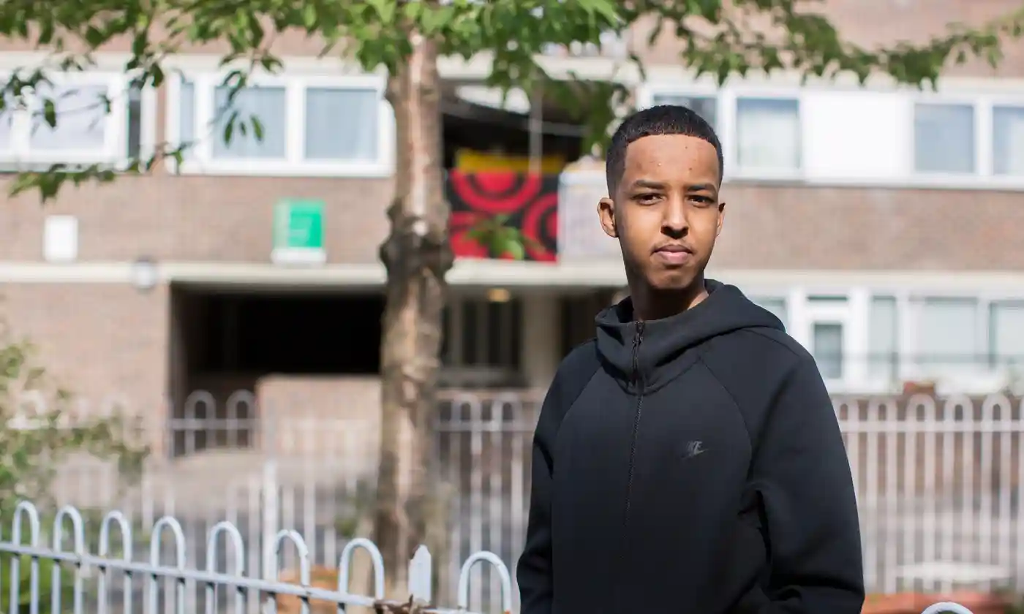
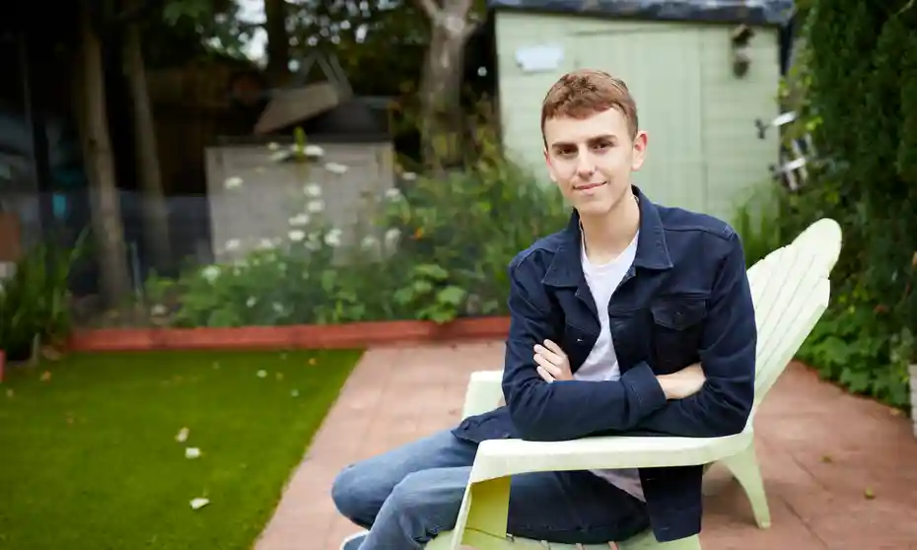

What can we do?

Slide 6
10
Must Do's for Transition
SECURE | Secure post 16 EET destinations
PREPARE | Provide curriculum time to prepare for transition
EQUIP | Make sure students have the tools they need – bus passes, bank account, photo id
SHARE | Share information about individual students to help post 16 meet their needs
COMMUNICATE | Make sure all key stakeholders have the right information
LINK | Work in partnership with post 16 providers
BUILD | Develop the employability and life skills students need
SUPPORT | Provide information about support services
CELEBRATE | Celebrate the success of their school career
TRACK | Track them into their destinations
Notes:
More information about each of the 10 points is found in the Transition Guide 2021

Slide 7
 | Secure offers & Destinations | Support and Advice | Transition readiness programme & Activities | Links with Post 16 | Promote summer activities | Communicate with parents | Celebrate success
 | Participate in activities to develop skills. | Check emails, letters, texts from your college, 6th form or training provider. | Engage in prep work set by course tutors including summer camps. | Get ready – email account, bus pass, photo ID. | Visit your destination (live or virtual) | RESULTS DAY 25 AUGUST 2022 Review grades and seek advice | Check enrolment information
 | Enrolment | Induction | Monitoring and reviewing progress | Support and advice | Tracking destinations | Check contact details | IAG Year 11's
SCHOOLS & Post 16 – Summer Term (April to May)
STUDENTS - Summer break (June to August)
SCHOOLS & POST 16 – Sept to Oct (Autumn Term)
Notes:
This slide provides a time line of key activities that high schools and post 16 settings will be carrying out with their students to prepare them for transition.
The yellow band in the middle is what students need to be encouraged to do for themselves over the summer months.

Slide 8
Transition Ready Activities
Before Year 11's leave, schools may wish to deliver some focused activities to get students ready for their next steps. You will find resources in the Transition Guide to support the delivery of sessions.
Transition Readiness | The World of Work | Skills development
Preparing for Transition | Employer encounters | Skills for Life
Practical support | Work Experience | Promoting Summer activities e.g NCS, Manchester Active
Getting to know post 16 | Mentoring | Volunteering

Slide 9






Skills for Life – Skills for transition
Notes:
The purpose of the Manchester Skills for Life project is to equip young people with skills they will need to be successful now and in the future. The ask of schools, colleges, youth & leisure providers and employers is to create opportunities where young people can practice these skills.
You may be able to create opportunities at school in the summer term and or encourage your school leavers to participate in activities over the summer e.g NCS, Manchester Active, Post 16 Summer Camps, work experience etc.
More information and ideas in the Transition Guide

Slide 10
Targeted Offer – Risk of NEET (RONI)
2022 -Total Year 11 cohort size = 6,460 students
Medium Risk – numbers of students with one risk factor
684 students (10.6% of cohort)
High Risk – Numbers of students with multiple risk factors
601 students (9.3% of cohort)
Notes:
Approximately 20% of this years school leavers will benefit from some extra help to prepare for transition to their post 16 destination and approximately 10% of these will need additional support over the summer and into the autumn term.

Slide 11
What we can do
Young Person at Risk
Attendance Officer
Designated Safeguarding Lead
SENCO
Young Carers Lead
Designated Teacher
Careers Adviser
Head of Year 11
Parent
Young Person at Risk
Whole school approach to transition
Carer
Notes:
Many of the High Risk Year 11 students are known to other members of staff in the school who have built a positive and trusting relationship. By adopting a whole school approach to transition, it means that those most at risk of becoming NEET will receive support from those they know best.
The SENCO and Designated Teacher can include any support needs that individual students have in their EHCP or EPEP plans.
The Careers Advisor can focus on securing appropriate destinations for both medium and high risk students.
The Year 11 pastoral team have a key role in preparing at risk students and ensuring they are ready for their next move.
It's important that parents and carers understand the role they have in supporting their son / daughter to transition.

Slide 12
Targeted offer
Named member of staff to provide additional support
Identify ‘those at risk’
Transition plans (EHCP, E-Pep's)
Practical support – email account, bus pass, photo id.
Check student has an appropriate Post 16 offer.
Links with post 16 – campus visits, staff/student interviews
Parents and carers
Notes:
Identify those at risk – all high schools have used the Risk of NEET Indicator (RONI) to identify those students at risk of becoming NEET.
Named member of staff – adopting a whole school approach is one way to share the responsibility of preparing at risk students for transition (See slide 11)
Transition Plans – there maybe high-risk students that would benefit from a Transition Plan to identify and respond to support needs. For EHCP and Our Young people these can be included in EHCP Plans and PEP's.
Practical support – Several post 16 settings require students to have an active email account and photo id. They can also apply for a free bus pass. (More information in guide)
Check destinations – The Careers Team will support students with the application and offers process to ensure they have an appropriate destination of their choice.
Links with post 16 – Where possible links should be made with the college, sixth form or training provider to arrange a visit or to meet with support staff.
Parents and carers – Send a regular communication to parents / carers explaining the transition process and outlining the role they can play in supporting transition.

Slide 13
Information sharing
The sharing of information between high schools and post 16 providers regarding vulnerable students enables colleges, sixth forms and training providers to:
Protect students where there are safeguarding concerns
Prepare bespoke support packages
Identify gaps in provision
Build relationships
Processes need to be GDPR compliant, and students should give consent if possible.
Transition referral form in Transition Guide
Notes:
More information in guide

Slide 14
Partnership working
Manchester City Council
Post 16 Sector
Colleges
Sixth Forms
Training Providers
Early Help
Social Care
Attendance
Virtual School
Young Carers Lead
EHCP Team
Transitions Team
Work and Skills
Parents
Young Person
at
Risk
NEET Support Services
Carers
Career Connect
The Growth Company (ESF NEET)
Prince’s Trust
Manchester SENDIASS
Youth Support and
Skills Development
NCS
The Growth Company
MCRActive
VCSE Summer programmes
Notes:
There are a number of partner agencies there to support those at risk of becoming NEET.
Many high risk students have complex needs and which may involve a number of partner agencies. Working together to either support transition or reduce barriers to participation is key. Using existing structures, relationships and where appropriate a lead professional to co-ordinate the support package, will improve the chances of individual students making a smooth transition.
More detailed information and links are included in the Transition Guide.

Slide 15
Career Connect – NEET Prevention Service
Prevention role – to support transition of 'high risk' students
Maintain contact across the summer break.
Provide advice and guidance and secure offers
Broker other support to reduce barriers to participation.
Support for enrollment and induction
Share information with post 16
Support for parent / carers
eet@careerconnect.org.uk or manchesteresf@careerconnect.org.uk
Tel: 0161 232 7863
Notes:
Career Connect are commissioned by the Manchester City Council to deliver a NEET Prevention Service.
A member of staff from Career Connect will be in touch with high schools who have high numbers of high risk students to identify those students who will need more intense support over the summer and autumn term. Where possible a staff member from Career Connect should meet students before they leave to start to build their relationship.
Career Connect staff are also co-located with the Manchester Secondary PRU, Endeavour Schools, Youth Justice Team.
Any school can make a referral to Career Connect.

Slide 16
Other support available
Growth Company ESF NEET Programme.
Princes Trust
National Citizenship Service
Voluntary Sector Youth Provision
Rising Stars Fund
Our Pass
Notes:
There are also a number of partner agencies that are commissioned by GMCA to work in Manchester.
The Growth Company and Princes Trust have specific programmes to work with young people at risk of becoming NEET.
More information about additional support available can be found in the Transition Guide.

Slide 17
Transition Guide 2022
Detailed description of universal and targeted offer
Whole school approach – roles and responsibilities
Timetable – Spring to Autumn
Partnership model – post 16 and wider partners
Tools to support transition
  Referral Forms
  Consent form
  Transition plan template
  Links to partner agencies

Slide 18
Transition Guide 2022
Together we can let the 2022 High School Leavers know that:

Slide 19
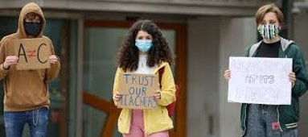
Transition Guide 2022
WE CARE ABOUT THEM AND THEIR FUTURES AND
WE ARE WORKING HARD TO SUPPORT THEM IN THEIR NEXT STEPS

