Slide 1
Findings from Women’s Health Engagement Sterling Rippy

Slide 2
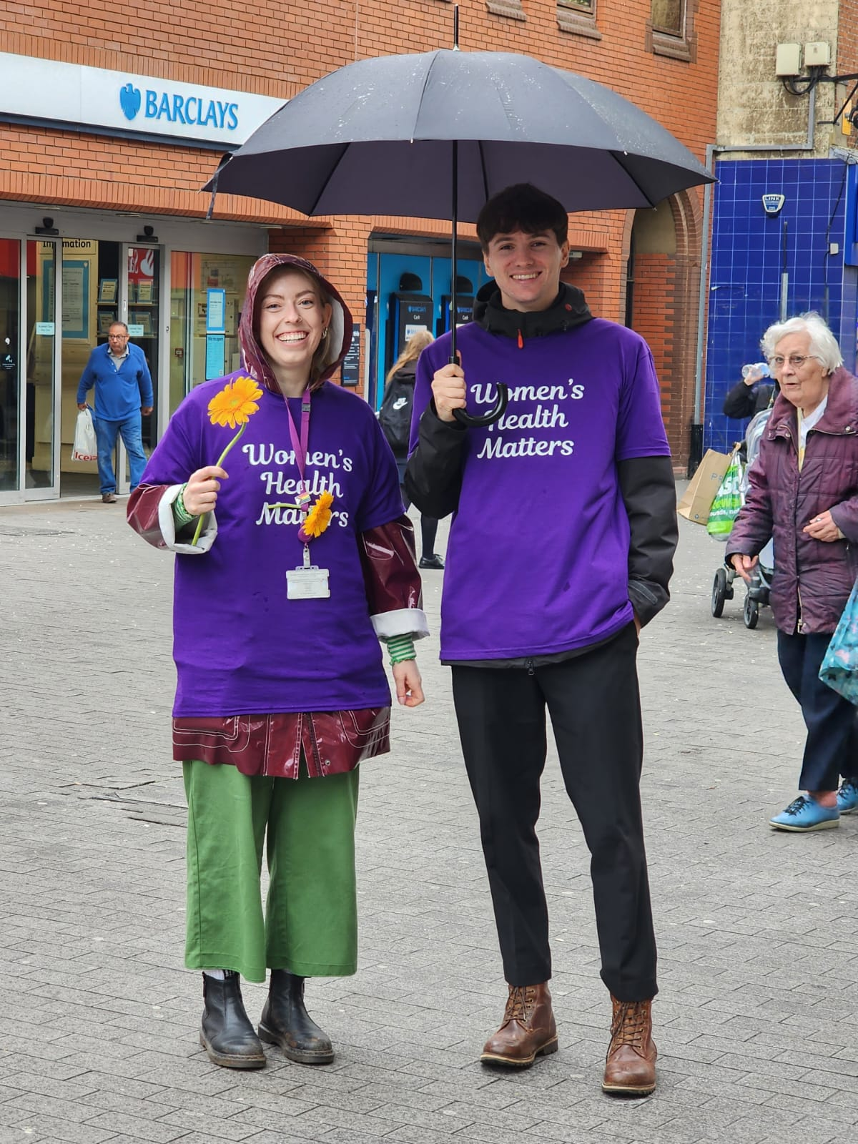
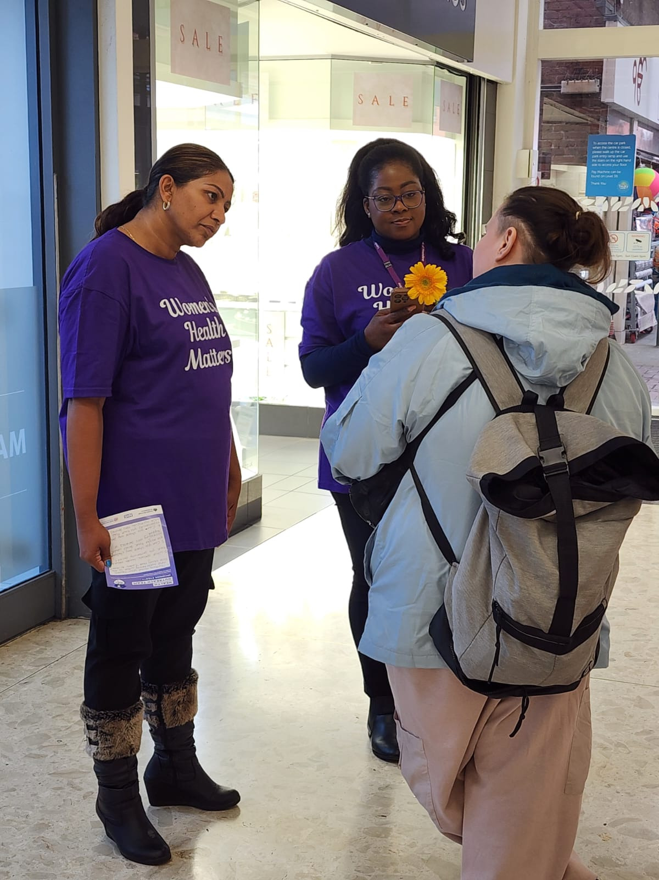
Earlier today..
For 2 hours, 35 health and council staff, volunteers went to 6 locations in the borough
Asking women 4 questions about their health and the health of their family
We recorded 145 responses from women

Slide 3
We asked: What's the first thing that comes to mind when it comes to health and wellbeing?
They said:
Physical Activity and Healthy Diet: Nutrition, exercise, being active, walking, being fit, getting out and about
Physical and Mental Health: Heart, health issues, mood, stress, trauma, thinking positively, cancer
Women’s Health Issues: Pre-menopause, menopause, hormones, sexual and reproductive health, maternal
Barriers: affordability, work or life gets in the way, afraid to mention to work, family responsibilities
Getting Older: who will look after me? What will happen?
State of mind: worried about health, not enough energy, tired, staying positive
“Being out and about and not doing anything out of the ordinary. Healthy eating, eating salad. Never smoked” - Almost 90 years old
“Being able to support myself and get out and about”

Slide 4
What comes to mind when you think of the health and wellbeing of the women in your family?
My mum
Daughters
Sister
Auntie

Slide 5
What comes to mind when you think of the health and wellbeing of the women in your family?
Health Conditions
Accessing care is hard
Getting older, more isolated
Worried
Hiding symptoms, ignoring issues
Caring, helping
“She didn't want to be seen as not a good role model so never wanted us to know about her symptoms”
“More important to carry on being healthy as you get older, it’s important to keep being active as staying inactive can lead to other health issues such as mental health although you are more isolated“
“Constantly worried as they are away from me”

Slide 6
Common issues women stated they face…
Mental health issues
Depression, anxiety, and panic attacks are frequently reported by most women, with many stating that they are on medication or under the care of mental health professionals.
Cardiovascular problems
High blood pressure (BP), high cholesterol, heart disease, and heart attacks are recurrent health issues among women, with some respondents mentioning specific heart conditions such as needing a heart valve replacement and having heart stents.
Back, knee, and joint pain
Common among older women, with some women mentioning arthritis and osteoporosis. Prolapsed discs and fractures in the spine are also noted.
Cancer
Breast cancer and skin cancer, and those with a history of multiple cancers, are also mentioned.
Women related health issues
Difficult menopause, PCOS, heavy periods, hysterectomies, and endometriosis are also noted by few respondents.
Nutritional deficiencies
Vitamin D and Vitamin B12 were highlighted by few respondents.
For the women in your family?

Slide 7
And for the women in their family, they mentioned…
Dementia and Alzheimer's disease are frequently mentioned, especially in elderly family members. Further, Osteoporosis and arthritis are also reported as being prevalent in elderlies.
Fewer women also addressed issues related to daughters' and teenagers' mental health. It's noteworthy to notice, though, that elder people's mental health was rarely discussed.
Other gynaecological concerns such as, Menopause-related problems and lack of support during menopause, PCOS related problems, difficult pregnancies are also highlighted by few women.

Slide 8
Accessing NHS services: women said…
Capacity Issues
long waiting times for initial or follow-up events after surgery
Accessibility & bureaucracy issues:
push for mainly digital/online or phone option can feel exclusive for those who are not literate digitally or feel more comfortable for in person appointments
forms to fill in that can take a long time
Communication issues:
Unhelpful/unfriendly attitudes especially when it comes to mental health or gynaecological issues
Unclear communication about why certain treatments have been given or not offered
unavailability of appointments or matching with the right type of support
No negative experiences: they’ve had positive experiences with appointment times and staff attitudes and received quick service – 20 out of 80 responses.
Lack of suitable treatments:
“Tablets didn't work. Talking therapy|
From women in the family:
Diagnosis
Delayed diagnosis or misdiagnosis
Language Issues

Slide 9
Positive experiences with accessing support
General appreciation and gratitude for the NHS has come through the responses:
“The NHS is there if needed and it is good for emergencies.”
Reminders are valued and these include:
upcoming appointments including for screening via letter and text message, follow-ups after initial consultation or surgery
Clear and compassionate communication is appreciated:
“When I was referred to fracture clinic they went above and beyond. They tried steroids. They
Clarity and variety of options in accessing care:
“Good experiences. Knew where to go to access care.”
Adequate, prompt appointments and diagnosis and suitable treatment with positive results:
“Good advice when first diagnosed with Diabetes but now manages it with diet.”
Positive experiences with specific health issues
Post-maternity care, Cancer treatment has been quick
“It is free! Where I'm from if you don't have money your health suffers”
For the women in your family?

